Slide 1
Impact of Higher Energy Prices on the US Economy
Presented By:
Maureen Raymond-Castaneda
Prepared By: Maureen Raymond-Castaneda,
Gwyn Koepke, & Margaret Carson
ENA Research Group
December 22, 2000

Slide 2
Overview: Impact of Higher Energy
Prices on the US Economy
Macro Economy
Impact on Consumers
Impact on the Energy Intensive Industrial Sector
Energy-intensive industries
New Economy Implications
1

Slide 3

U.S. Energy Market Size*
($567.3 billion)
* Source: Energy Information Administration, 1997 (latest date available)
2

Slide 4
U.S. Energy Market Size in 1975
($171.8 billion)
* Source: Energy Information Administration
2

Slide 5
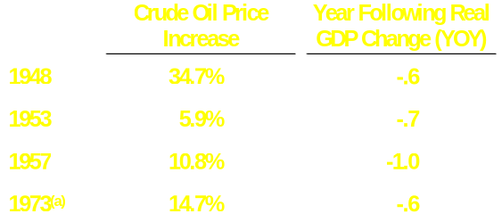
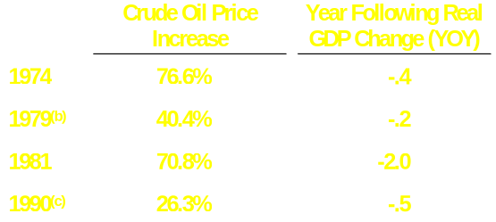
Higher Oil Prices and Sustainable
Economic Growth
On September 7, 2000 President Clinton warned Saudi Arabia’s Crown Prince Abdullah that high oil prices might tip the U.S. economy into another recession after 10 years of economic expansion
The 8 worst GDP growth years for the U.S. economy since 1947 have ALL followed a yearly increase in the average price of crude oil of 5 percent to 76.6 percent
(a) Arab Oil Embargo (b) Iranian Hostage Crisis (c) Gulf War
Source: Dr. Edward Renshaw, Economist, SUNY, Sept. 2000 Table 6.1, Page 33.
4

Slide 6
Consensus of GDP Forecasts for 2000 and 2001

Slide 7
Policy Response: Fiscal &
Monetary Mix
Monetary Response
  As a result of the 3 previous oil price shocks it has become “conventional” wisdom that central banks should not attempt to “accommodate” (or eliminate) the negative output effects of an oil price shock
Previous Oil Price Shocks
  Oil Embargo (1973-74)
  Federal Reserve Chairman Volcker
    Fiscal Policy: Loose
    Monetary Policy: Neutral
    Consequence: Central Banks were forced to battle inflation for almost 2 decades, temporary recession
  Iranian Revolution, Iran Hostage Crisis (1979-80)
  Federal Reserve Chairman Volcker
    Fiscal Policy: Expansionary (Reagan tax cuts and defense spending)
    Monetary Policy: Tightened decisively to control inflation
    Consequence: Inflation came down more rapidly than 1974
  Gulf War (1990-91)
  Federal Reserve Chairman Greenspan
    Fiscal Policy: Had no room to accomplish G7 high budget deficits
    Monetary Policy: Tightened to control inflation
    Consequence: Inflation remained under control throughout the 1990’s
5

Slide 8
This Energy Price Shock is Different than Past Shocks
The US crude oil bill accounted for 8.5% GDP in 1980 v. 2.8% in 1999, the importance of oil in the US Economy has declined
However, the combined effect of higher oil, natural gas and electric bills will have more lasting effects on consumers and industries
6

Slide 9
Wealth Transfer
Oil
  Wealth transfer from non-oil producing countries to oil producing countries
    According to Fed Chairman Alan Greenspan “The hike in the price of imported energy has acted, in effect, as a tax equivalent of roughly 1% of national income.” (Dec. 5, 2000)
    There has been a $100 billion transfer of wealth to oil-producing countries caused by the run up in oil prices from $10.76/barrel for WTI in December 1998 to $37.21/barrel in September 2000.
Natural Gas
  Wealth transfer from industrial producers and consumers to natural gas producers
7

Slide 10
Impact of Higher Energy Prices
Gas
Increased Spending*
Industrial $22B Immediate
Commercial $12B 30-360 day lag
Residential $19B 30-360 day lag
Total $53B
$ MMBTU
Power
Industrial $14B Immediate
Commercial $29B 30-360 day lag
Residential $38B 30-360 day lag
Total** $81B
$ MWH
* Assumes 2001 demand based on 2000 levels. Source: DOE EIA National Gas Monthly, October 2000; 10 months actuals, Nov/Dec
estimated. NYMEX prices for natural gas.
** Assumes average U.S. electricity cost is 40% higher than 1999-2000 PJM prices.
Weather conditions and cost pass through rates are the same as 2000 levels. Demand 10 month actuals, Nov/Dec estimated, DOE, EIA EIA
Monthly Energy Review, November 2000.
Source: Enron Government Affairs
Margaret Carson
ENA-Research Group
9

Slide 11
Future Impact of Higher Energy Prices on Consumers
Reduced purchasing power
Erosion of Income
  Higher gasoline prices at the pump
  Higher heating bills and electricity
Surging natural gas prices
  EIA estimates consumers will pay 44% more this winter for natural gas bills
  53% of US households use natural gas
Enron estimate of cost of natural gas to residential consumers:
$19 Billion
Slower economic activity
  Layoffs-higher unemployment
10

Slide 12
Comparison of U.S. CPI vs. U.S.
Average Gasoline Price
Gasoline prices spurred CPI increases in 1981, 1990, 1996 and 2000
$Gallon
CPI Change as %
Source: U.S. Bureau of Labor Statistics; IFS: U.S. Gulf Coast - * Through November 2000 Actuals for All Urban Consumers
12

Slide 13
Wellhead Prices and Weather Effect
Annual Residential Gas Bills $(Nominal)
Key
In 2000, annual residential gas bills in states like Michigan and Pennsylvania (if demand is the same as last year) will increase $278/$255 due to higher wellhead gas prices
Wellhead
Price Average
$MCF
$1126
$879
$871
$872
$736
$778
$682
$669
$585
$611
$607
$554
$594
$502
$533
$4.48 MCF
$2.51 MCF
$1.71 MCF
$1.55 MCF
$2.08 MCF
1985
1990
1995
1999
2000
Source: American Gas Association, Table 9-5; U.S. DOE National Gas Monthly 10/00
13

Slide 14
U.S. Natural Gas Prices and Weather Effect on Annual Residential Gas Bills
2000-2001 Cases
Key
Wellhead
Price Average
$MCF
In 2001, higher wellhead gas prices are likely to yield residential bills in the $1000 a year range or higher
$1450
$1319
$1126
$1075
$977
$912
$872
$829
$669
$5.36*
$5.36*
$4.48
2000
2001
*
2001
*
Demand 10% higher
due to weather
Demand Held
Constant
* Natural Gas Week, 11/27/00,* NYMEX 12 Month 2001 Strip
Note: Assumes demand and LDC WACOG at 1999 nominal levels escalated by wellhead price increase
Source: AGA Gas Facts, Table 9-5; U.S. DOE Natural Gas Monthly; Natural Gas Week, 11/27/00
14

Slide 15
Impact of Higher Energy Prices on the Industrial Sector
Plant Shutdowns due to higher cost of production
  Selling natural gas or electricity contracts for greater profit margins
  Interruptible service contracts
  Economically unviable
  Layoffs
Profit squeeze
  According to Alan Greenspan, “The most significant effect to date from higher energy prices appears to be on profit margins, where corporate business, constrained by competitive market forces, have not been able to raise prices to fully offset energy costs increases.” (Dec. 5, 2000)
  Credit Spreads Widen
15

Slide 16
The Combined Effect of Higher Oil,
Natural Gas & Electricity Prices on
the Industrial Sector
  Makes planning more difficult
  Makes expenses more difficult to forecast
  Reduces earnings predictability
16

Slide 17
Most Energy Intensive Industries
Aluminum
Forest Products
Steel
Glass Making
Metal Casting
Chemicals
Petro Chemicals
17

Slide 18
Which Industrial States Are Most Susceptible to Higher Energy Costs?
Pennsylvania
Illinois
Indiana
Texas
Ohio
New York
California
Wisconsin
Georgia
New Jersey
18

Slide 19
U.S. Employment by Industry and State
(1,000)
State
Source:U.S. DOE
19

Slide 20
Energy Use by Fuel - Aluminum
Total Market Size: 727 Trillion Btu
Source: U.S. DOE
Electrical System Energy Losses: The amount of energy lost during generation, transmission,
and distribution of electricity, including plant and unaccounted-for uses.
20

Slide 21
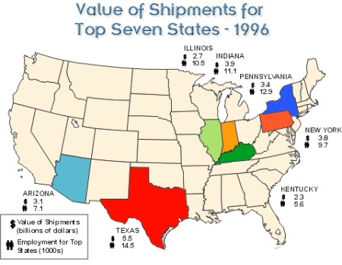
Aluminum: Value of Shipments for Top Seven States
Source: DOE, EIA
21

Slide 22
Energy Use by Fuel - Paper Mills
Total Market Size: 2,665 Trillion Btu
Source:U.S.DOE, EIA
24

Slide 23
Energy Use by Fuel - Pulp
Total Market Size: 491 Trillion Btu
Source: U.S. DOE, EIA
25

Slide 24
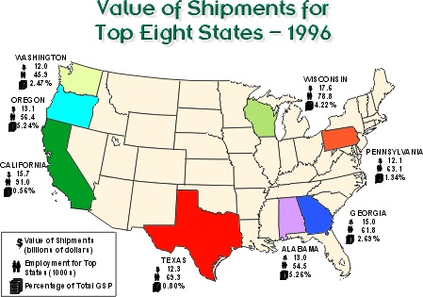
Forest Products: Value Shipments For Top Eight States
Source: DOE, EIA
26

Slide 25
Energy Use by Sector - Steel
Total Market Size: 1,993 Trillion Btu
Source: U.S.DOE, EIA
Electrical System Energy Losses: The amount of energy lost during generation, transmission,
and distribution of electricity, including plant and unaccounted-for uses.
29

Slide 26
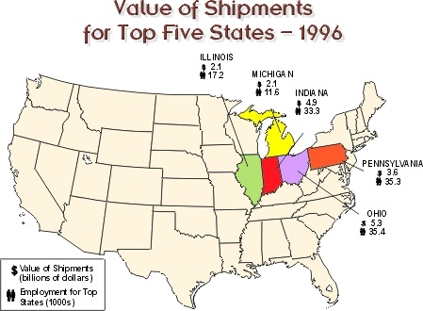
Steel: Value of Shipments for
Top Five States
Source: DOE, EIA
30

Slide 27
Higher Electricity Prices will also harm the New Economy
The average microchip processing plant uses enough power to run 50,000 U.S. homes
Silicon Valley Companies consume as much power as mini-steel mills--and their use is growing over 7% per building per year
Oracle has built its own inside the fence power plant and Sun Microsystems and Microsoft are proposing to follow suit
Power quality is key--power disturbances can cause over 17,000 different computer problems, from frozen cursors to a full crash
Source: WST, Forbes
34

Slide 28
Summary: Impact of Higher Energy Prices on the US economy
Consumers
  Inflation feed through higher CPI and PPI
  Reduced consumer spending and erosion of purchasing power
Industry
  Higher cost of production
  Weaker profits
  Tighter credit
Key Energy Intensive Industries
  Shutdowns
  Layoffs
  Losses
  Credit tightens as a result of profit squeeze
35

Slide 29

®

Slide 30
Energy Use by Sector - Glass
Source: U.S.DOE, EIA
Electrical System Energy Losses: The amount of energy lost during generation, transmission,
and distribution of electricity, including plant and unaccounted-for uses.
31

Slide 31
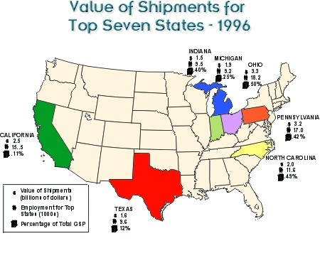
Glass:Value of Shipments for
Top Seven States
Source: DOE, EIA
32

Slide 32
Energy Use by Sector -
Metal Casting
Source: U.S. DOE, EIA
Electrical System Energy Losses: The amount of energy lost during generation, transmission,
and distribution of electricity, including plant and unaccounted-for uses.
27

Slide 33
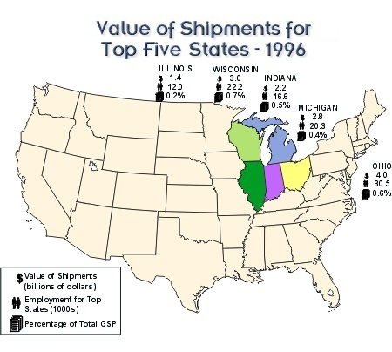
Metal Casting: Value Shipments for Top Five States
Source: DOE, EIA
28

Slide 34
Energy Use by Sector - Chemicals
Source: U.S. DOE, EIA
Electrical System Energy Losses: The amount of energy lost during generation, transmission,
and distribution of electricity, including plant and unaccounted-for uses.
22

Slide 35
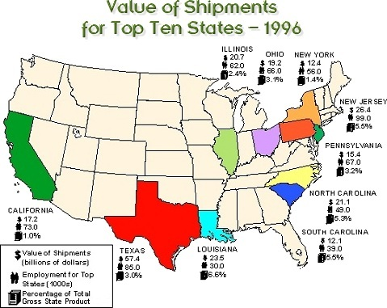
Chemicals: Value of Shipments for Top Ten States
Source: DOE, EIA
23

Slide 36
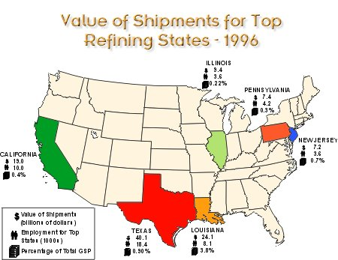
Petroleum: Value Shipments for
Top Refining States
Source: DOE, EIA
33

Slide 37
Impact of Higher Energy
Prices on the Economy
Consumers
  Erodes disposable income and personal savings
  Distributes wealth away from consumers
  Distributes income from consumption states to production states
  Raises consumer prices
  Decreases domestic demand
  Relative importance of energy in CPI-U:
    Energy Commodities: 3.4%
    Energy Services: 3.5%
  Causes layoffs- higher unemployment
    Producers
      Industrial production: Plant shutdowns and higher production costs
      Profits squeezed from higher energy costs and a reduction in economic activity
      Credit tightens as a result of profit squeeze
      Contingency planning becomes very difficult
8

