Slide 1
CHAOS
NNG
SLA
637
Carlton
Processing/Gas Quality
TRANSWESTERN
California Gas Supply
Transport Uncertainty
Basis Volatility

Slide 2

CONTROL
NNG
New Services
Peak Day Max
Gray Interconnect
Trailblazer Expansion
TRANSWESTERN
Red Rock Expansion
Transport Options
Index-Based Transport

Slide 3
Dave Neubauer, Vice President
Enron Transportation Services
Chaos and Control
®
Notes:
11:30 a.m., Tuesday, March 20
Good Morning Everyone - thanks for the introduction….
Today I’d like to discuss something very unusual for our industry -- a cold winter and high energy prices.
I’ll be reviewing some of the causes of the supply/demand situation that we found ourselves in as well as the effects that the industry and consumers felt during the winter.
It’s always good to step back at the end of any winter season and look at what happened and how the industry responded -- and to assess if we could or should have done things differently.

Slide 4
NNG Issues
Winter Review
®

Slide 5
NNG Issues
CHAOS
SLA
Order 637
Carlton
Processing/Gas Quality
®

Slide 6
SLA
System Levelized Account
Rate Base Account
Captures the cost associated with replacing (buying) or selling shipper imbalances
1998 Value - $12 Million
2001 Value - $67 Million

Slide 7
Order 637 Issues
Imbalances
Penalties
Segmentation

Slide 8
Carlton
Re-file Carlton Surcharge Mechanism.
Original $0.04 surcharge for non-Carlton volumes was equivalent to $0.60 premium paid by Carlton shippers.
Current market premium is $0.20
New surcharge would change based upon actuals.

Slide 9
Processing Impacts
Changing Processing Economics
Changing Gas Quality Mix
Market Zone Burner Tip Risk
®

Slide 10
Processing Economics
®

Slide 11
NNG Issues
CONTROL
New Services
Peak Day Max
Gray Interconnect
Trailblazer Expansion
®

Slide 12
New Services
Preferred Deferred Delivery
Auto Balance
Internet Services
Capacity On-Line

Slide 13
PROJECT
Market
Area
eXpansion
Project Max
  Matches customers’ growth plans
  Provides several years’ growth
  Target November 2003 In-Service
  Open Season invitations out soon

Slide 14
Key NNG Interconnects

Slide 15
Transwestern Interconnect
at Gray County, TX
Interconnect with Transwestern on NNG
Matches 150 mmcfd TW Red Rock Expansion
June 2002 In-Service
Option to bring gas from Rockies, Anadarko, Hugoton or Permian with flow to California
®

Slide 16
Trailblazer Interconnect at NNG Beatrice
NNG Interconnect Expansion to match Trailblazer Expansion
June 2002 In-Service
Potential volume of 150 mmbtu
Premium markets for producer
Alternative supplies for markets
®

Slide 17
Winter 2000/2001 Review
How stressed were our resources and infrastructure?
Why was this winter so much different than the past?
®
Notes:
Let’s go back to the main topic – how did the industry perform this winter?
Let’s talk about some of the primary factors at work – and then come back to what conclusions we can make.
Weather
Storage
Bottlenecks
Commodity costs
Transport Costs
Gas Quality
Regulatory

Slide 18
Transportation Issues
Bottlenecks
Investment
Liquidity
®

Slide 19
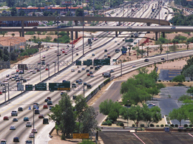
Capacity Bottlenecks --
Did you feel like you went from this….

Slide 20
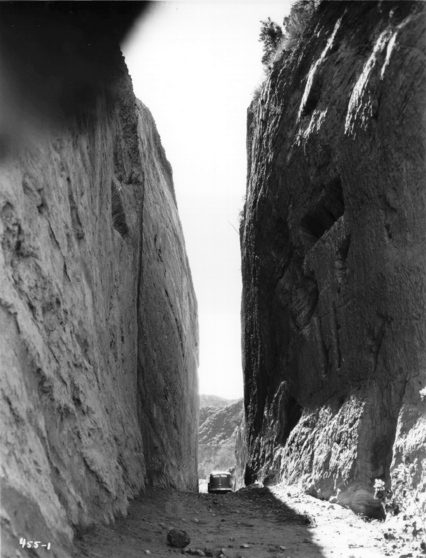
…to this?
®

Slide 21
Bottlenecks
1st of Month Indexes
January 2001
  TW Permian $ 9.81
  SoCal California $16.39
  Transco Zone 3 Pool $ 9.97
  New York City $19.33
  NNG Demarcation $10.52
  Minnesota City Gate $11.05

Slide 22
Capacity Investment
Index
Spread
Variable
Cost
Demand
Contribution
January 2001
  TW Permian $6.58 - $0.38 = $6.20
  To SoCal California
  Transco Zone 3 Pool $9.36 - $0.58 = $8.78
  To New York City
  NNG Demarcation $0.53 - $0.13 = $0.40
  To Minnesota City Gate
®

Slide 23
Capacity Investment
Index
Spread
Variable
Cost
Demand
Contribution
May 2000
  TW Permian $0.16 - $0.18 = ($0.02)
  To SoCal California
  Transco Zone 3 Pool $0.32 - $0.20 = $0.12
  To New York City
  NNG Demarcation $0.14 - $0.095 = $0.045
  To Minneapolis City Gate
®

Slide 24
Capacity Investment
Annual Average Demand Coverage must equal Cost to Build in a market driven expansion
Downstream markets must be willing to contract for incremental service
®

Slide 25
Transportation Liquidity
Gray Market
Capacity Release
Option Pricing Valuation
Capacity On Line
®

Slide 26
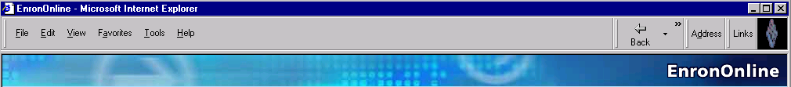
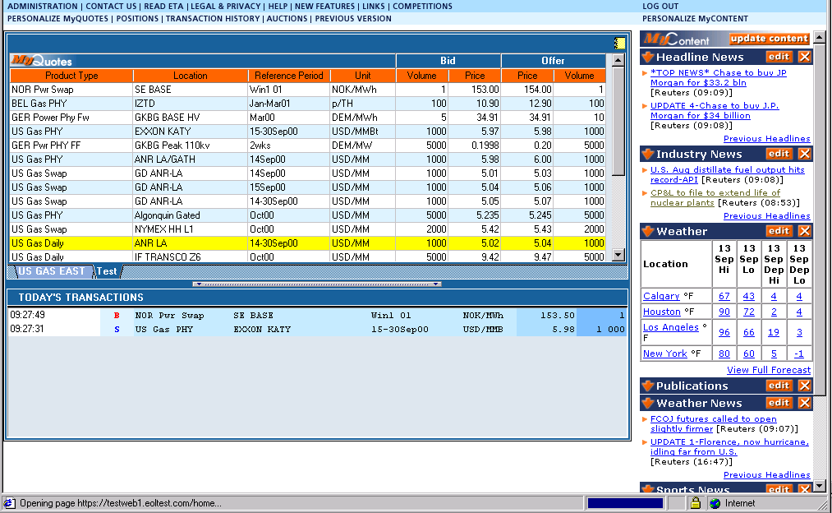
Capacity On Line
Notes:
A Free, Internet-based, Global Transaction System Which Allows Counter parties to View Real Time Prices From Enron’s Traders and Transact Instantly Online
Free, Reliable Transaction System with Enron as Principal
Fully Integrated into Enron’s
Established Risk Management
and Logistic Processes
Utilizing Site to Offer Energy-Related Auction Capabilities
Expands Enron’s Information Base and Market Knowledge
“Tried and Tested” Platform for Expanding Enron’s
eCommerce Activity

Slide 27
Commodity Issues
®

Slide 28
Price Drivers
Price
Supply
Demand
Inventory
Price
®

Slide 29
Are we in an energy crisis? –1970’s Headlines
Gas Diversion Curbed
Blizzard Strikes Gas-Short States
Ford, Governors Discuss Gas Shortages
Industrial Output down 1% in January -
Shortages Blamed
FPC Reprisals Charged
Industry Accused
Law Waived to Ease
Gas Transport
Overcharge Suit Settled
FPC Hikes 'New' Natural
Gas Rate; Court Orders Refund
Carter warns of "Impending Crisis"
Factories Closed in 15 States
Gas Withholding Charges Denied
Reserves Fall in '75
Schools Closed for Lack of Heat
®

Slide 30
2000 Headlines
Panel OKs Power Rate Hikes of Up to 46%
Judge Frees Small Firm From Edison Contract
Futures Skyrockets; California jumps over $23
Blackouts keep whole system functioning_x000b_
Forty-one dollars in California – ‘nuff said!
Estimate of Possible Overcharges for Electricity Rises to $6.3 Billion
Ford claims $23 Million Loss in Supply Dispute
Blackout Brings Together Factions in Crisis
Greenspan warns of energy price dangers
California Electricity Crisis
How State's Consumers Lost With Electricity Deregulation
Notes:
Ford claims $23 Million Loss in Supply Dispute
Futures Skyrockets; California jumps over $23
Forty-one dollars in California – ‘nuff said!
Greenspan warns of energy price dangers
Tuesday, March 27, 2001 03:44 PM
Panel OKs Power Rate Hikes of Up to 46%
California Electricity Crisis
Judge Frees Small Firm From Edison Contract
Blackouts keep whole system functioning
How State's Consumers Lost With Electricity Deregulation
Estimate of Possible Overcharges for Electricity Rises to $6.3 Billion
Blackout Brings Together Factions in Crisis

Slide 31
Regulatory Death Spiral
Commodity on Transportation
Shortages
Regulated
Shortages
More Demand
Less Supply
Price Spikes
Brownouts
Blackouts
Blackouts
Price Caps
RB
-
PressClub
-
0900
-
16
®

Slide 32
2000/2001 Winter
Source: U.S. DOE (EIA)
®

Slide 33
Costs Per Day

Slide 35
Volatility
NNG Demarcation
®

Slide 36
Credit Impact 2000
January 2000
LDC Purchases
100,000/day x $2.50 x 31= $7.8 Million
Deduct Line -$10.0
($10Mil. line of credit with Supplier)
Credit Capacity Impact: $0
®
Notes:
(these bullets from Paul Cherry)
Due to price volatility, credit conditions have changed, requests have increased for additional security, letters of credit, guaranties, and prepayments.
Financially distressed situations have been reduced due to:
Increased sophistication - Information accessibility
Hedging strategies
Strategic Alliances/Relationships

Slide 37
Credit Impact 2001
January 2001
LDC Purchases
130,000/day x $10.50 x 31= $42.1 Million
Deduct Line -$10.0
$32.1
60 Day LC Required __x 2
($10Mil. line of credit with Supplier)
Credit Capacity Impact: $64.20 Million
®
Notes:
(these bullets from Paul Cherry)
Due to price volatility, credit conditions have changed, requests have increased for additional security, letters of credit, guaranties, and prepayments.
Financially distressed situations have been reduced due to:
Increased sophistication - Information accessibility
Hedging strategies
Strategic Alliances/Relationships

Slide 38
Demand Components
®

Slide 39
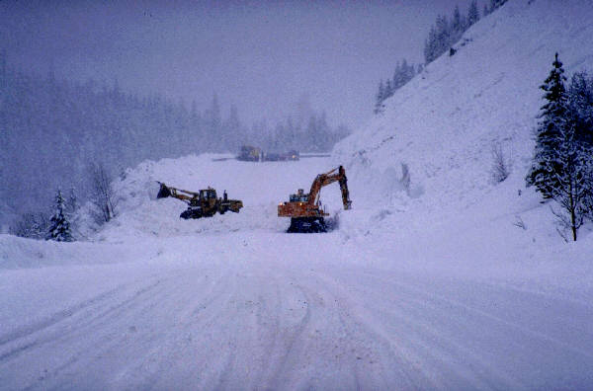
Weather

Slide 42
NNG System Heating Degree Days

Slide 45
Other Demand Factors
Processing
Industrial Impact
Alternative Fuels

Slide 47
Production and Storage
®

Slide 50
Projected U.S. Storage Levels
Beginning Inventory 600 bcf
Injection @ 7.2/Day 1541 bcf
November 1, 2001 2141 bcf
November 2000 2748 bcf
5-Yr. Nov. Average 2869 bcf
®

Slide 51
US Production/Demand
Summer Summer
2000 2001
Production 60.7 61.8
Demand 53.5 54.6
Available for Storage 7.2 7.2
Source: EIA
®

Slide 52
Price Outlook
®

