Slide 1
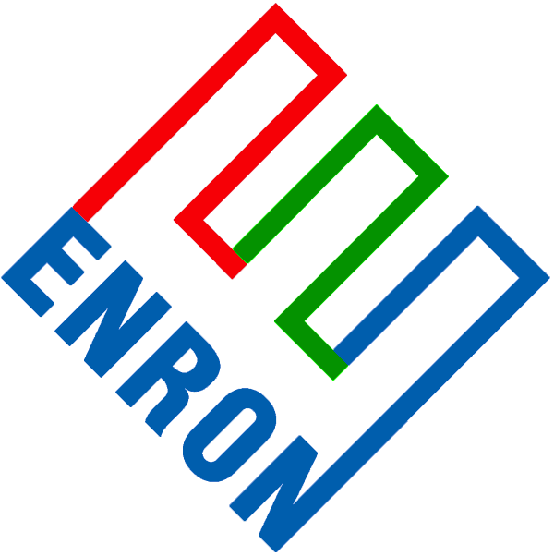
Wholesale
Energy
Transportation
&
Distribution
Retail
Energy
Broadband
Services
Net Works
Expansion Vehicle
for New Commodity
Industry Penetration

Slide 2
Current Market Conditions
Many Industries Exist That Sell Commodity Products Through Legacy Distribution Channels
Channels Often Consist of Complex Sales Forces and Long Term Relationships with Little Price Transparency
Enormous Inefficiencies Exist in the Pricing of Commodity Products
The Internet Provides a Unique Opportunity to Have Immediate and Inexpensive Access to Customers

Slide 3
Opportunity for Enron
Use Proven Enron e-Commerce Platforms As Accelerators
Leverage Off Enron’s Proven Skills in Logistics, Risk Management and Back Office Capabilities
Provide High-Margin, Structured Products to Customers
Move Quickly and Minimize Effect on Enron’s Balance Sheet

Slide 4
Enron Has the Capabilities Required
to Capture this Market Opportunity
Market Making Capabilities
Operating
Capabilities
Other
Capabilities
Cash Markets
Forward Markets
Futures Markets
Transactions
Logistics
Settlement
eCommerce Platforms
Risk Management Process
Capital

Slide 5
Target Markets and Approach
Enron Business Plan Upon Entering New Markets:
Upgrade: Streamline Process to Do Business the Best, Most Efficient Way Possible
Expand: Grow Market Share in Current Business
Penetrate: Rapidly Establish Significant Stakes in New Markets
Target Markets
Metals
Pulp & Paper
Steel
Chemicals
Credit/Finance
Data Storage
Settlements
Logistics

Slide 6
Recent Net Works Transactions
MG PLC
Garden State Paper
Leading Merchant of Base Metals
Significant Customer Overlap with Enron’s Existing Energy Customers
Metals Market Receptive to Enron-like Products
U.S. Based Newsprint Manufacturer
Compliments Existing Pulp and Paper Business
Enables Deployment of Enron’s eCommerce Business Model (Clickpaper.Com)

Slide 7
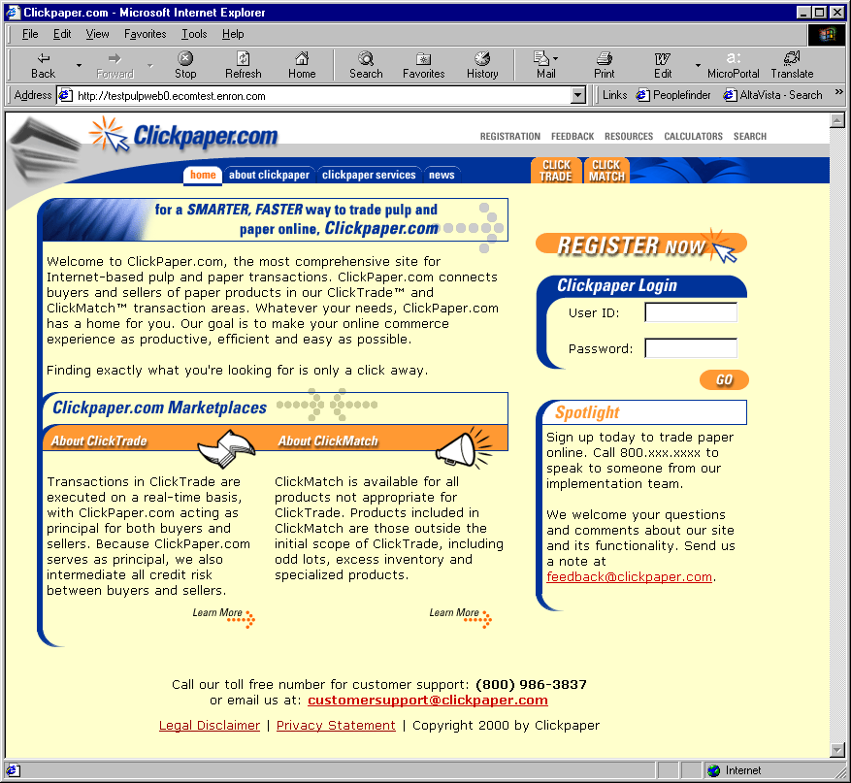
Clickpaper.com
Extension of Enron Online Platform
Principal Based
Free of Charge
Real Time
Financial and Physical Products
Tailored to Paper Industry Participants

Slide 8
Net Works Funding Plan
No Enron Equity Issuance Anticipated
Targeted Investors for Each Vertical Markets
Limited Enron Financial Support Required
Capital Available by Third Quarter

