Slide 1

THE MULLET

Slide 2
DEFINITION
Mullet (mulit): a hairstyle, common among those of lower socioeconomic status, consisting of short, well groomed hair anteriorly and long, flowing locks posteriorly.

Slide 3
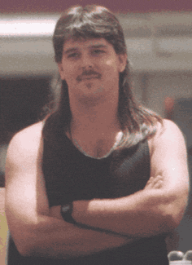
EXAMPLE
Business
Party

Slide 4
NOMENCLATURE
Mistakes: “mullet hairstyle” or “mullet cut”
Eponyms: drape ape, Wisconsin waterfall, Mississippi mudflap, Missouri compromise, Louisiana purchase

Slide 5
SUBTYPES

Slide 6

SUBTYPES
CAMERO CUT
Common among drivers of Chevy Cameros, as well as Trans Am’s and Thunderbirds

Slide 7
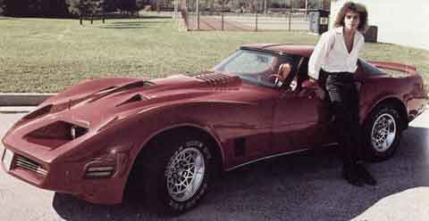
SUBTYPES
CAMERO CUT

Slide 8
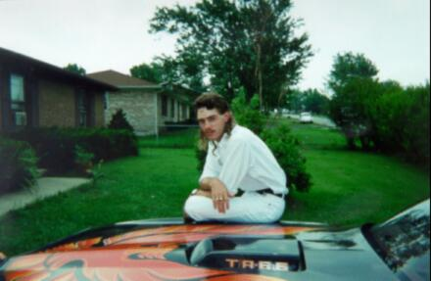
SUBTYPES
CAMERO CUT

Slide 9
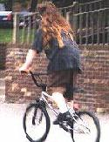
SUBTYPES
BMX MULLET
Among the longest of the subtypes
Some are mistaken for ugly girls

Slide 10
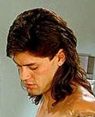
SUBTYPES
PORN MULLET
Elegant blend of form and function

Slide 11
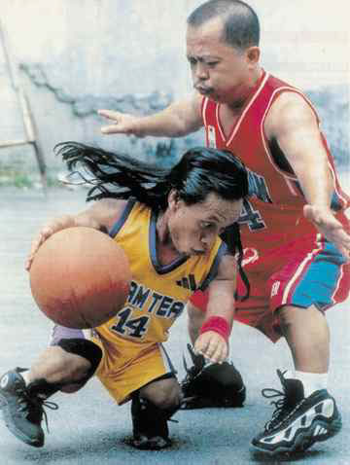
SUBTYPES
MIDGIE-MULLET
Makes up for short stature with long hair
mullet
Mullet

Slide 12
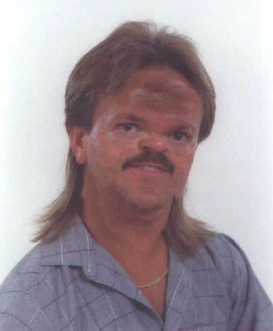
SUBTYPES
MIDGIE-MULLET
Makes up for short stature with long hair

Slide 13
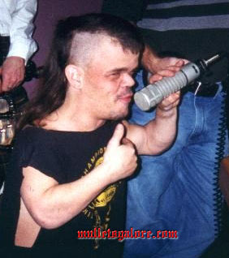
SUBTYPES
MIDGIE-MULLET
Makes up for short stature with long hair

Slide 14
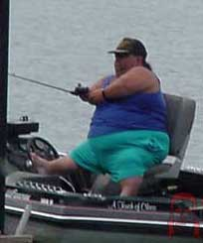
SUBTYPES
?

Slide 15
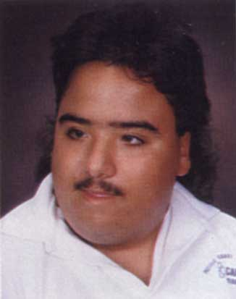
SUBTYPES
“SPECIAL” MULLET
The intellectually challenged who sometimes forget to cut the back of their hair

Slide 16
MEAN AGE UNTIL 1ST SEXUAL ENCOUNTER AMONG MULLETS

Slide 17
FEMALES: A MAJOR MULLET CONTRAINDICATION

Slide 18
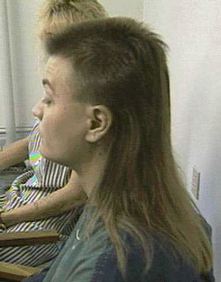
FEMALES: A MAJOR MULLET CONTRAINDICATION

Slide 19
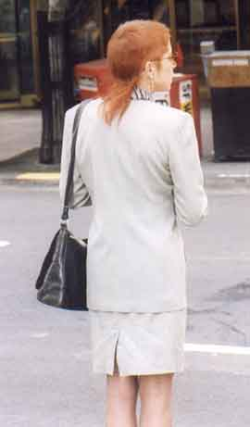
FEMALES: A MAJOR MULLET CONTRAINDICATION

Slide 20

FEMALES: A MAJOR MULLET CONTRAINDICATION

Slide 21
WHY THE MULLET?

Slide 22
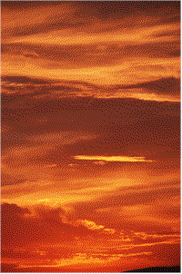
WHY THE MULLET?

Slide 23
MULLET HOT SPOTS
Professional wrestling matches
auto races
monster truck rallies
dog tracks

Slide 24
MULLET HOT SPOTS
On the web:
www.mulletsgalore.com
www.northamericanmulletpage.com
www.nomullets.com

Slide 25
MULLET HOT SPOTS
In Houston:
Anywhere on Richmond Ave. west of 610

Slide 26
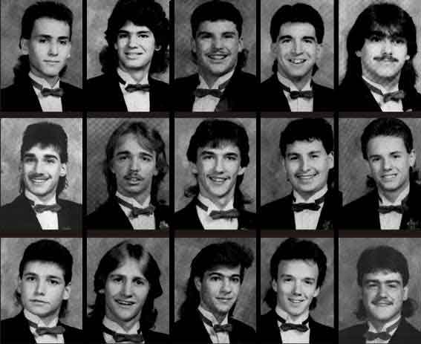
MULLET QUESTIONS?

