Slide 1

IPAMS 2001
Coalbed Methane Symposium
Paul Miller
Director of Marketing,
Interstate Pipelines
October 16, 2001

Slide 2

Bison
Pipeline
Project

Slide 3
Overview
Bison Pipeline Project
Proposed Project Modifications
Downstream Market Access
What’s Next

Slide 4
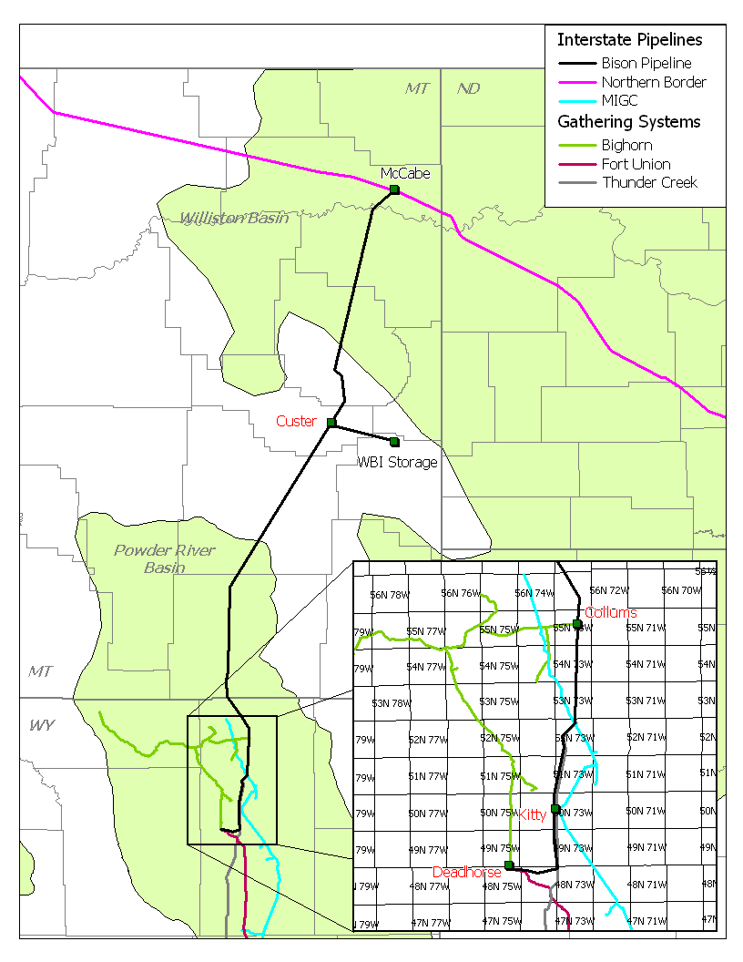
Bison Project Description
Deadhorse, WY to McCabe, MT
Interconnect with Northern Border
  325 Miles
  24” pipeline
Expected Volume
  375 - 500 MMcf/d
Open Season held “late 2000”

Slide 5
Open Season Results
872,100 Mmbtu/d of non-binding bids
17 entities submitted bids including:
  Producers
  Marketers
  Local Distribution Companies
10 Year Terms
Issues surrounding bids:
  Water Permits
  Term Supply Deals

Slide 6
Proposed Bison Project Modifications
Reduction in threshold volume for viable project from 375 Mmcfd to 275 Mmcfd
Move receipt point from Deadhorse to Recluse (Collums, WY)
Volume ramp up feature to track rising CBM production

Slide 7
Proposed Bison Project Modifications
Recluse (Columns), WY to McCabe, MT
Interconnect with Northern Border
  280 Miles of 24” pipeline
  Recluse Interconnects:
    Bighorn
    WBI Bitter Creek System
    MIGC
Expected Ramp up Volume to 275 Mmcfd:
    2003 150 mmcfd
    2004 225 mmcfd
    2005 275 mmcfd
Estimated Demand Rate (Mmbtu/d): $0.26
Approximate fuel: 1%

Slide 8
Downstream Market Access
Monchy
MT
McCabe
ND
MN
SD
Ventura
IA
Harper
Chicago
Indiana
IL
IN

Slide 9
Northern Border Pipeline
Transportation Overview
Capacity Rate Fuel
2
2.4
Bcfd
Monchy
McCabe
30¢
ND
Prebuild Line
Monchy - Ventura
1.9%
MN
MT
1
SD
Iowa Line
Ventura - Harper
1.5
Bcfd
.5%
Ventura
5¢
IA
Harper
Chicago
Indiana
Chicago Line
Harper - Manhattan
861
Mmcfd
9¢
Note: NNG has Receipt Capacity
of 1,583 Mcfd at Ventura
IL
IN
.7%
Indiana Line
Manhattan - North
Hayden
545
Mmcfd
1
McCabe to Ventura
.1%
1¢
2
Estimated Fuel Percentage

Slide 10
Market Access on Northern Border Pipeline
MN
17
18
19
14
SD
4
6
16
15
IA
Ventura
5
7
(NNG)
Company MMcf/d Location
1 Northern Natural Gas 1.5 Bcf/d Ventura, IA
2 Natural 900 Harper, IA
3 MidAmerican Energy Co. 100 Iowa City, IA
4 MidAmerican Energy Co. 100 Davenport, IA
5 Alliant Interstate Power Co. 120 Prophetstown, IL
6 NICOR 400 Troy Grove, IL
7 NICOR 400 Minooka, IL
8 ANR Pipeline 500 Will County, IL
9 Midwestern Gas Transmission Co. 200 Channahon, IL
10 Peoples Gas Light and Coke 600 Manhattan, IL
11 Northern Indiana Public Service 545 North Hayden, IN
12 Elwood Power Plant 360 Elwood, IL
13 Wilton Power Plant 150 Will County, IL
14 Cordova Power Plant 53 Rock Island County, IL
15 Elm Creek Power Plant 175 Martin County, MN
16 Vector 700 Will County, IL
17 Northern Natural Gas 35 Aberdeen, SD
18 Northern Natural Gas 80 Marshall, MN
19 Northern Natural Gas 175 Welcome, MN
20 Guardian Pipeline 650 Joliet, IL
8
1
Harper
(NGPL)
3
11
2
20
9
10
12
13
IL
IN

Slide 11
NBPL Ventura Market Point
Powder
River
Basin
Canadian
Gas
Williston
Basin
2.3
Bcfd
Ventura
Chicago
Market
Minneapolis
1.5 Bcfd
1.7 Bcfd

Slide 12
Ventura Market Dynamics
Post Chicago
Project
Project 2001
Pre Chicago
Project
NNG
NNG
NBPL
NNG
NBPL
Primary
Delivery
Capacity
1.2 Bcf
NNG
Take
Away
1.2 Bcf
Ventura to Chicago Spread
$0.11
NBPL
Ventura to Chicago Spread
$0.20
Ventura to Chicago Spread
$?
.9 Bcf
1.5 Bcf
. 7 Bcf
1.5 Bcf
Winter ’97-98
Winter ’98-99
Winter ’01-02

Slide 13
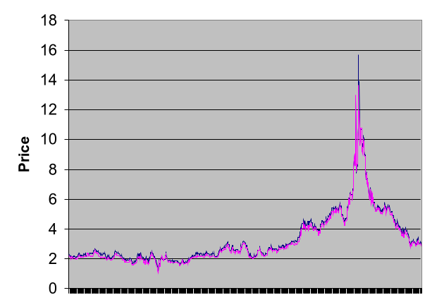
Ventura – Chicago Correlation
18
16
14
12
10
Chicago Index
Ventura Index
8
6
4
2
0
1/98
5/98
9/98
1/99
5/99
9/99
1/00
5/00
9/00
1/01
5/01
9/01

Slide 14
Ventura Vs. Greensburg
Ventura
Greensburg
$5.20
$5.08
Source: Inside FERC Index Last 12 months August 2001

Slide 15
Bison Project Features
PRB Supply Access
  New interstate pipeline capacity into the basin
  Competitive export route out of the basin
  Pipeline infrastructure to capture developing Montana production
Link to Northern Border downstream infrastructure and markets
2.4 Bcfd of pipeline capacity to liquid markets that are highly correlated to Chicago pricing
Access to other interstate pipelines:
- NNG - NGPL
- ANR - MGT
- Vector - Guardian
Access to Northern Border services

Slide 16
What’s Next
Approach Interested Parties
  Modifications
  Timing of In-Service Date
Positive Feedback
  Open Season 4th Quarter?
In-Service Date
  11/2003?
Contact: Dick Shepherd (402) 398-7755
Paul Miller (402) 398-7758

