Slide 1
East Power Trading

Slide 2
East Power Fundamentals

Slide 3
West Power Trading
Risk Management
John Postlethwaite
Fran Chang
Heather Dunton
Samantha Law
Legal/Reg Affairs
Alan Comnes
Steve Hall
Christian Yoder
IT Dev. Group
Susan Amador
Bala Kandaswamy
Jim Meyer
Richard Schweiger
Structuring
Todd Perry
Mo Elafandi

Slide 4
Power Origination

Slide 5
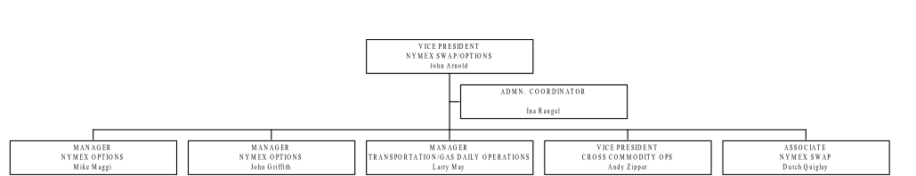
Financial Gas Trading Desk
January 4, 2002

Slide 6
East Gas Trading & Origination

Slide 7
Central Gas Trading and Origination

Slide 8
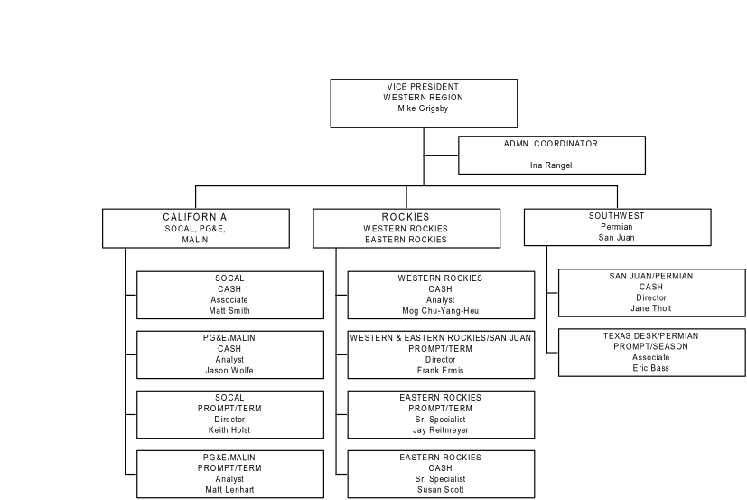
West Gas Trading Desk
January 4,2002

Slide 9
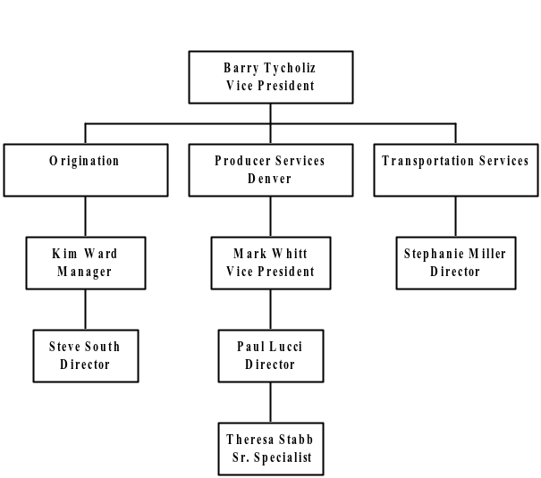
West Gas Origination
January 4,2002

Slide 10
Texas Gas Trading & Origination

Slide 11
Gas Derivatives & Middle Marketing

Slide 12
Canada
Commercial: 27
Admin: 4
Total: 31
Full Time: 31

Slide 13
Gas Trading - Scheduling Function

Slide 14
Gas Fundamentals
1/03/02
9/19/01

Slide 15
EnronOnline

Slide 16
Structuring

Slide 17
Market Risk Management

Slide 18
Government & Regulatory Affairs

Slide 19
Legal

Slide 20
Human Resources
Michelle Cash
Legal

Slide 21
Credit Risk Management

Slide 22
Canada Non-Commercial

Slide 23
NETCO Financial Operations
Wes Colwell
Managing Director
Shirley Tijerina Executive Secretary
FINANCIAL OPERATIONS Georganne Hodges Vice President
TAX
Stephen Douglas Sr. Director
TRANSACTION SUPPORT Chris Sherman/Mike Patrick Vice Presidents
TREASURY TBD

Slide 24
Wes Colwell
Managing Director
Shirley Tijerina Executive Secretary
TAX
Stephen Douglas Sr. Director
TRANSACTION SUPPORT Chris Sherman/Mike Patrick Vice Presidents
TREASURY TBD
Susan Musch
Sr. Director
Ryan Krogmeier
Director
TBD
TBD

Slide 25
Wes Colwell
Managing Director
Shirley Tijerina Executive Secretary
Georganne Hodges
Vice President
Renee Carter Sr. Admin. Asst.
REPORTING Faith Killen - Director
SPECIAL PROJECTS Tammy Shepperd - Director
TRADING ACCOUNTING
Greg Whiting - Director
GENERAL ACCTG/AP
Hope Vargas - Director
Kelly Ellis Admin Asst. II
Consolidated Reporting
Profit Center Reporting
Cost Center
Reporting
MTM Acctg & Reg Exch
Physical
Gas Acctg
General Acctg & AP
Balance Sheet & Cash Acctg
Sarah Brown
Manager
Paula Harris
Manager
Edie Leschber
Manager
Tracy Irvin
Manager
Angeles Beltri
Manager
Karen Gruesen
Manager
Stacey Aune Manager
Kim Harris
Manager
Todd Warwick
Manager
Jennifer Smith
Sr. Specialist
Keith Simper
Sr. Specialist
Debra Brannen
Sr. Specialist
Trey Hardy
Sr. Specialist
Diane Fellers
Sr. Specialist
Connie Lo
Specialist
Misti Day
Specialist
Stephen Wolfe
Sr. Specialist
Tracy Greene
Sr. Specialist
Anne Eastwood
Specialist
Lynna Kacal
Specialist
Jon Price Staff
Cassie Mayeux
Specialist
David Vandor
Sr. Specialist
Ricardo Guerra
Specialist
Nikole Jackson
Staff
Shannon McPearson
Sr. Specialist
Amanda Schultz
Analyst
Jennifer Longoria
Sr. Clerk
Stacey Hardy
Sr. Specialist
Mary Kay Moore
Specialist
Lisa Guilliams
Specialist
Ana Maria Hernandez
Analyst
Noemi Camacho Clerk
Toni Bustamante Specialist

Slide 26
NETCO - Energy Operations

Slide 27
Power Trading Operations Risk Management
Power Trading Operations Risk Management

Slide 28
Energy Operations Power & Gas Trading

Slide 29
Volume Management
Gas & Power

Slide 30
Deal Clearing & Documentation
Operational Databases

Slide 31
Physical Power & Financial (All Commodities) Settlements

Slide 32
Physical Gas Settlements

Slide 33
Gas Risk Management

Slide 34
West Power Volume Management

Slide 35
Applications and Development

Slide 36
Applications and Development

Slide 37
Applications and Development

Slide 38
Applications and Development

Slide 39
Applications and Development

Slide 40
Applications and Development

