Slide 1

Project Redford
March 28, 2001
Strictly Confidential - The information in this presentation is confidential and for informational purposes only. Enron Canada and its affiliates assumes no liability for, and makes no representation or warranty as to the content of this presentation.

Slide 2
Agenda
Deregulation
Sundance B Characteristics
Alberta Power Market
Structure
Economics

Slide 3
Deregulation Background
Electric Utilities Act, 1995
Established Power Pool and open physical energy market
Electric Utilities Amendment Act, 1998
Details on customer choice
PPA process
Independent Transmission Administrator established
Enhanced MSA authority
Enabling Regulations, 1998 - 2000
Generation Deregulation
PPA regulations
Balancing Pool regulations
PPA Auction completed August, 2000
Market Achievement Plan completed November, 2000
Market open January 2001
Customer Choice
Code of Conduct
Distribution regulations
RRO/Default supply regulations

Slide 4
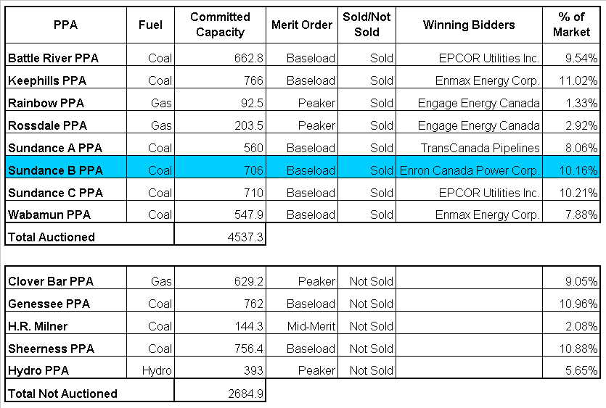
Alberta PPA Results

Slide 5

PPA Structure
Illustration of PPA financial flows
PPA Buyers sell power directly to customers or through the Power Pool at market-driven prices
Direct Sales
PPA Buyers
Owners
Power Pool
PPA buyers make fixed and variable payments to owners based on the terms of the Power Purchase Arrangements approved by the EUB
PPA Buyers pay auction proceeds into a financial account called the Balancing Pool, managed by the Power Pool of Alberta
Balancing Pool
Consumers
Notes:
<number>
<footer>
<header>
<date/time>

Slide 6
PPA Structure
Buyers Rights / Obligations
Buyer commits to pay fixed payments over term of PPA as well as up-front payment
Costs indexed to inflation
Buyer pays variable costs per MW produced
Buyer controls plant dispatch
Owners Rights / Obligations
Owner must meet TA or pay penalty
Owner receives plant as IPP at end of PPA term
Balancing Pool Rights / Obligations
Receives up-front payments
Manage unsold PPA’s
Make payments to Owner in case of Force Majeure
Notes:
<number>
<footer>
<header>
<date/time>

Slide 7

Sundance B PPA Description

Slide 8
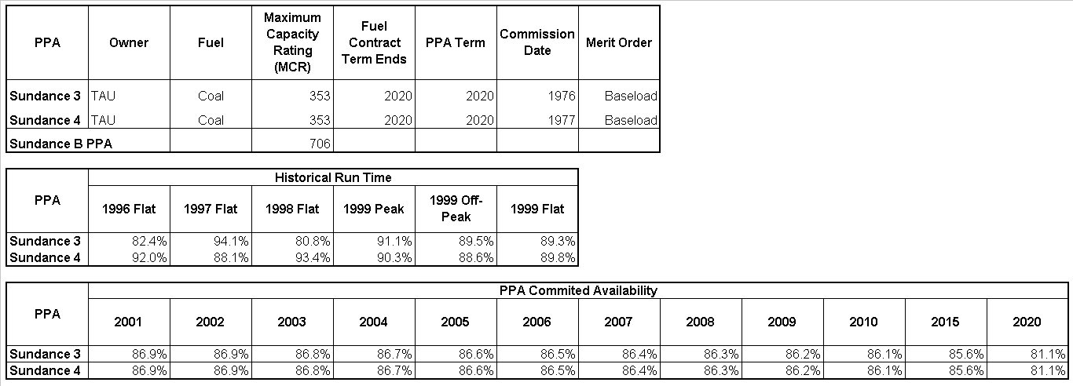
Sundance B PPA Availability

Slide 9
Alberta Load Characteristics
Winter peaking market (February - November is normal while December and January demand is 106% of normal)
Load Composition (1999)
Farm 3.6%
Industrial 55.2%
Commercial 27.0%
Residential 14.1%
Alberta Economic Growth
forecast 5% growth for 2001
Notes:
<number>
<footer>
<header>
<date/time>

Slide 10
Alberta Historical Load Growth
Year on Year Load Growth
Alberta load growth has accelerated in 2000 fueled by robust economic growth and strong oil and gas demand

Slide 11
ESBI Load Growth Forecast
Notes:
<number>
<footer>
<header>
<date/time>

Slide 12
Historical Supply Sources
When Gas and Imports are on the margin, there has tended to be opportunistic pricing and price spikes
Notes:
<number>
<footer>
<header>
<date/time>

Slide 13
Alberta Power Supply Composition

Slide 14
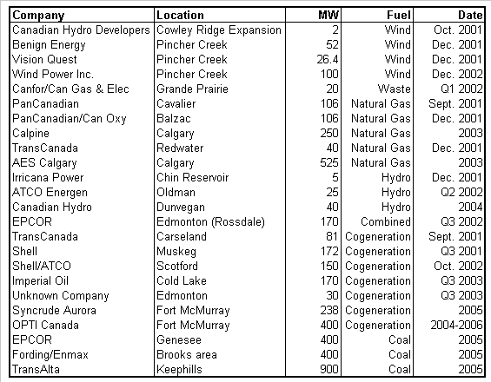
Potential New Supply
Significant new capacity expansions have been announced
Majority of these projects will not be built
Why isn’t Coal going to be built?
Environmental Issues
Transmission Constraints
Why isn’t Gas going to be built?
New build economics
Total Announced Projects 4408 MW

Slide 15
Alberta Generation Retirement Schedule

Slide 16
Historical Power Pool Price C$/MWh (7x24)
Average Pool Price
1996 $14.41
1997 $20.38
1998 $32.84
1999 $42.60
2000 $134.07
2001 YTD $117.57

Slide 17
Historic Alberta Power and Gas Prices

Slide 18
Pricing Factors Summary
Bullish
Over the past three years, the generation supply has remained largely the same while load growth has increased at a higher rate than expected
Very strong U.S. markets - high Mid-C price (competition for electrons)
Higher natural gas prices - natural gas units are on the margin
Coal generation is getting older - increasing outages (ie. Wabamum)
Regulatory risk
Bearish
Slowdown in economic growth in North America (less demand)
Overbuilding of generation
Regulatory risk
Demand response
Notes:
<number>
<footer>
<header>
<date/time>
- volatility is lowest to highest price
- illiquid market right now, thus, not as tight (basis)
- financial markets 4 to 1 financial to physical
- Alberta normally has winter peak (maintenance is finished by then)
- in next 1 to 1.5 years Enron will be looking at generating opportunities
- people moving away from cogen

Slide 19
Conceptual Structure
Split Sundance B PPA into 2 separate PPA’s
Counterparty to purchase one PPA for an up-front payment
Counterparty assumes all rights & obligations as PPA buyer
Notes:
<number>
<footer>
<header>
<date/time>

Slide 20
Why Purchase a PPA ?
Allows the counterparty to instantly become a key player in the Alberta power market
Goal alignment with ENRON
Counterparty will be able to buy into the Alberta market at a discount to new build economics
3 years ahead of new build
Allows the counterparty to participate at half the original exposure levels
Notes:
<number>
<footer>
<header>
<date/time>

Slide 21
New Build Economics

Slide 22
Historical Heat Rates
Average Heat Rate
1996 10.10
1997 12.18
1998 16.88
1999 15.17
2000 24.87
2001 YTD 13.76
Historical Avg 15.74
ECC offer is lower than new build economics and the Average Historical Heat Rate

Slide 23
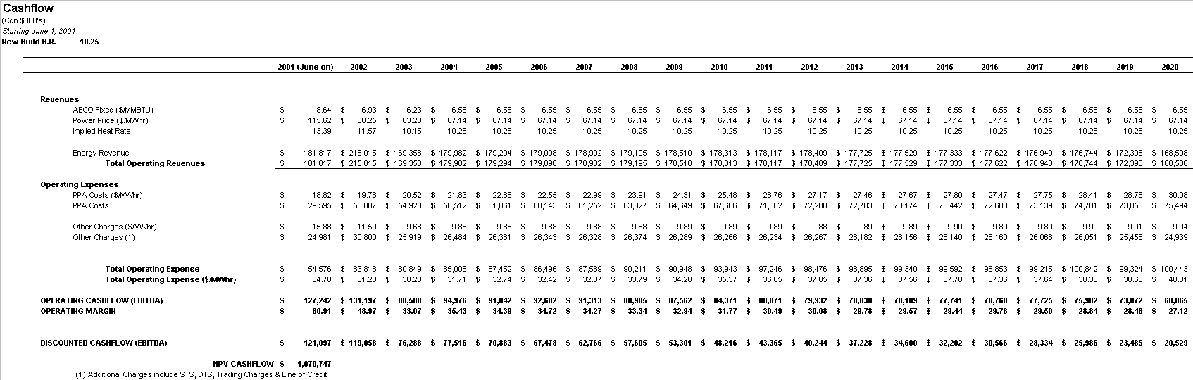
Cash Flow - 10.25 Heat Rate

Slide 24

Cash Flow - 8.5 Heat Rate

Slide 25
Transaction Upside
Excess Energy
STS Resolution
Increased Capacity
Ancillary Services
Notes:
<number>
<footer>
<header>
<date/time>

Slide 26
Risks & Mitigants
Risks
Mitigants
1. Legal Nature of PPAs
The PPAs are “arrangements” given legal force under the Electric Utilities Act.
Enforceable as a statutory obligation similar to a regulation.
2. Counterparty Risk
The PPAs have no credit collateralization mechanism.
The current Owner is an “A” rated entity. The Owner is a regulated utility under the Alberta Energy and Utilities Board and Buyer could object to any asset restructuring.
3. Allocation of Operational Risks/Cost
The Buyer indirectly assumes the risk of certain variable operating costs of the Plants and the Units while the Owner maintains operating control.
Due diligence has quantified costs where available.
Notes:
<number>
<footer>
<header>
<date/time>
- can do this on peak, off-peak basis
- a lot of our customers use gas structures such as this

Slide 27
Risks & Mitigants Cont’d
Risks
The PPAs are a form of Plant / Unit contingent power.
Mitigants
4. Operational/Logistics
The Owner has committed to high levels of Unit availability relative to historical performance.
The PPAs provide for a mechanism, known as the Monthly Incentive Payment, for cover damages when Actual Availability is less than Target Availability.
The PPA Owners also have a financial incentive under the PPAs to operate at levels of output above that required to be delivered to the PPA Buyer (90% of the proceeds from the sale of “excess energy” accrues to the Owner).
Notes:
<number>
<footer>
<header>
<date/time>
- can do this on peak, off-peak basis
- a lot of our customers use gas structures such as this

Slide 28
Risks & Mitigants Cont’d
Risks
(i) Change in Law.
The PPAs require PPA Buyers to compensate the Owner for increased costs or reduced revenues resulting from a Change in Law.
Mitigants
5. Termination Events
(i) The PPA requires the Owner to take all reasonable steps as agreed to by the Buyer to minimize to the fullest reasonable extent any decrease in revenues or increase in fixed costs or variable costs resulting from a Change in Law.
The Buyer is entitled to elect to terminate the PPA if it can demonstrate that the continued performance by the PPA Buyer under the PPA would be unprofitable or more unprofitable.
(ii) “No Fault” Termination - Force Majeure Termination provisions exist whereby if a Force Majeure event lasts for six consecutive months, or both the PPA Owner and PPA Buyer agree that a Force Majeure event will last for six consecutive months, then the PPA Buyer may terminate the PPA.
(ii) No mitigant necessary
Notes:
<number>
<footer>
<header>
<date/time>
- can do this on peak, off-peak basis
- a lot of our customers use gas structures such as this

Slide 29
Risks & Mitigants Cont’d
Risks
(iii) “No Fault” Termination - Destruction.
If a Unit is destroyed or damaged and there is agreement between the Owner, Buyer and Balancing Pool that the cost of repair is greater than the economic value of the Unit.
(iv) Election by Buyer
The Buyer may elect to terminate the PPA at any time.
Mitigants
(iii) Available Insurance Products
(iv) No mitigant applicable
(v) Termination Resulting from Buyer’s or Owner’s Default
Under a Buyer’s default, the Buyer would forego any in-the-money position and have to compensate the Balancing Pool for any out-of-money position.
Under an Owner’s default, the Buyer may elect to terminate, in which case the Owner is liable to the Buyer for the Buyer’s in-the-money position under the PPA.
Notes:
<number>
<footer>
<header>
<date/time>
- can do this on peak, off-peak basis
- a lot of our customers use gas structures such as this

Slide 30
Risks & Mitigants Cont’d
Risks
The Plants require sufficient fuel supply for the term of the PPA’s.
Mitigants
6. Fuel Supply
There is sufficient coal fuel supply in Alberta for the term of PPAs. Generally speaking the Buyer does not take fuel supply risk because of (i) Force Majeure provisions; (ii) terminations rights; and (iii) the Owner’s risk of default of “good operating” obligation.
7. Labour
Labour supply needs to be maintained throughout the term of the PPA’s.
The Owner is obligated under the PPA to maintain sufficient operational employment. Generally speaking the Buyer does not take labour supply risk because of (i) Force Majeure provisions; (ii) termination rights; and (iii) the Owner’s risk of default of “good operating” obligation.
Notes:
<number>
<footer>
<header>
<date/time>
- can do this on peak, off-peak basis
- a lot of our customers use gas structures such as this

Slide 31
Risks & Mitigants Cont’d
Risks
(i) The Units are coal-fired generation.
(ii) PPA Buyer is liable for costs associated with changes in permit requirements under Change in Law.
Mitigants
(i) Sundance B is compliant to all current regulations. Buyer does not have direct responsibility for environmental liabilities.
(ii) Any cost to comply with current environmental standards are built into the cost structure of the PPA. As noted under Change in Law above, Buyer is entitled to elect to terminate the PPA if it can demonstrate the continued performance by Buyer under the PPA would be unprofitable or more unprofitable.
8. Environmental/Permitting
Notes:
<number>
<footer>
<header>
<date/time>
- can do this on peak, off-peak basis
- a lot of our customers use gas structures such as this

