Slide 1

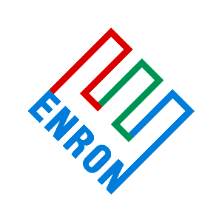
Lyondell / Enron December 11, 2000
Opportunities for collaboration
Center-of-the -fairway alliance
Options

Slide 2
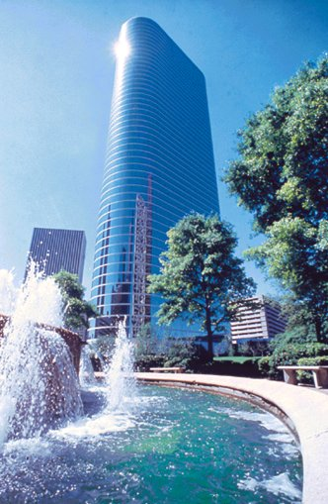
Enron Today
$70 Billion in Revenue (est. 2000)
$46 Billion in Assets (est. 2000)
$55 Billion Market Cap
> $305 Billion in On-line Transactions
A Leading, Global Commodity Company
- Ranked #1 in Innovation, Quality of Management,North American Natural Gas and Power Marketing
- First to broadly introduce price risk management products to plastics, petrochemicals, pulp & paper, coal, weather and bandwidth commodity markets
Notes:
<number>
<footer>
<header>
<date/time>

Slide 3
Collaborative Opportunities
“Total Solution” - Overlay core competencies (4X multiple enhancement)
Trading, Utilization of Assets, Finance, Price/Margin management, e-Commerce
“Market-Place Solution” - Joint market-place approach (3 X)
Trading, Utilization of Assets, e-Commerce
“Condo Assets” - Enron acquires virtual asset position (2 X)
Utilization of Assets, Finance
Equistar Equity - Enron acquisition of Millennium stake (2 X)
Utilization of Assets, Finance

Slide 4
Enron’s current points of contact
Crude and refined products supply and trading
Natural gas supply and trading
Power generation and trading
Utility outsourcing solutions
NGL production, physical supply and trading
Petrochemicals and plastics supply and trading
Production of MeOH, MTBE
Physical aromatics
Only real financial market maker
Broadband solutions
Financial services
e-Commerce

Slide 5
Enron Trading Model
Risk
Management
Finance
Cash/Physical

Slide 6
Creation of Additional Market Space

Slide 7
Market E-Volution:
Accelerated commoditization
Margin Erosion
Increased Price Volatility
Efficient Market Will Dictate New Approaches to Increasing Shareholder Value
(e.g. Financial Engineering, e-Business)

Slide 8
Lyondell S.W.O.T.*
* Adapted from Salomon Smith Barney, Gyrus 2000, The Search for Value in Global Chemicals - September 2000

Slide 9
Option #1: “Total Solution”
Deep integration of Lyondell and Enron business models
Allows value extraction from market transformation
Highest expected p/e multiple improvement
Both companies bring the full force of their respective strengths to bare on the market
Lyondell: one of World’s leaders in operations and physical markets served
Enron: immense commodity trading expertise
Margin stabilization via price risk management
Upside from trading around assets shared in some manner
Global replication possibilities

Slide 10
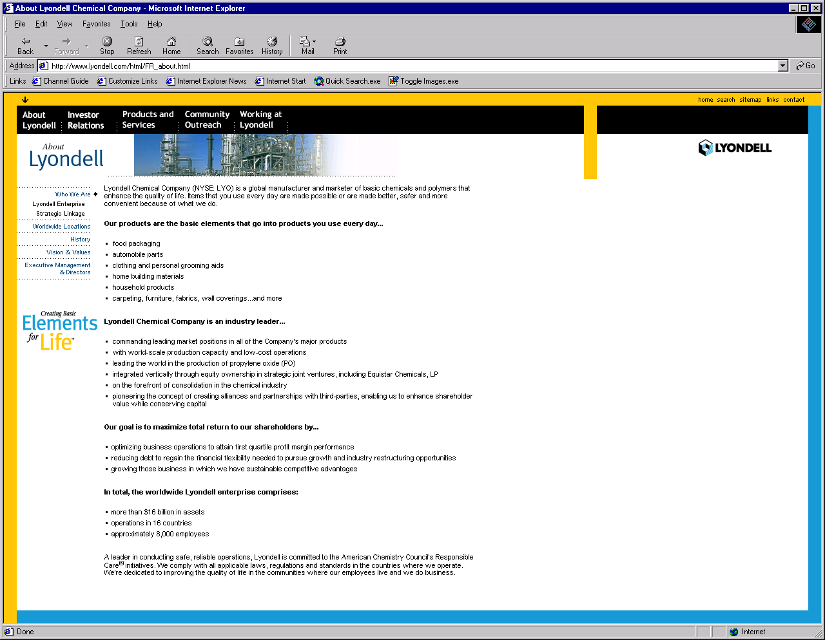
Lyondell Core Competencies
Manufacturing
Product Management
Sales and marketing
Logistics
Storage
Docks
R & D
E/H/S
Information technology
Communications
Accounting
Credit
Customer service
Procurement
Legal
Finance
Facilities risk management
Pipeline
e-Commerce

Slide 11
Lyondell / Enron Combined Competencies
Manufacturing
Product Management
Sales and marketing
Logistics
Storage
Docks
R & D
E/H/S
Information technology
Accounting
Credit
Customer service
Procurement
Legal
Finance
Facilities risk management
Pipeline operation
e-Business
Trading
Market creation
Forward market ownership
Price (margin) risk management
Financial risk assessment and control
Pipeline value extraction
Storage value extraction
e-Commerce, Ventures
Broadband, Communications
Monitization of assets

Slide 12
Specific Value to Lyondell via “Total Solution”
First mover, leader advantage, in transforming marketplace
Excellent position to capitalize on the $486 billion market expansion
A real-time opportunity
Partner with the world’s largest online transaction engine
Partner with a non-competitor
Become the company to define on-line standard contracts
“Own the contract”
Access to unique suite of commodity e-commerce platforms
Millions of dollars in trading transaction fee savings
Millions of dollars in one-off transaction savings
Potential selective monetization of assets
Additional debt reduction possibility

Slide 13
Option #2: “Market-place Solution”
E-Originator -
DealBench^{tm}
Specialty Exchange
(Enron)
EnronOnline^{tm}
Buy-side
Lyondell ++
Sell-side
Lyondell ++
Envera
E-Solution Provider (Enron)
Value to Lyondell and structure similar to Option #1 without intra-Lyondell price (margin) risk management.
Adapted from Wise and Morrison, Harvard Business Review, Nov-Dec 2000

Slide 14
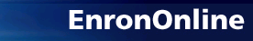
Direct Exchange
Example
Characteristics
Largest B-2-B site, Global
Many-to-One-to-Many
Real-time price discovery
“Click-and-trade” ease
Intrinsic liquidity
Free, no transaction costs
Always “two-way” markets
Standardized contracts
Market-maker’s best prices
Internet access
Customizable content
Internal credit clearing
Financial where-with-all hurdle
High cost to develop

Slide 15
Markets Made on EnronOnline
Commodity Segment
Argentine Natural Gas
Asian Crude & Products
Australian & Japanese Weather
Australian Power
Austrian Power
Bandwidth
Belgian Natural Gas
Canadian Natural Gas
Credit Derivatives
Dutch Power
Emissions
European Coal
European Weather
German Power
International Coal
Japanese Aluminum
LME Metals Contracts
LPG
Nordic Power
Oil & Refined Products
Petrochemicals
Plastics
Pulp & Paper
Sea Freight
Spanish Power
Swiss Power
UK Metals
UK Natural Gas
UK Power
US Gas Pipeline Capacity
US Lumber
US Metals
US Natural Gas
US Power
US Steel
US Weather

Slide 16
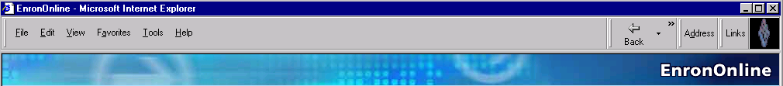
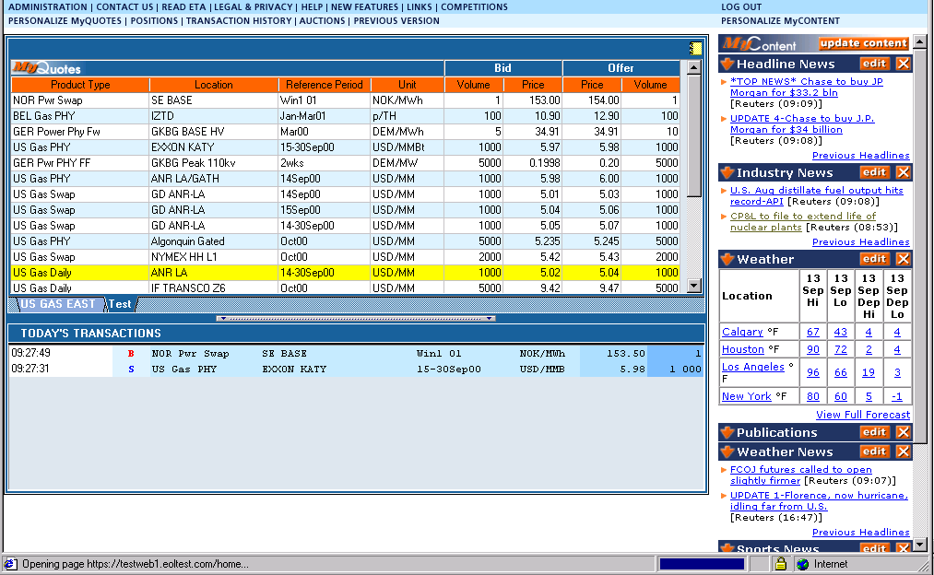
EnronOnline: Direct Exchange Answers “What’s The Price?”

Slide 17
EnronOnline Statistics
Rapid Deployment
Development Time Approximately 7 Months, launched 11/29/99
Version “2.0” launched 9/18/00
Tremendous Product Depth and Breadth
~1,200; fixed price, options, spreads; 13 currencies; Auctions
Spawned DealBench, RAC.com, ClickPaper, EnronCredit.com
“Linking” to other models (e.g. HoustonStreet, others pending)
Capital Investments - organic, accretive acquisitions
Phenomenally Successful
Total Transactions > 510,000 (>4,300/day, 30 day trailing avg.)
> 59 % of Enron’s Transactions & 45% of Notional Volume
Notional Value of Transactions > $305 billion ($3.3 Billion/day, L30d)

Slide 18
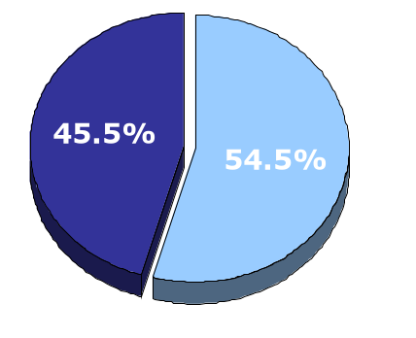
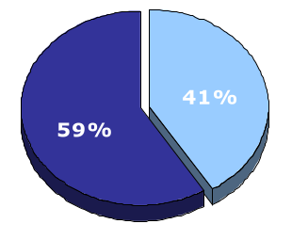
EnronOnline vs. Traditional Channels
(Currently)
Volume
Transactions
Traditional Channels
EnronOnline

Slide 19
Enron’s Current Market Space
Market A
Market B
Market C
...
Market X
Enron

Slide 20
Lyondell / Enron Market Expansion
Market A
Market B
Market C
...
Market X²
Enron
Lyondell

Slide 21
Option #3 “Condo Assets”
Realization of strategy
Physical Ethylene, PG Propylene, Styrene
Minimum of 50 million pounds/year each
Polyethylene, Polypropylene
Minimum of 35 million pounds/year each
Refined products (volumes to be discussed)
Value to Lyondell
Partial (and temporary) monitization of assets
Cash now to re-deploy
Participation in market expansion
Utilization of existing assets
Stabilized margins via unique price structures
Could be concurrent with other options

Slide 22
Option #4 Equity Position: Acquisition of Millenium’s stake in Equistar
Enron becomes minority player in the Equistar JV
Continuation of existing asset operating agreement
Direct Enron involvement in areas of core Enron expertise:
Physical spot market making
E-commerce for commodity transactions
Price and margin risk management services
Fees / profit sharing arrangement to be discussed
Predefined exit option for Enron at some point in the future
Value to Lyondell
Profit sharing
Participation in market expansion
Utilization of existing assets
Stabilized margins via unique price structures

Slide 23
Next Steps:
Confidentiality agreement
Letter of Interest
Period of exclusivity
On-site due diligence to determine value creation potential

