Slide 1
Tips for avoiding
falling luggage
on airplanes

Slide 2
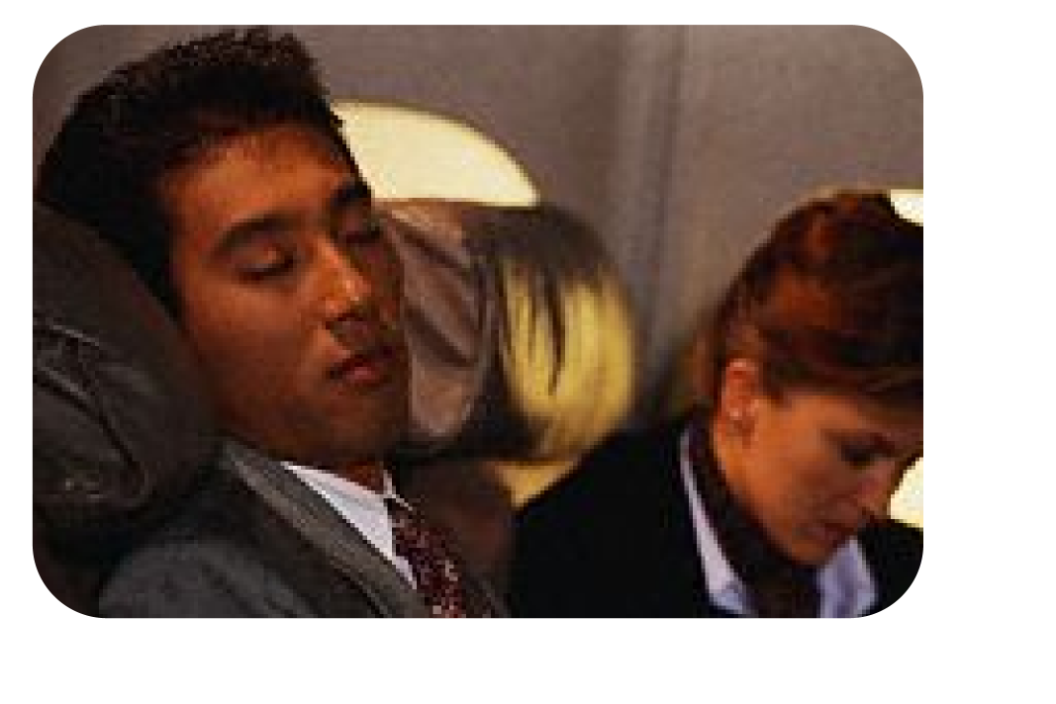
Stay awake and alert at ALL times

Slide 3
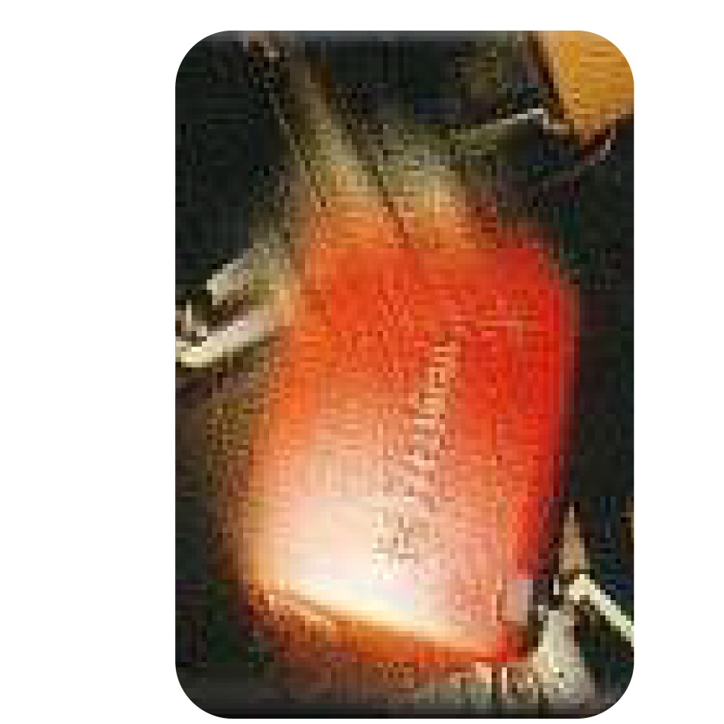
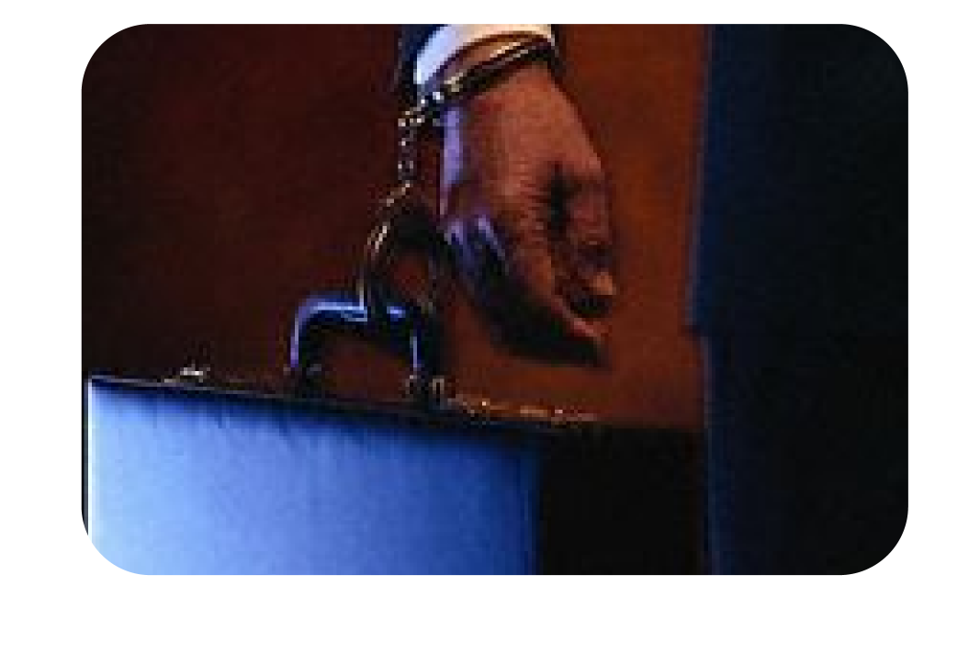
Keep an eye on overhead bins and
wayward briefcases

Slide 4
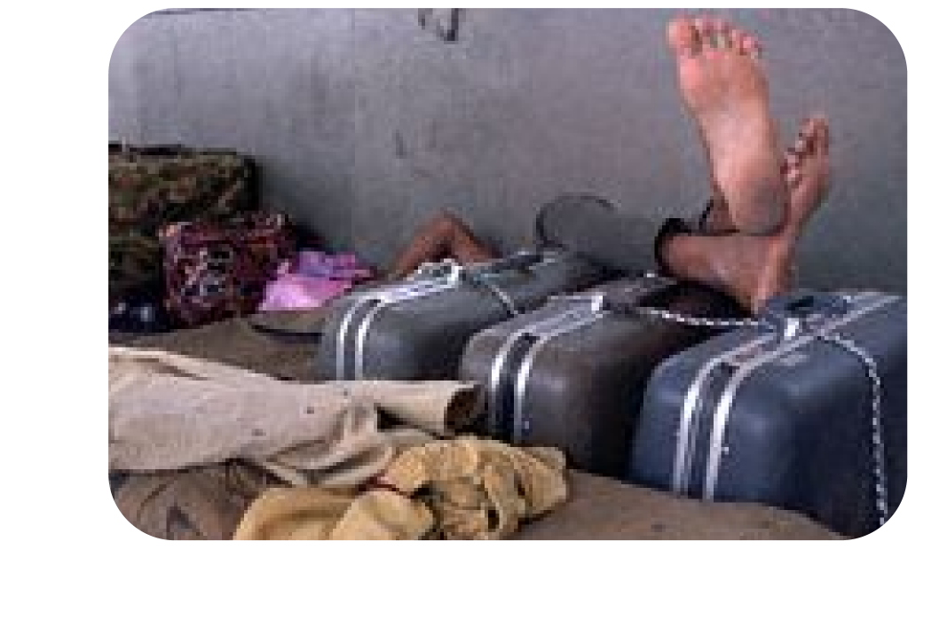
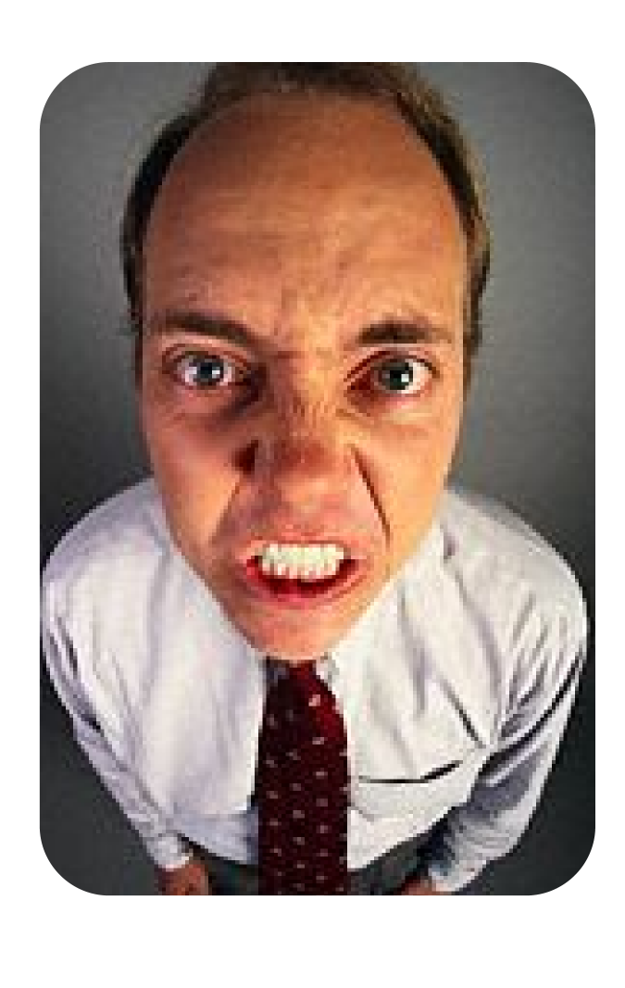
If struck by falling luggage, blame
Person who opened bin, then blame
Owner of luggage.
If neither demonstrates remorse, call them
An ***hole and threaten legal action

Slide 5


Be sure to sit next to an ear-nose-throat
specialist

Slide 6

Ask the flight attendant for extra ice
and kleenex to stop bleeding
If she is tall, attractive and buxom,
appeal for sympathy

Slide 7

Don’t
Cry

Slide 8
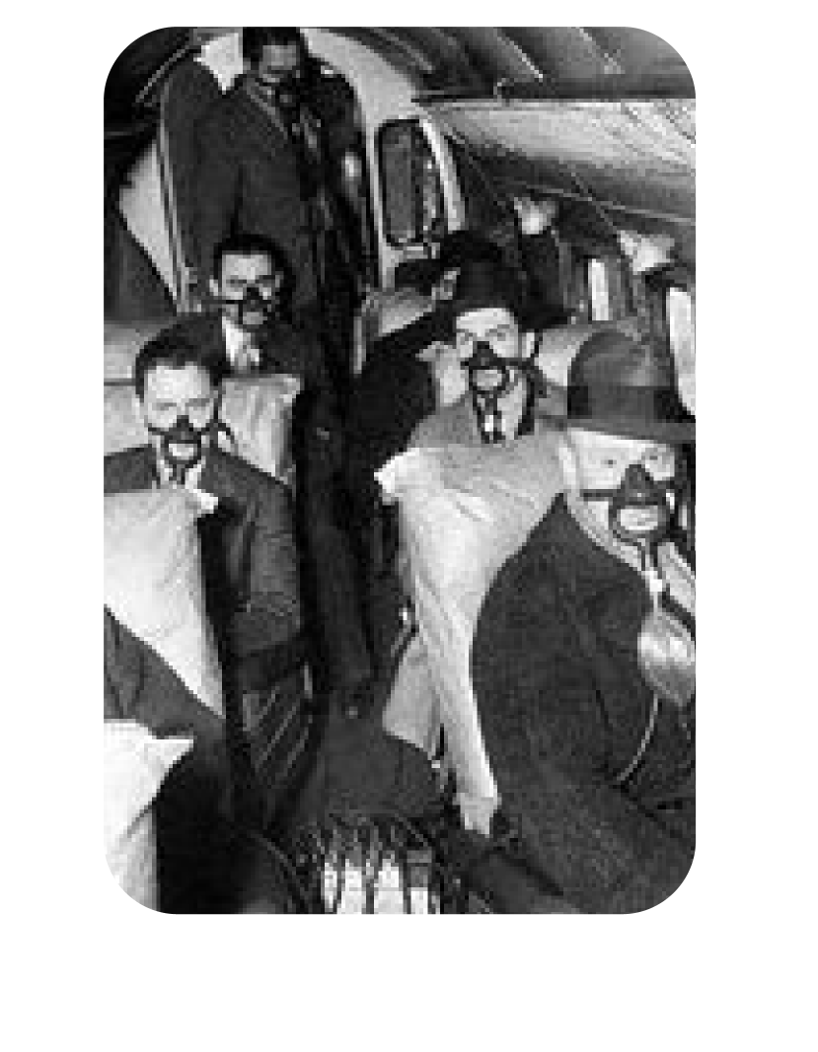
If you should experience a drop in cabin pressure, an oxygen mask will drop from compartment above your head. Place over your mouth and nose. Breathe through your mouth

Slide 9

There are six exits throughout the cabin
Locate the exit nearest your seat.
Push the ***hole out of the nearest exit
Remind him that he may use his seat cushion as a floatation device

Slide 10

Standard Enron travel gear

