Slide 1
LIQUIDITY MARGIN EXPOSURE

Slide 2
Purpose
Provide Risk Managers/Treasury with information about margins.
To provide VaR-like confidence intervals for net cash flow arising from margin calls over the next n days.
Analysis is done for specific counter-party contracts and can be aggregated and by counter-party, portfolio, or Enron as a whole.

Slide 3
Methodology
New prices curves are simulated using Potential Exposure simulation engine.
DETAILED ANALYSIS OF EACH CONTRACT WITHIN CP. (Asset Liability Management).
For each relevant counter-party contract, a new mark to market value, MTMnew, is calculated from simulated prices using valuation engine.
Cash due Enron = max(MTMnew-CPThreshold-CPPostedColl, 0)

Slide 4
Methodology(contd.)
Cash due CP = max(-MTMnew-EnronThreshold-EnronPostedColl, 0)
TotalCashflow = Cash Due Enron – Cash due CP
TotalCashflow numbers for each simulation are aggregated across the relevant counter-party contracts.
The resulting list of 1000 simulated cashflows are sorted and p.05, p.10, p.50, p.90, and p.95 quantiles are reported.

Slide 5
Simulating Forward Returns
Consider a portfolio of instruments derived from forward prices
  Obtain the covariance matrix of the forwards
  Apply eigenvector decomposition Σ=ΓΛΓ^{T}

Slide 6
Heath-Jarrow-Morton
Simulate forward prices with the multifactor equation
  over horizon T, F is given by
  Note, identical to Market Risk 2 formalism
  Note that the volatilities are preserved in this process since we are simulating actual rather than relative prices
$F_{t_{j},T}=F_{t_{j},0}\text{exp}\left[−\frac{1}{2}\sum_{i=1}^{7}{\left(v_{\text{ij}}^{2}λ_{i}\right)}+\sum_{i=1}^{7}{\left(v_{\text{ij}}\sqrt{λ_{i}}ε_{i}\right)}\right]$
$ε\text{\sim }N(0,1)$

Slide 7
General Simulation Algorithm
For I = 1 to 1000 simulations
(1) Time horizon (T) = 7, 14, 30 days.
(2) Move all the forward curves with maturity > T
(3) Obtain MTM_{new}
Next For

Slide 8
Model Validation Example: Range Resources Corp.
Counter-party has a single swap deal with with mark to market value $1,488,787
Delta positions on 3 NG forward dates:
      1/1/02: 694,329
      2/1/02: 625,227
      3/1/02: 690,306

Slide 9
Example (cont.)
One price change is simulated for each of the forward dates:
      1/1/02: 0.4359
      2/1/02: 0.3800
      3/1/02: 0.3165
Based on these price changes, simulated P&L is calculated:
    P&L = δP₁*Δ₁ + δP₂*Δ₂ + δP₃ *Δ₃
    = 0.4359*694329 + 0.3800*625227 + 0.3165*690306
    = $758,726
MTMnew = MTMold + P&L
= $1,488,787 + $758,726
= $2.24 MM

Slide 10
Example (cont.)
Using MTMnew, net cash flow is calculated:
    Cash due Enron = max(MTMnew-CPThreshold-CPPostedColl, 0)
    = max(2.24 MM – 0 – 0, 0)
    = $2.24 MM
    Cash due CP = max(-MTMnew-EnronThreshold-EnronPostedColl, 0)
    = max(-2.24 MM – 10MM – 0, 0)
    = $0
    Cash Flow = Cash Due Enron – Cash due CP
    = $2.24 MM - $0
This process is repeated for 1000 simulations
Resulting cash flows are sorted and the p.05, p.10, p.50, p.90, p.95 are reported.

Slide 11
Example (cont.)
System results match simulation for
P-99, P-95, P-50, P-5, P-1.
System
Verificat.

Slide 12
Observables
Margins and Refunds at all confidence levels for each counterparty.
Margin Contribution: The contribution of curveshift and initial margin to total margin.
Stressed Margins: Assuming CP calls and we do not receive any margins, what the worst-case exposures are. Provides confidence bands on our exposures.

Slide 13
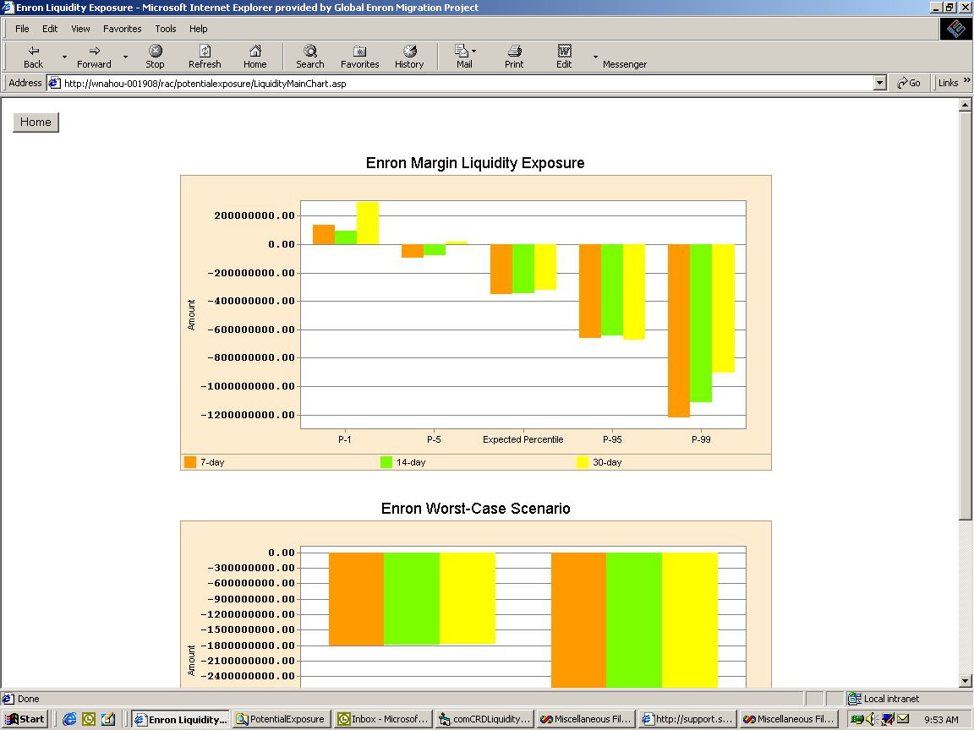

Slide 14
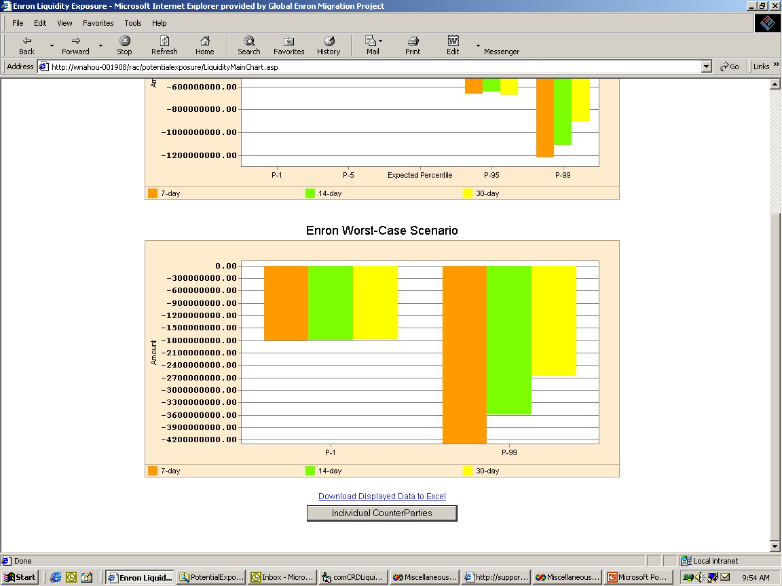

Slide 15
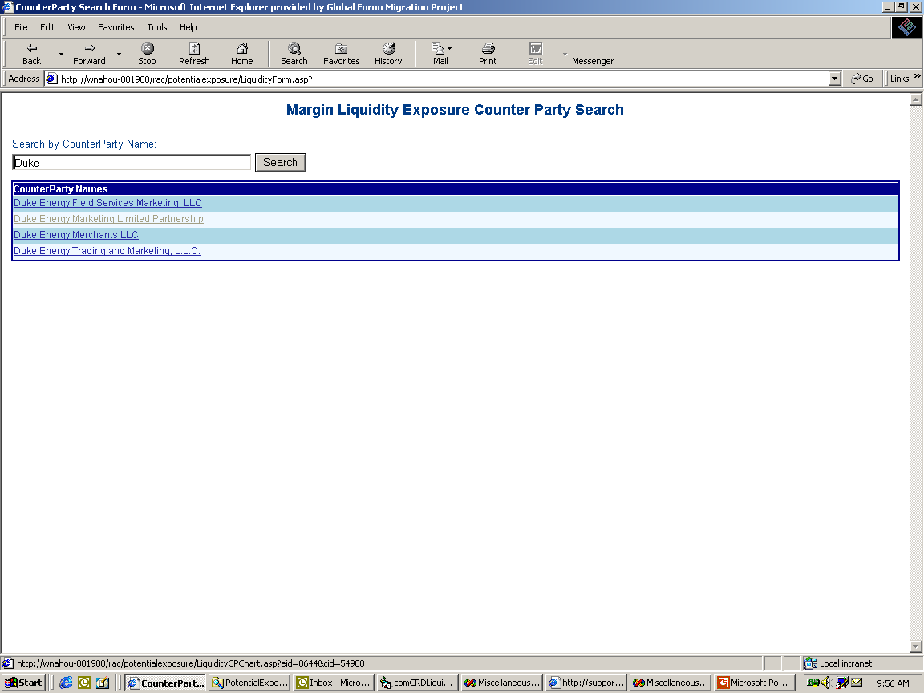

Slide 16
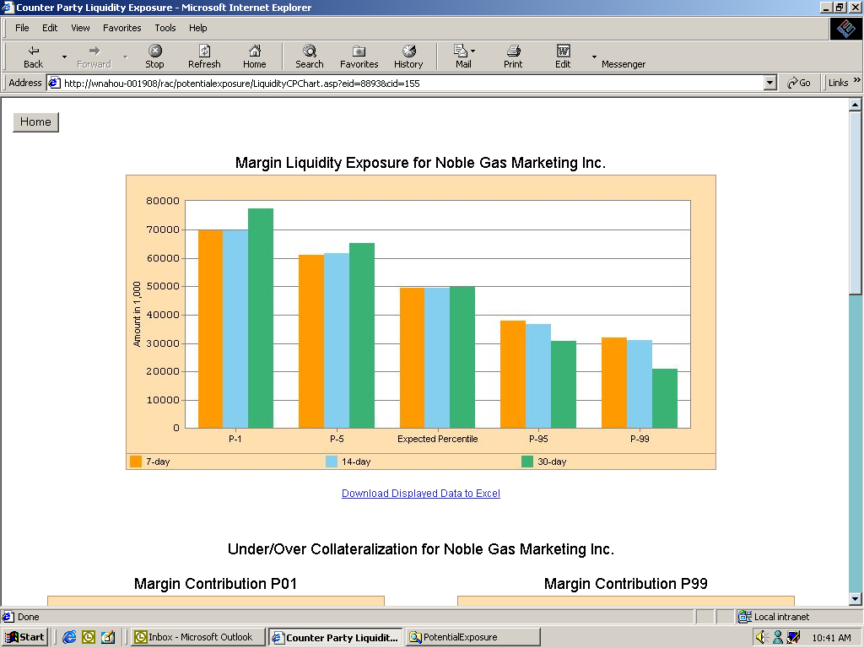

Slide 17
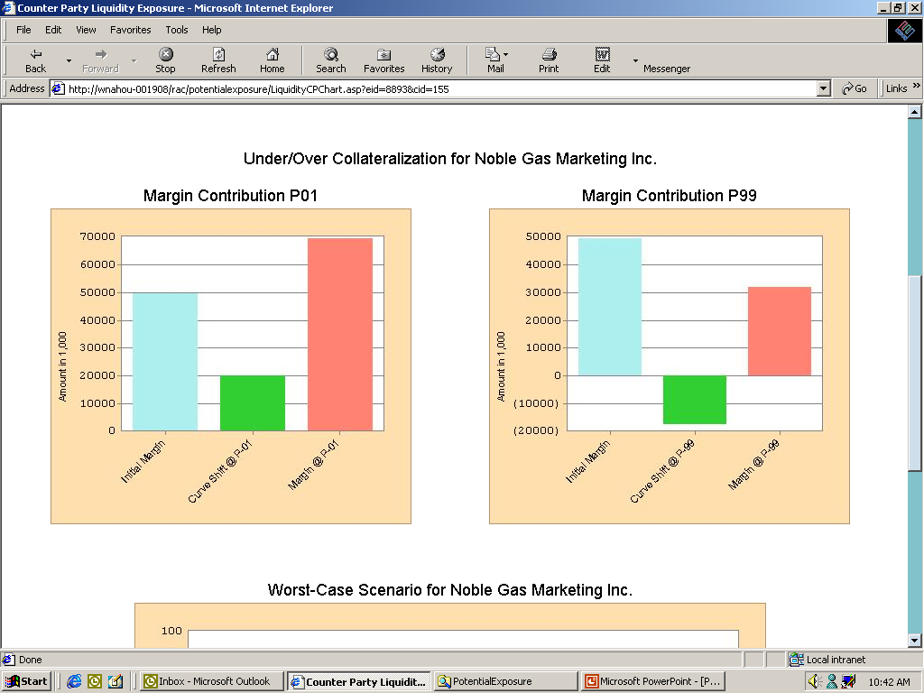

Slide 18
