Slide 1
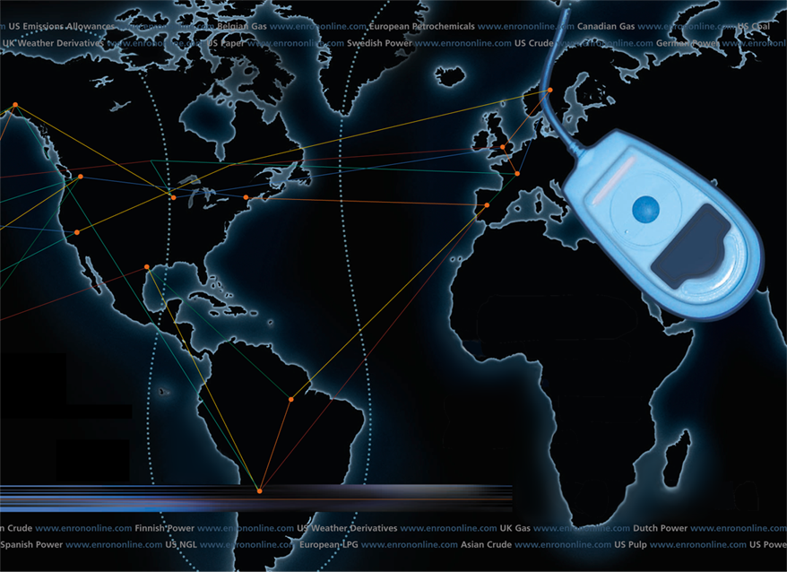
Putting the Energy into e-commerce
EnronOnline
TM
TM
Louise Kitchen
President - EnronOnline
Managing Director - Enron Net Works

Slide 2
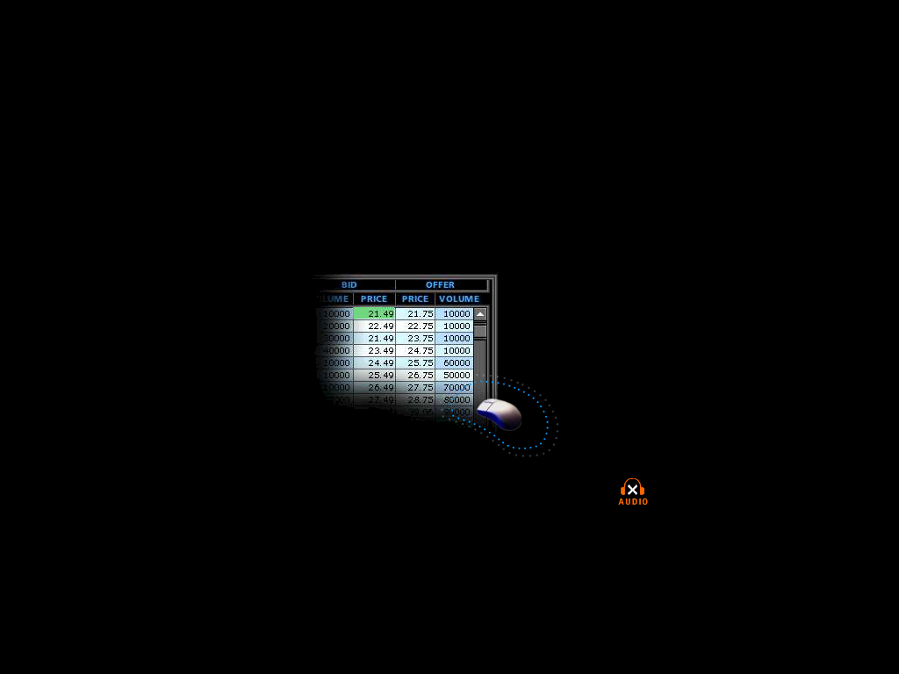
What is EnronOnline?
A Free, Internet-based, Global Transaction System Which Allows Counterparties to View Real Time Prices From Enron’s Traders and Transact Instantly Online
click & transact

Slide 3
Customers can transact with Enron using the phone or EnronOnline
Internet
via EnronOnline
Enron

Slide 4
Benefits of EnronOnline
Free of charge
Real-Time Pricing Information
Access to complementary markets and product information
Simple access via the Internet
Easy to use
Fast and Secure Execution
Enron’s Best Prices

Slide 5
EnronOnline Launch Schedule
November 1999 US & Canadian Natural Gas
December 1999 US Power
Nordic Power
Plastics
Pulp & Paper
Coal
January 2000 Belgian Natural Gas
Emissions
German Power
LPG
Oil & Refined Products
Petrochemicals
Spanish Power
Swiss Power
UK Natural Gas
UK Power
US Weather

Slide 6
Enron’s global wholesale transaction business …………..moves online
February 2000 EnBank Virtual Storage Auction (UK)
European Weather
March 2000 Australian Power
Credit Derivatives
Dutch Power
Emissions Auctions (US)
April 2000 Austrian Power
May 2000 Bandwidth
European Coal
Asian Crude & Products

Slide 7
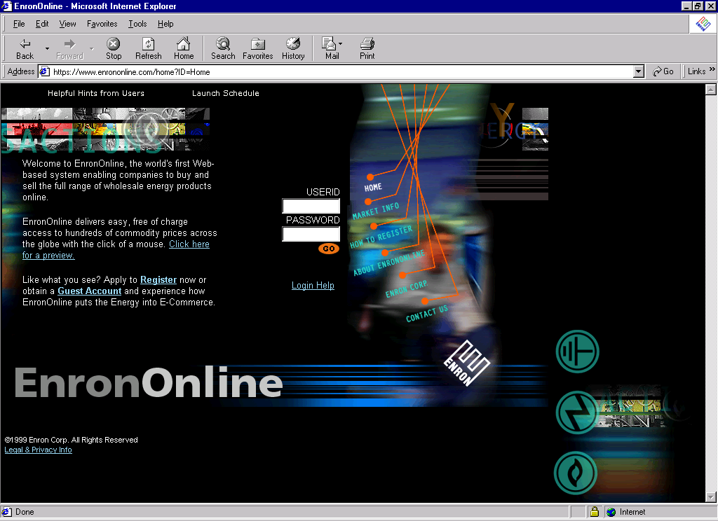
www.EnronOnline.com

Slide 8
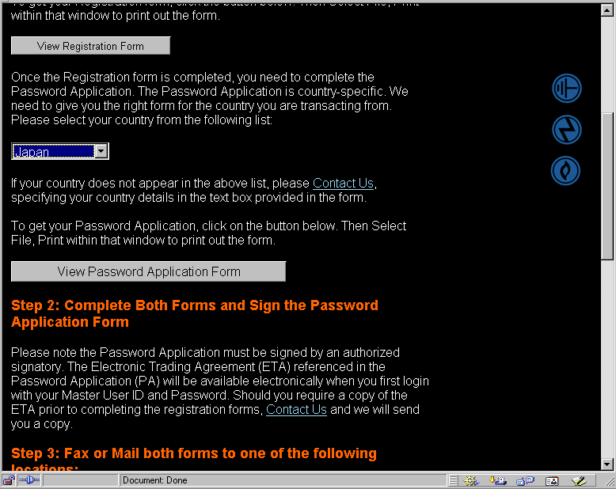
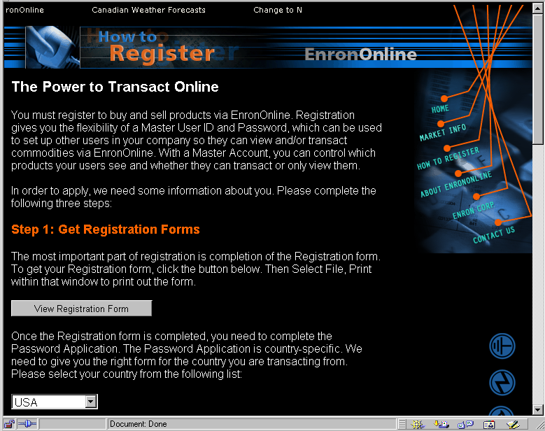
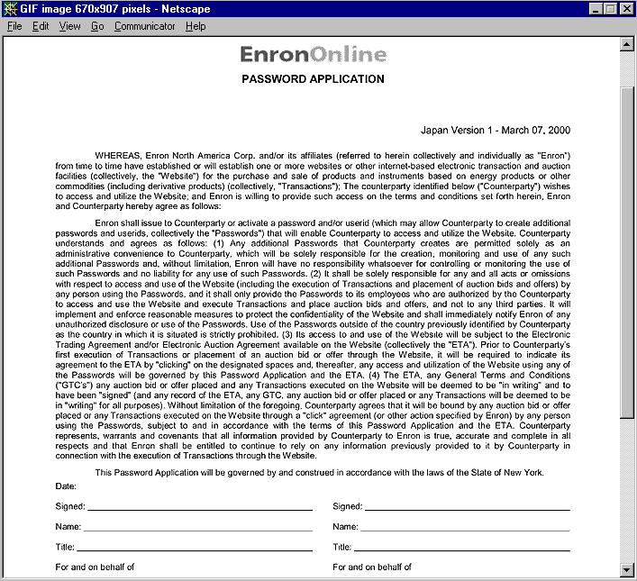
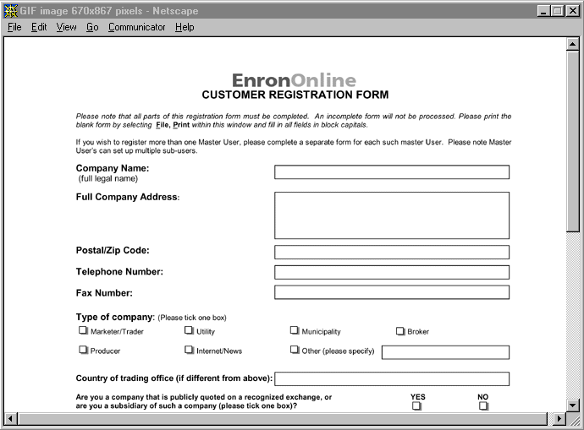
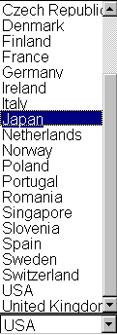
How to Register

Slide 9
www.EnronOnline.com
New User
*******

Slide 10
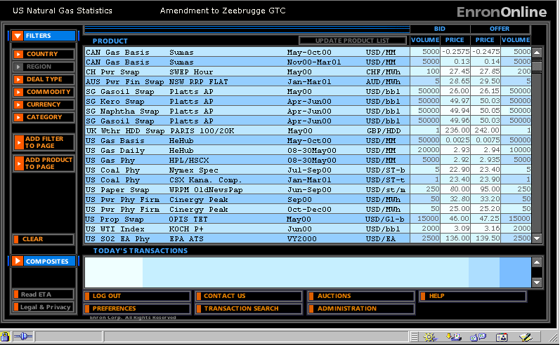
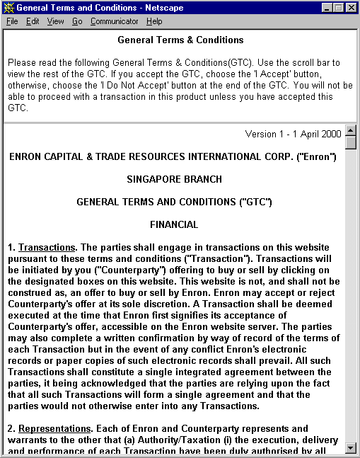
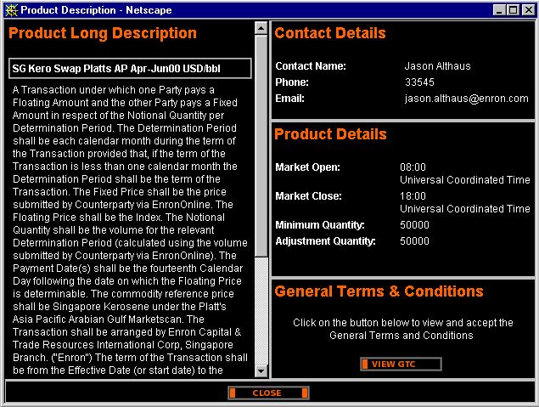
Legal Definition and Product Information

Slide 11
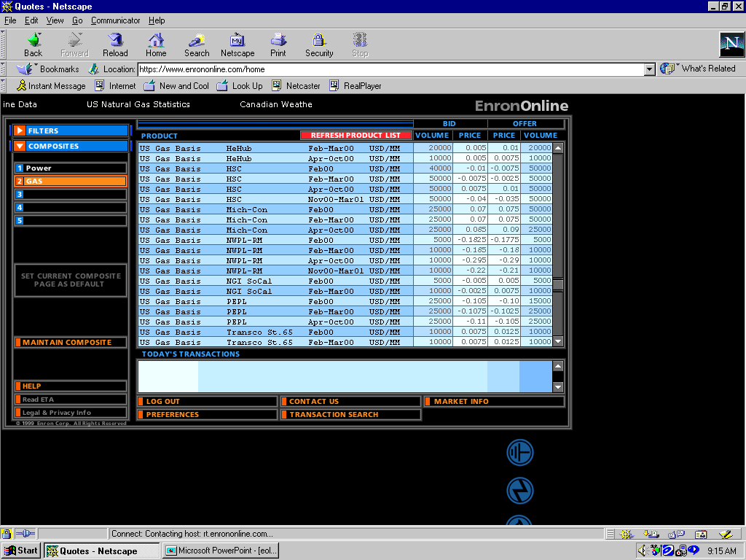
Click on Bid or Offer Price

Slide 12
Submission Screen

Slide 13
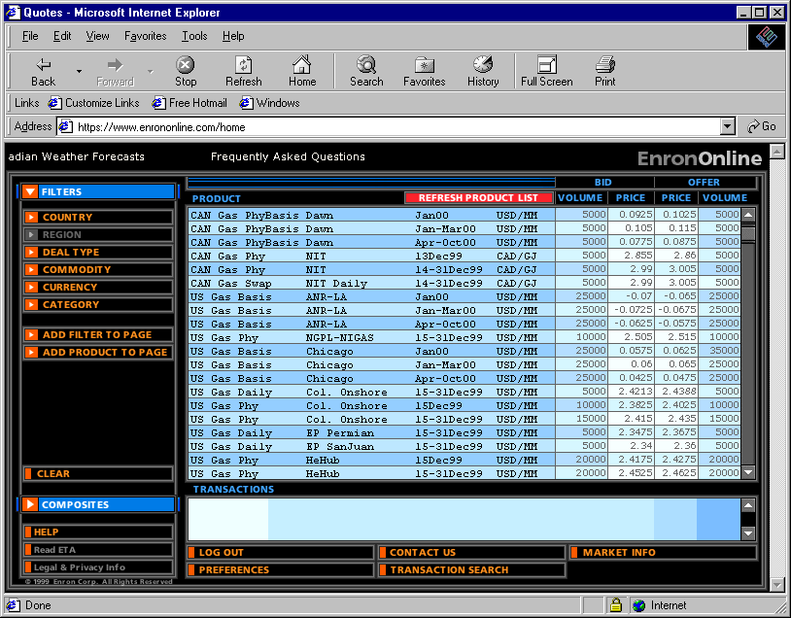
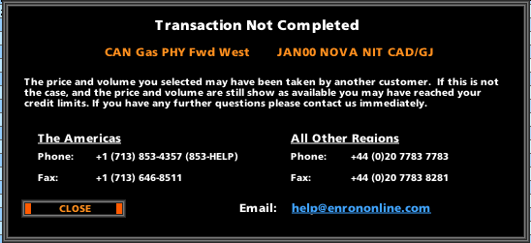
Failed Transaction

Slide 14
Why a Transaction Might Fail
The price has moved
The requested volume is no longer available
Credit Limit

Slide 15
Successful Transaction

Slide 16
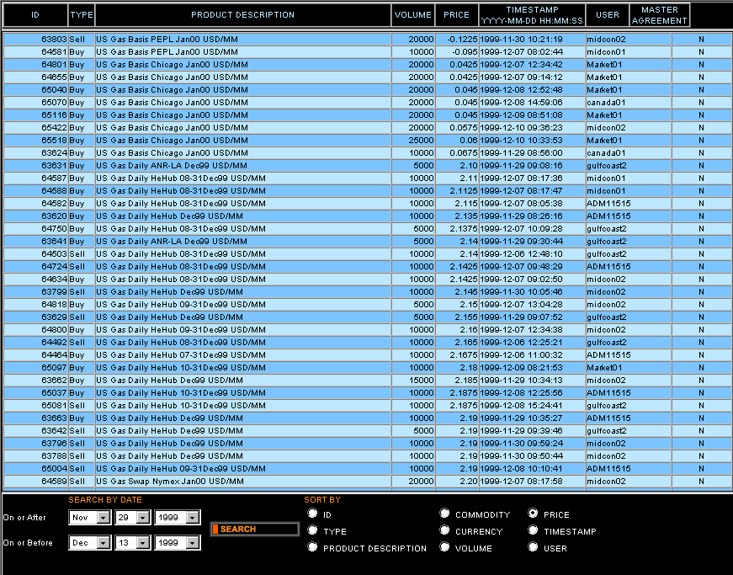
Transaction Search

Slide 17
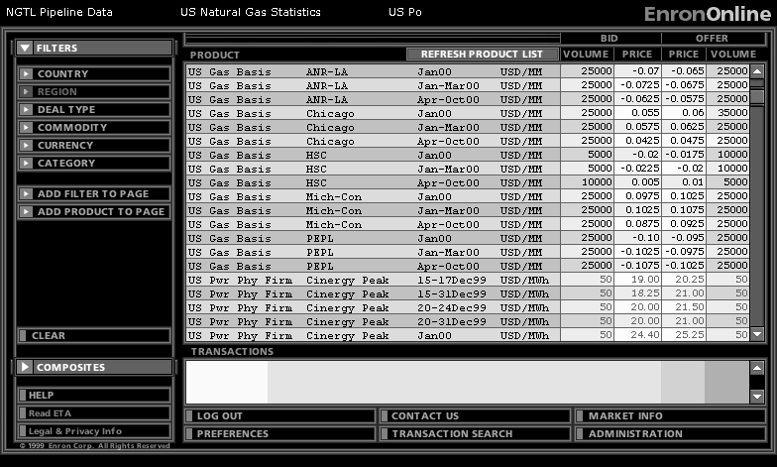
Quotes Page

Slide 18

Making the global market

Slide 19
Making the global market
Enron is Principal to all transactions, Enron is not an Intermediary

Slide 20
EnronOnline
Development Time: Approximately 7 Months
Announcement Date: October 26, 1999
Launch Date: November 29, 1999
Number of Products Offered: Approximately 800
Number of Currencies Traded in: 13

Slide 21
EnronOnline Statistics
Total Life to Date Transactions: > 116,000
Average Daily Transactions: > 1,500
2000 Notional Value of Transactions: > $47 billion
Daily Notional Value: Approximately $800 Million

Slide 22
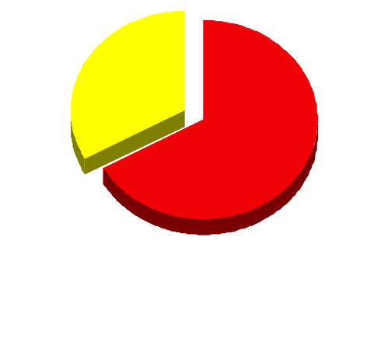
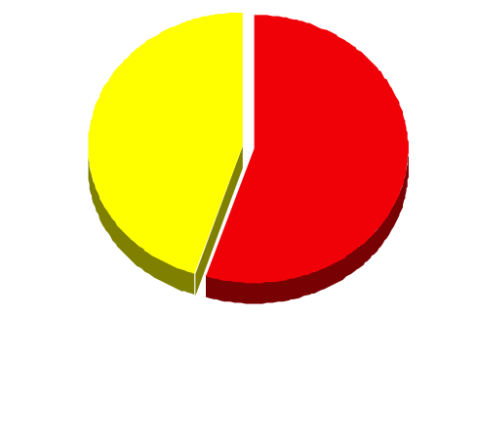
EnronOnline Versus Traditional Channels (Currently)
Volume
Transactions
33%
45%
55%
67%
EnronOnline
Traditional Channels

Slide 23
Transactions via EnronOnline (Weekly)

Slide 24
eCommerce Business Comparison
Value of Goods*
Value of Goods
(Millions)
Business To Consumer (B2C)
eBay
Amazon.com
Dell.com
$ 2,650
1,600
10,190
1999 Data*
Business To Business (B2B)
FreeMarkets
Cisco
Intel
Altrade
$ 1,400
9,480
10,500
12,000
2000 to date
EnronOnline
> $ 47,000
* Est. 1999 Annual Results

Slide 25
Contact Us
Call us:
The Americas: Japan: All Other Regions:
+1 (713) 853-4357 (HELP) 0120-8 36766 (ENRON) +44 (0)20 7783 7783
Write us:
EnronOnline EnronOnline EnronOnline
P.O. Box 4656 Kamiyacho Mori Building Enron House
1400 Smith Street 14th floor P.O.Box 29173
Houston, TX 77002 4-3-20 Toranomon, Minato-ku London SW1X 7WB
USA Tokyo 105-0001 UK
Japan
E-Mail us at help@enrononline.com

Slide 26

Putting the Energy into e-commerceTM

