Slide 1

Alberta Fundamentals
Senior Management Meeting
Calgary
May 11th, 2001

Slide 2
Alberta Load Characteristics
Winter peaking market (February - November is normal while December and January demand is 106% of normal)
Load Composition (1999)
Farm 3.6%
Industrial 55.2%
Commercial 27.0%
Residential 14.1%
Estimated Load Curtailability 300 MWs
Notes:
<number>
<footer>
<header>
<date/time>

Slide 3
Alberta Historical Load Growth
Year on Year Load Growth
Alberta load growth has accelerated in 2000 fueled by robust economic growth and strong oil and gas demand

Slide 4
PEAK DEMAND GROWTH
Notes:
<number>
<footer>
<header>
<date/time>

Slide 5
OFFPEAK DEMAND GROWTH
Notes:
<number>
<footer>
<header>
<date/time>

Slide 6
Historical Supply Sources
Notes:
<number>
<footer>
<header>
<date/time>

Slide 7
Proposed Generation

Slide 8
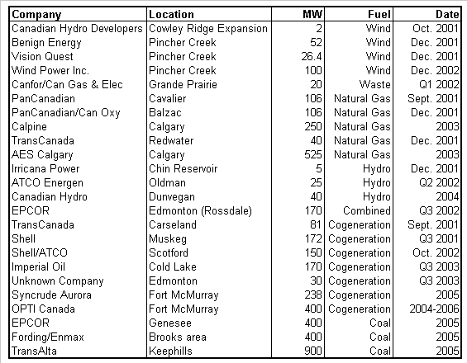
PROPOSED GENERATION
Significant new capacity expansions have been announced
Issues Surrounding Coal Projects
Environmental Issues
Transmission Constraints
Issues Surrounding Gas Projects
New build economics
Total Announced Projects 4408 MW

Slide 9
Alberta Generation Retirement Schedule
Sundance A
Battle River 3&4
HR Milner
Cloverbar
Rainbow & Sturgeon
Rossdale
Wabamun

Slide 10
Generation Stack – Marginal Generator

Slide 11
Generation Stack – Marginal Generator

Slide 12
Generation Stack – Marginal Generator

Slide 13
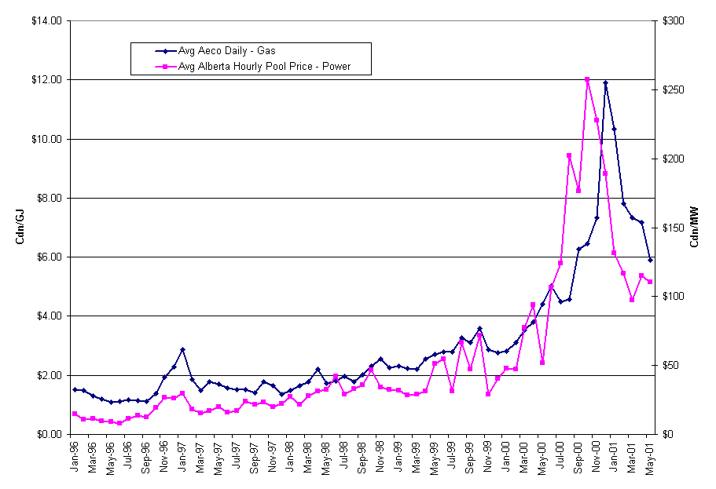
Historic Alberta Power and Gas Prices

Slide 14
Historical and Forward Power Pool Price C$/MWh (7x24)
Historical Yearly Average Pool Price
Year: Peak Avg. Off-Peak
1996 $10.49 $14.41 $17.57
1997 $14.42 $20.38 $25.19
1998 $22.27 $32.84 $41.38
$25.20 $42.78 $56.98
$71.74 $134.07 $183.44
YTD $90.60 $114.60 $133.57
Yearly Avg.

Slide 15
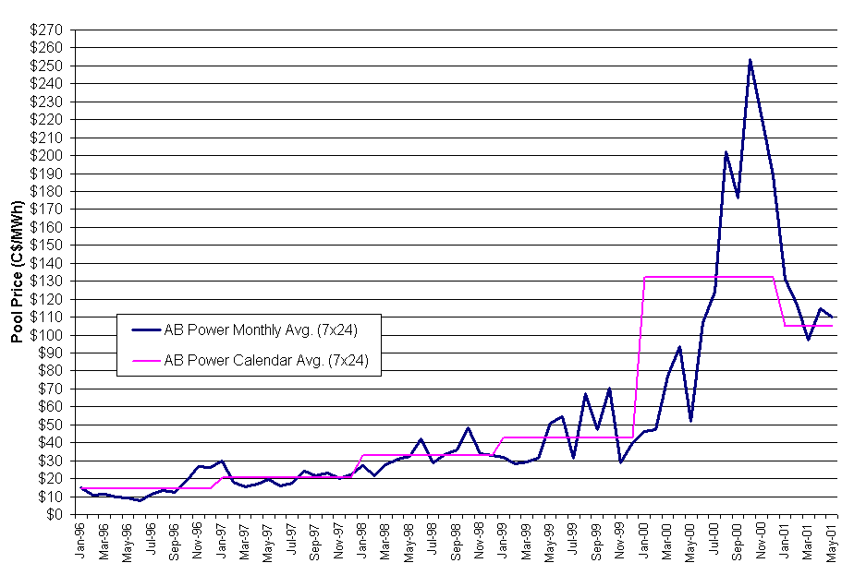
Historical Power Pool Price C$/MWh (7x24)
Average Pool Price
1996 $14.41
1997 $20.38
1998 $32.84
1999 $42.60
2000 $134.07
2001 YTD $114.62

Slide 16
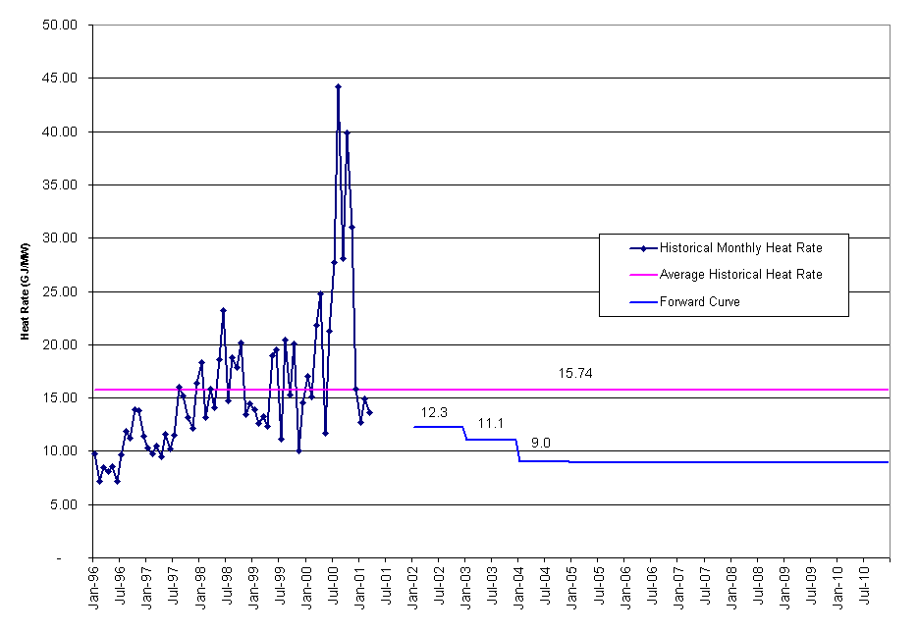
Historical Heat Rates
Average Heat Rate
1996 10.10
1997 12.18
1998 16.88
1999 15.17
2000 24.87
2001 YTD 14.27
Historical Avg 15.74
Peak Heat Rates
1996 12.64
1997 14.82
1998 21.11
1999 20.57
2000 34.61
2001 YTD 16.63
Historical Avg 20.06
Off-Peak Heat Rates
1996 7.55
1997 8.48
1998 11.36
1999 9.10
2000 13.54
2001 YTD 11.28
Historical Avg 10.22

Slide 17
CLOVERBAR DAILY AVG (5x16) GENERATION ALL UNITS
Notes:
<number>
<footer>
<header>
<date/time>

Slide 18
SASK TIE: 5x16 AVG TRANSMISSION
Notes:
<number>
<footer>
<header>
<date/time>

Slide 19
BC TIE: 5x16 AVG TRANSMISSION
Notes:
<number>
<footer>
<header>
<date/time>

Slide 20
BC TIE: 7x8 AVG TRANSMISSION
Notes:
<number>
<footer>
<header>
<date/time>

