Slide 1
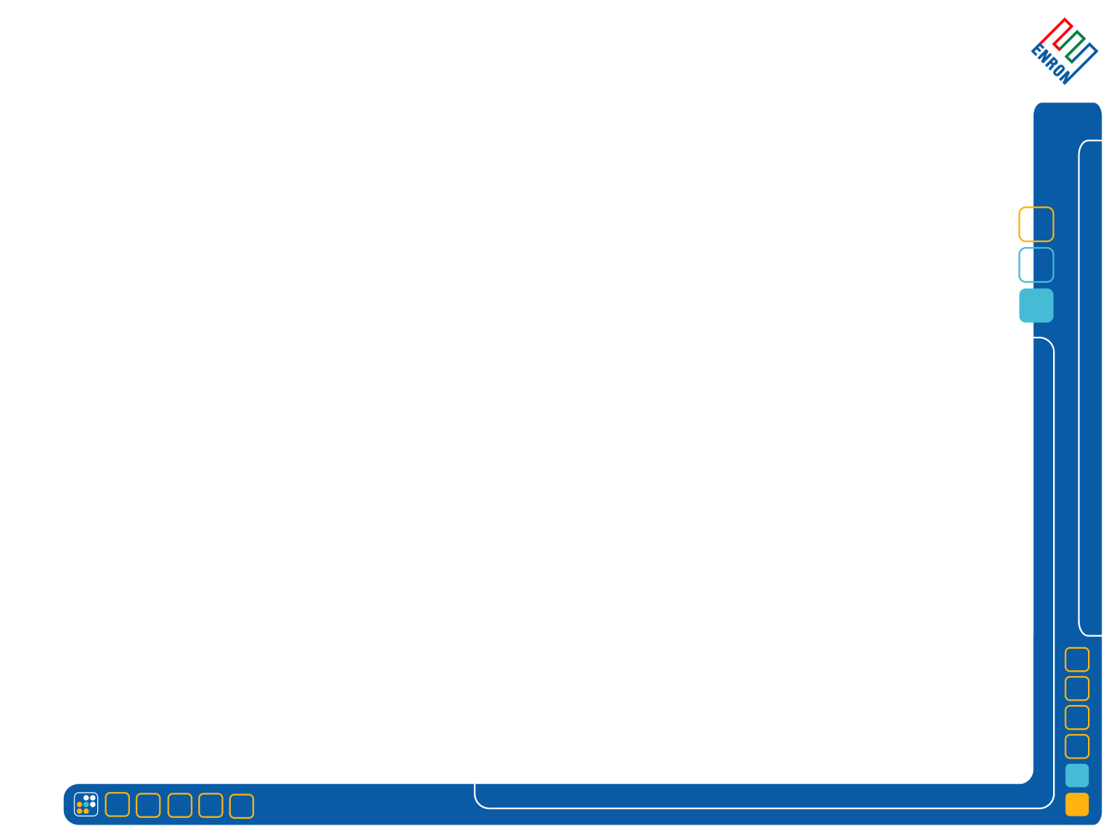
Key Elements of the Kyoto Protocol
Lisa Jacobson, Manager Environmental Strategies Group, Enron Corp

Slide 2
Key Elements of the Kyoto Protocol

Slide 3
The Kyoto Protocol: Background
Adopted December 1997 in Kyoto, Japan
84 Countries Signed (as of 9/28/01)
40 Ratified (as of 9/28/01); one industrialized country, Romania
The protocol will enter into force after it has been ratified by at least 55 parties to the United Nations Framework Convention on Climate Change (UNFCCC), including industrialized countries representing at least 55 percent of the total 1990 carbon dioxide emissions from that group
Bush Administration opposes the Kyoto Protocol, views it as “fatally flaw”
No developing country emission reduction commitments
Bush Administration Believes that Meeting the Kyoto targets will harm the U.S. economy
EU committed to ratify by 2002
Japan expected to ratify in 2002
Canada, Australia – would like to ratify with U.S. on board. They are waiting for the U.S. to release a new plan, but have remained supportive of the Kyoto Protocol

Slide 4
The Kyoto Protocol: Key Elements
Legally Binding Targets and Timetables for Developed Countries and Transition Economies (countries listed in Annex B of the Protocol)
Average 5.2% Reduction in Greenhouse Gases from 1990 levels for Annex B Countries Between 2008 and 2012
Targets: U.S. 7% Reduction below 1990 levels; 8% for EU; 6% for Japan
Six Gases Covered – Accounting in metric tons of carbon dioxide equivalent reductions
(carbon dioxide (CO₂); methane (CH₄); nitrous oxide (N₂O); hydrofluorocarbons (HFCs); perfluorocarbons (PFCs) and sulphur hexafluoride (SF₆)
Market-Based Approach
Flexibility mechanisms
Rules under development – could be adopted in November 2001 at Seventh Conference of the Parties to the UNFCCC

Slide 5
Market-Based Mechanisms Under the Kyoto Protocol
Emissions Trading
Annex B countries (developed and transition economies)
2008 – 2012 (first budget period)
Seller liability – with a 90% commitment period reserve or five times most recent inventory
Consequences of non-compliance
No financial penalties
True-up with penalty in second budget period (rate of 1.3)
Joint Implementation
Project-based mitigation in developed countries
Credit generation starting in 2008
Must meet additionality and baseline requirements**
Level of international oversight less certain**
Reporting, monitoring and verification may be required by national partner governments**
**Rules to be adopted at COP-7

Slide 6
Market-Based Mechanisms Under the Kyoto Protocol
Clean Development Mechanism
Project-based mitigation efforts in developing countries can generate credits for Annex B compliance purposes
Credits can be generated after January 1, 2000
Host country approval required
Nuclear energy projects are discouraged
Sinks projects included
afforestation and reforestation in first budget period
capped to 1% of countries base year emissions
2% across the board levy for climate mitigation fund
Must meet additionality and baseline requirements**
Reporting, monitoring, verification and certification required**
Fast-track rules for small projects (below 15 MW or reduce energy consumption by up to 15 GW per year)
**Rules to be adopted at COP-7

