Slide 1
Corporate Staff Functions
Notes:
1
1

Slide 2
Overview
Areas
Topics
PR/Communications
Government and Regulatory Affairs
Human Resources
Corporate Administrative Services
Functions
Approach
Progress
Initiatives

Slide 3
PR/Communications

Slide 4
PR/Communications
Functions
Public
Relations
Brand
Internal
Communications
Media Relations
“Experience Enron”
University Outreach
Annual Report
Advertising
Common “Look and Feel”
Employee Publications
Employee Meetings
Intranet:my.home.enron.com
ETV
Online and Interactive: E-Speak / E-Meet / Idea Bank

Slide 5
PR/Communications
Approach
Focus on target audiences
CXO’s
Opinion Leaders: Media and policy makers
Investors
Prospective Employees
Active engagement of media
Targeted advertising on key elements of our brand
Challenging the status quo-- “Ask Why”
Feature Enron’s innovation

Slide 6
PR/Communications
Progress
Breakout performance in earned media
Enron-only feature stories
New media coverage
Broader view of Enron: from “Leading Energy Company” to “Leading Company”
Substantial expansion of Familiarity and Favorability as measured by opinion research
Internal Communication is no longer just a “newsletter”
Moved Online
ETV
IPTV Broadcast Employee Meetings
“Best Lists”
Most admired companies
Best companies to work for
Global

Slide 7
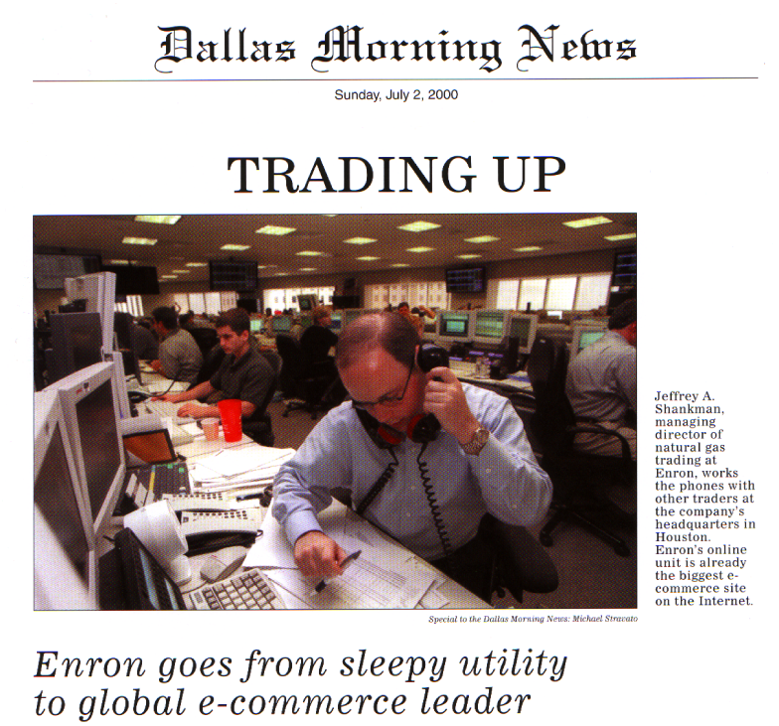
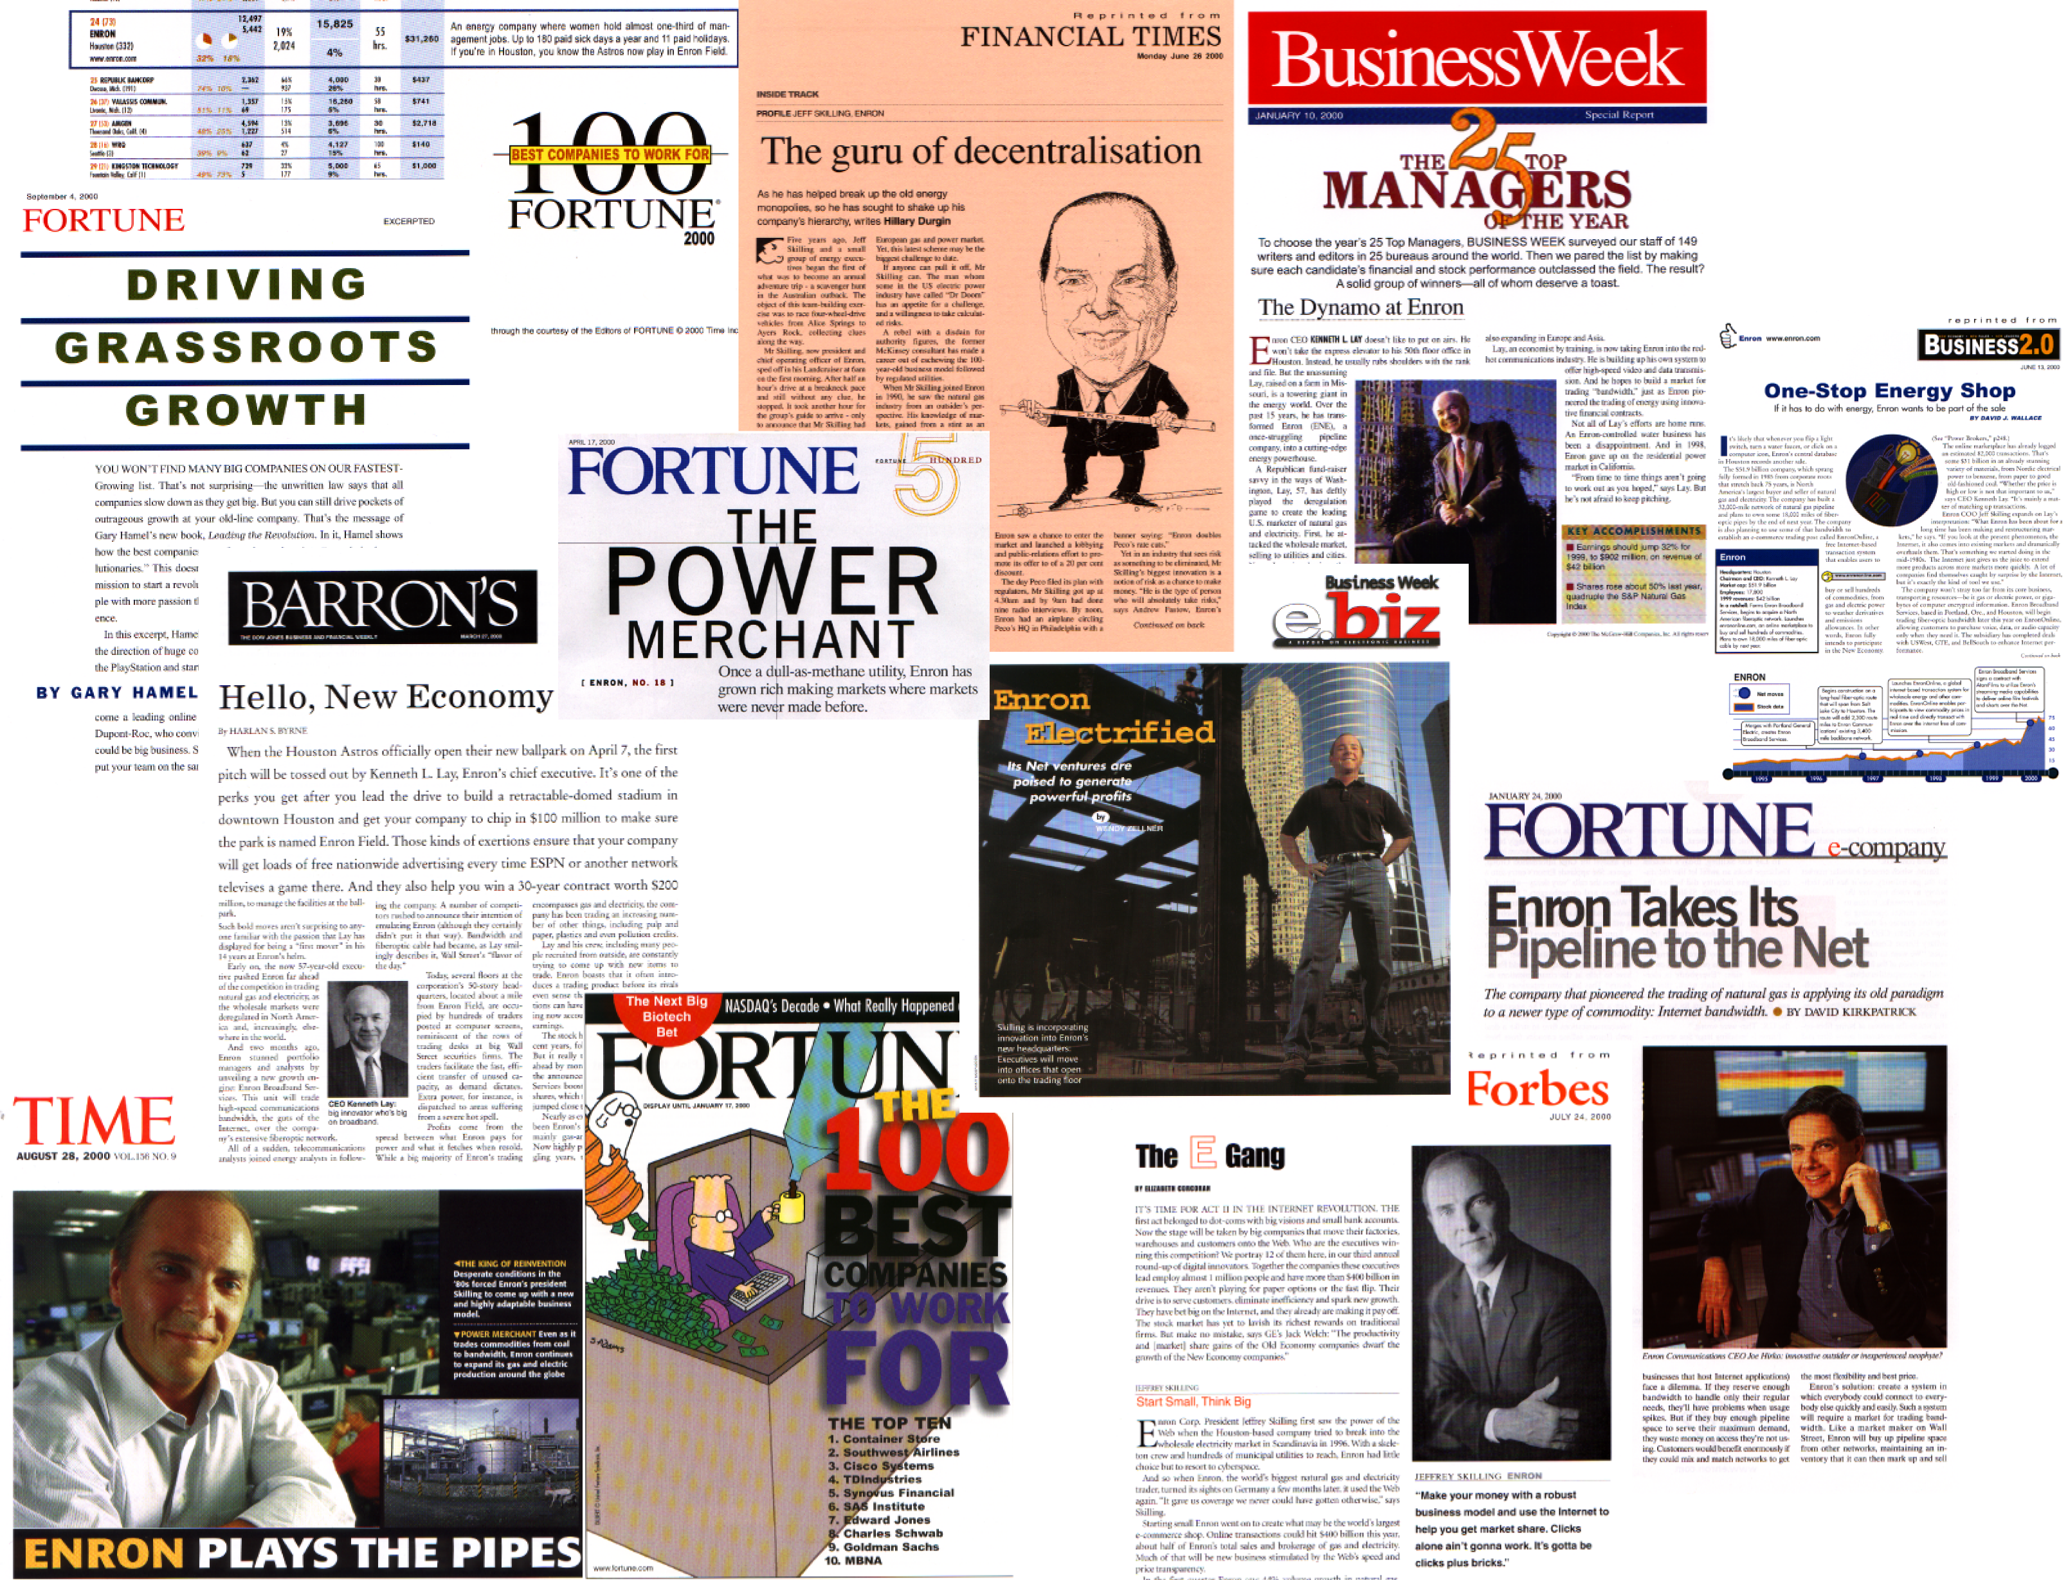

PR/Communications
Enron Public Relations

Slide 8
PR/Communications
Initiatives
Further Expansion of Enron Coverage
From feature stories to cover stories
Targeted, direct delivery of Brand

Slide 9
Government and Regulatory Affairs

Slide 10
Government and Regulatory Affairs
Functions
Advocacy
Business Unit Support
Risk Identification and Mitigation
Open markets and free trade
Focus on
Electric Market Open Access
Derivatives regulation
North America,
Europe and Japan
Transaction support
Protection of existing assets and positions
Gathering of Information/Intelligence
Identification of regulatory/political risks/ opportunities
Mitigation/capture plan

Slide 11
Government and Regulatory Affairs
Approach
Positioned as the leading voice for open and competitive markets
Form/Lead coalitions to effect change
Mission Shift: From advocacy to transaction support and risk mitigation
Rigorous resource allocation process

Slide 12
Government and Regulatory Affairs
Progress/Update
Quantifiable opportunities captured and risks mitigated substantially exceeded expenditures
CEA reforms
Environment, Health and Safety organization successfully launched
California crisis generating backlash

Slide 13
Government and Regulatory Affairs
Initiatives
Campaign to
isolate California
get the real story out
generate opportunities for Enron’s services
Support for new Enron business units including Enron NetWorks, Enron Global Markets and Enron Industrial Markets
Focus on wholesale open access in North American, European and Japanese power markets

Slide 14
Human Resources

Slide 15
Human Resources
Functions
Facilitation of HR Strategy & Policy
Executive Compensation
Compliance
Redeployment
Systems
Organize discussions across business units regarding
Compensation
Performance Mgmt.
Gathering Market Data
Implementing Corporate Compensation Policy
Ensuring Consistency
Fair Employment
Reporting
Formalized process to move talent around Enron
Performance Management
Online employee Information
Directory/Expert Finder
Business Units
Training
Staffing/Recruiting
Compensation
Employee Relations
Outsourced
Payroll
Benefits

Slide 16
Human Resources
Approach
Decentralize core functions
Compensation
Recruiting
Training
Establish a collaborative, non-hierarchical approach to HR strategy and implementation
Outsource noncore functions
Develop common systems to support company-wide activities
Performance management
Compensation
Redeployment
Enable employee self service (HR online)
Ensure that programs/initiatives have quantifiable business value

Slide 17
Human Resources
Progress
Reduced HR costs across Enron by 20% ($12mm/year)
Improved HR ratio from 1:35 to 1:75
Took HR services to online platforms
Expanded Community Relations efforts:
United Way: 33% increase
JDF/MS-150: 89% increase
Other fundraising: 77% increase

Slide 18
Human Resources
Initiatives
Increase Focus on Culture and Work Environment
Click@Home
Onsite daycare
alternative work arrangements
Implementation of partnership model
Commercialization of HR systems

Slide 19
Corporate Administrative Services

Slide 20
Corporate Administrative Services
Functions
Property
Development
Aviation
Security
Property Management
and Administration
Real Estate Leasing and Acquisition
Facility Planning
Construction Management
Relocation/ churn
New Building
Corporate Aircraft
Chartering
Building Security
“Default provider” of security services
Billing and Allocations
Administration of third party contracts

Slide 21
Corporate Administrative Services
Approach
Outsource noncore functions; employees focus on administration of third party contracts
Drive cost accountability through detailed billing and allocation process
Drive productivity: co-location, flexible and open environment, churn

Slide 22
Corporate Administrative Services
Progress
Further outsourcing - EES assuming facility management services (25% of budget)
Dramatic efficiency gains (16% reduction in G&A)
30% increase in Houston employee/contractor population
25% increase in churn (8400 moves)
design and construction of 300,000 sq. ft. of short term leases
Corporate aviation fleet reconfigured
New building (EBII) on track to meet schedule and
budget commitments

Slide 23
Corporate Administrative Services
Initiatives
Enron Center
creating the premier urban office campus
utilizing new work place design and collaboration technology
showcasing transaction floors
focusing on up-to-date work life amenities (daycare, restaurants, fitness center)
Mitigation of exposure to downtown lease obligations

Slide 24
Corporate Staff Functions
Notes:
1
1

