Slide 1
AN INTRODUCTION TO STRATEGIC BIDDING IN PJM
SEVIL YAMAN
ENRON RESEARCH GROUP

Slide 2
THE GOAL OF THE STUDY:
Understanding energy price formation in PJM by answering the following questions:
Who are the players in the market? Strategic vs. fringe
How do players bid? Market based vs. cost based
What pattern do bids follow?
Can we explain this pattern?
Is there any sign of capacity withholding?
How do transmission constraints affect the bidding behavior of the electricity producers in East and West?
How could generators located in Western and Eastern PJM act to take advantage of the transmission constraint between East and West interface?
What kind of role do imports to region play?

Slide 3
WHO ARE THE MAJOR PLAYERS?
Strategic firms (those with enough capacity to potentially exercise some market power by using different bidding techniques): PECO, PP&L, PSE&G, and POTOMAC ELECTRIC POWER CO. etc.
fringe firms (those with little or no market power): ATLANTIC CITY ELECTRIC, BG&E, DELMARVA POWER, JCP&L, METROPOLITAN EDISON CO. etc.

Slide 4
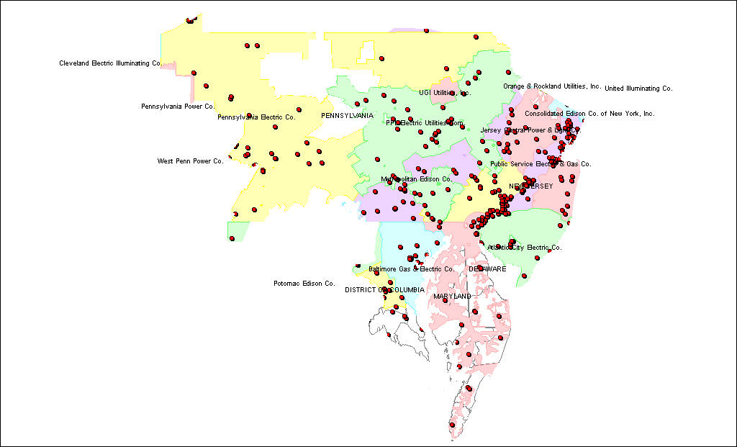
Figure 1: Electricity producers in PJM

Slide 5
TOP FIVE COMPANIES BY CAPACITY:
Public Service Electric & Gas Co. - 10,534 MW
Peco Energy Co. - 9,060 MW
PP&L Electric Utilities Corp. - 8,131 MW
Potomac Electric Power Co - 6,240 MW
Baltimore Gas & Electric Co. -6,218 MW
Other - 17,519 MW
Figure 2

Slide 6
TOTAL INSTALLED GENERATION CAPACITY BY FUEL TYPE (1999)
Table 1

Slide 7
FUEL TYPES:
Water - 5.05
Uranium - 22.92
Resid - 12.05
Propane - 0.00
Natural Gas - 18.24
Geothermal - 0.00
Distillate - 8.67
Coal - 30.25
Other - 2.81
Figure 3

Slide 8
DISTRIBUTION OF BIDS BY FUEL TYPE (07/28/99)
Table 2

Slide 9
TYPE OF BIDS:
MARKET BASED: In 1999, PECO and PP&L are bidding market based for most of their units. Starting from January 2000, almost all of the producers are switching to market based bidding from cost based bidding.
COST BASED: In 1999 except PECO and PP&L, the rest were bidding cost based for the energy they provide to the market. In 2000 only PSE&G and Atlantic City are bidding cost based for the condensing spin they offer.

Slide 10
Figure 4

Slide 11
TYPE OF PECO BIDS SORTED BY NUMBER and MW (07/28/99):
Table 3

Slide 12
DESCRIPTION OF DATA AND THE ANALYSIS:
Historical bid data is posted on PJM web site based on six month delay.
As of today, our analysis is based on the data which is belong to the period of April 1999 - May 2000. Data is being updated each month based on six month delay.
The identity of each generator and company is not revealed by PJM. But we are informed by PJM that the utility and generator codes are not changing, they stay same all the time.
In October 1999 a new company coded as N8 was added to the data.
We tried to reveal the name of each generator and company by matching the maximum capacities they bid to their existing generating capacity given by MAAC Response to the 2000 NERC Data Request Report dated April 1, 2000 (see Figure 5, 6, 7, 8).

Slide 13
We sort the data out based on product code, market bid, and direction (energy bids vs. condensing spin bids, cost based vs. market based, and into PJM vs. out of PJM)
Two database programs were created to analyze the data. By using these databases, we look at the bids and the hourly locational marginal prices for each day, then determine the winning bids, marginal bids, and losing bids, in other words, determine the units who got dispatched and who did not (See Figure 9, 10, 11) .
By doing the above we started to determine some key units who might have been strategically dispatched or not dispatched to influence the price formation process. (By strategic we mean any kind of action which can increase the market price)
This is where we stand right now.

Slide 14
MATCHING ANONYMOUS COMPANY WITH PJM UTILITY
Figure 5

Slide 15
MATCHING ANONYMOUS COMPANY WITH PJM UTILITY
Figure 6

Slide 16
Figure 7

Slide 17
Figure 8

Slide 18
OFFER CURVES OF PECO UNITS
Figure 9

Slide 19
Figure 10
PSEG bids
PECO bids
40 energy bids out
of 426 bids
LMP=935, the
highest price of the day

Slide 20
Figure 11

Slide 21
FUTURE AGENDA:
Improve the database programs to one which will allow us to examine the bidding behavior of the strategic firms in a time series manner
Study the impact of transmission constraints on market generation bidding behavior
Study the role of imports to the area (especially from NY to New Jersey region)
As a result of the analysis, understand energy price formation and its fundamental rules in PJM

