Slide 1
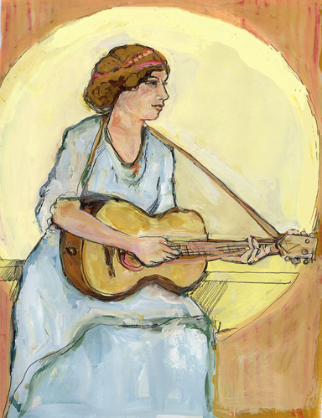
Warm wishes for the Season & a Joyful New Year!
Much love from Elissa & Ben
December 2001.

