Slide 1

EARTH SATELLITE CORPORATION’S HEATING SEASON WEATHER SEMINAR
September 2000

Slide 2
SEMINAR GOALS
What’s new in the weather
Visit the hurricane season outlook
Examine the status of conditions across the Pacific
Explain the EarthSat Forecast Model
What to Monitor This Heating Season
Illustrate the monthly and seasonal outlooks

Slide 3
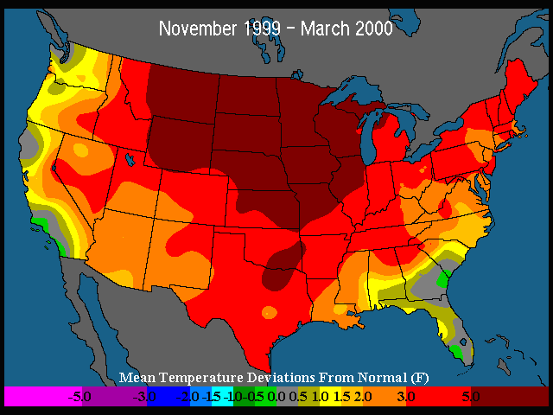
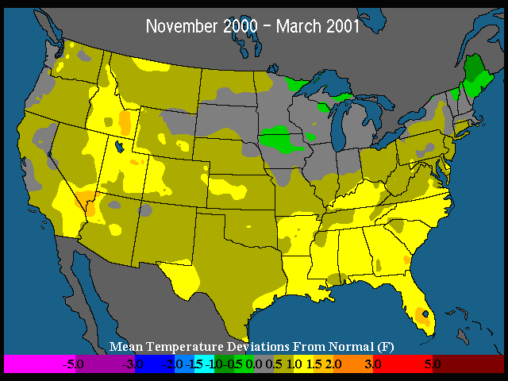
HEATING SEASON HIGHLIGHTS
WINTER 1999/2000
ACTUAL
WINTER 2000/2001
FORECAST
2000/2001 winter, colder than last three (3) winters.
November and December colder than normal months.
January, February, and March warmer than normal months.

Slide 4
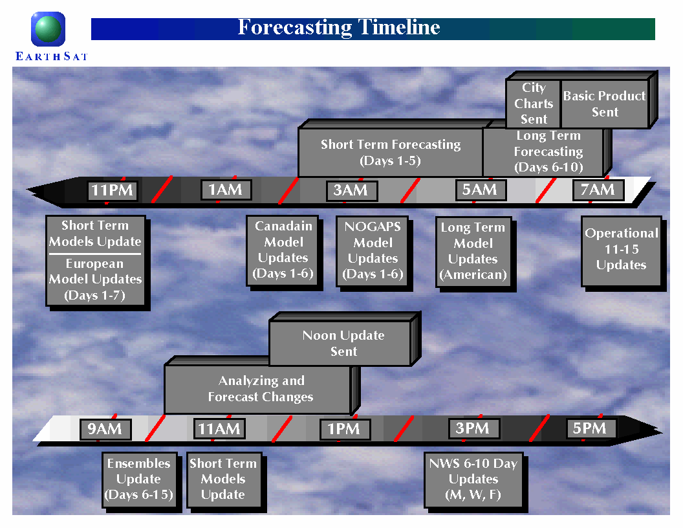

Slide 5
WHAT’S NEW IN WEATHER
RMS and EarthSat Introduce New Product
CLIMETRIX
A comprehensive weather risk management system
1. Catalog of Cleaned and Enhanced Historical Data
initial focus on U.S. temperature data
next stage is international expansion
future addition of other temperature variables
2. Transaction Pricing Tools
advanced simulation models
multi-perspective risk analysis
3. Portfolio Management Capabilities
data management
daily marking of positions
www.climetrix.com

Slide 6




RMS - EARTHSAT PARTNERSHIP
A multidisciplinary team has been conducting research on historical data enhancement for more than 1 year.
Expertise in modeling, actuarial science, and risk analysis
A culture of deep investigation of historical events
Meteorological expertise and experience with weather recording processes
Long history of analyzing, processing, and distributing weather data

Slide 7
WHAT’S NEW IN WEATHER
National Weather Service Temperature Graphics
-rankings and departure from normal
http://www.cpc.ncep.noaa.gov/products/analysis_monitoring/regional_monitoring/usa.html
National Weather Service Temperature Trends
-long term seasonal temperature trending
http://www.cpc.ncep.noaa.gov/charts.htm

Slide 8
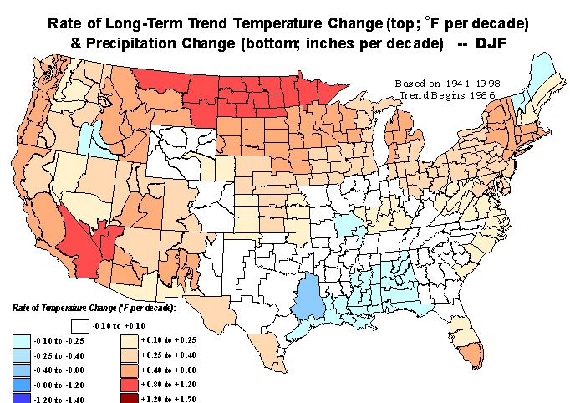
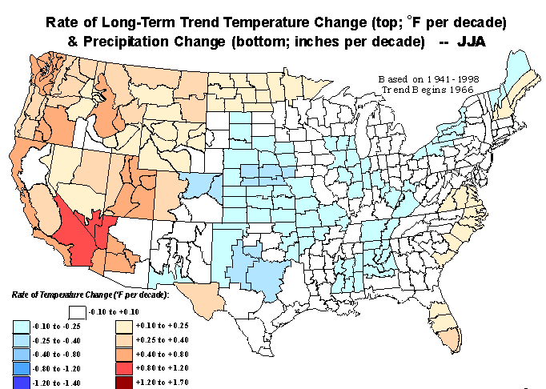
WHAT’S NEW IN WEATHER
Winters Getting Warmer.
Summers Getting Cooler.

Slide 9
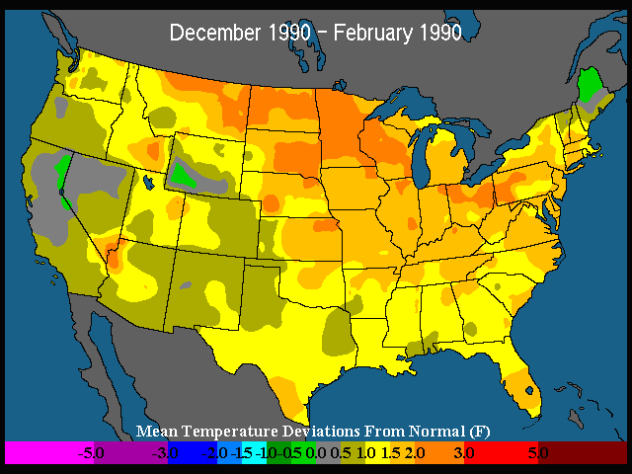
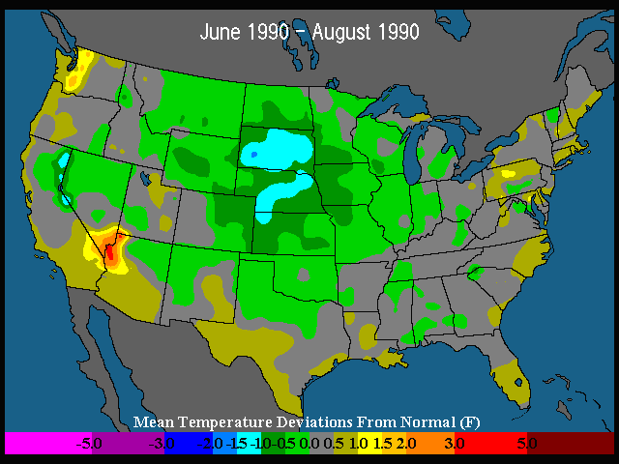
WHAT’S NEW IN WEATHER THE 1990’s
Decembers - Februarys
WARMER WINTERS
Junes - Augusts
COOLER SUMMERS

Slide 10
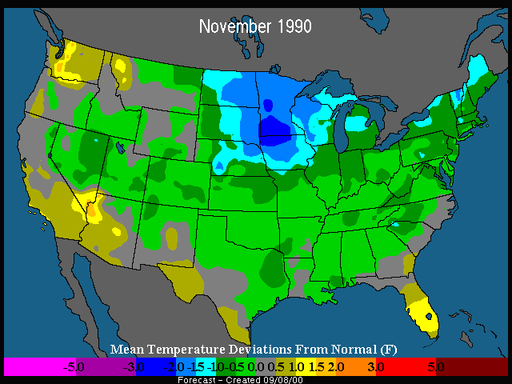
WHAT’S NEW IN WEATHER 1990’s NOVEMBERS
1990’s Novembers
Start of
Heating
Season
Typically
Colder in the
1990’s.

Slide 11
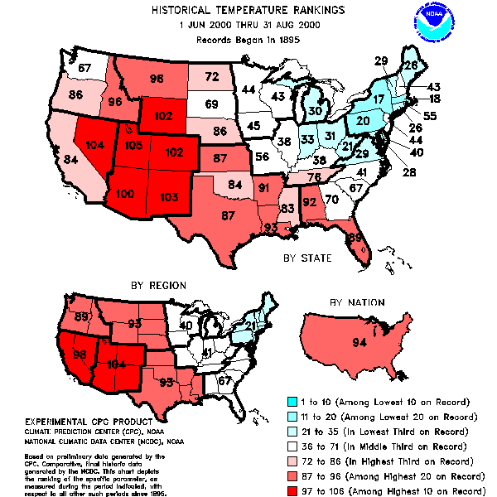
WHAT’S NEW IN WEATHER

Slide 12
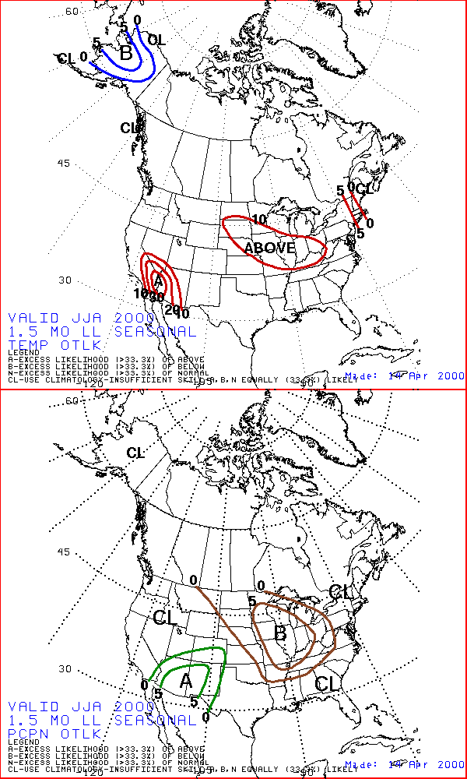
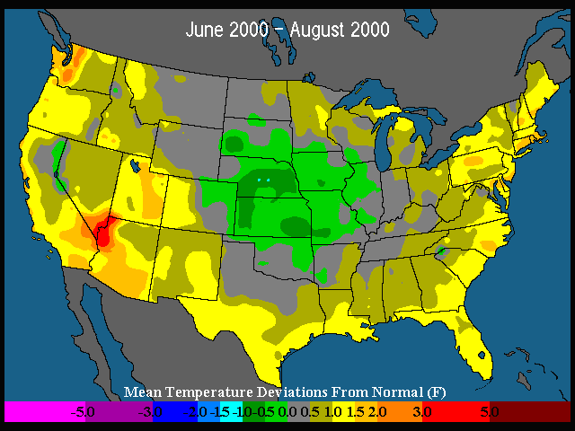
WHAT HAPPENED
TO THE SUMMER?
Forecasts From April 2000
NATIONAL WEATHER
SERVICE
EARTH SATELLITE
CORPORATION

Slide 13
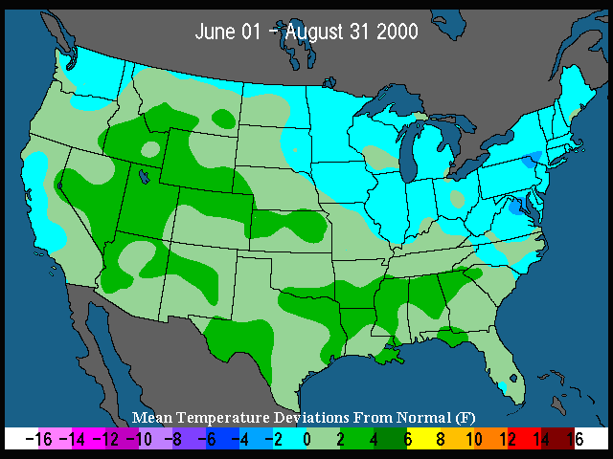
SUMMER 2000
(June – August)
Strong Eastern Canada Trough Dominates
Warm Pacific Supports Western Ridge
Patterns Remain Very Volatile In East
South and West
See Best Scoring.
Scorecard | NWS | EarthSat | Actual
East | A | A | N/B
South | A | A | N/A
Midwest | A | N | N/B
West | A | A | N/A

Slide 14
YEAR ON YEAR COMPARISON

Slide 15
6-10 DAY VERIFICATION
Bottom Line: So far this cooling season EarthSat is ~10% more accurate vs. NWS

Slide 16
6-10 DAY VERIFICATION
Bottom Line: EarthSat almost 30% more accurate vs. NWS

Slide 17
SHORT RANGE VERIFICATION (1-3 Day Forecasts)
Cities Tested:
ATL, CVG, LGA, PHL
~7% better than TWC
~10% better than mean
~16% better than TWC
in Cincy

Slide 18
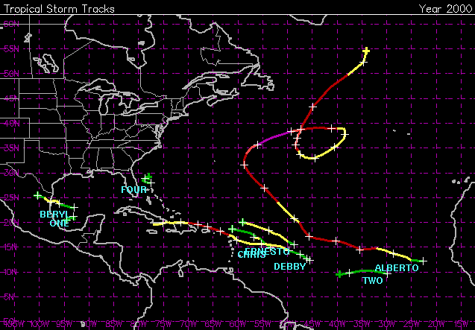
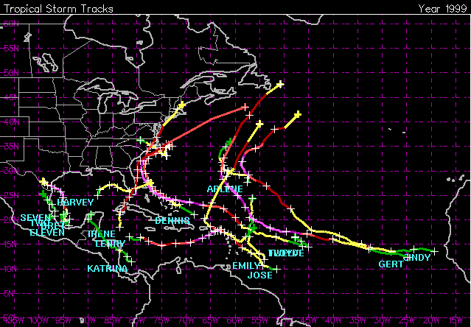
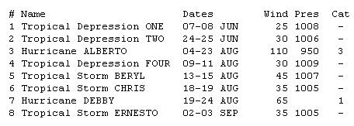
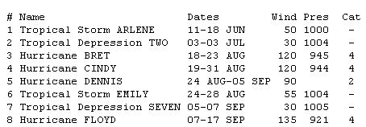
2000 HURRICANE SEASON WHERE WE STAND…..
CURRENT SEASON
LAST YEAR
Bottom Line
Slow start to
the 2000 season

Slide 19
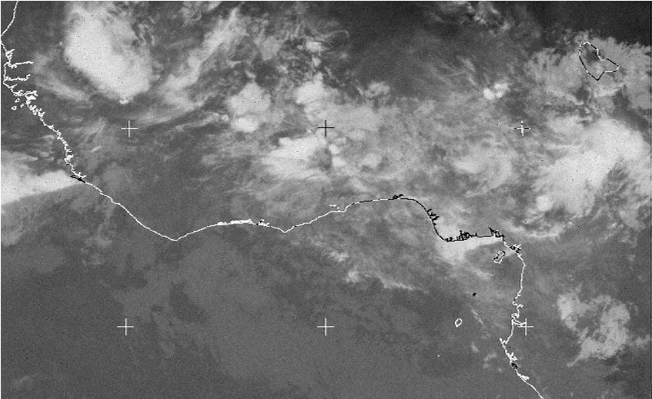
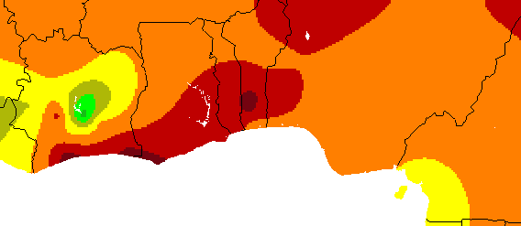
CURRENT CONDITIONS WEST AFRICA
SEPTEMBER 6, 2000
PRECIP. PERCENT OF NORMAL
AUGUST 1, 2000 – SEPTEMBER 6, 2000

Slide 20
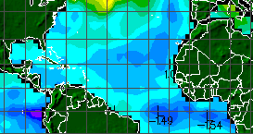
CURRENT CONDITIONS SEA SURFACE TEMPERATURES
September 2, 2000

Slide 21
2000 HURRICANE SEASON BOTTOM LINE
June 1, 2000
Forecast
September 1, 2000
Current Forecast
Seasonal
Normals
Named Storms 11 4 10 9
Hurricanes 7 2 6 7
Intense Hurricanes 3 1 3 2

Slide 22
TROPICAL PACIFIC
CURRENT STATUS
Prepared: September 7, 2000
Equatorial Pacific Water Temperatures (SST)
Surface layers +0.5 C to –1.0 C from normal.
Sub-surface layer warming back to normal.
Southern Oscillation Index (SOI)
Five month SOI is (+0.1).
August SOI is (+0.3).
Pacific Outgoing Long Wave Radiation (OLR)
Near normal convection.
Normal precipitation.
Trade Winds (850mb Zonal Wind)
Trade winds returning to normal levels.
NEUTRAL CONDITIONS IN PLACE….

Slide 23
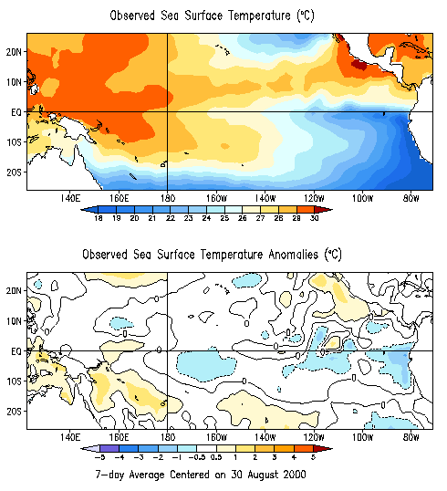
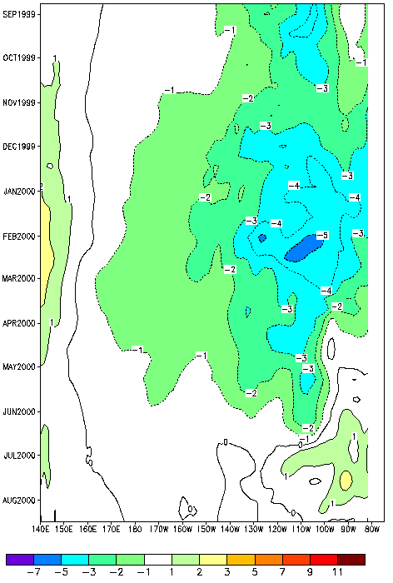
PACIFIC SEA SURFACE TEMPERATURES
(SST)
Surface Temperatures
Change In Sub-Surface

Slide 24
Nino 3.4
SEA SURFACE TEMPERATURES
NEUTRAL
Expected Trend
WEAK
LA NINA
MODERATE
LA NINA
La Nina Intensification
Seen Late Last Summer
1999
STRONG
LA NINA
2000

Slide 25
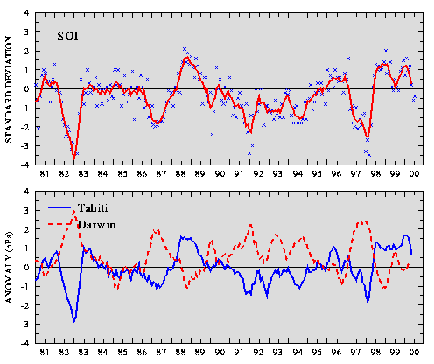
PACIFIC
SOUTHERN OSCILLATION INDEX (SOI)

Slide 26
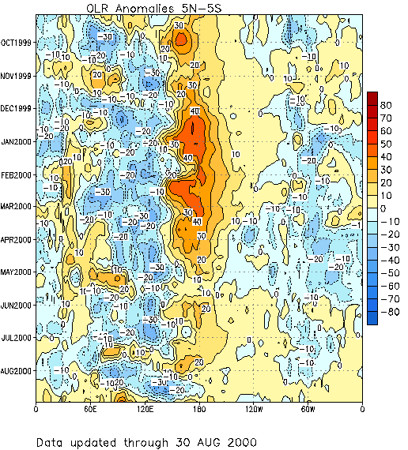
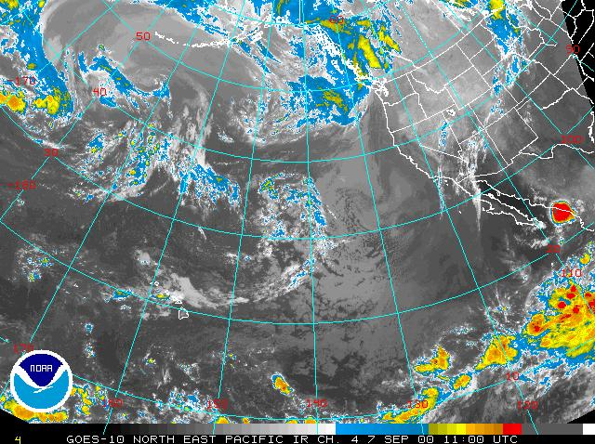
PACIFIC
OUTGOING LONGWAVE RADIATION (OLR)
Clear Skies
La Nina Signature
Cloud Cover Increasing – Neutral Phase

Slide 27
RUNNING THE MODEL
Analyze latest SST Consolidation forecast for NOAA
Use historical and forecast data for the Nino3.4 region (Tropical Pacific)
Cross reference SST data with SOI data
Use weighted differencing to calculate closest ten years
Historical SST data back six months
Forecast SST data forward six months
Analog years determined and weighted inversely by difference
Best fit analog years are assigned the highest weight
Other considerations
Neutral phase conditions are highly considered in the 10 analog years
Decadal adjustments of analog years to fit the 90’s temperature profile
Generate temperature/precipitation forecasts
Maps created using monthly temperature data from NCDC (1950-present)
Mapping program using 344 data points (climate divisions) for the display

Slide 28
Decadal Adjustment Theory
*Based on the theory that temperature trends are cyclic
*Analog years from other decades are adjusted to the 1990’s

Slide 29
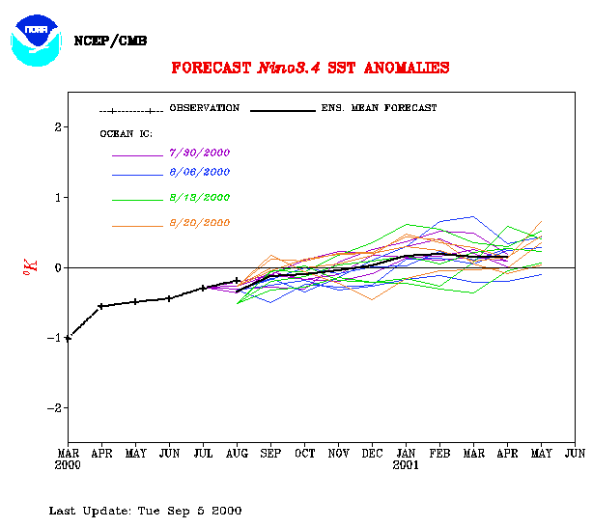
EARTHSAT MODEL RUN
September 2000
SIMILAR PERCENT
YEARS WEIGHT
(Fall/Winter) (%)
1989/90
1978/79
1981/82
1985/86
1952/53
1996/97
1974/75
1962/63
1967/68
1971/72
19.5
11.4
10.9
10.0
9.1
8.5
8.1
8.0
7.3
7.2

Slide 30
Best Analog Comparison Nino 3.4 SST Departures

Slide 31
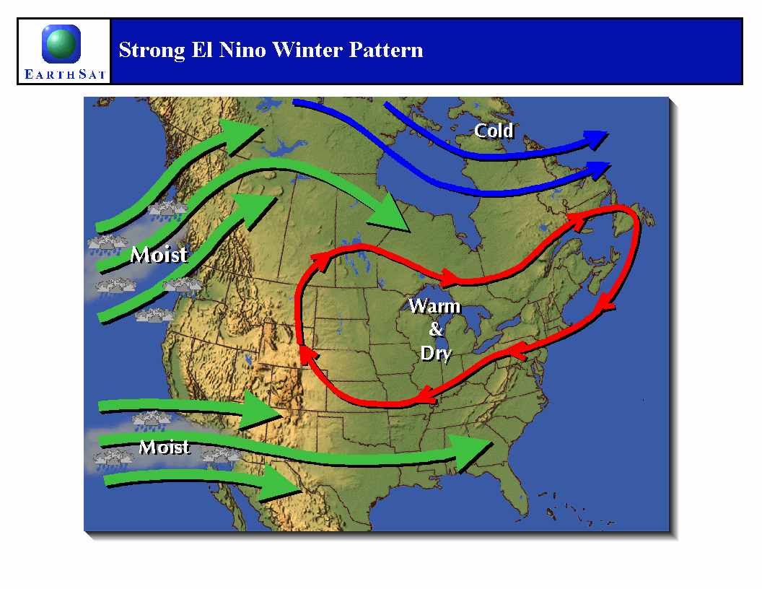
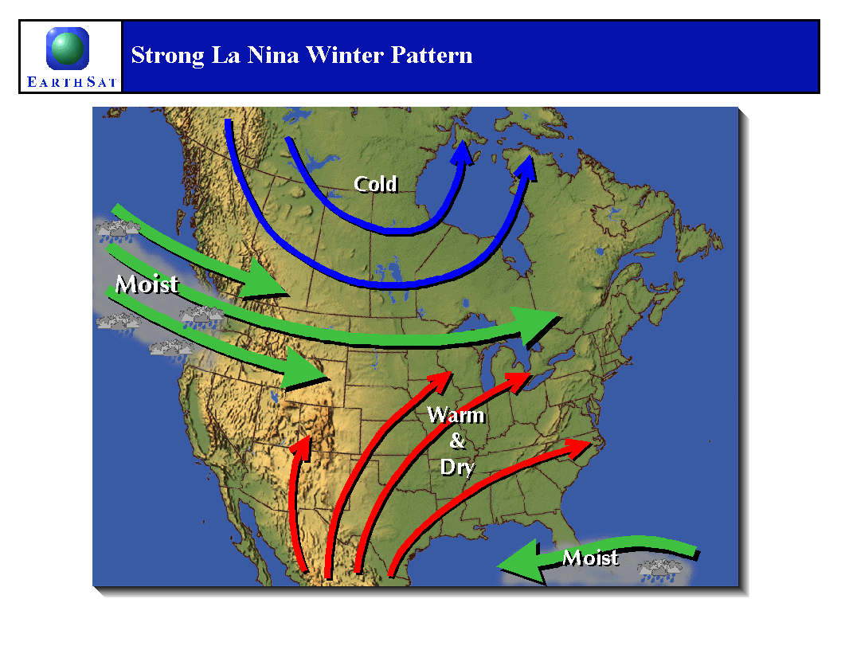
The El Nino and La Nina

Slide 32
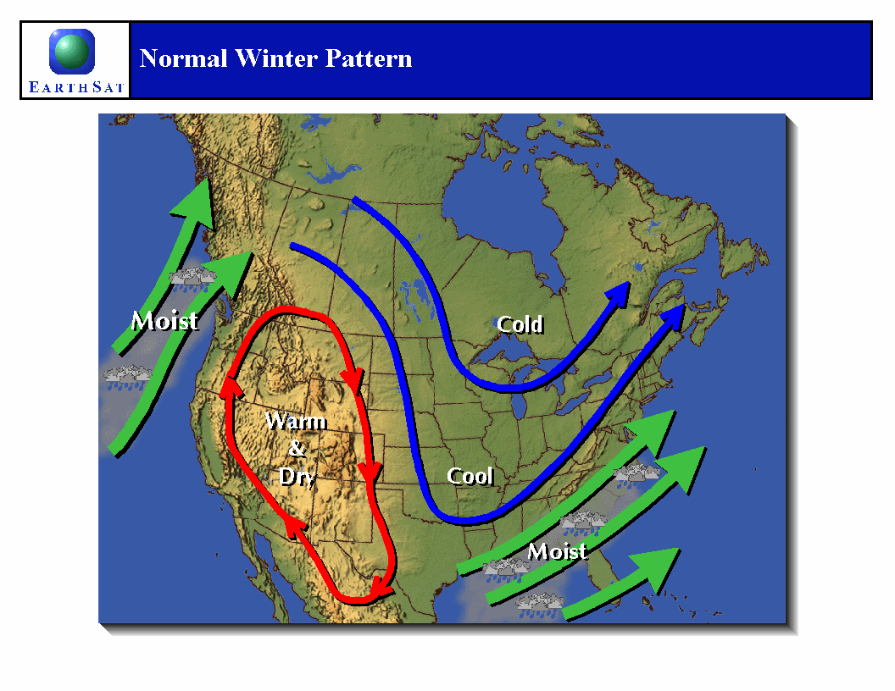

Slide 33
WHAT TO MONITOR FOR THE HEATING SEASON
Greenland Blocking (North Atlantic Ridging)
Hudson Bay Low
Ridging in Western North America
Cold Air in the Source Region
Snow Cover Between the U.S. and Arctic
East Coast Storms (Snow Producers)

Slide 34
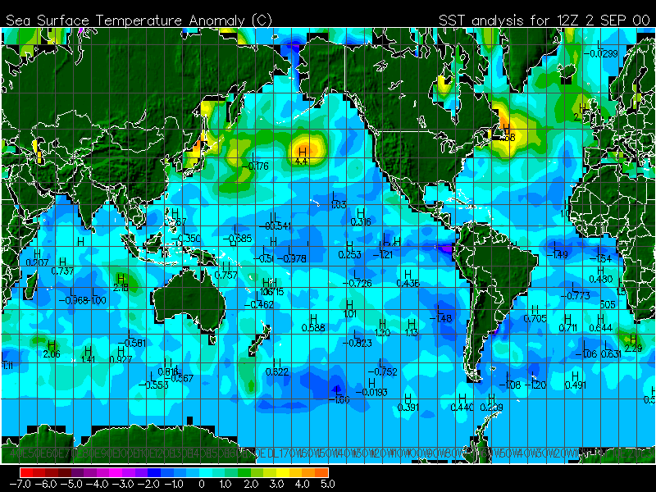
EAST COAST STORMS
Severe temperature gradient.
Should help storm development.

Slide 35
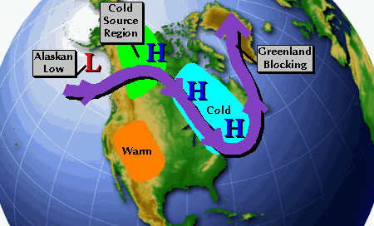
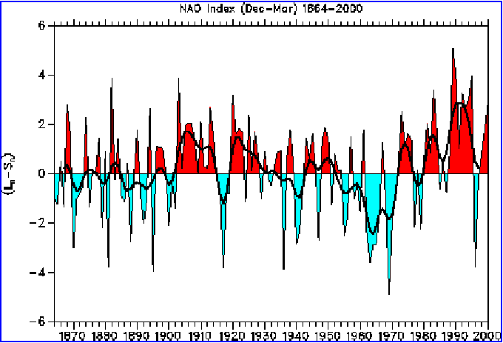
WHAT TO MONITOR
GREENLAND BLOCKING

Slide 36
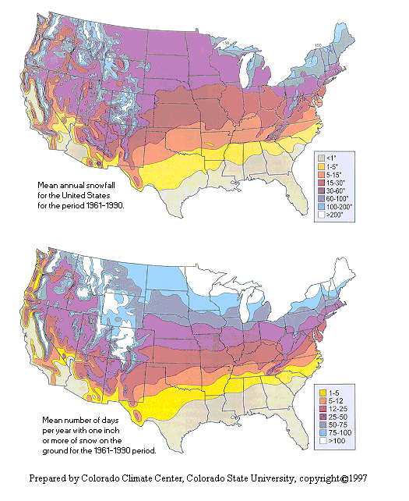
WHAT TO MONITOR
NORTHERN U.S. / CANADA SNOW COVER

Slide 37
NATIONAL WEATHER SERVICE COMMENTARY From the Long-lead Prognostic Map Discussion August 17, 2000
“SST anomalies in the Pacific became ENSO-Neutral during mid-July to mid-August.”
“On average – this winter will be colder than the last three.”

Slide 38
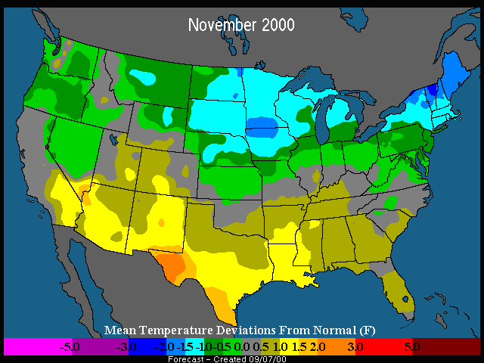
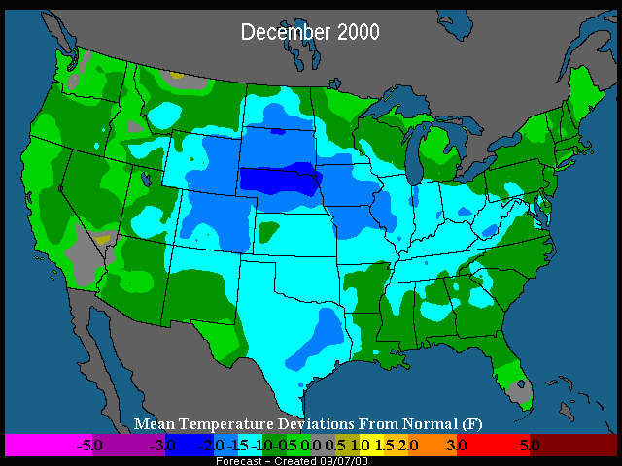
WINTER
TEMPERATURE OUTLOOKS

Slide 39
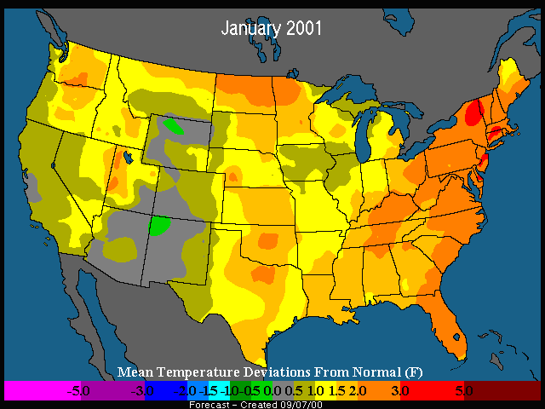
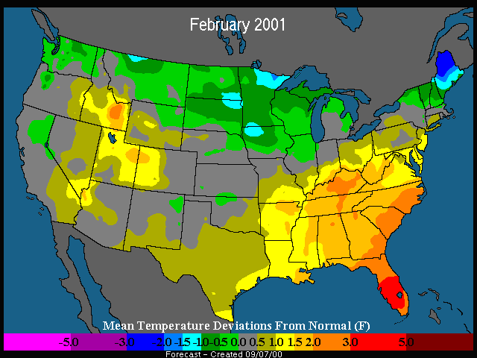
WINTER
TEMPERATURE OUTLOOKS

Slide 40
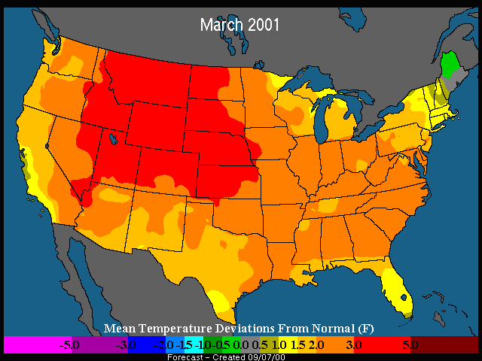
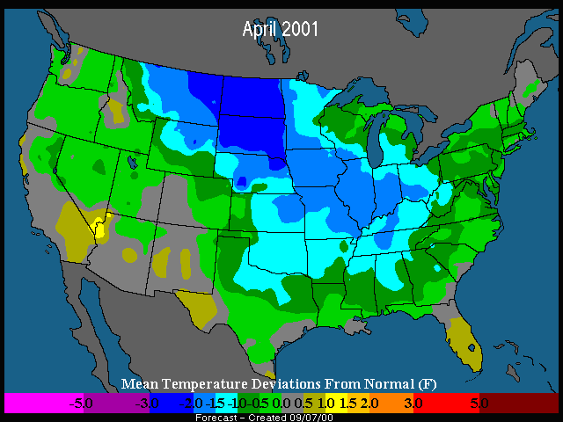
WINTER
TEMPERATURE OUTLOOKS

Slide 41
INSIDE THE NUMBERS
(HDD Outlook)
Chicago
Nov-Dec: 120%
Jan-Mar: 75%
New York
Nov-Dec: 115%
Jan-Mar: 80%
Burbank
Nov-Dec: 95%
Jan-Mar: 90%
Atlanta
Nov-Dec: 90%
Jan-Mar: 75%
Houston
Nov-Dec: 100%
Jan-Mar: 85%

Slide 42
HEATING SEASON CONCLUSIONS
WINTER 1999/2000
ACTUAL
WINTER 2000/2001
FORECAST
2000/2001 winter, colder than last three (3) winters.
November and December colder than normal months.
January, February, and March warmer than normal months.

Slide 43
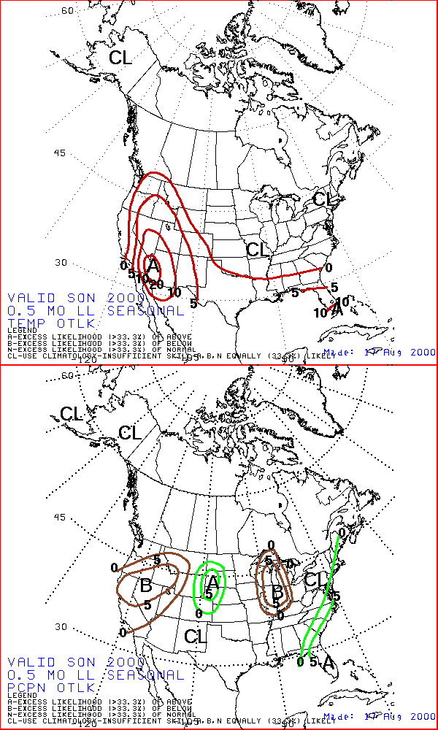
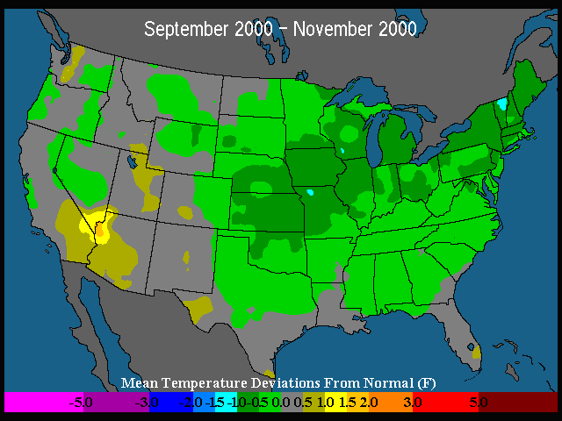
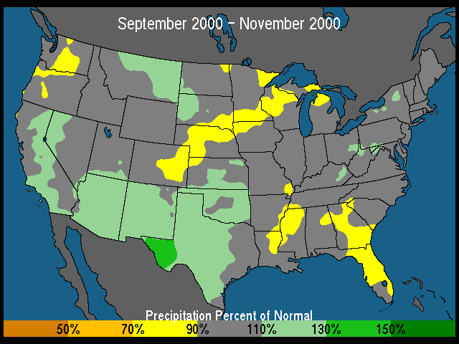
COMPARE & CONTRAST – FALL 2000
NATIONAL WEATHER
SERVICE
EARTH SATELLITE
CORPORATION

Slide 44
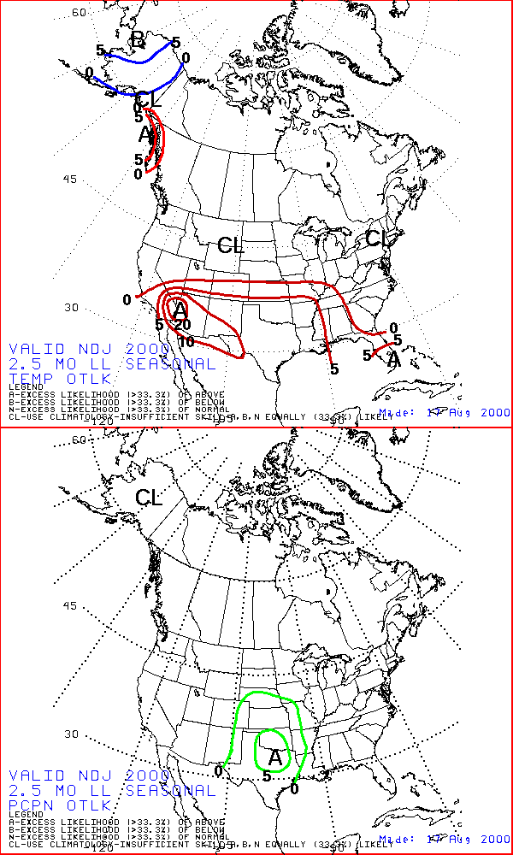
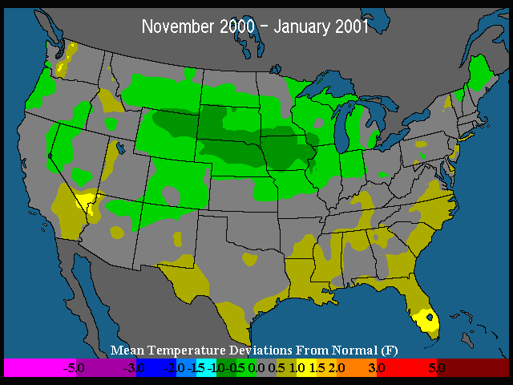
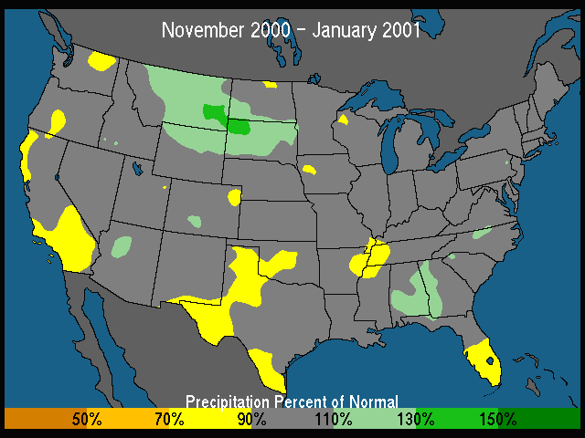
COMPARE & CONTRAST – Early Winter
NATIONAL WEATHER
SERVICE
EARTH SATELLITE
CORPORATION

Slide 45
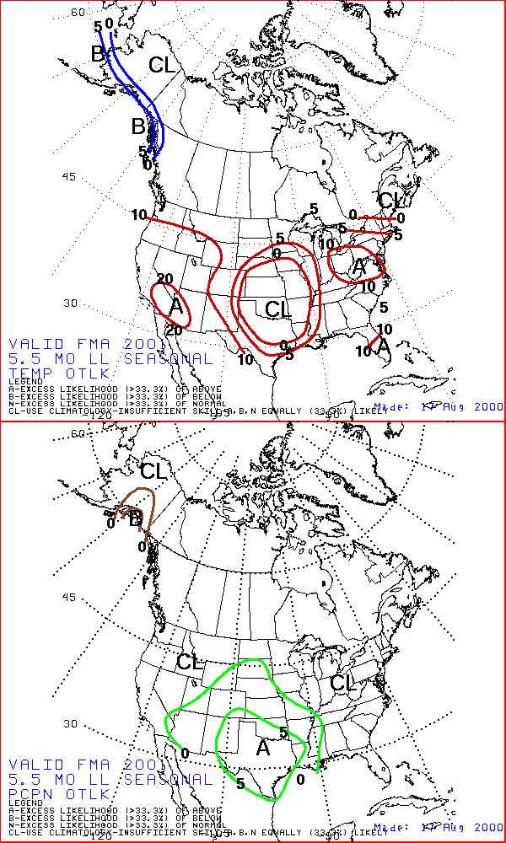
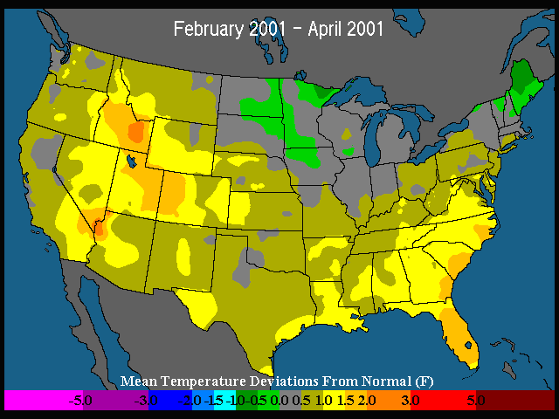
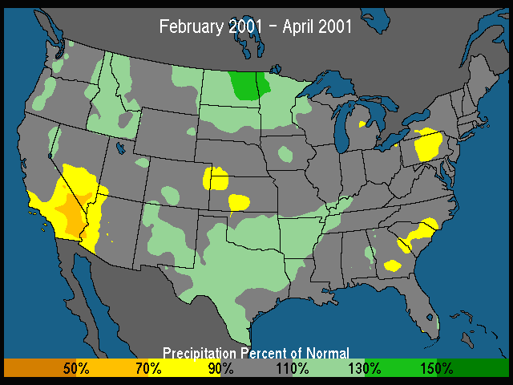
COMPARE & CONTRAST – Late Winter
NATIONAL WEATHER
SERVICE
EARTH SATELLITE
CORPORATION

Slide 46
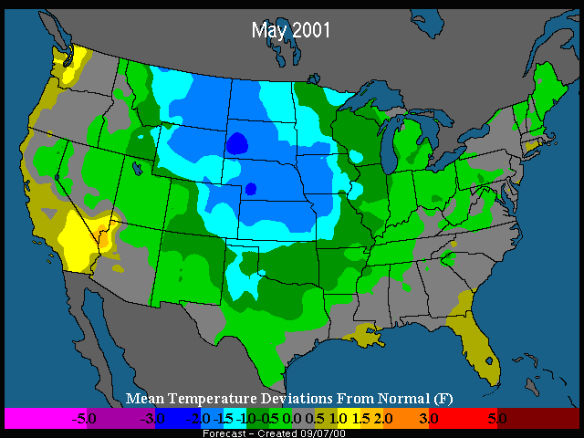
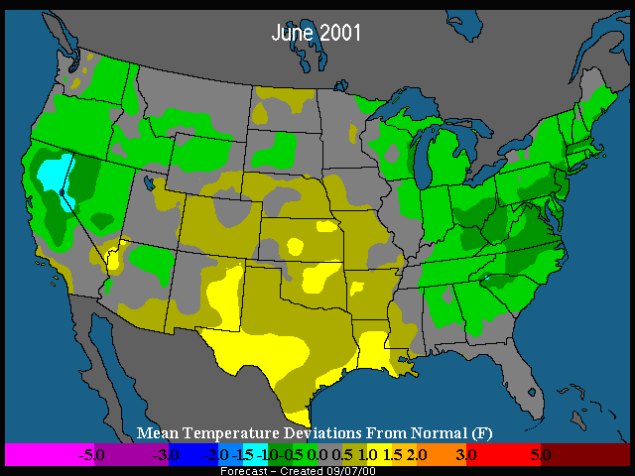
EARLY SUMMER 2001
TEMPERATURE OUTLOOKS

Slide 47
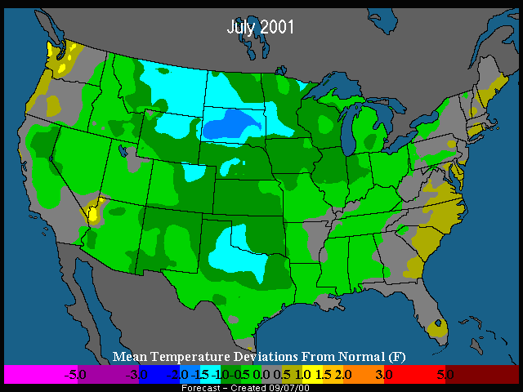

SUMMER 2001
TEMPERATURE OUTLOOKS

Slide 48


PACIFIC NORTHWEST
HYDRO OUTLOOK
Drier than normal for the rest of 2000
Wetter than normal in early 2001

Slide 49
Questions & Comments?

