Slide 1
L A P L A T A
TRANSWESTERN PIPELINE COMPANY
DOCKET NO. CP01-
LA PLATA "A"
EXHIBIT ‘F’
PAGE 1 OF 2
BLOOMFIELD
BEAVER
NAVAJO
APACHE
BISTI
COCONINO
SAN JUAN
PROPOSED
SHERMAN
HANSFORD
LIPSCOMB
ELLIS
MOHAVE
GALLUP C.S, MOD.
STA.4
HUTCHINSON
ROBERTS
STA.1
STA.2
STA.3
STA.5
HEMPHILL
ROGER
NEEDLES
RIO GRANDE
C A N A D I A N
RIVER
MILLS
TOPOCK
MC KINLEY
POTTER
CARSON
GRAY
SAN BERNARDINO
LITTLE COLORADO
STA.6
DEAF SMITH
ARM
CIBOLA
VALENCIA
TORRANCE
P-2
RANDALL
STRONG
YAVAPAI
STA.7
CURRY
PARMER
CASTRO
STA.8
P-1
ROOSEVELT
SOCORRO
STA.9
LINCOLN
LEA
CHAVES
EDDY
WT-1
WT-2
WINKLER
LOVING
TRANSWESTERN PIPELINE COMPANY
WARD
CRANE
HOUSTON, TEXAS
REEVES
PECOS
EXHIBIT ‘F’
SYSTEM MAP

Slide 2
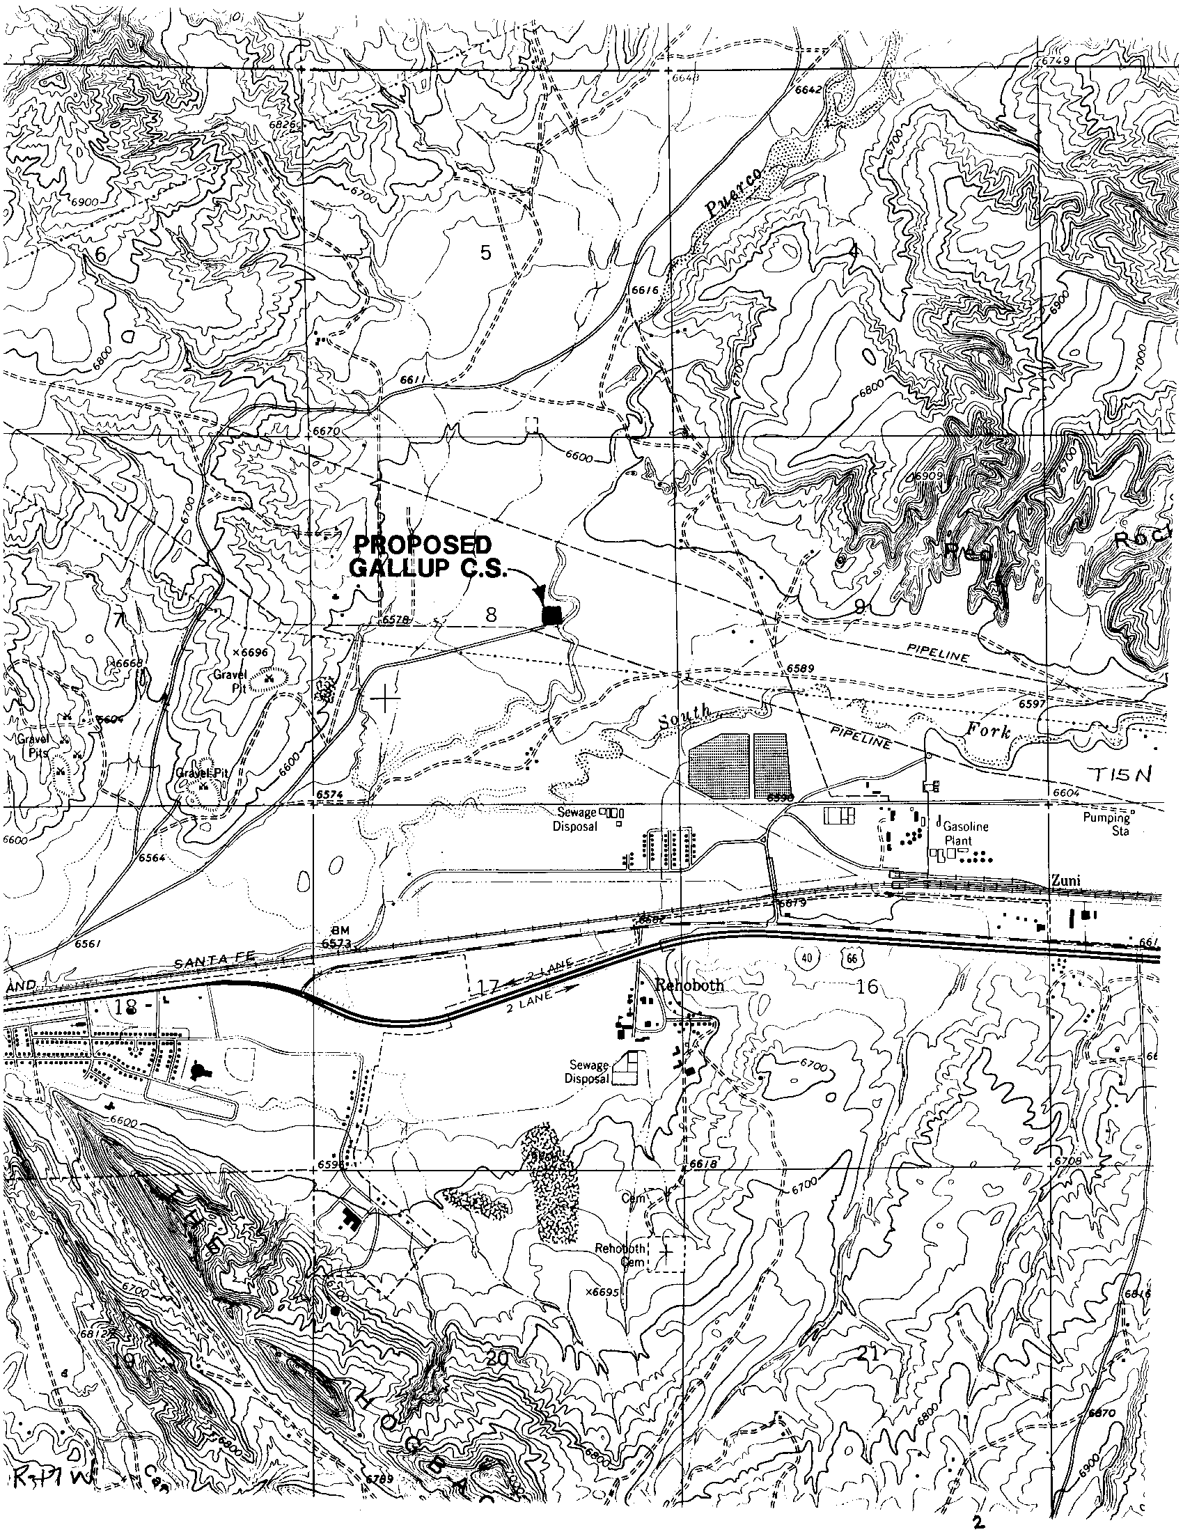
TRANSWESTERN PIPELINE COMPANY
DOCKET NO. CP01-
EXHIBIT F
PAGE 2 OF 2
PROPOSED
GALLUP
COMPRESSOR
STATION, MOD.
TRANSWESTERN PIPELINE COMPANY
HOUSTON, TEXAS
EXHIBIT ‘F’
DETAIL MAP
Prepared by: Engineering Records

