Slide 1
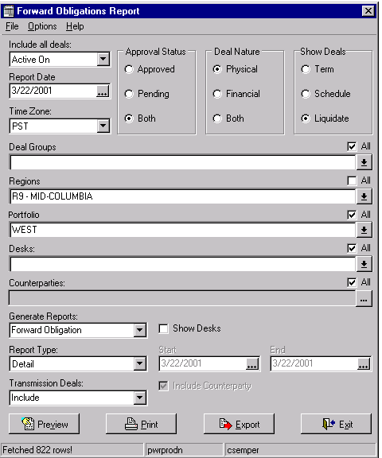
Selection Criteria

Slide 2
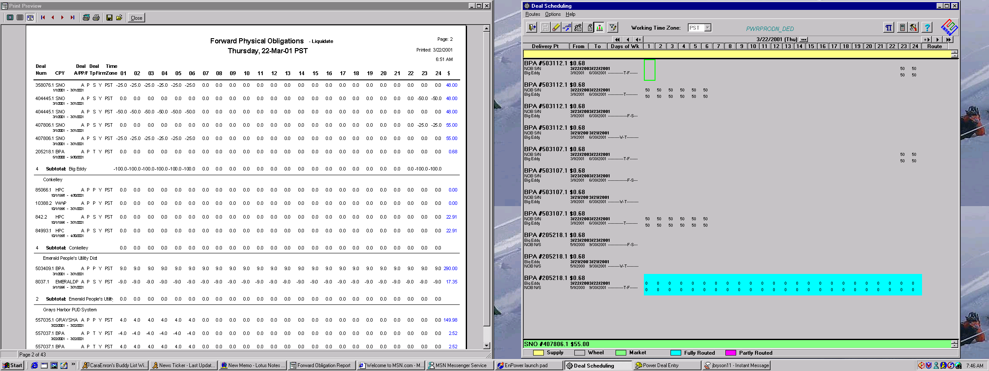

Slide 3
These had been adjusted
in scheduling, but did not
show on the report.
This had been adjusted to zero
in scheduling, and did show as zero
on the report.

Slide 4
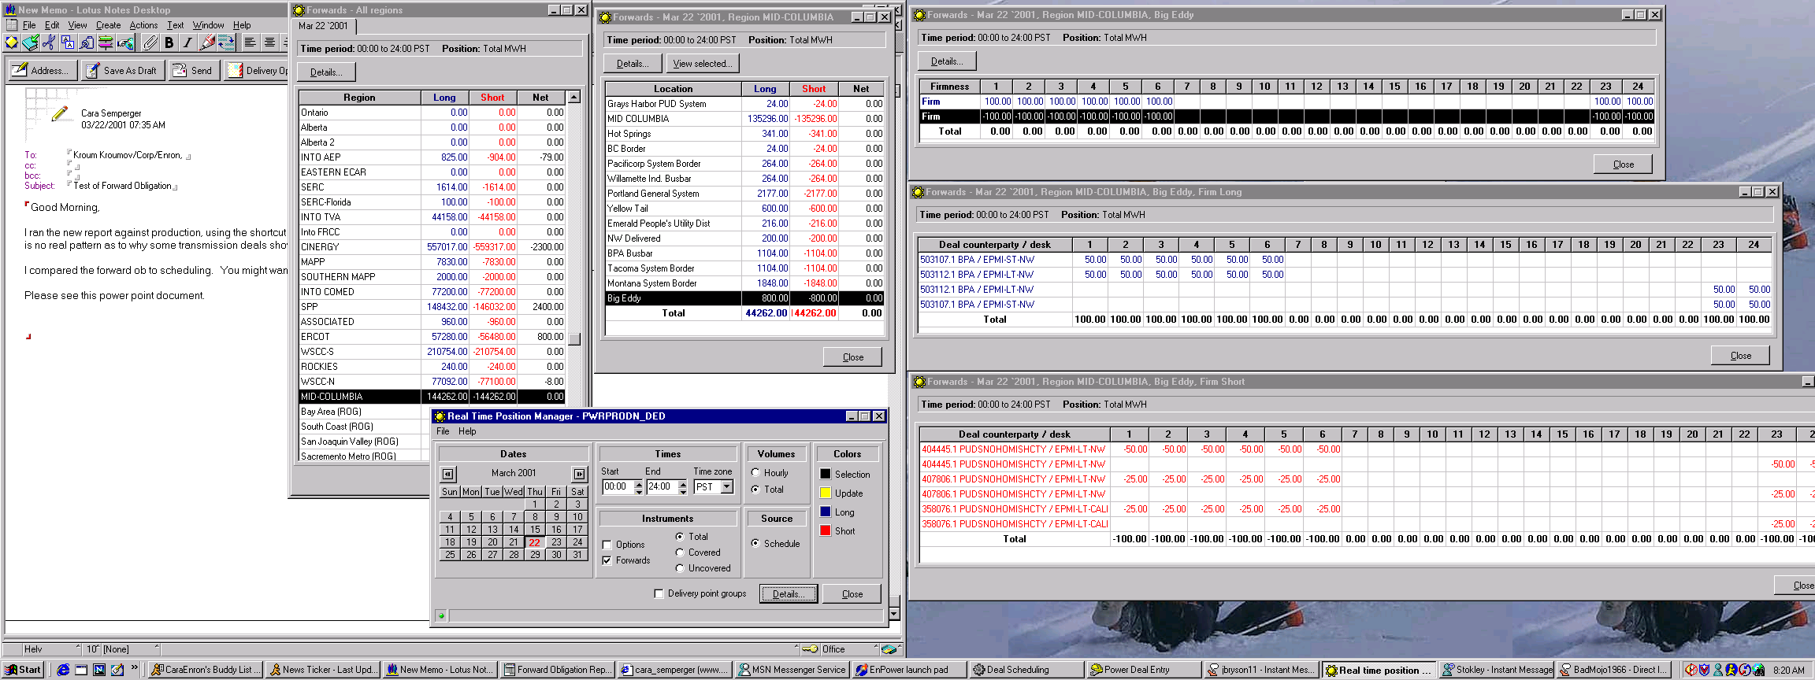
We are balanced
on the RT position
manager.

Slide 5
The detail of RT position manager clearly shows that we are
balanced because the transmission is in place. This transmission
is missing in the forward ob, giving us the false impression that we are
100 mw short on hours 1-6 and 23-24.

