Slide 1

Wholesale
Energy
Transportation
&
Distribution
Retail
Energy
Broadband
Services
Net Works
Expansion Vehicle
for New Commodity
Industry Penetration

Slide 2
Current Market Conditions
Many Industries Exist That Sell Commodity Products Through Legacy Distribution Channels
Channels Often Consist of Complex Sales Forces and Long Term Relationships with Little Price Transparency
Enormous Inefficiencies Exist in the Pricing of Commodity Products
The Internet Provides a Unique Opportunity to Have Immediate and Inexpensive Access to Customers

Slide 3
Enron Net Works - Strategy
Identify Industries with Commodity-like Products Utilizing Legacy Distribution Channels
Leverage Off Enron’s Existing Logistics, Risk Management and Back Office Capabilities
Use Proven Enron e-Commerce Platforms As Accelerators
Provide High-Margin, Structured Products to Customers
Move Quickly and Minimize Effect on Enron’s Balance Sheet

Slide 4
Why Enron?
We Have Been B2B for Years
We Have a Proven Business Model and Track Record of Transforming Markets (Gas, Power, Broadband, Coal, Etc.)
We Have Strong Skills in Risk Intermediation and Proven Systems to Control Risk
We Have Already Successfully Migrated From an “Old Economy” Company to a “New Economy” Company

Slide 5
Business to Business Market Activity Spectrum
Futures and
Derivative
Markets
Credit
Capabilities
Forward
Markets
Cash
Markets
Transactions
Logistics
Settlements
Operations Capabilities

Slide 6
Business to Business Market Activity Spectrum
Pure B2B
Exchanges
Futures and
Derivative
Markets
Forward
Markets
Cash
Markets
Transactions
Logistics
Settlements

Slide 7
Business to Business Market Activity Spectrum
Pure B2B
Exchanges
Futures and
Derivative
Markets
Enron
Forward
Markets
Cash
Markets
Transactions
Logistics
Settlements

Slide 8
Business to Business Market Activity Spectrum
Logistics
Data Storage
Credit
Finance
Chemicals
Steel
Metals
Pulp & Paper
Coal
Bandwidth
Power
Natural Gas
Futures and
Derivative
Markets
Forward
Markets
Cash
Markets
Transactions
Logistics
Settlements

Slide 9
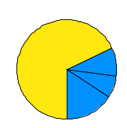
Market Size
($Billions)
Markets Where Enron Participates Today
Future Enron Markets
[Other]
Bandwidth
$____
Coal
$___
Gas
$40
Power
$140

Slide 10
Recent Net Works Transactions
MG PLC
Garden State Paper
Leading Merchant of Base Metals
Significant Customer Overlap with Enron’s Existing Energy Customers
Provides Domain Expertise
Metals Market Receptive to Enron-like Products
U.S. Based Newsprint Manufacturer
Compliments Existing Pulp and Paper Business (#1 Derivatives Position)
Provides Access to Physical Product
Enables Deployment of Enron’s eCommerce Business Model (Clickpaper.Com)

Slide 11
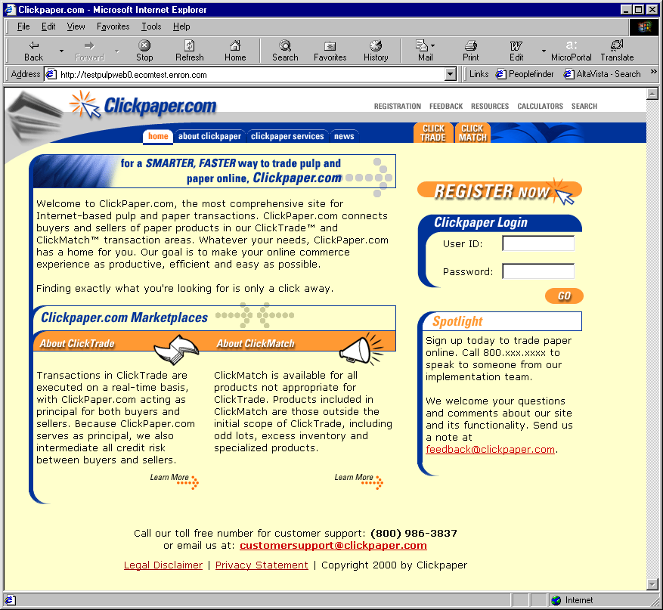
Clickpaper.com
Principal Based
Free of Charge
Real Time
Financial and Physical Products
Tailored to Paper Industry Participants

Slide 12
Networks Funding Plan
No Equity Issuance Anticipated
Targeted Investors for Each Vertical
Limited Enron Financial Support Anticipated
Capital Available by Third Quarter

Slide 13
Conclusion
Market-Leading Positions of Core Businesses Providing Consistent, Sustainable Earnings Growth
New Businesses and New Technology Adding to Earnings Power and Valuation
Continuing to Evaluate All Methods to Increase Return on Investment

