Slide 1

New Generation in WSCC
Presentation
October 1, 2001
Proprietary and Confidential 10/1/01

Slide 2
Updates
Regional News
California Peaker Plants Update:
The Federal Energy Regulatory Commission’s actions this summer intended to lower electric and gas prices in the West have prompted many generators to rethink projects throughout the U.S. As a result of lower forward power prices, some which have dropped 30% or more from earlier highs this year, expectations of future earnings from new projects do not justify completing many projects that have been proposed. This appears to be a direct result of the FERC’s willingness to impose price caps in the Western market to help mitigate soaring wholesale power prices. At least fifteen peaker plants that were scheduled to be built in California have either been put on hold or permanently cancelled in the past two months. The projects include Tejas, Fresno, Stockton, Palm Springs, Los Banos, El Cajon, Vaca Dixon, Midway, Mission, Panoche, and Susuin City. The total output from these plants would have been at least 700 MW. Tejas Energy, DG Power, and Wellhead, PLC were among the owners of the plants.
PIRA Western Grid Summary:
WSCC U.S. electricity generation climbed an estimated 800 aMW from July to reach 68,800 aMW during August, but was 5.8% below August 2000. In California, August gas-fired generation hit a seasonal peak of just under 12,200 aMW, down about 1,000 aMW from last year’s historic peak.
Overall, September generation in the WSCC is expected to average 62,600 aMW, down 5.4% from last year; output should hit a seasonal low of 59,400 aMW next month before heating load begins to increase during November. Precipitation for the water year to date slipped from 71% of normal in July to 69% by the end of August. Northwest hydro generation swelled to 8,750 aMW, compensating for declines in hydro generation in other parts of the WSCC, while coal and nuclear generation remained strong.
Major Changes Since Last Report
Construction Updates:
On September 25, construction commenced on the 500 MW Three Mountain Power Project. The plant is owned by Ogden Pacific and is located in Shasta County, California. Commercial operation is expected to begin by December 2003.
Two Alliance Energy peaker projects in the SP-15 region have been completed. The 40 MW Century Peaker and the 40 MW Drews Project are located in Colton, CA..
In the ZP-26 region, The Hanford Energy Park project has been completed. The 90MW plant is owned by GWF Energy and its output has been sold under a long term PPA to the CDWR.
In the Pacific Northwest, the 270 MW Rathdrum project was completed. The Kootenai County, ID plant is co-owned by Avista and Cogentrix and its output will be marketed by Avista.
In Mexico, the 541 MW Rosarito III project has commenced commercial operations. The plant was constructed primarily to export power to California.
Permitting Issues:
In California, the permit for the 600 MW Metcalf Energy Center was approved and construction is scheduled to begin in October with commercial operation slated for 2003.
The siting permit for the 720 MW Caithness Big Sandy project was denied. The Arizona Commission ruled the plant would damage endangered species’ habitat. It is unclear whether Cathness will appeal.
California

Slide 3
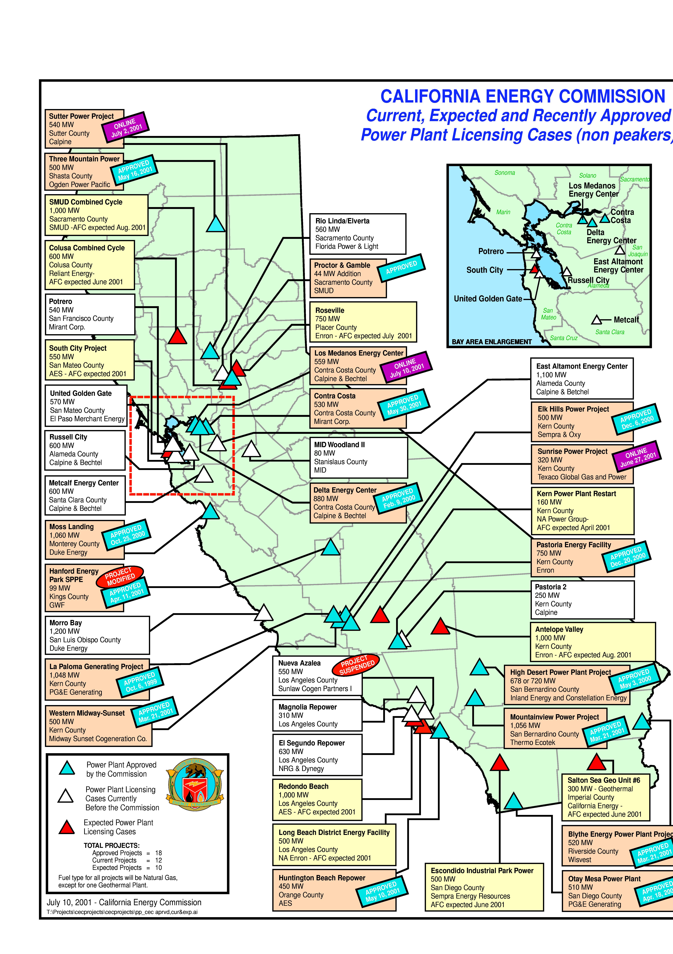
CALIFORNIA
High Probability Plants (UC) Under Construction (AP) Approved by CEC
San Gorgonio / 20 MW / Oct-01 (UC)
Pegasus Power Partners / 135 MW / Oct-01 (UC) / 9664 HR
Huntington Beach Modernization / 430 MW / Nov-01
Elk Hills (Phase 1) / 350 MW / Mar-02 (UC) / 7,067 HR
La Paloma (Phase 1) / 521 MW / Mar-02 (UC) / 6,870 HR
La Paloma (Phase 2) / 522 MW / Jun-02 (UC) / 6,870 HR
Moss Landing / 1,060 MW / Jul-02 (UC) / 7,067 HR
Delta Energy / 880 MW / Jul-02 (UC) / 7,178 HR
Midway-Sunset / 500 MW / Oct-02 (UC) / 6,793 HR
Blythe (Phase 1) / 520 MW / Mar-03 (UC) / 7,100 HR
Elk Hills (Phase 2) / 220 MW / Apr-03 (UC) / 7,067 HR
High Desert / 720 MW / Jun-03 (UC) / 7,178 HR
Otay Mesa / 510 MW / Jun-03 (UC) / 7,100 HR
Pastoria (Phase 1) / 755 MW / Jul-03 (UC) / 6,760 HR
Sunrise Power (Phase 2) / 320 MW / Aug-03 (UC) / 11,021 HR
Mountainview / 1,056 MW / Jul-03 (UC) / 6,704 HR
Medium-High Probability Plants
(UC) Under Construction (AP) Approved by CEC
Benicia Refinery Cogen / 51 MW / Jun-02 (AP)
Metcalf Energy Center / 533 MW / Jan-03 (AP) / 7160 HR
Woodland Generation Center / 80 MW / Jul-03 (AP)
Four Mile Hill Project / 50 MW / Dec-03 (AP)
Rio Linda / 560 MW / May-04 (AP)
California

Slide 4
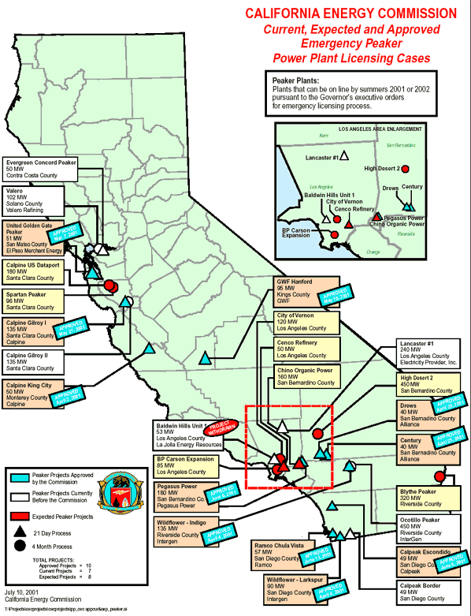
CALIFORNIA
Emergency Peaker Plants
NP15
Red Bluff / 49 MW / Oct-01
Gilroy (Phase 1) / 135 MW / Oct-01
King City / 50 MW / Oct-01
SP15
CalPeak Border / 49 MW / Oct-01
Escondido (CalPeak) / 49 MW / Oct-01
Pegasus Power Project / 180 MW / Nov-01
Recently Withdrawn / On Hold Peaker Plants
El Cajon / 49 MW / DG Power
Vaca-Dixon / 49 MW / DG Power
Midway / 49 MW / DG Power
Panoche / 49 MW / DG Power
Mission Peaker / 49 MW / DG Power
Susuin City / 49 MW / Panda West
Los Banos / 45 MW / Wellhead
Stockton Peaker / 20 MW / Wellhead
CENCO Peaker / 50 MW / CENCO Electric Company
Evergreen Concord / 50 MW / Evergreen
Lancaster #1 / 240 MW / Electricity Provider, Inc
Chula Vista (RAMCO) / 62 MW / RAMCO
Baldwin / 53 MW / La Jolla
San Ysidro / 43 MW / Tejas Energy
Palm Springs Peaker / 43 MW / Tejas Energy
California

Slide 5
CALIFORNIA UPDATES
(9/10/01 EIS) PSEG Global announced today that Hanford Energy Park, a 90 MW natural gas-fired power plant, began operation on August 27, 2001. The simple-cycle peaker plant, based on two General Electric LM6000 gas turbines, is located in Hanford, California. The plant was designed to provide up to 90 megawatts of electricity during ``peak periods'' of high electric demand. Construction on the Hanford plant began on June 1, 2001 and was completed in less than 90 days. The construction schedule was accelerated to more quickly help California meet its urgent energy needs. The plant is owned and operated by GWF Energy LLC, of which PSEG Global is a 50 percent owner. Harbert Power of Birmingham, Alabama, owns the other 50%, and is PSEG Global's partner in seven other existing QF renewable power plants in California. This facility is one of three plants GWF Energy is building in California to support a long-term power purchase agreement entered into in May of this year with the California Department of Water Resources
(9/11/01 MW Daily) Sacramento’s municipal utility has begun a series of field hearings on its 10-year resource plan aimed at securing low-cost power and boosting the amount of power produced from renewable resources. “Our goal is to continue our competitive rates for customers while building more renewable resources and contributing to cleaner air,” Jan Schori, general manager of the Sacramento Municipal Utility District, said in a statement introducing the plan. SMUD, according to the report, was able to protect its customers from most of the negative impacts of the ongoing financial and power crisis in California through a mix of power generated at utility- owned facilities and forward contracting. A number of power purchase contracts will expire over the next three to five years, the report says, making it necessary for the utility to secure additional supplies. The key provisions of the resource plan include building new gas-fired generation in the city, renewing operating licenses for existing hydroelectric facilities and increasing green power. The thrust of the plan is to give the city a resource base that is varied enough to resist market and price fluctuations and maintain system reliability. The plan includes the addition of about 45 MW of wind power and 35 MW to 45 MW of solar energy, enough to power 20,000 homes. The city currently supplies 13.2 MW through existing solar and wind sources. SMUD is also developing plans for a new 500-MW facility to provide round-the-clock power by 2005. By 2003, staff will recommend whether to move ahead with the addition of a second phase to boost the plant’s output to 1,000 for a state siting permit. With cost to consumers a major consideration for the utility directors, the resource plan sets Pacific Gas & Electric retail prices as a benchmark and aims to keep prices for Sacramento customers 30% lower than those for PG&E customers. SMUD customers currently pay a system-wide average of 9.5¢/kWh, compared to PG&E prices SMUD predicts will continue to exceed 13¢/kWh. SMUD purchases close to 1,100 MW through various long-term deals and foresees wholesale power prices at $40 to $50/MWh by 2005. SMUD can currently supply peak loads up to 2,890 MW through its own generating assets, contracted power and spot purchases. That peak is expected to increase to 3,123 MW by 2005, with 2% annual growth in sales and system peak through 2011. The SMUD Board plans to vote on the proposal at its Oct. 4 meeting.
California
Notes:
CISO has reset target pricing mechanism for the real time energy imbalance market. The price of the highest decremental bids is greater than the price for the lowest incremental bid. The new price is to be greater of zero or the lowest incremental bid.

Slide 6
CALIFORNIA UPDATES (cont’d)
(9/12/01 DJI) As the power plant that plunged San Jose into a yearlong controversy moves toward final approval from regulators, Calpine is trying to ease noise and aesthetic standards for the Coyote Valley project. And the state agency that had proposed tougher rules now appears ready to grant the company's wishes. Ending months of deliberations, the California Energy Commission is expected to give final approval to the Metcalf Energy Center on Sept. 12 in Sacramento. The decision will cap a protracted battle. In the fall, the project seemed doomed after the city council, led by Mayor Ron Gonzales, voted it down. But as the energy crisis deepened and it became clear the state would override his opposition, Gonzales reversed himself, and the long-shot proposal became almost a sure thing.
(9/12/01 DJI) Once considered largely off-limits to power plant development, the Bay Area has become the hottest spot in California for new electricity generators. Thirteen new power plants are in the works, including two projects in San Jose and Milpitas not previously publicized. Another major plant recently began operating in Pittsburg. No other comparably sized area has that much power on the drawing boards, according to a Mercury News review of California Energy Commission documents. While some of these plants may never get built, those under consideration could conceivably bolster the state's power grid by more than 6,200 megawatts, which is enough for 4.5 million homes. And that doesn't include an expansion under way at Monterey County's Moss Landing facility. The only area coming close to that much new generation is the considerably larger territory encompassed by Kern and San Luis Obispo counties, where plants generating about 5,700 megawatts have been proposed.
(9/21/01 Power Daily) In one of the more ironic developments in California’s power crisis, recently completed peaking capacity that the state ordered to be built under a fast-track process, is now sitting idle because Western power prices are at their lowest level since 1996. Two units, The Century Project and The Drews Project, at Alliance’s Century facility in Colton, California were tested and certified as complete last week by the state Dept. of Water Resources, which has a ten-year lease of the four 10-MW simple-cycle units on the site. The units are expected to remain off-line because of low demand, a DWR spokesman said Wednesday. Crews worked around-the-clock to get the peaking units ready by Sept. 15, the deadline contained in the contract the developer signed with DWR in April. In Palm Springs, Indigo Energy’s third 45-MW peaking unit was also certified for commercial operation last week and is expected to remain idle. Market players see little use for the electricity the plants could produce given that day-ahead power prices are stuck in the $20/MWh range and hourly are mired in the low-$20s/MWh because of mild temperatures and loads across the West. Power from small peaking units, such as the Alliance’s, would cost DWR about $23/MWh based only on spot gas prices. That cost does not include the up to $4.1-million, or about $143/MWh, in capacity payments the state makes to Alliance each month. The units are, however, fulfilling DWR’s need for non-spinning reserve and reducing what the state must pay in the market for ancillary services. DWR also has told the plant’s operator to be prepared to run for a significant number of hours during the fall maintenance season. Planned outages are expected to take more than 10,000 MW of generation off-line in California by the end of October. Even with a heavier than expected amount of generation off-line it is unclear if the units will be eco-nomically feasible, traders said. Forward power for October in Southern California is $27- $28/MWh, with only a slight premium for November.
California
Notes:
CISO has reset target pricing mechanism for the real time energy imbalance market. The price of the highest decremental bids is greater than the price for the lowest incremental bid. The new price is to be greater of zero or the lowest incremental bid.

Slide 7
CALIFORNIA UPDATES (cont’d)
(9/24/01 Henwood) GWF Energy LLC is seeking approval of a "Four-Month" Application for Certification from the California Energy Commission for the construction and operation of the Henrietta Peaker Project. The project is to the south of and contiguous with Pacific Gas and Electric Company's Henrietta Substation, which is approximately 20 miles southwest of Hanford, in unincorporated Kings County, California. The project is a nominal 91.4-megawatt, simple-cycle power plant. The project will consist of the power plant, an onsite 70-kilovolt (kV) switchyard, and approximately 550 feet of new 70-kV transmission line. Natural gas for the facility will be delivered via approximately 2.2 miles of new 12-inch pipeline that will connect to the existing Southern California Gas Company (SoCalGas) Line 800 transmission pipeline. The project will use two General Electric LM6000 PC Sprint combustion turbine generators (CTGs), each with a base load nominal output of 46.9 MW at annual average conditions.
(9/24/01 CEC e-mail) By a 5 to 0 vote, the California Energy Commission today gave the Metcalf Energy Center final approval for construction and operation. The natural gas-fired, combined-cycle power plant project, proposed by Calpine Corporation and Bechtel Enterprises, Inc., is expected to cost approximately $400 million and create 25 permanent jobs. The 600-megawatt power plant is approved for a 20-acre site located in San Jose at the southern base of Tulare Hill in northern Coyote Valley. Calpine and Bechtel Enterprises are scheduled to begin construction on the project this October with commercial operation expected to serve the summer load of 2003. This merchant plant will sell power in California's electricity market.
(9/26/01 CEC) Two new power plant applications started the California Energy Commission approval process with unanimous votes today. Commissioners deemed the applications data adequate for the Magnolia Power Project in Burbank and the Los Esteros Critical Energy Facility in North San Jose. The 4-to-0 Commission vote finding the Magnolia Power Project data adequate means that the staff has enough information to begin the six-month licensing review. A unanimous vote also began the four-month licensing process for the Los Esteros Critical Energy Facility. Simple-cycle power plants that can be on-line by December 31, 2002 can be licensed under the four-month - fast track - process. The six-month process is for thermal power plants that will not cause significant adverse impacts to public health, the environment or transmission system. In both cases, projects must comply with local, state and federal laws, ordinances, regulations and standards, including the California Environmental Quality Act. The Magnolia Power Project is a proposal from the Southern California Public Power Authority. The 250-megawatt, natural gas, combined-cycle electrical generating facility would be located at the site of the existing City of Burbank power plant. The city would operate the new plant that is intended to supply power as well to Anaheim, Colton, Glendale and Pasadena.
California
Notes:
CISO has reset target pricing mechanism for the real time energy imbalance market. The price of the highest decremental bids is greater than the price for the lowest incremental bid. The new price is to be greater of zero or the lowest incremental bid.

Slide 8
CALIFORNIA UPDATES (cont’d)
(9/26/01 DJI) California's power authority has begun negotiations to put as much as 3,165 megawatts of renewable and natural gas-fired peaker projects on the state's power grid by summer 2002, an authority spokeswoman said Monday. The California Consumer Power and Conservation Financing Authority will negotiate contracts for 1,846 MW of gas-fired peaker projects, 1,219 MW of wind projects and 100 MW of bio-fuel projects, said spokeswoman Linda Chou. The authority received proposals from more than 60 developers of gas-fired peakers and will negotiate with 14 wind and bio-fuel generation developers, according to a press release.
(9/27/01 Energy Infosource) Foster Wheeler Ltd. announced that its subsidiary, Foster Wheeler Energy Corp., was awarded a contract valued at approximately $50 million by Bechtel Power Corporation, to supply four heat recovery steam generators (HRSGs) with selective catalytic reduction (SCR) systems for the Mountainview Power Project in California. The project is a new 1000 MW natural gas-fired combined-cycle plant being built by Mountainview Power Company, L.L.C., a subsidiary of AES Corporation, in Redlands. Construction of the Redlands plant, expected to begin in 2001, is scheduled for completion in the summer of 2003. The project will help meet demand for additional electric energy to residents of southern California.
California
Notes:
CISO has reset target pricing mechanism for the real time energy imbalance market. The price of the highest decremental bids is greater than the price for the lowest incremental bid. The new price is to be greater of zero or the lowest incremental bid.

Slide 9
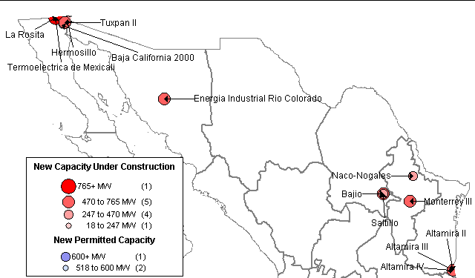
MEXICO NEW GENERATION MAP
High Probability Plants
Tuxpan II / 495 MW / Dec-01 / 7,160 HR
Altamira II / 495 MW / May-02
Naco-Nogales / 339 MW / Jun-02
Energia Industrial Rio Colorado / 470 MW / Sep-02
Hermosillo / 250 MW / Sep-02
La Rosita / 765 MW / Apr-03
Monterrey III / 490 MW / May-03
Bajio / 495 MW / Jun-03
Saltillo / 248 MW / Jun-03
Campeche / 250 MW / Jul-03
Medium-High Probability Plants
Altamira III / 518 MW / May-03
Altamira IV / 518 MW / May-03
Termoelectrica de Mexicali / 600 MW / Aug-03
Mexico

Slide 10
MEXICO UPDATES
(09/05/01 Power Daily) CYMI, the electrical subsidiary of Spain’s Grupo Dragados, has signed three contracts, worth $80-milion, to design, build and equip 32 sub-stations for Mexico’s state-owned Federal Electricity Commission (CFE), a CFE spokesman confirmed Tuesday. Dragados will finance 27 of the projects, the spokesman added. The largest of the three contracts is for the construction of 24 sub-stations in west-central Mexico. Delivery is due within 18 months.
Mexico

Slide 11
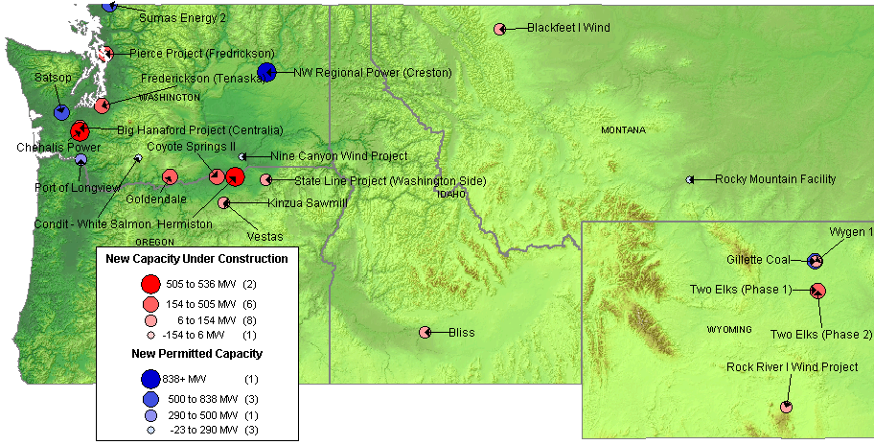
NORTHWEST NEW GENERATION MAP
High Probability Plants
Kinzua Sawmill / 10 MW / Oct-01
Bliss Idaho Power Peaker / 90 MW / Sep-01
Rock River I Wind Project / 50 MW / Oct-01
Two Elks (Phase 1) / 300 MW / Dec-01
Vestas / 35 MW / Dec-01
State Line Project / 60 MW / Dec-01
Pierce Project / 154 MW / Jun-02
Coyote Springs II / 231 MW / Jun-02 / 6,760 HR
Frederickson (Tenaska) / 248 MW / Jun-02
Big Hanaford Project (Centralia) / 248 MW / Jul-02 / 7,349 HR
Goldendale / 288 MW / Sep-02 / 7,200 HR
Blackfeet I Wind / 22 MW / Dec-02
High Probability Plants (cont’d)
Hermiston / 536 MW / Jan-03 / 6,700 HR
Two Elks (Phase 2) / 250 MW / Jun-03
Wygen 1/ 80 MW / Jul-03
Chehalis Power / 520 MW / Nov-03 / 6,704 HR
Medium-High Probability Plants
Rocky Mountain Facility / 110 MW / Jul-02
Sumas Energy 2 / 660 MW / Sep-02 / 6,793 HR *
Nine Canyon Wind Project / 11 MW / Sep-02
NW Regional Power (Creston) / 838 MW / Jun-03 *
Port of Longview / 290 MW / Jul-03 / 7,800 HR
Satsop / 600 MW / Oct-03 / 6,765 HR *
Gillette Coal / 500 MW / Jun-05 *Indicates increased uncertainty
PNW

Slide 12
NORTHWEST UPDATES
Washington
(9/18/01 PMI) About 5 percent of Seattle City Light's power will be generated in a few years by wind in Eastern Washington and Oregon by the Stateline Wind Project. City Council members yesterday unanimously approved Mayor Paul Schell's proposal to begin buying wind power from plants in Walla Walla County and from Umatilla County, Ore. The contract with PacifiCorp Marketing Inc., operator of the world's largest wind farm, makes City Light the largest buyer of wind power by a public utility in the nation. The city will begin buying 50 megawatts of capacity beginning Jan. 1, and increase it over the following two years.
Oregon
(9/19/01 PMI) The Oregon Energy Facility Siting Council has awarded a site certificate for the Umatilla Generating Project, a proposed generating plant being developed by the PG&E Corporation's PG&E National Energy Group. The action, taken by the Siting Council late last week, is a major milestone in the process to prepare the plant in northeastern Oregon for construction. The proposed plant will be designed with the capacity to generate up to 598 megawatts of electricity and will be located across the street from PG&E NEG's Hermiston Generating Plant near Hermiston, Ore. The plant is expected to be in service by 2004.
Montana
(9/10/01 Power Daily) Montana Power agreed late last week to buy up to 150 MW for 20 years from a new plant that will be built by NorthWestern Corp., the company that is in the process of buying Montana Power’s electric and gas utility divisions. NorthWestern said the power will come from the $140- million, 160-MW power plant it is attempting to permit near Great Falls, Mont. The plant will be expanded to 240 MW by late 2002. Cost of the power and other financial details were not disclosed. As agreed, Montana Power will receive 75 MW year around and a total of 150 MW from November through February each winter. The utility also has an option to buy an additional 40 MW during March through October. The Montana Public Service Commission must approve the deal. Montana Power had planned on buying 150 MW from a coal gasification plant proposed by Rocky Mountain Power for $40/MWh. But the PSC has delayed approving the deal until it has more details on how that deal compares to other power supply options. The utility also is negotiating to buy power from PPL Montana, which bought Montana Power’s 1,300 MW of generation in 1999.
PNW
Notes:
Formerly (stalled) NWPE 220 MW project. FPL bought rights in 1/99. Construction to began 9/1/99 As of 4/25/00 Unit 1 not complete and gas line construction has been stalled.

Slide 13
NORTHWEST UPDATES (cont’d)
Montana, cont’d.
(9/17/01 MW Daily) Montana Power, in a six-month battle over ratemaking control, recently filed a complaint against state regulators, challenging the Public Service Commission’s jurisdictional authority to oversee rates for the company’s former generating assets, which were sold to PPL Montana in 1999. In March, the PSC issued a declaratory order claiming jurisdiction over generation sold from Montana Power’s former plants. The company divested its generating assets a few years earlier in accordance with a state law promoting customer choice and a wholesale electric supply market, and it has been steadily removing itself from the electric utility sector. But the commission has never approved Montana Power’s proposed transition plan, which was filed in 1997 and which would effectively separate the company’s generation function from its distribution and transmission business. The PSC acknowledged that it did not have the authority to prohibit Montana Power from divesting its generating assets, but claimed to have the power to require the utility to continue providing electricity service to customers at tariffed rates it would approve. As long as Montana Power remains an integrated public utility, any purchaser of its generation assets must provide electricity to meet Montana Power’s full native load requirements at prices that would reflect the cost of power if the generation assets had not been sold, the PSC said in its June order.
PNW
Notes:
Formerly (stalled) NWPE 220 MW project. FPL bought rights in 1/99. Construction to began 9/1/99 As of 4/25/00 Unit 1 not complete and gas line construction has been stalled.

Slide 14
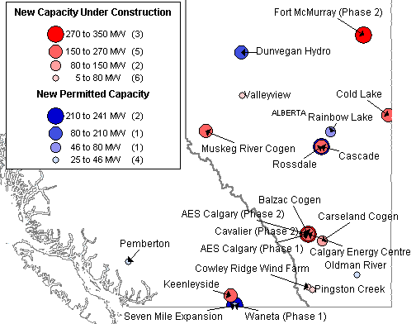
CANADA NEW GENERATION MAP
High Probability Plants
Cowley Ridge Wind Farm / 6 MW / Oct-01
Sinnot / 10 MW / Oct-01
Balzac Cogen / 106 MW / Nov-01
Carseland Cogen / 80 MW / Nov-01
Redwater Cogen / 40 MW / Nov-01
Cavalier (Phase 2) / 26 MW / Dec-01
Valleyview / 46 MW / Dec-01
Pingston Creek / 30 MW / Jun-02
Cold Lake / 170 MW / Oct-02
Muskeg River Cogen / 170 MW / Nov-02
Scotford Cogen / 150 MW / Dec-02
Keenleyside / 150 MW / Jan-03
Calgary Energy Centre / 300 MW / May-03
AES Calgary (Phase 2) / 175 MW / Dec-03
Fort McMurray (Phase 2) / 238 MW / Aug-04
Medium-High Probability Plants
Waneta Phase 1 / 15 MW / Dec-01
Rainbow Lake / 46 MW / Feb-02
Rossdale / 241 MW / Mar-02
Oldman River / 32 MW / May-02
Medium-High Probability Plants Cont’d)
Cascade / 26 MW / Jun-02
Pemberton / 25 MW / May-03
Dunvegan Hydro / 80 MW / Jun-03
Seven Mile Expansion / 210 MW / Mar-04
Canada

