Slide 1
Creating a Marketplace for Online Commodities Trading
Mike McConnell
Vice Chairman & COO
Enron Net Works

Slide 2
“It Is Not the Strongest of the Species That Survives, Not the Most Intelligent, but the Most Responsive to Change.”
Charles Darwin
The Origin of the Species

Slide 3

Endless possibilities.
TM
Largest gas merchant in the US, Canada, and the UK.
Largest electricity merchant in the US, UK, and Nordic Region.
Manages the largest natural gas derivatives book in the world.
Over 20,000 employees worldwide.
Activities in over 30 countries.
World’s leading energy company.
$40.1 billion in annual revenues.
$33.38 billion in assets.
Transports 15% of US natural gas.
Operates one of the nation’s
largest natural gas
transmission systems.

Slide 4
eBusiness Trends
The Internet is a Disintermediary
The Internet Cannibalizes Existing Businesses
The Internet Allows for Mass Customization
Barriers to Enter Markets are Dramatically Changing
The Internet Provides a Unique Opportunity to Have Immediate and Inexpensive Access to New Customers

Slide 5
eBusiness
The Effects of Increasing
Internetworking
Source: Forrester Research, Inc
Business-to-Business
Business-to-Consumer

Slide 6
Categories of Major Initiatives
Upgrading
- Streamlining processes to do business the best, most
efficient way we can
Expanding
- Growing market share in current businesses
Penetrating
- Rapidly establishing significant stakes in new markets

Slide 7
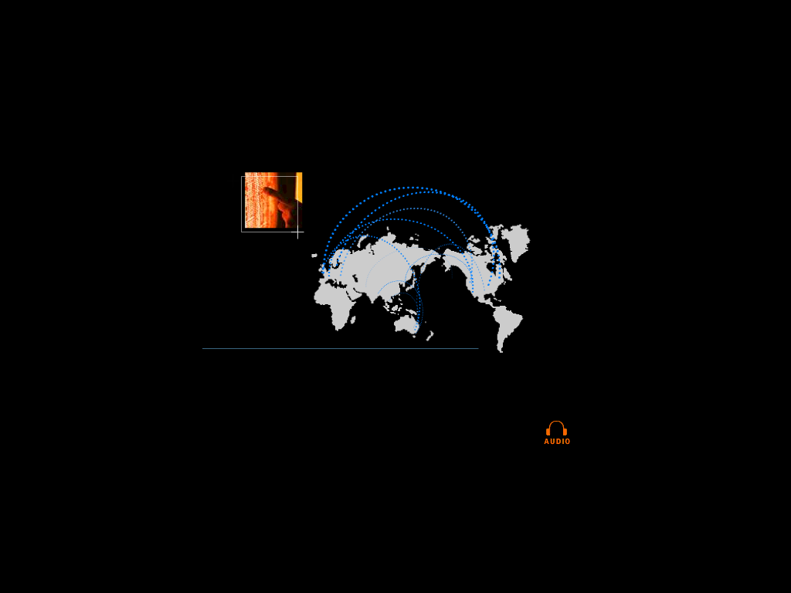
eCommerce is Becoming Core to the Global Energy Business
01010
91919
01382
83710
91817
01010
91919
01382
83710
91817
01010
91919
01382
83710
91817
01010
91919
01382
83710
91817
91919
010102374621985712398571928509129759812659821598601010237462198571239857192850912975981265982159860101023746216
010102374621985712398571928509129759812659821598601010237462198571239857192850912975981265982159860101023746298
global networks

Slide 8
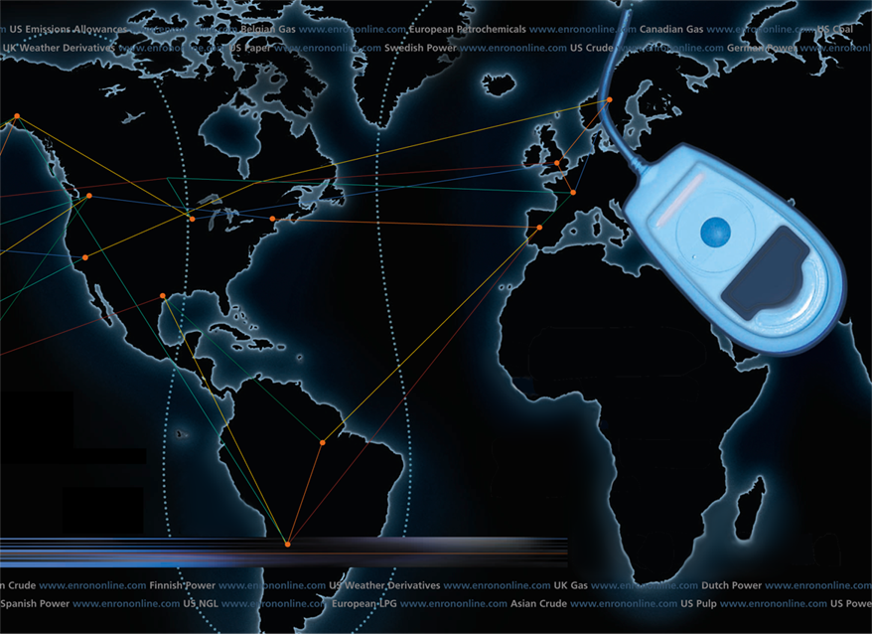
Putting the Energy into e-commerce
EnronOnline
TM
TM

Slide 9

What is EnronOnline?
A Free, Internet-based, Global Transaction System Which Allows Counterparties to View Real Time Prices From Enron’s Traders and Transact Instantly Online
click & transact

Slide 10
Benefits of EnronOnline
Free of charge
Real-Time Pricing Information
Access to complementary markets and product information
Simple access via the Internet
Easy to use
Fast and Secure Execution
Enron’s Best Prices

Slide 11
Enron’s global wholesale transaction business ….……..moves online
November 1999 US Natural Gas
Canadian Natural Gas
December 1999 Coal
Nordic Power
Plastics
Pulp & Paper
US Power
January 2000 Continental European Power
Continental European Gas
Emissions
LPG
Oil & Refined Products
Petrochemicals
UK Gas
UK Power
Weather
February 2000 EnBank Virtual Storage Auction (UK)
March 2000 Credit Derivatives
Enron Emissions Auctions (US)
Australian Power
May 2000 Bandwidth
Spring 2000 Asian Products
Summer 2000 European Coal
Clicks & Mortar

Slide 12
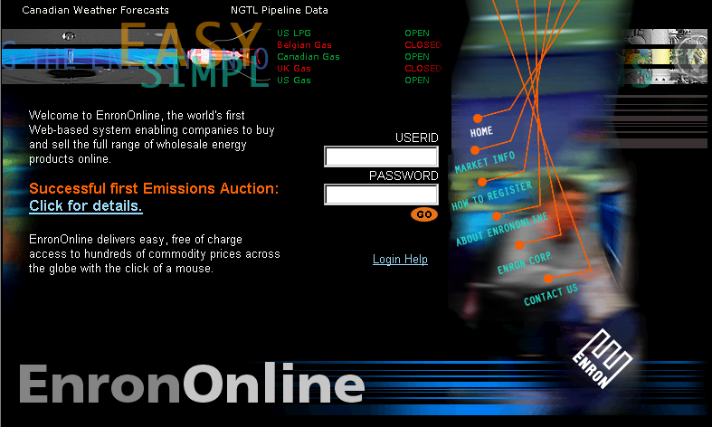
www.EnronOnline.com
New User
*******

Slide 13
Due Diligence
Legal
27 Firms
Tax
International
Interstate
Credit
Back Offices
Regulatory
Information Technology
Traders!!!!!!

Slide 14
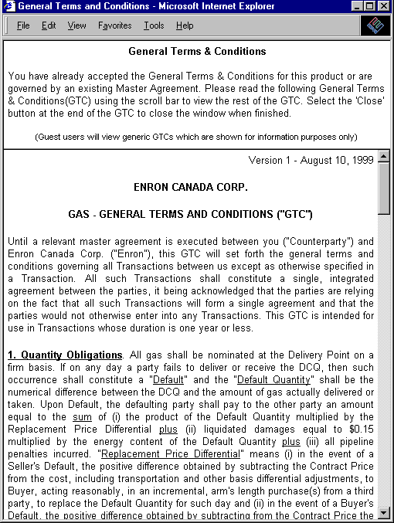
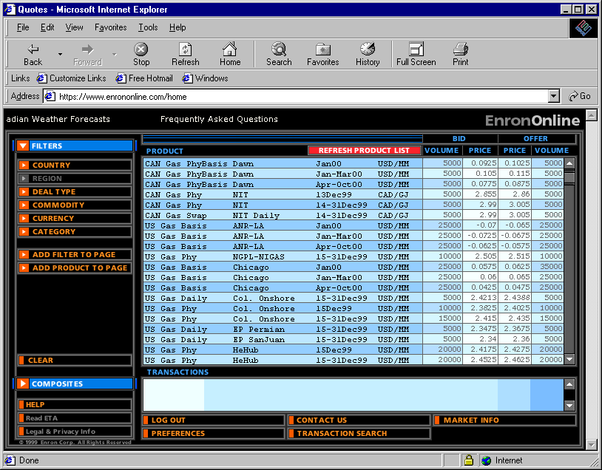
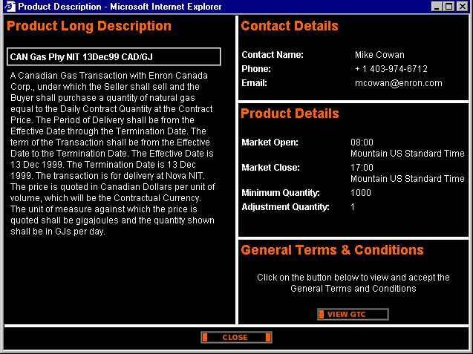
Legal Definition and Product Information

Slide 15
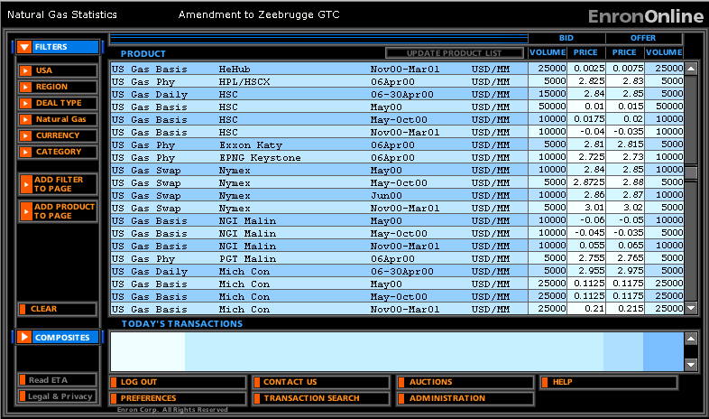
Quotes Page

Slide 16
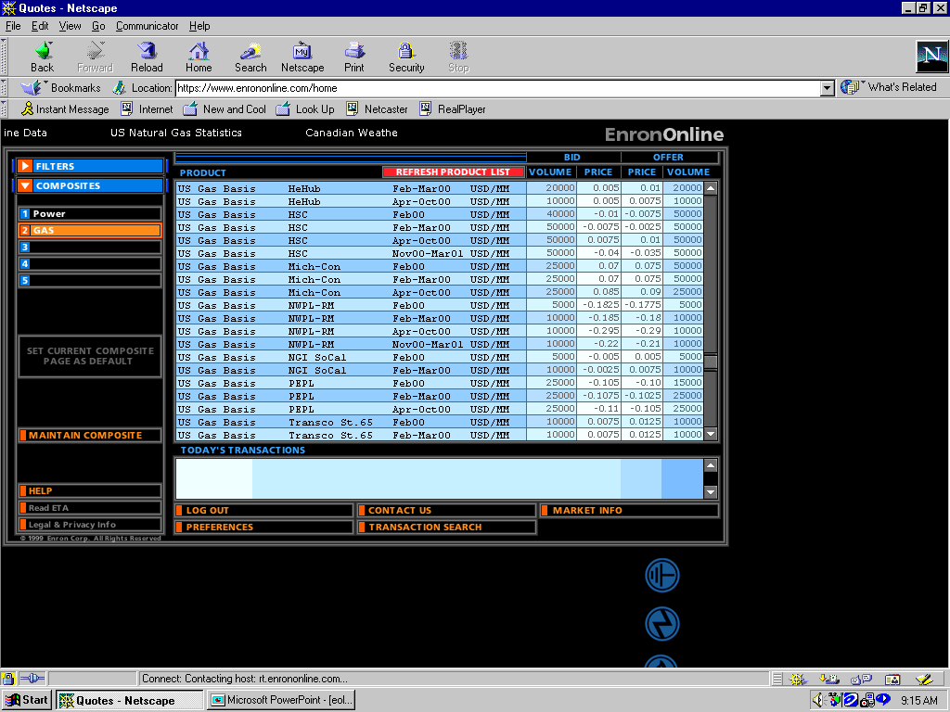
Click on Bid or Offer Price

Slide 17
Submission Screen

Slide 18
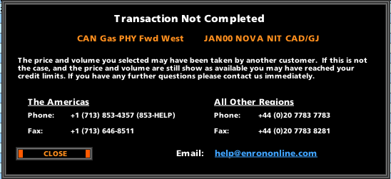
Failed Transaction

Slide 19
Successful Transaction

Slide 20
EnronOnline Statistics
Total Life to Date Transactions > 100,000
Currently > 45 % of Enron’s Transactions
Average Daily Transactions > 1,400
Life to Date Notional Value of Transactions > $39 billion
Daily Notional Value Approximately $700 Million
Currently > 33% of Enron’s Notional Volume
Number of Products Offered - Approximately 750
Number of Currencies Traded in = 13
Development Time Approximately 7 Months
Announcement Date October 26, 1999
Launch Date November 29, 1999

Slide 21
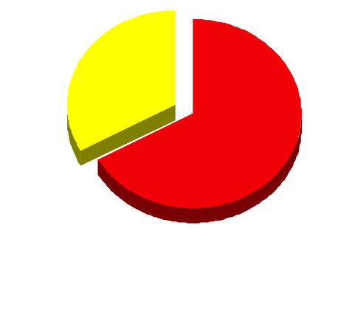
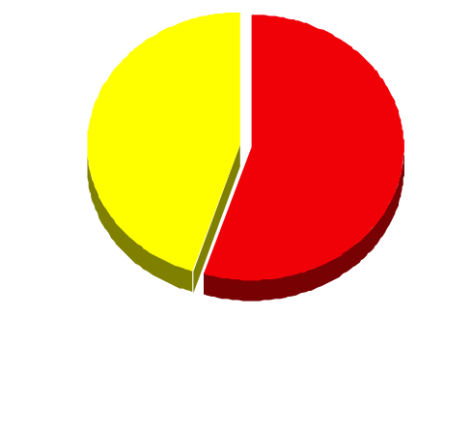
EnronOnline Versus Traditional Channels (Currently)
Volume
Transactions
33%
45%
67%
55%
EnronOnline
Traditional Channels

Slide 22
Transactions via EnronOnline (Weekly Cumulative)

Slide 23
eCommerce Business Comparison
Value of Goods*
(Millions)
Business To Consumer (B2C)
eBay
Amazon.com
Dell.com
$ 2,805
1,640
10,435
1999 Data*
Business To Business (B2B)
FreeMarkets
Cisco
Intel
Altrade
$ 2,700
9,500
10,500
12,000
2000 Est.**
EnronOnline
> $ 40,000
* Actual 1999 Results: eBay, Amazon.com, Dell.com, FreeMarkets
Est. 1999 Annual Results: Cisco, Intel, Altrade
** Annualized Based on Results to Date

Slide 24


