Slide 1

Leveraging Technology
Enron Net Works

Slide 2

Outline
Enron Overview
EnronOnline: An Example
The Future

Slide 3

Transportation
&
Distribution
Wholesale
Services
Retail
Energy
Broadband
Services
Natural Gas Transportation and Electric Distribution
Marketing and Delivery
of Commodities Worldwide
Energy Outsourcing to Commercial and Industrial Customers
Bandwidth Intermediation and Content Services

Slide 4
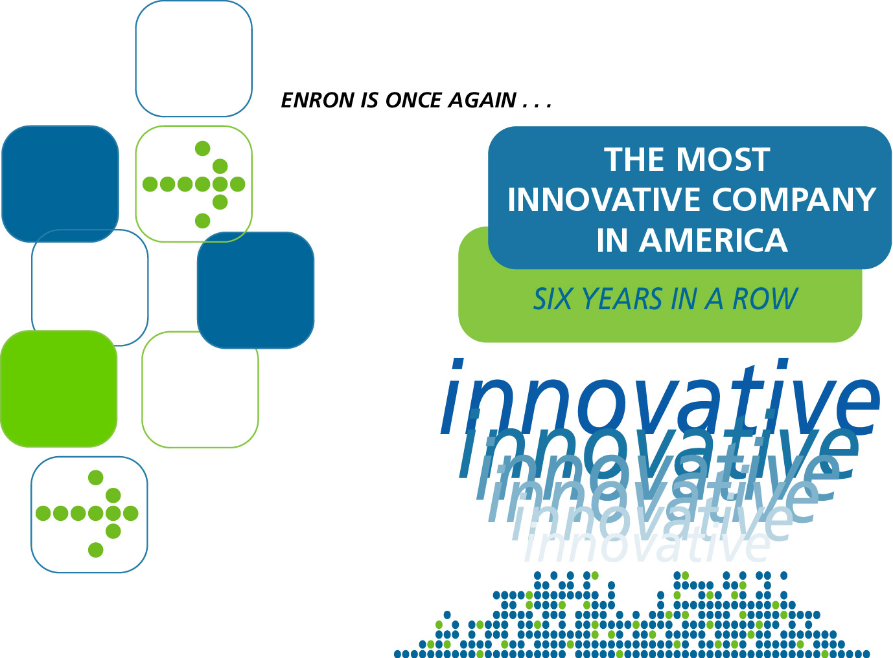


Fortune Magazine, February 2001

Slide 5
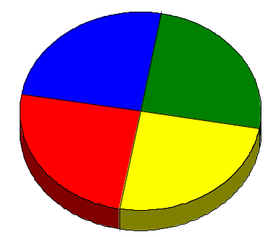
Enron’s Wholesale Services Model
Physical
Financial
e-Commerce
Origination
Enron uniquely combines its physical, financial and origination capabilities with e-Commerce to provide wholesale commodity services

Slide 6

Enron e-Commerce Model
Traditional
Technology
Companies
Traditional
Commercial
Companies
Core Strengths:
Research
Development
Testing
Marketing
Sales
Support
Core Strengths:
Industry Knowledge
Production
Customer Relationships
Supply Chain
Risk Management
Marketing
ROI Focus
Technology
Strengths
Commercial
Strengths
Research
Development
Testing
Marketing
Industry Knowledge
Production
Customer Relationships
Supply Chain
Risk Management
Marketing
ROI Focus

Slide 7
Enron Technology Practices
Partnership with Commercial Teams
Focus on Design and Architecture
Vendor Neutrality
Effective Buy vs. Build Decisions
Small Team with Big Talent
Notes:
We don’t view technology group as a service where you throw down requirements and wait for them to deliver. There are deep partnerships between the commercial team and the technology group.
We are always focused on the ability to extend pieces of technology. When requirements are defined, we step back and build a framework that allows the final product to be scalable and reusable in other applications. This is where outsource fails because they are only incented to do the task at hand and as a result may build technology that is not scalable or reusable.
We are not married to a particular technology. We use specification standards that can me provided by a multiple vendors.
We apply software best practices for usage and have world-class process implementation in order to mitigate our systems risk.
We are good at understanding the cost/benefits of building something from scratch vs. making the effort to integrate an off-the-shelf solution into our environment.
Two outstanding developers are better than 10 mediocre ones. Many SW companies use undertrained people who create products that are fraught with risks.
We don’t train new people through trial by fire. They learn from the best.
Even the best processes can’t succeed without the “right” people. In our case, we have an environment with great processes and heros who are able to push and stretch those processes to deliver outstanding products in record times. Example: EnronOnline

Slide 8
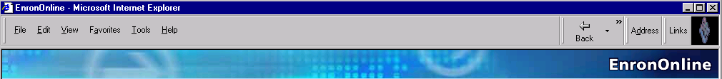
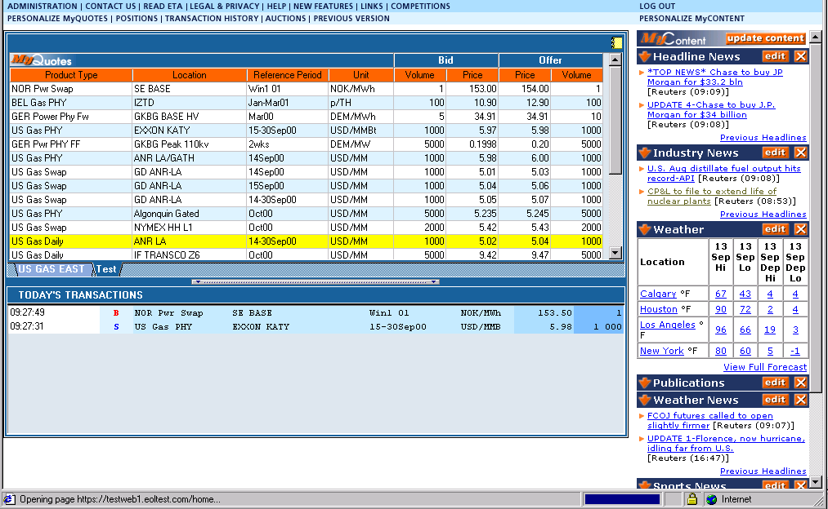
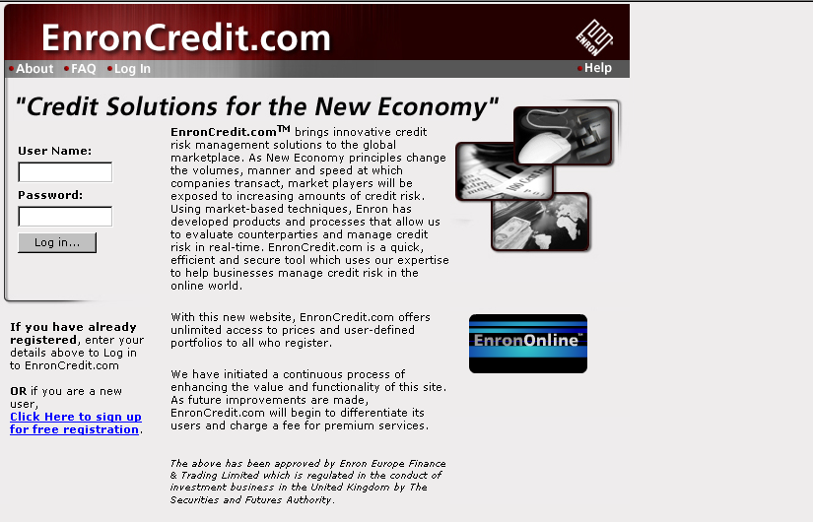
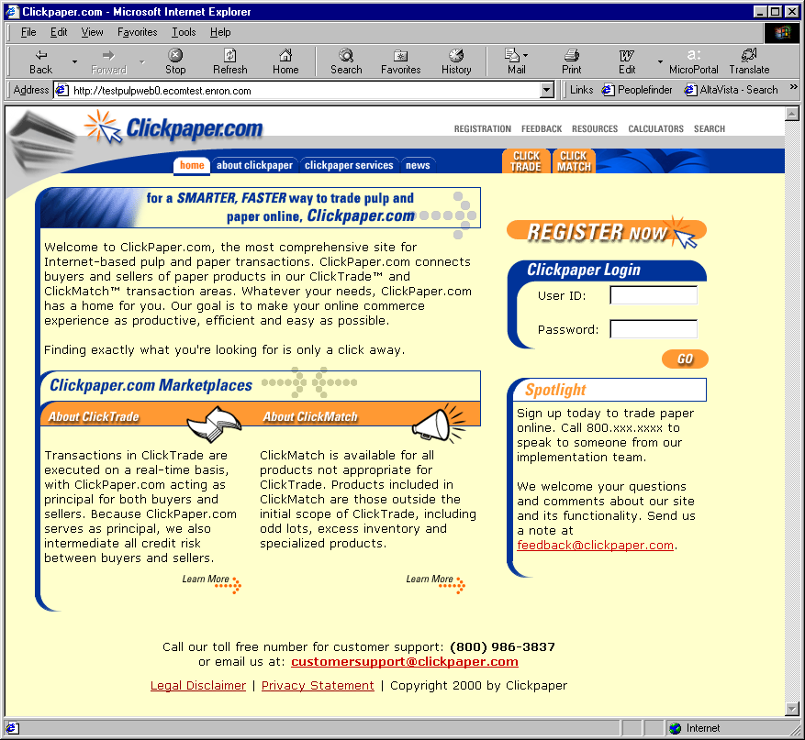
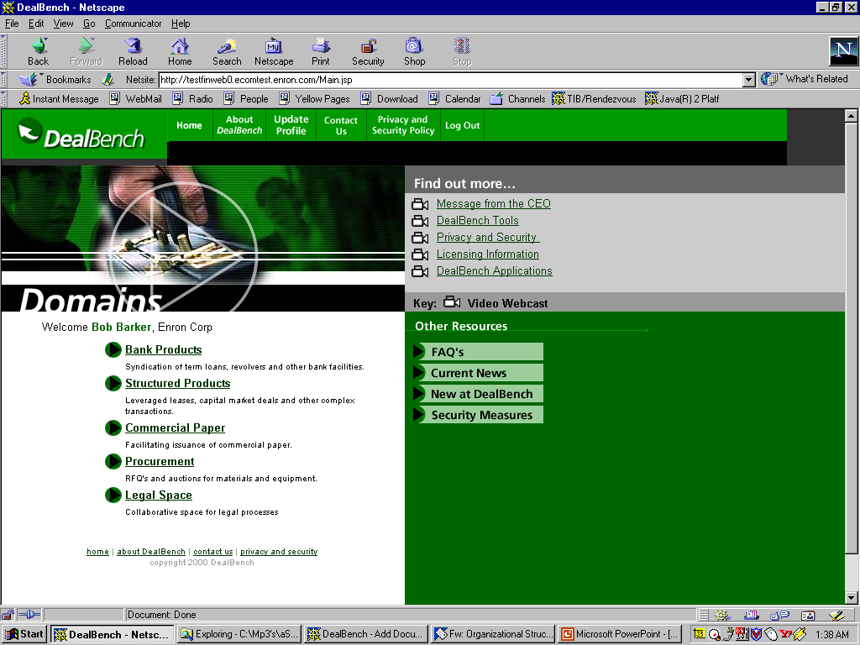
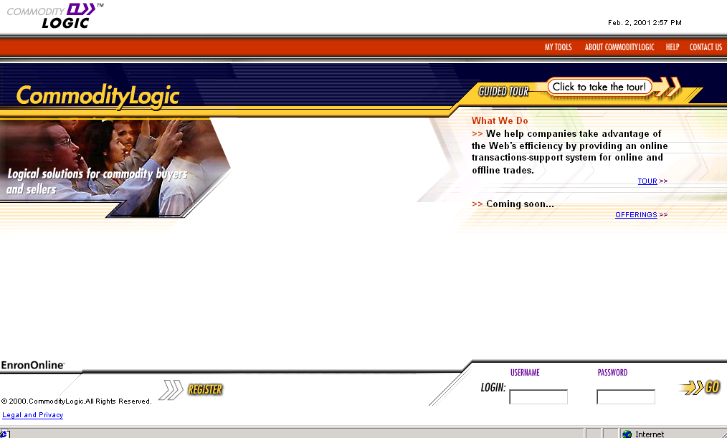
Web Applications
Global Commodities
EnronOnline.com
EnronCredit.com
Credit Products
ClickPaper.com
Pulp, Paper & Lumber
Auctions/RFQs
M&As
Syndications
DealBench.com
CommodityLogic.com
Settlements and Back Office

Slide 9
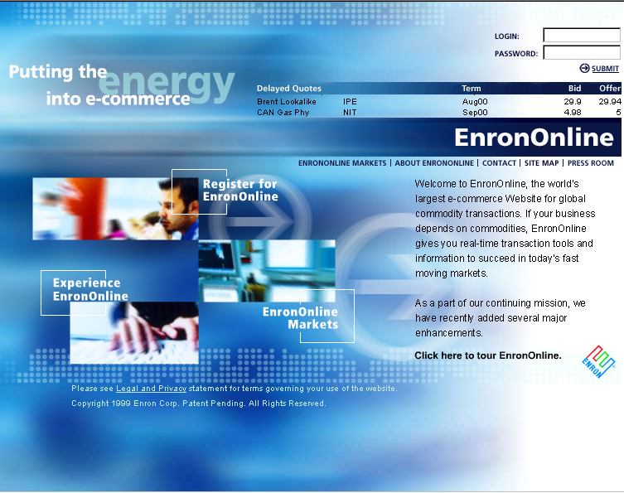
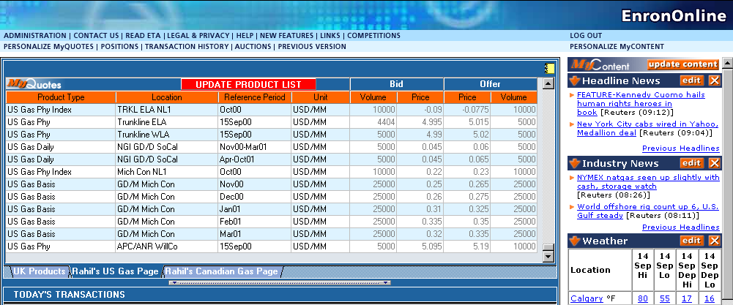
EnronOnline: An Example
The World’s Largest Web-Based e-Commerce Site

Slide 10
EnronOnline - Product Offerings
1999 - 4Q
2000
Natural Gas
U.S.
Canada
Power
U.S.
Nordic
Coal
Pulp & Paper
Plastics
Natural Gas
U.K.
Belgium
Argentina
Power
U.K.
Germany
Holland
Switzerland
Australia
Spain
Austria
Nordic Pool
Coal
European
U.S.
Bandwidth
Weather
U.S.
Europe
Japan
Australia
Emissions Credits
Crude & Refined Products
Petrochemicals
LPG
Steel
Metals
U.S.
U.K.
Japan
Seafreight
Lumber
Auctions
Emissions
EnBank Virtual
Storage
Pipeline Capacity
Credit Derivatives

Slide 11
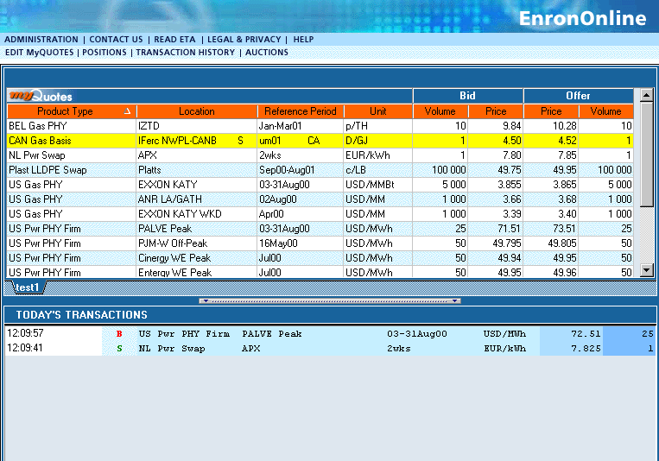
Quotes Page

Slide 12
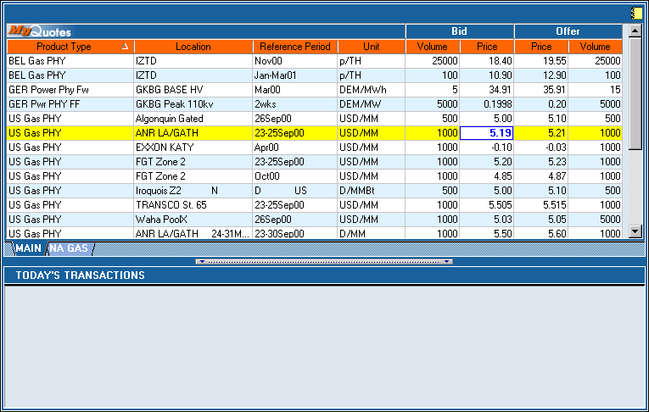
Click On Bid Or Offer Price

Slide 13
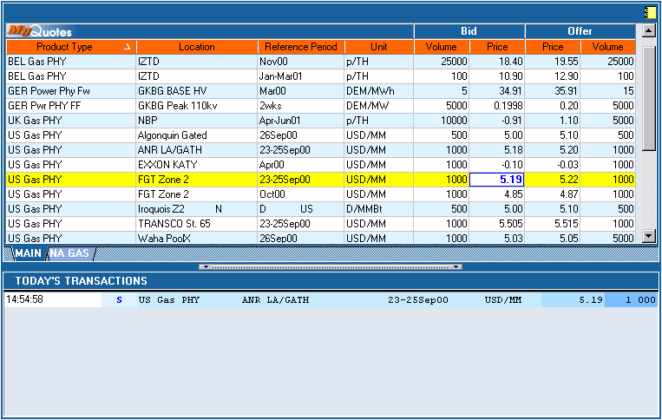
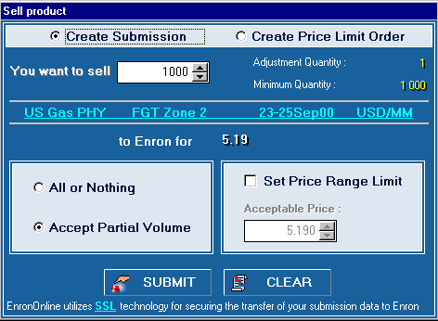
Submission Screen

Slide 14
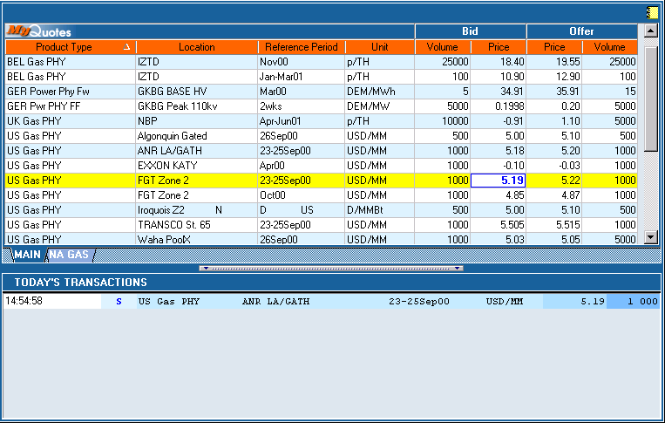
Successful Transaction

Slide 15
EnronOnline Architecture Advantages
Real-Time
Modular, standards-based design
Scalable product management system
Handles hundreds of price updates to users per second
Allows for application in volatile or non-volatile markets
Processes thousands of Enron’s online transactions per day
Handles complete transaction cycle including credit, legal, tax jurisdiction, deal capture and confirmation
Supports thousands of products and multiple currencies
Allows real-time deal capture of transactions in back-office systems, eliminating deal entry errors

Slide 16
Why did Enron Introduce EnronOnline?
Allow all customers the same access to Enron’s best prices and allow them to transact on those prices
Reach more counterparties
Simplify the existing transaction process
Remove marketplace inefficiencies
Complete more transactions in less time
Increase market liquidity
Extend Enron’s reach across product lines
Achieve scalability

Slide 17
EnronOnline - As of June 15, 2001
Number of Transactions 1,080,000
Gross Notional Value Transacted $640 Bn
Daily Transactions 5,000
Daily Notional Value $3 Bn
Products Offered 1,600
Number of Currencies Traded in 13
The World’s Largest Web-Based e-Commerce Site

Slide 18
EnronOnline Growth

Slide 19
North American Natural Gas and Power
EnronOnline Utilization Online Transactions as a % of Total Transactions
4Q 1Q 2Q 3Q 4Q 1Q
1999
2000
2001
Traditional
EnronOnline

Slide 20
Average Daily Number of Transactions
EnronOnline vs Traditional

Slide 21
Efficiency Gains
Transactions
Per Commercial Employee
Marginal
Cost Per Transaction
(Indexed)
3,084
100
$370
25
672
1999
2000
1999
2000

Slide 22

Reinventing Enron Net Works
Future
Leveraging
Technology and
Commercial Skills
for the Benefit of
Business Partners
Present
Proprietary
e-Commerce
Platform &
Applications
Past
Information
Technology
Infrastructure
and Support

