Slide 1
Enron Net Works Enron Advisory Council September 8, 2000

Slide 2
Enron Net Works
Many Industries Exist That Sell Commodity Products Through Legacy Distribution Channels
Channels Often Consist of Complex Sales Forces and Long Term Relationships with Little Price Transparency
Enormous Inefficiencies Exist in the Pricing of Commodity Products
The Internet Provides a Unique Opportunity to Have Immediate and Inexpensive Access to Customers

Slide 3
Opportunity for Enron
Use Proven Enron eCommerce Platforms As Accelerators
Leverage Off Enron’s Proven Skills in Logistics, Risk Management and Back Office Capabilities
Provide High-Margin, Structured Products to Customers
Move Quickly and Minimize Effect on Enron’s Balance Sheet

Slide 4
Enron Has the Capabilities Required
to Capture this Market Opportunity
Market Making Capabilities
Operating
Capabilities
Other
Capabilities
Cash Markets
Forward Markets
Futures Markets
Transactions
Logistics
Settlement
eCommerce Platforms
Risk Management Process
Capital

Slide 5
The Enron Business Model
Logistics
Chemicals
Agriculture
Steel
Data Storage
Credit
Metals
Finance
Pulp & Paper
Petrochemicals
Bandwidth
Coal
Power
Natural Gas
Term Structured
Derivatives Markets
Spot
Markets
Producer to
Consumer
Transactions
Logistics
Settlements
Retail Services
Wholesale Services
Supply Aggregation

Slide 6
The Net Works Opportunity
Components of Transformation Process
Define
Product
Standards
and
Contracts
Obtain
Physical
Distribution
Develop
Physical
Distribution
Market
Making
Establishes
Liquidity
Risk
Management
Innovative
Structured
Products
Transformed Markets Transformation in Process
Natural Gas Base Metals
North America Broadband
United Kingdom Emissions Credits
Power Pulp and Paper
North America Weather
United Kingdom
Nordic Region
Australia
Continental Europe
Global Coal

Slide 7
Target Markets
Core Product must have Commodity-like Attributes
Base Grade (Index)
Fungibility
Switch Points Based on Price
Capital Intensive
Large Sums Invested and at Risk
Reliability of Delivery and Product Spec is Customer Concern
Complex Distribution / Logistics System
Scale and Scope Matters
Expensive to Replicate Network
Slow Moving Incumbents
Playing Defense
Metals
Pulp & Paper
Steel
Chemicals
Credit/Finance
Data Storage
Settlements
Logistics

Slide 8
Approach
Enron Business Plan Upon Entering Markets
Upgrade
Streamline Process to Do Business the Best, Most Efficient Way Possible
Expand Grow Market Share in Current Business
Penetrate Rapidly Establish Significant Stakes in New Markets
Upgrade
Expand
Upgrade
Upgrade
Penetrate

Slide 9
Recent Net Works Transactions
MG PLC
Garden State Paper
Leading Merchant of Base Metals
Significant Customer Overlap with Enron’s Existing Energy Customers
Metals Market Receptive to Enron-Like Products
U.S. Based Newsprint Manufacturer
Complements Existing Pulp and Paper Business
Complements Deployment of Enron’s eCommerce Business Model (Clickpaper.com)

Slide 10
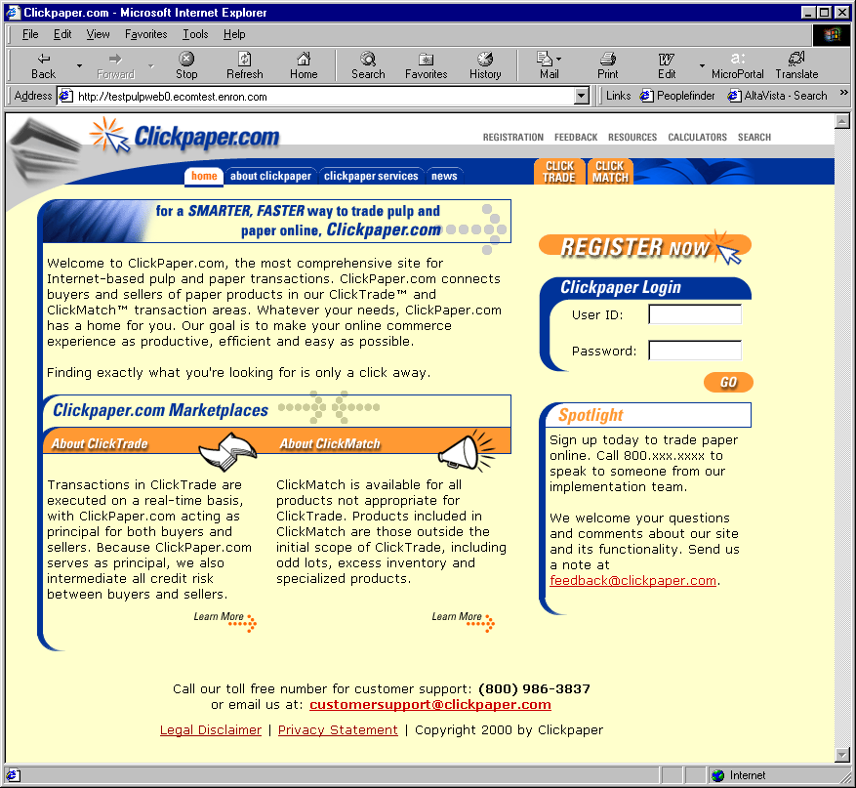
Clickpaper.com
Extension of EnronOnline Platform
Principal-Based
Free of Charge
Real Time
Financial and Physical Products
Tailored to Paper Industry Participants

Slide 11
Net Works Funding Plan
No Enron Equity Issuance Anticipated
Targeted Investors for Each Vertical Markets
Limited Enron Financial Support Required
Capital Available by Third Quarter

