Slide 1
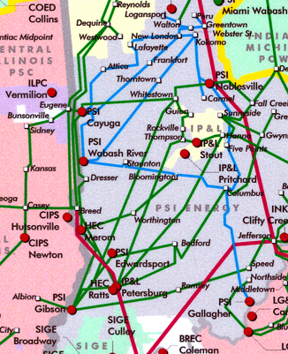
Wheatland

Slide 2
I.T. Systems

