Slide 1
ENRON.COM
Sketches for
New Services Area
May 18, 2000
*This presentation includes sample content from the Energy Transportation Services area

Slide 2
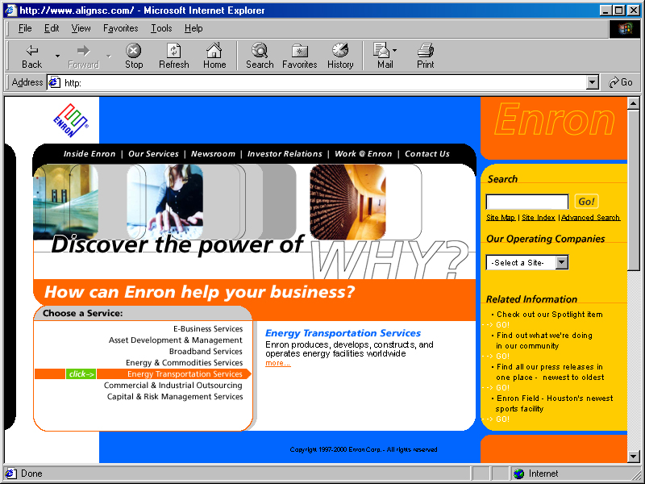
New Home Page

Slide 3
How the Home Page works--
Enron businesses are grouped into 7 areas, as shown on home page.
Visitor to site clicks on the 7 area titles for a short description of the area.
Energy Transportation Services Intro Text
Enron produces, develops, constructs, and operates energy facilities worldwide. We deliver physical commodities, risk management, and financial services to our customers around the globe. Our goal is to help you make the most of the enormous opportunities that competitive energy markets offer. Our wide array of Energy Transportation Services clearly illustrates how Enron is changing the way the world thinks about energy.

Slide 4
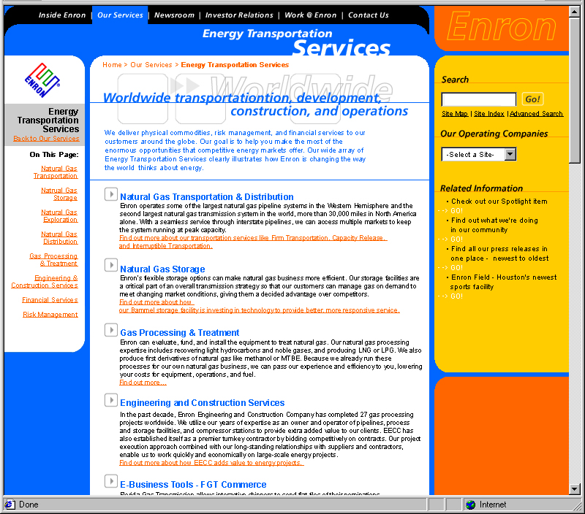
2nd Level Page: Details for one of the 7 service areas

Slide 5
How the Second Level Page Works--
For each main service area, a Second Level Page lists Enron’s unique services.
Any E-commerce web sites are also listed as a unique service.
A brief paragraph describes each unique service.
Where available, clicking the link jumps to a business unit or e-commerce web site.
For Energy Transportation Services, the unique services are
Natural Gas Transportation & Distribution
Natural Gas Storage
Gas Processing & Treatment
Engineering and Construction Services
FGT Commerce
ETS Electronic Data Exchange
HotTap
Oil Transportation Services
Exploration & Production

Slide 6
Energy Transportation Services
Natural Gas Transportation & Distribution
Enron operates some of the largest natural gas pipeline systems in the Western Hemisphere and the second largest natural gas transmission system in the world, more than 30,000 miles in North America alone. With a seamless service through interstate pipelines, we can access multiple markets to keep the system running at peak capacity. Find out more about our transportation services like Firm Transportation, Capacity Release, and Interruptible Transportation.

Slide 7
Energy Transportation Services
Natural Gas Storage
Enron's flexible storage options can make natural gas business more efficient. Our storage facilities are a critical part of an overall transmission strategy so that our customers can manage gas on demand to meet changing market conditions, giving them a decided advantage over competitors. Find out more about how our Bammel storage facility is investing in technology to provide better, more responsive service.

Slide 8
Energy Transportation Services
Gas Processing & Treatment
Enron can evaluate, fund, and install the equipment to treat natural gas. Our natural gas processing expertise includes recovering light hydrocarbons and noble gases, and producing LNG or LPG. We also produce first derivatives of natural gas like methanol or MTBE. Because we already run these processes for our own natural gas business, we can pass our experience and efficiency to you, lowering your costs for equipment, operations, and fuel. Find out more…

Slide 9
Energy Transportation Services
Engineering and Construction Services
In the past decade, Enron Engineering and Construction Company has completed 27 gas processing projects worldwide. We utilize our years of expertise as an owner and operator of pipelines, process and storage facilities, and compressor stations to provide extra added value to our clients. EECC has also established itself as a premier turnkey contractor by bidding competitively on contracts. Our project execution approach combined with our long-standing relationships with suppliers and contractors, enable us to work quickly and economically on large-scale energy projects. Find out more about how EECC adds value to energy projects.

Slide 10
Energy Transportation Services
FGT Commerce
Florida Gas Transmission allows interactive shippers to send flat files of their nominations. Find out more…

Slide 11
Energy Transportation Services
ETS Electronic Data Exchange
EDI can increase the accuracy of downstream data and eliminate redundant data entry. Find out more about how to become an EDI trading partner.

Slide 12
Energy Transportation Services
HotTap
Bid for capacity with our streamlined online process, or learn about other ways that Enron can facilitate your pipeline needs electronically. Find out more…

Slide 13
Energy Transportation Services
Oil Transportation Services
EOTT Energy has been serving the Oil Industry’s needs since 1946. Operating in most major producing areas in the United States, we handle purchasing, gathering, transporting, trading, storage, and resale of crude oil and NGL’s (Natural Gas Liquids). Our pipeline and truck transportation system moves from wellheads to refineries and other trade points. Find out more about how we are moving crude oil and NGL’s to commercial markets to meet your transport needs.

Slide 14
Energy Transportation Services
Exploration & Production
EOG Resources, Inc. utilizes a balanced approach of acquisitions and exploration and development to fuel its growth in reserves, production, and cash flow. The company's acquisition effort targets those geographical areas in which its existing operations may yield opportunities to add value through cost reduction, production enhancement, new drilling, and modern technology. Find out more about how EOG Resources, Inc. pursues acquisitions as a means of developing new focus areas that provide upside potential for exploration and development.

