Slide 1

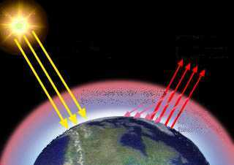
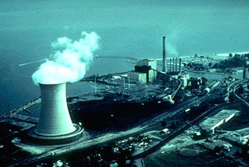
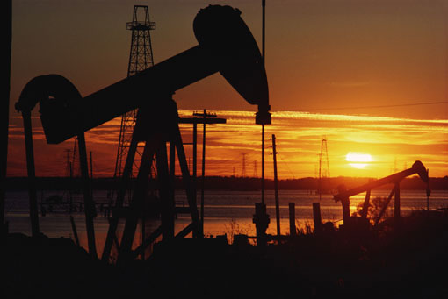
Decision and Information Sciences Division
Argonne National Laboratory
Application of Simulation Models
to Analyze International
Energy and Environmental Issues
Guenter Conzelmann
Energy and Environmental Systems Analysis Group
Argonne National Laboratory (ANL)
9700 South Cass Avenue
Argonne, Illinois 60439, USA
phone: 630-252-7173 fax: 630-252-6073
email: guenter@anl.gov
Argonne National Laboratory

Slide 2





DIS Develops, Applies, and Transfers Innovative Tools, Models, and Information Systems for Energy and Environmental Systems Analysis
Apply
Develop
Transfer

Slide 3
DIS has been Involved in International Energy and Environmental Systems Analysis for more than 20 Years
DEVELOP energy systems analysis software (ENPEP, GTMax, APEX, new complex adaptive systems tools, etc.)
APPLY models to
  conduct country-specific studies for foreign governments and power companies
  consult lending agencies on specific energy project loans
TRANSFER software tools by
  conducting training programs in energy demand forecasting, energy and electric system analysis, analysis of environmental impacts (first training course in 1978)
  participating in technical cooperation projects to provide technical support to in-country institutions (World Bank, IDB, USDOE, USDOS, IAEA, etc.)
CAPACITY BUILDING IS A MAJOR COMPONENT OF ANL’S
INTERNATIONAL ENERGY AND ENVIRONMENTAL SYSTEMS STUDIES

Slide 4



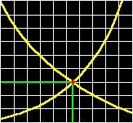


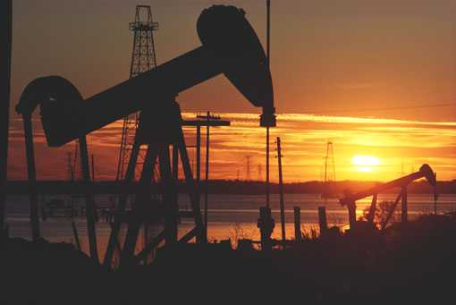
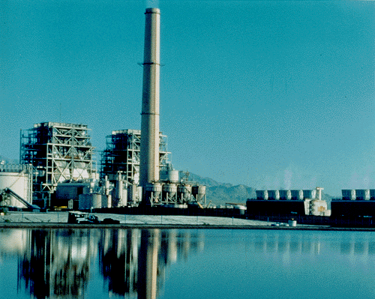
DIS has an Integrated Approach to Energy, Economic, and Environmental Systems Analysis
ECONOMIC
ANALYSIS
ENERGY
DEMAND
ANALYSIS
SUPPLY/
DEMAND
BALANCE
IMPACTS
ANALYSIS
DECISION
ANALYSIS
ENERGY
RESOURCE
EVALUATION
ENERGY
TECHNOLOGY
CHARACTERI-
ZATION
ITERATION

Slide 5


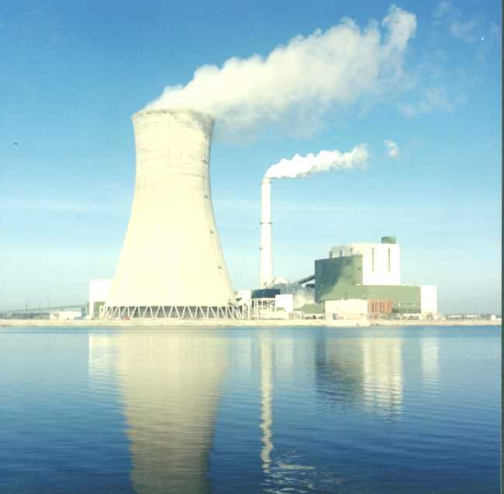


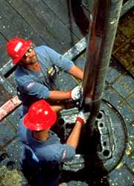
DIS Has Developed a Variety of Tools for Use in Energy, Economic, and Environmental Systems Analysis
AMIGA
MACRO
LIEF
MAED
DEMAND
BALANCE PACE
ELECTRIC SMN
ICARUS GTMAX
Economic Analysis
Energy Demand Analysis
Supply/ Demand Balance
Impact Evaluation
Decision Analysis
Energy Resource Analysis
Energy Technology Characterization
MDA
DAM
STATS
IMPACTS
RAINS
TAF
AIRPACTS
ADAP
GASMAP
DECADES
Notes:
<date/time>
Over the years, DIS has developed and assembled a unique set tools to support our broad-based analytical approach.
Each model is complex and sophisticated stand-alone tools. DIS goes beyond this myopic viewpoint to analyses the complex interactions among different aspects of economic, energy, and environmental control systems.
These tools have become increasing complex as we learn more about system behavior and as issues and problems in the world evolve.

Slide 6
One of DIS’s Major Software Products, the Energy and Power Evaluation Program (ENPEP), Consists of 10 Integrated Analysis Tools

Slide 7
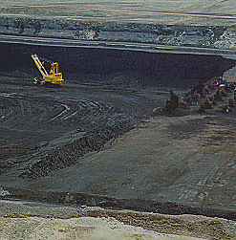

ENPEP is Designed to Analyze the Entire
Energy System in an Integrated Framework
Reveal cross-sectoral effects; provide structure for consistent energy “planning” program
Integrated framework allows evaluation of feedback effects
Price of Coal/
Carbon Tax
Price of
Electricity
Demand
for Coal
Atmospheric
Emissions
Demand for Electricity

Slide 8
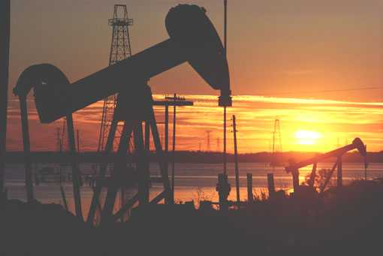
BALANCE Determines the Equilibrium Supply/Demand Balance of the Energy System
INPUT
OUTPUT
Energy system
structure
Base year energy
flows and prices
Energy demand
growth projections
Technical and
policy constraints
Price/Cost
Demand
Supply
BALANCE
Equilibrium
Quantity

Slide 9
BALANCE Uses an Energy Network to Simulate Energy Markets
Residential
Paper
Industry
Textile
Industry
Ceramic
Industry
Chemical
Industry
Cement
Industry
Other
Industry
Food Proc.
Industry
Agriculture
& Fishing
Transport
Commercial
Transmission and Distribution of Oil Products, Coal, Electricity, and Other Fuels/Resources
Electric Sector
Oil and Gas Supply Sector
Coal Sector Supply Sector
Renewables and Others Sector

Slide 10
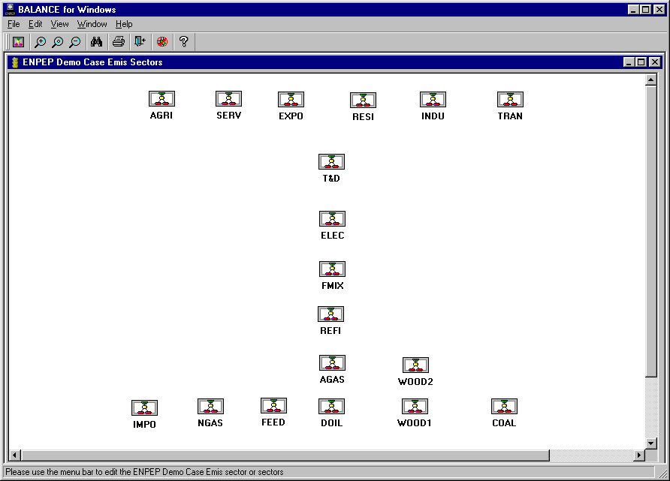
In the Model, a Network Implementation
May Look as Follows:

Slide 11
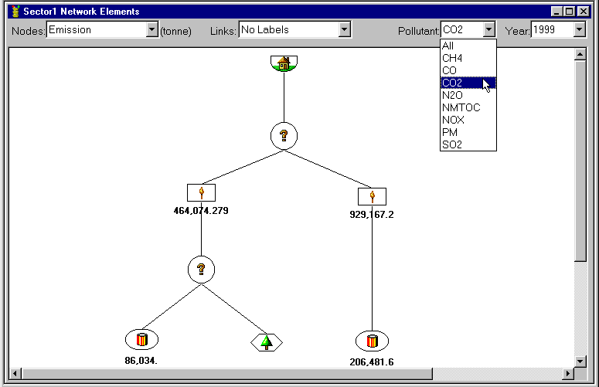
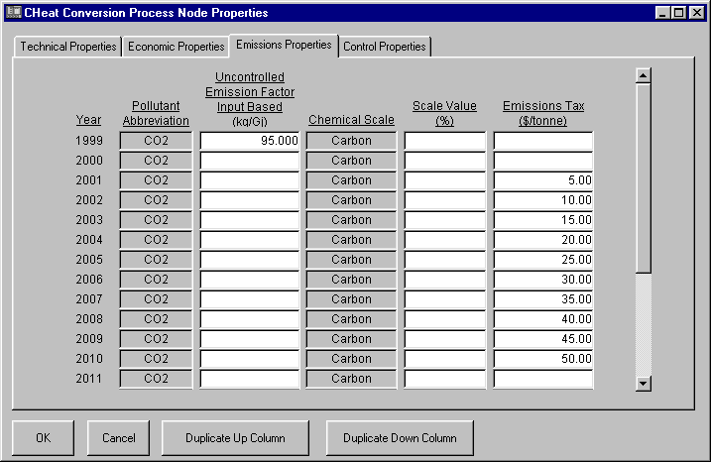
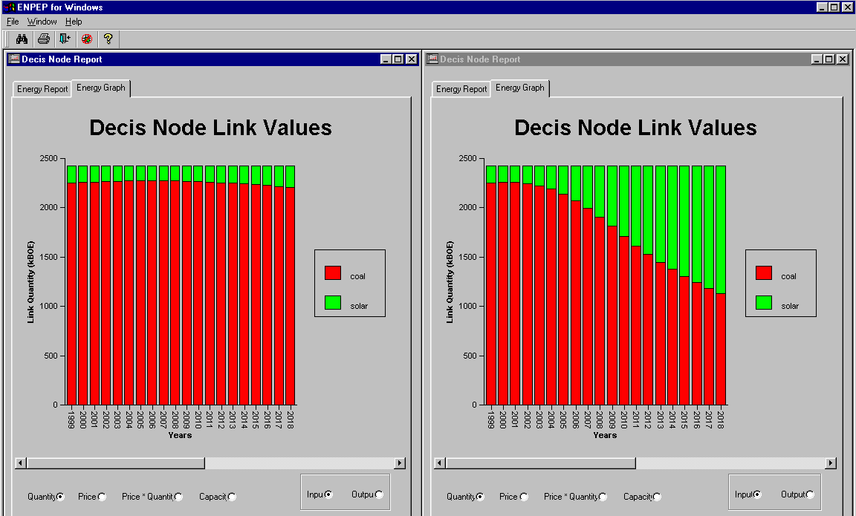
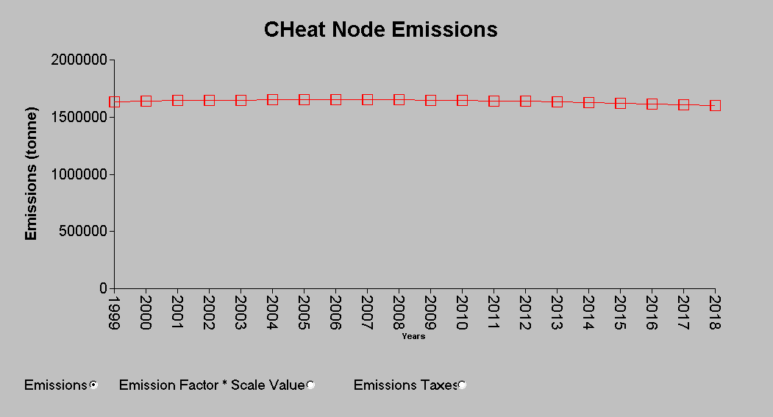
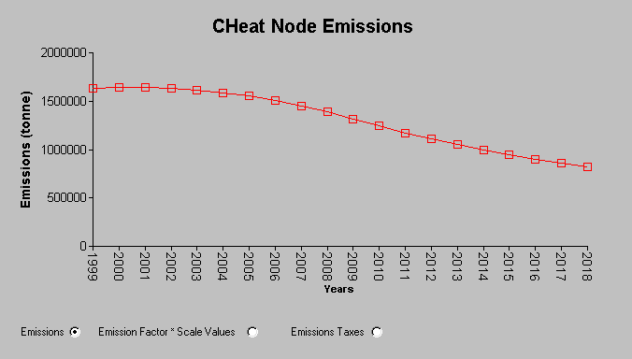
Each Sector is Modeled Using a Series of Nodes and Links - Design Differs Depending on Data Availability and Type of Issue Analyzed
CO2 - No Carbon Tax
CO2 - With Carbon Tax
Fuel Shares - No C Tax
Fuel Shares - With C Tax

Slide 12
BALANCE Uses a Logit-Function to Estimate Future Market Shares of Competing Commodities
Qdemand
γ
γ
price sensitivity for
1
this decision process
Q
P
1
x PM
1
MS:
market share
Decision
MS
1
=
1
=
γ
γ
Q
1
+ Q
2
P:
price
1
1
PM:
premium multiplier
P
x PM
+
P
x PM
Q:
quantity
P1
Q1
P2
Q2
1
1
2
2
Increasing
price sensitivity
Notes:
15
15
Balance uses a non-linear equilibrium algorithm to determine the energy supply and demand balance.
One of the key node types in the development of a network is the decision node. This node type is used to determine the market share of competing commodities. BALANCE uses a logit function shown here to estimate demand for various energy options based on relative prices.
When two commodities have the same price, the price ratio equal 1.0 and it is assumed that each commodity will get an equal share of the market.
However, when the price of the first fuel is more expensive expensive than the second, it market share is less than 50 percent. A relatively lower price for the first fuel results in a market share greater than 50 percent.
By adjusting the price sensitivity parameter in the logit function the shape of the price response curve can be changed.
Market share calculations assume a perfect market. However, adjustments can be made to simulate energy policies and energy system constraints. A lag factor is used to account for delays in capital stock.
The result is a market based equilibrium with policy constraint that is solved using the Jacobi iterative method.

Slide 13
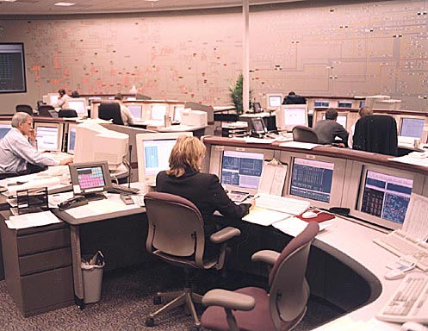
DIS Developed the New GTMax Model to Analyze the Complex Marketing and Operational Issues in Today’s Deregulated Power Markets
GTMax: Generation and Transmission
Maximization Model maximizes net
revenues and ensures that market
transactions and system operations
are within physical and institutional
limitations
Identifies utilities and assets that can
successfully compete in deregulated
markets
Formulates optimal spot market transactions and strategies with
interconnected systems/countries
Determines the optimal path of contractual
power flows
Identifies operational and network bottlenecks
and the marginal value of relieving system
obligations and constraints
Identifies stranded investments

Slide 14
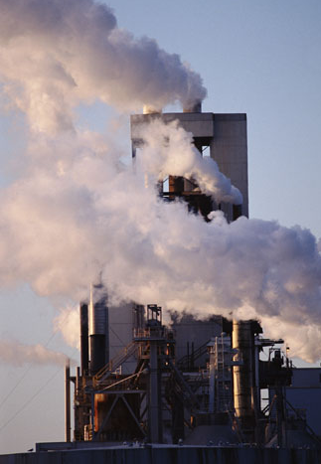
ENPEP is Used by Energy and Environmental Experts Worldwide to Analyze a Variety of Critical Issues
Electric system analysis
  expansion analysis, demand side management
  optimal hydro/thermal dispatch ($, environment)
  deregulation, independent power producers,
  power market studies, interconnection studies, etc.
Total energy system
  overall energy sector
  development strategies
  natural gas market analysis
  energy conservation+efficiency
Environmental analysis
  emissions projections for PM, SO₂, NO_{X}, etc.
  emissions reduction strategies for PM, SO₂ and NO_{X}
  emissions trading for SO₂ and CO₂ (cap and trade)
  GHG mitigation studies and Kyoto Mechanisms
  waste generation, land use, water pollution
Notes:
<date/time>

Slide 15
Current/Recent ENPEP Applications in South America
VENEZUELA
(WASP, BALANCE, IMPACTS)
National energy analysis
GHG mitigation analysis
BRAZIL
(WASP, BALANCE,
VALORAGUA, IMPACTS)
State energy analysis
State electric system development
Air pollution analysis
Land use analysis
Decision analysis
COLOMBIA
(MAED, WASP, BALANCE,
IMPACTS, VALORAGUA)
National energy analysis
Natural gas expansion
Electric system development
Air pollution (PM, SOX, NOX, GHG, etc.)
PM + SOX control cost analysis
PERU
(WASP, BALANCE, IMPACTS)
Load forecasting
Electric system expansion
National energy analysis
Air pollution analysis
GHG mitigation
URUGUAY
(BALANCE, IMPACTS)
National energy analysis
Market penetration of natural gas
GHG mitigation analysis
FCCC Nat Com (submitted)
Notes:
<date/time>

Slide 16
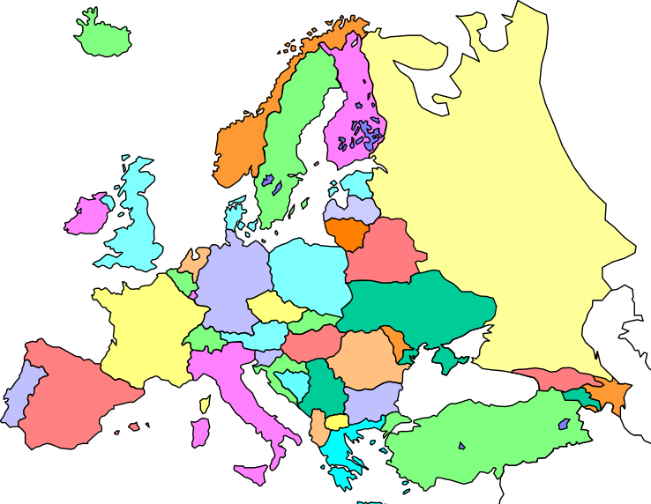
Current/Recent ENPEP Applications in Eastern Europe
Poland
(MAED, WASP, BALANCE, IMPACTS)
Deregulated power market analysis
National energy analysis
Air pollution analysis
GHG mitigation analysis
PM and SOX control cost analysis
Lithuania
(WASP, MAED)
Electric system analysis
Belarus
(WASP, BALANCE, IMPACTS)
Electric system expansion
National energy analysis
Air pollution analysis
Slovakia
(BALANCE, IMPACTS)
National energy analysis
GHG mitigation analysis
FCCC Nat Com (submitted)
Joint implementation
Romania
(WASP, BALANCE, IMPACTS)
National energy analysis
Energy sector restructuring
Natural gas imports
Rehabilitation, IPPs
Removal of energy subsidies
Air & water pollution analysis
GHG mitigation analysis
FCCC NatCom (submitted)
Waste generation
Hungary
(WASP, BALANCE, IMPACTS)
Electric sector expansion
National energy analysis
GHG mitigation analysis
IPP Bid Evaluation
Croatia+Balkans
(MAED, WASP, BALANCE,
IMPACTS)
National energy plan
Electric system expansion
Air pollution analysis
IPP+Interconnection study
Bulgaria
(WASP, BALANCE, IMPACTS)
National energy plan
Electric system development
GHG mitigation analysis
FCCC Nat Com submitted
Turkey
(WASP, ICARUS, BALANCE, IMPACTS, etc.)
National energy plan
Electric sector dispatch and expansion
Privatization, Environmental assessments
Notes:
<date/time>

Slide 17
Current/Recent ENPEP Applications in Asia
Kazakstan
(BALANCE, IMPACTS)
National energy plan
GHG mitigation analysis
China
(BALANCE)
Regional energy plan
South Korea
(WASP)
Electric system development
GHG mitigation analysis
FCCC Nat Com (submitted)
Thailand
(BALANCE, IMPACTS)
National energy plan
GHG mitigation analysis
Vietnam
(MAED, WASP, IMPACTS, BALANCE)
Electric system development
National energy plan
Air pollution analysis
Pakistan
(WASP)
Electric system development
Indonesia
(WASP, BALANCE, IMPACTS)
Electric system analysis
National energy plan
Air pollution analysis
Nepal
(WASP)
National energy plan
GHG mitigation analysis
Bangladesh
(WASP)
IPP Evaluation

Slide 18
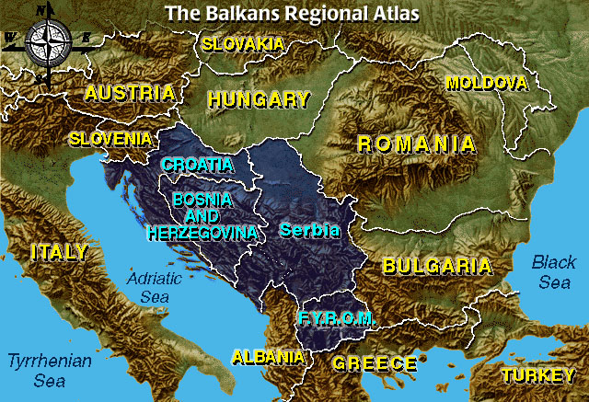
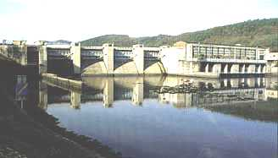
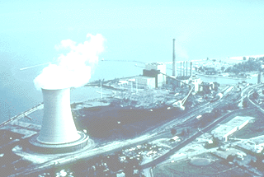

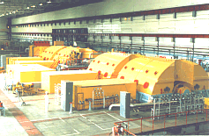
DIS Used Several ENPEP Modules to Evaluate Two Proposed Transmission Lines in the
Restructured Balkan Power Markets
PC-VALOR AGUA
Detailed Hydro Data
ELECTRIC
(WASP-III+)
System Configurations 2005 + 2010
Water inflows, reservoir characteristics, thermal and hydro generating units, etc.
Demand forecast, existing generating units, system expansion options, etc.
Project Finance Model
Financial Viability
GTMax
Power Transactions, Market Clearing Prices, etc.
Hourly system loads, location of power plants, transmission capacities, etc.
Economic and financial data and assumptions, etc.

Slide 19
DIS Used Several ENPEP Modules to Evaluate Two Proposed Transmission Lines in the
Restructured Balkan Power Markets

Slide 20
Model Results Show Clear Economic Benefits of Proposed Interconnections

Slide 21
Bi-Directional Transfers are Projected to be Significantly Below Line Capacities

Slide 22
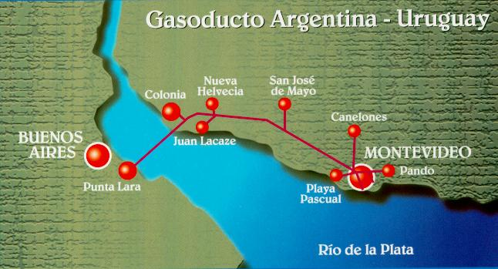
ANL and Local Experts Used ENPEP to Analyze
Natural Gas and Electricity Issues in Uruguay
Overall energy sector development
strategy in light of increasing
regional integration
Uruguay’s energy supply system is
undergoing change (MERCOSUR,
natural gas imports, potential
increase in electricity connections
with other countries, energy sector
reform, etc.)
For a total of six scenarios, analyze fuel substitution trends due to
gas imports and increased electricity interties, and project future market penetration of natural gas by sector
DIS collaborated with a team of local energy experts from the
Presidential Planning Office (OPP), Ministry of Energy (MoE),
National Energy Office (DNE), Electric Utility (UTE),
Oil Refinery (ANCAP), and Gas Company
Project sponsored by The World Bank
Notes:
33
33

Slide 23
Uruguay’s Projected Natural Gas Imports Are
Highest in an Open Regional Electricity Market

Slide 24
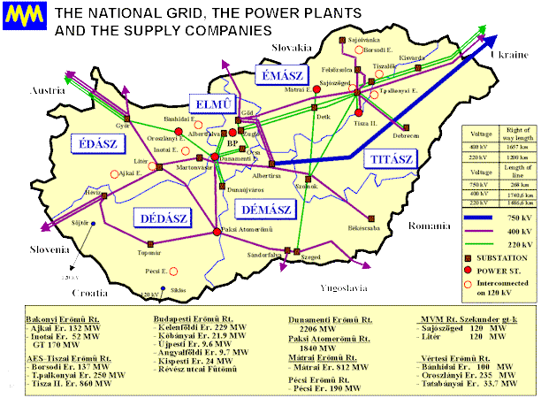
ANL Used ENPEP to Assist the Hungarian Power Companies in Evaluating IPP Bids
The Hungarian Power Companies
(MVMRt) were recently restructured
from a state-owned vertically
integrated utility into a transmission
company; generation is owned by
private (domestic and foreign)
companies; 6 regional private
distribution companies
MVMRt determined additional power
generation capacity is needed;
MVMRt issued a tender in 1997 and
received 80 initial responses
MVMRt contracted Argonne to develop a methodology for evaluating the IPP bids and to audit the evaluation process
MVMRt signed two long-term PPA contracts with operators of gas-fired combined cycle combustion turbines worth $1.3 billion
Announcement can be found at http://www.mvm.hu/angol/angkapac.html

Slide 25
What Will the Future Bring?
Model development to meet changing
environment, such as restructuring
and deregulation of energy markets
  continue to adapt existing tools
  create new, cutting-edge tools using
  agent-based complex adaptive systems
  approach
Model applications
  expand domestic and international client base
  promote restructuring and deregulation expertise
  promote interdependency expertise
Model transfer
  new model licensing arrangements to make tools available to private, for-profit companies
  new model distribution channels

