Slide 1
Comparison of U.S. CPI
vs. U.S. Refiners Average Crude Oil Price
Crude oil prices spurred CPI increases in 1981, 1990, 1996 and 2000
$Bbl
CPI Change as %
*
Source: U.S. Bureau of Labor Statistics; U.S. DOE Monthly Energy Review - * Through October 2000 Actuals for All Urban Consumers

Slide 2
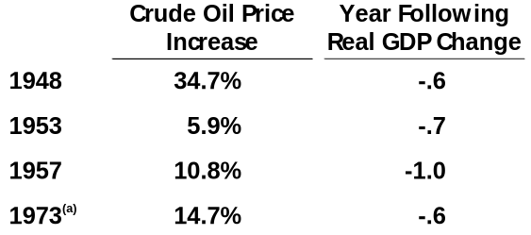
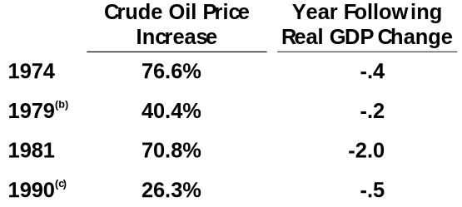
Energy and Sustainable Economic Growth
On September 7, 2000 President Clinton warned Saudi Arabia’s Crown Prince Abdullah that high oil prices might tip the U.S. economy into another recession after 10 years of economic expansion
The 8 worst GDP growth years for the U.S. economy since 1947 have ALL followed a yearly increase in the average price of crude oil of 5 percent to 76.6 percent
(a) Arab Oil Embargo (b) Iranian Hostage Situation (c) Desert Storm
Source: Dr. Edward Renshaw, Economist, SUNY, Sept. 2000 Table 6.1, Page 33.

Slide 3
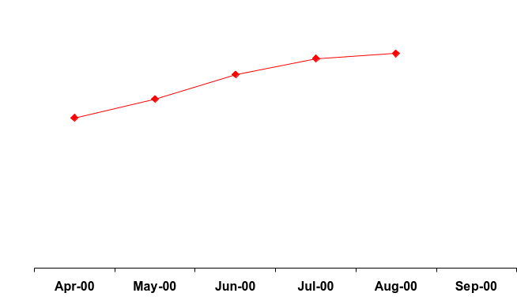



Monthly Percent Change in Energy CPI vs
Residential Energy Prices
Key
$9.78
$10.03E
MCF
Residential Natural Gas
Residential Electricity
% CPI Energy
Gasoline
$9.02
$7.87
Residential
Natural Gas
$7.00
8.51¢
8.57¢
8.61¢
KWH
7.87¢
Residential
Electricity
7.00¢
+5.6
+3.8
+0.1
-1.9
-1.9
-2.9
Energy CPI
$1.67
$1.64
$1.64
$1.56
$1.55
$1.56
Gasoline
Source: U.S. DOE EIA; U.S. Bureau of Labor Statistics

Slide 4
Wellhead Prices and Weather Effect
Annual Residential Gas Bills
$(Nominal)
Key
Wellhead
Price Average
$MCF
In 2000, annual residential gas bills in states like Michigan and Pennsylvania (if demand is the same as last year) will increase $278/$255 due to higher wellhead gas prices
$1126
$879
$871
$872
$736
$778
$682
$669
$585
$611
$607
$554
$594
$502
$533
$4.48 MCF
$2.51 MCF
$1.71 MCF
$1.55 MCF
$2.08 MCF
1985
1990
1995
1999
2000
Source: American Gas Association, Table 9-5; U.S. DOE National Gas Monthly 10/00

Slide 5
U.S. Natural Gas Prices and Weather Effect on
Annual Residential Gas Bills
2000-2001 Cases
Key
Wellhead
Price Average
$MCF
In 2001, higher wellhead gas prices are likely to yield residential bills in the $1000 a year range or higher
$1450
$1319
$1126
$1075
$977
$912
$872
$829
$669
$5.36*
$5.36*
$4.48
2000
2001
2001
Demand Held
Constant
Demand 10% higher
due to weather
* Natural Gas Week, 11/27/00, NYMEX 12 Month 2001 Strip
Note: Assumes demand and LDC WACOG at 1999 nominal levels escalated by wellhead price increase
Source: AGA Gas Facts, Table 9-5; U.S. DOE Natural Gas Monthly; Natural Gas Week, 11/27/00

Slide 6
COB Electricity Prices Move Directionally with Gas Prices
Key
COB
Elec. Price ¢ KWH
PJM
Elec. Price ¢ KWH
US Henry Hub
Gas Price $ MMBTU
US Avg Coal
Source: Megawatt Daily and Gas Daily, 1st of month issue

Slide 7
U.S. Gas Pricing Along the Value Chain--
to Residential Customers
(In $MCF)
$7.98E
$6.82
Revenue above
City Gate
$6.16
$5.47
Gathering Marketing and Transportation to City Gate
Producer Wellhead Price
Source: www.cera.com for 1988-1998; and estimated U.S. average wellhead price, 2000

Slide 8
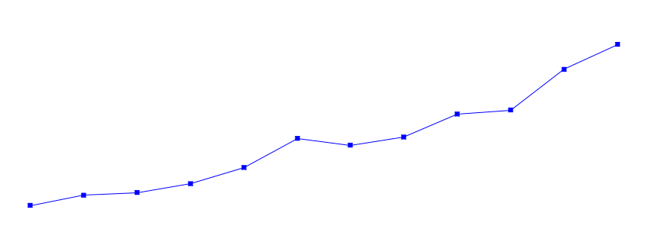
Henry Hub Natural Gas Prices
and Consumer Effects
($MMBTU)
$9.78
$10.03E
$7.00+ est
$9.02
(25¢)
$6.28
(76¢)
(72+¢)
$7.87
($1.15)
($1.17)
$6.77
$7.00
$5.11
$6.24
$6.39
(87¢)
$5.01
(38¢)
(23¢)
$4.30
$4.35
(66¢)
(10¢)
Key
(15¢)
$4.10
$3.47
(83¢)
(25¢)
Mo.-Mo. Change
Residential Gas Price
Henry Hub
(-20)
( )
$2.99
$2.66
$2.75
(48¢)
$2.37
(24¢)
(29¢)
(9¢)
Source: Natural Gas Week, Henry Hub price; U.S. Natural Gas Monthly Residential Consumer price, Table 4

