Slide 1
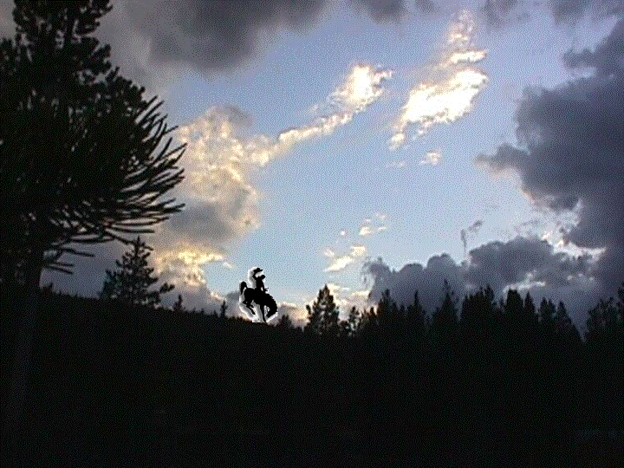




Western Energy: Ready for Action
CSG-WEST & PNWER 2001 Annual Meeting
Whistler, British Columbia
"Future of The North American WEST: Three Nations, One Region"
Wyoming Gov. Jim Geringer
July 26, 2001

Slide 2
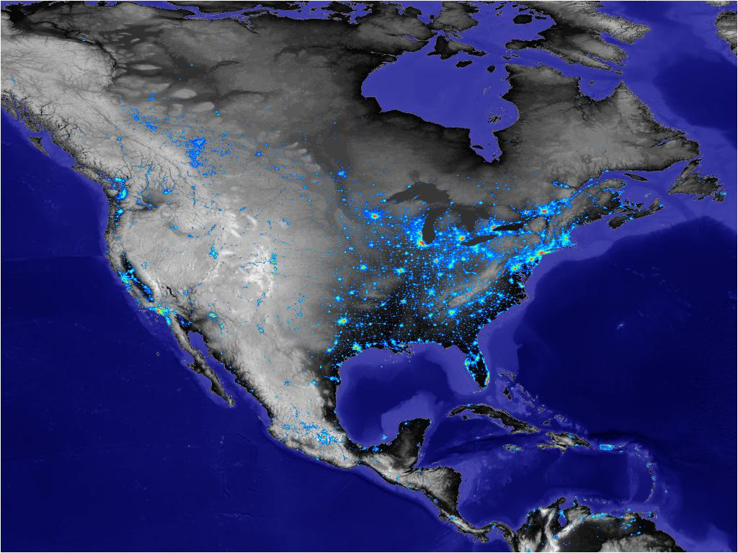
Turn off the lights
In the Rockies
<date/time>
<footer>

Slide 3
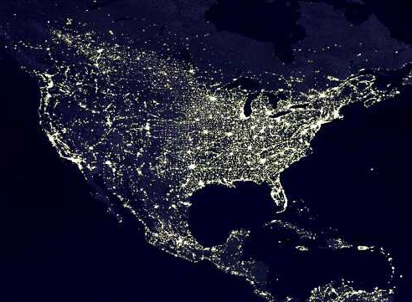
California needs
The Juice
<date/time>
<footer>

Slide 4
The West
High altitudes, low multitudes, great attitudes
Low taxes, high energy
States and Provinces, not colonies
Strict air, water, land laws
Develop energy compatibly with our goals, our laws

Slide 5
Western Energy Situation
Short Supply: Oil, natural Gas, electricity, water, generating plants, transmission
A crisis? Most people don’t really believe there is a crisis. At least not a crisis of supply. They might believe there’s a price crisis or a political crisis
Electricity demand is growing at two to three percent per year, driven by the new economy and increasing use of technology, increased consumption and affluence. Supply is growing at one percent.
Several factors came together all at one time to create the recent upsurge in prices

Slide 6
Lessons from California
Deregulation wasn’t
Low prices discouraged investment in plants
Under-investment in infrastructure
Pipelines
Transmission
Un-bundling of Generation, Transmission and Distribution caused everybody to take a wait-and-see approach to planning
Dangerously low reserve levels led to high price sensitivity

Slide 7
Western States Impact
Secretary Richardson’s order in December to move all excess power to California
Effect was to drive spot prices higher in the rest of the West
Western Interconnect affects 11 states, two provinces, part of Mexico
California’s past average shortfall was equal to the total generation of Idaho, Oregon
California’s population exceeds all others combined

Slide 8
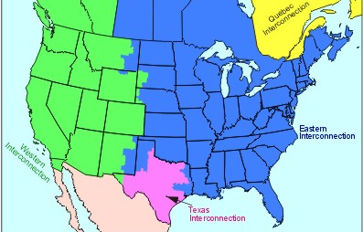
Western InterConnect Population w/o California 30 M
California Population: 34M

Slide 9
Who’s in Charge?
Crisis? What do you mean, Crisis?
In times of real crisis, we respond without regard to who gets the blame, who gets the credit.

Slide 10
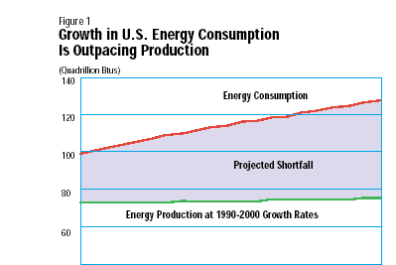
Lack of consensus concerning the numbers

Slide 11
What are the trends?
Population growth
Growth in the New Economy
What are the investors willing to put their money into?
Who is willing to take risks on supply and distribution?
Movement away from vertical integration into virtual integration
Long-term solutions are necessary but aren’t necessarily happening

Slide 12
Putting Things in Perspective
Making access a commodity
Internet Access
10
Years for Major Technologies to Reach
50% of American Homes
CD Players
11
VCRs
12
Electricity as a percent of all consumption:
25% in 1970
40% in 2000
We move fast, but not that fast toward long term solutions
Cell Phones
14
Cable
Only 50 web
Sites in 1992
15
Color TVs
18
PCs
19
Radios
28
Electricity
52
Telephones
71
10
20
30
40
50
60
70
Years Since Introduction
Sources:
Electronics Industry Alliance; PC Data, Inc.; U.S. Census Bureau,
Historical Statistics of the United
States: Colonial Times
to 1970, Part 2;
A.C. Nielson Co.; National Cable Television Association.
Notes:
<number>
<footer>
<header>
<date/time>

Slide 13
Elements of Energy Policy
Economic
Balancing goals
Competitive markets
Energy: the economic engine
Environmental
Performance based
Air, water, land quality
Incentives for attainment
Trading
Security
Strategic alliances, strategic reserves
Regulatory
Federal – Control or Coordination
State – move to market based
North American Energy
Canada
Mexico
U.S.

Slide 14
Elements of Energy Policy (cont.)
Research and Development
Enhanced coal
Less intrusive extraction
New technologies for supply, transmission
Renewables
Conservation, efficiency
Distributed Generation
Taxation
Making the transition
Fuel diversity
Fossil
Renewable
Nuclear

Slide 15
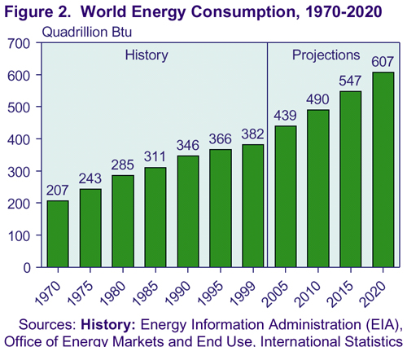
59% Growth/20 yrs

Slide 16
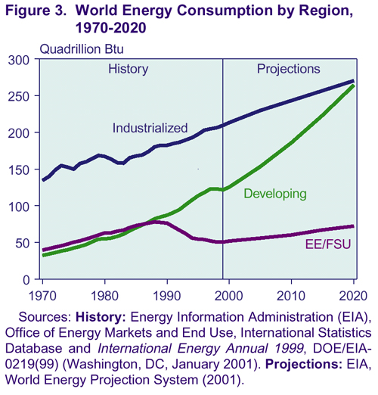

Slide 17
Energy Consumption and Carbon Emissions by Region, 1990-2020
Region
Energy Consumption (Quadrillion Btu)
Carbon Dioxide Emissions (Million Metric Tons Carbon Equivalent)
1990
1999
2010
2020
1990
1999
2010
2020
Industrialized
182.4
209.6
243.4
270.4
2,842
3,122
3,619
4,043
EE/FSU
76.3
50.5
60.3
72.3
1,337
810
940
1,094
Developing
Asia
51.0
70.9
113.4
162.2
1,053
1,361
2,137
3,013
Middle East
13.1
19.3
26.9
37.2
231
330
451
627
Africa
9.3
11.8
16.1
20.8
179
218
294
373
Central and South America
13.7
19.8
29.6
44.1
178
249
394
611
Total
87.2
121.8
186.1
264.4
1,641
2,158
3,276
4,624
Total World
346.0
381.8
489.7
607.1
5,821
6,091
7,835
9,762
Sources: History: Energy Information Administration (EIA), International Energy Annual 1999, DOE/EIA-0219(99) (Washington, DC, January 2001). Projections: EIA, World Energy Projection System (2001).
Back to Highlights Section

Slide 18
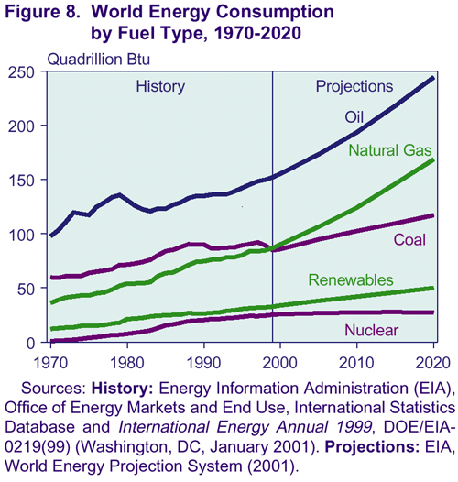

Slide 19
Western Ways
Long-standing tradition of working together
Identified likely shortages in 1998 but we didn’t forsee the drought. Elements of the Perfect Storm?
Energy Policy for the Americas
North/South is better than Middle East
Put capital at risk, not our troops
We have clear policies on principles of environmental management, fuel diversity, reliable electric power supply, natural gas, public lands access, renewables

Slide 20
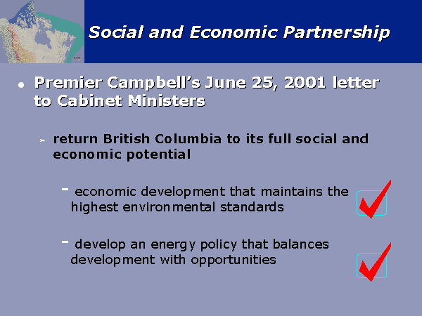
CAPP Canada

Slide 21
Fuel Sources for U.S. Electricity 2000
Source: EIA/DOE

Slide 22
Wyoming Energy Profile (BOE)
Coal 226 Billion 1 (50 state rank)
Uranium 140 B 1
Natural Gas 7 B 2
Oil .6B 8
NG Liquids .5B
Wind Infinite
Solar, Hydro, Ethanol, Biomass
Enough to put OPEC completely out of business for 40 years
Alberta is similar in total energy potential

Slide 23
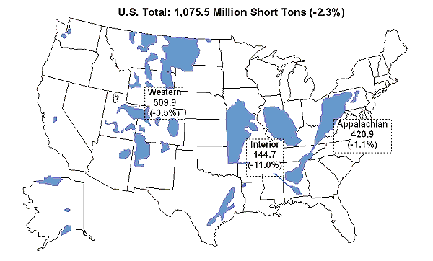
Western Coal Fuels 28% of Total U.S. Electricity Generation
(Wyoming coal fuels 17% of U.S. Total)
Coal Production
East of the Mississippi 522MT
West of the Mississippi 597MT
(Wyoming Total 359MT)
U.S. Coal Production
52 Weeks Ending 6-9-01
Western 539 M tons
Appalachia 428 M tons
Interior 151 M tons
Source: EIA/DOE
Notes:
<number>
<footer>
<header>
<date/time>

Slide 24
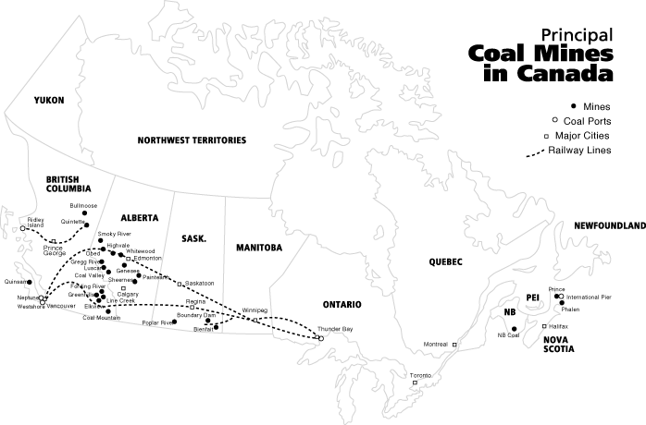

Slide 25
Western States are Increasing Their Reliance on Gas
(Max case)
Notes:
<number>
<footer>
<header>
<date/time>

Slide 26
Generation
From June 2000 WSCC
Load & Resource Summary
British
Columbia
Alberta
Total Capacity = 158,504 MW
As Of Jan. 1, 2000
WA
Mid-
Columbia
MT
Colstrip
Oregon
Snake
SE
Idaho
ID
ID
WY
WDL
JB
Northern
California
N.
NV
Utah
CHB
Colorado
S.
NV
NavGlen
Four
Corners
Southern
California
Palo
Verde
Coal
Hydro
Gas
Nuclear
Wind
Other
Market
NM
AZ
Notes:
Existing again so that it can be toggled with next slides

Slide 27
2005 Generation
With Wind and East Side Coal Additions
Made Possible
with Infrastructure Additions
British
Columbia
Alberta
Total Additions = 22,300 MW
WA
Mid-
Columbia
MT
Colstrip
Oregon
Snake
ID
WY
WY
WDL
JB
Northern
California
N.
NV
Utah
CHB
S.
NV
Colorado
NavGlen
Four
Corners
Southern
California
Palo
Verde
Coal
Hydro
Gas
Nuclear
Wind
Other
Market
NM
AZ
Notes:
Addition of 4,300 MW Diverse Fuel Based Resources:
500 MW NW Wind
500 MW Wyoming & Montana Wind
3300 MW of East Side Coal in Wyoming, Colorado, Montana
Additions require Interstate Electricity Highway Infrastructure additions to:
Serve Peak Loads in NW and East Side
Serve Base Loads in West
Augment Hydro and Gas Peaking and Load Shaping
Provide Fuel Diversity
Add Low Price Fuel Base

Slide 28

U.S. Working Gas in Storage (Difference from Previous 5-Year Average)
Sources: History: EIA; Projections: Short-Term Energy Outlook, July 2001.

Slide 29
U.S. Comparison of Key Natural Gas Spot Prices Monthly Average Delivered to Pipeline Prices
Source: Natural Gas Week

Slide 30
Selected Regional Spot Electricity Prices
Source: Reuters

Slide 31
U.S. Natural Gas Spot Prices (Base Case and 95% Confidence Interval )
Sources: History: Natural Gas Week; Projections: Short-Term Energy Outlook, July 2001.

Slide 32
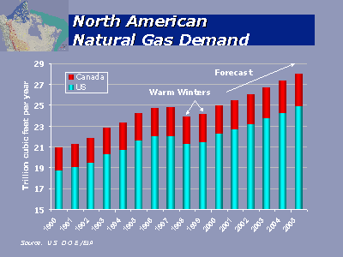

Slide 33
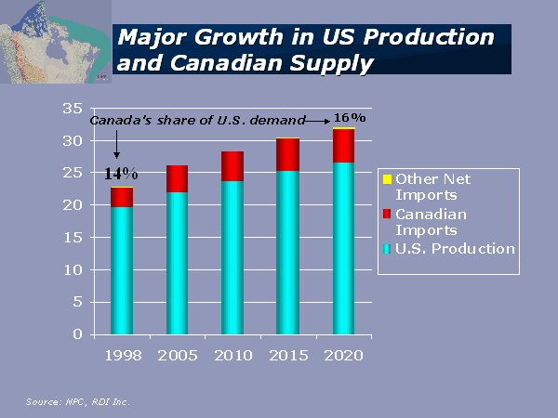

Slide 34
Western Transmission
Main Grid System
Transmission Voltages
500 kV - Red
345 kV - Green
230 kV & below - Blue

Slide 35
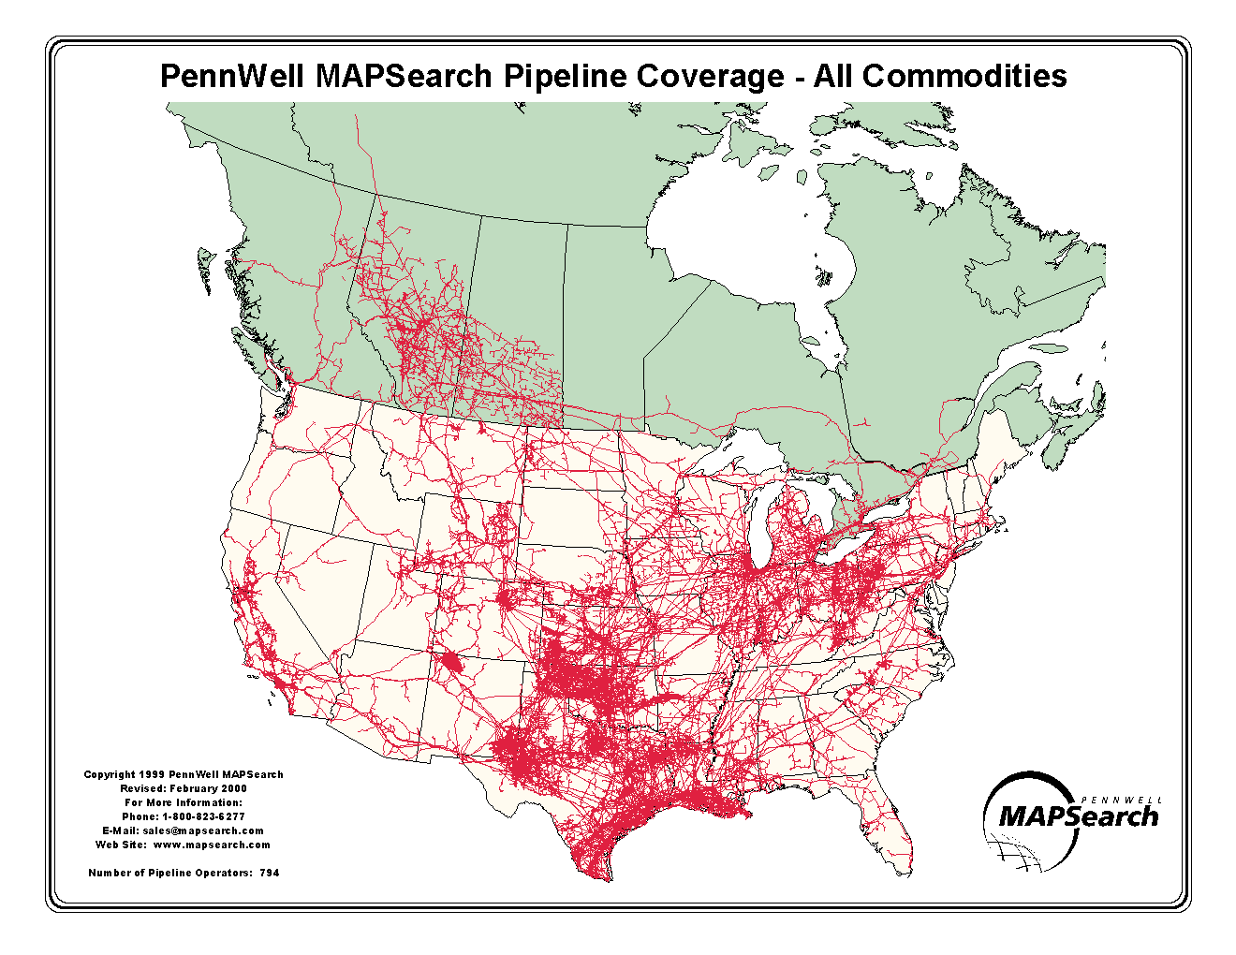
794 Total

Slide 36
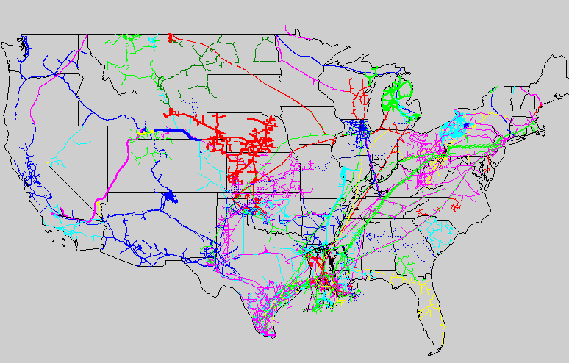
Most of the Natural Gas in the U.S. Flows
from the Southwestern States & Canada to the
Northeastern,Midwestern and Western Markets
<date/time>
<footer>
Major North American Natural Gas Transportation Corridors

Slide 37

uE is unit of energy equivalent, price per million BTU
6.11
7.45
42.29
6.42
uE averages the cost of electric power, natural gas, refined products
and natural gas liquids
<date/time>
<footer>
5/23/01

Slide 38
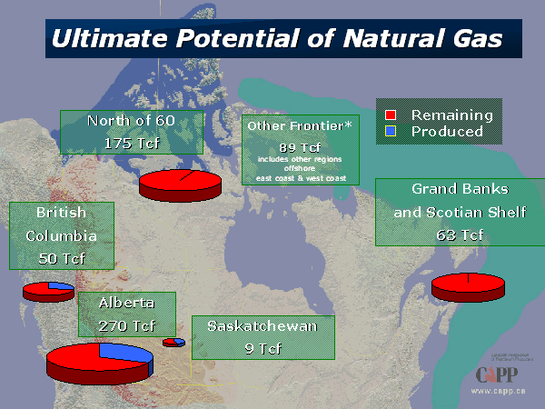

Slide 39
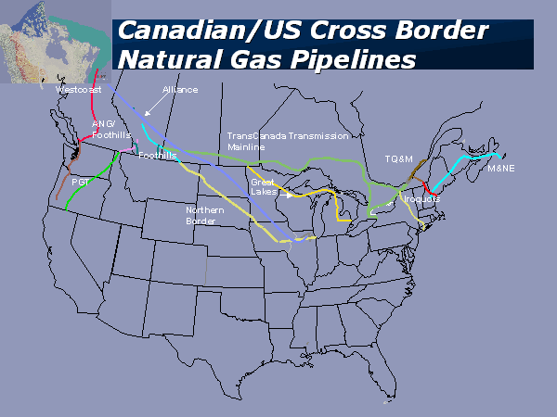

Slide 40
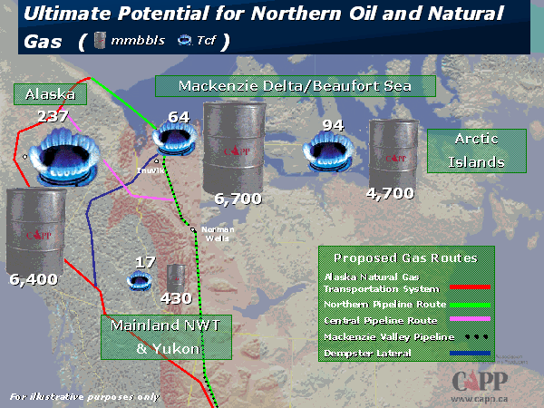
Canadian Assoc of
Petroleum Producers

Slide 41
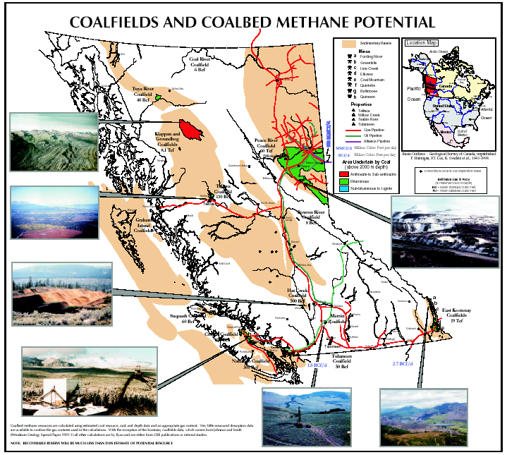

Slide 42
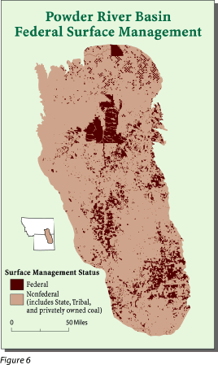
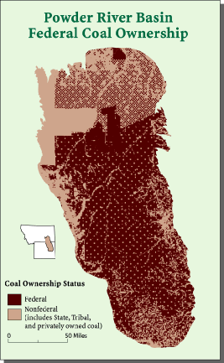

Slide 43
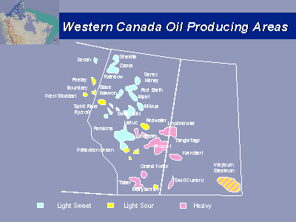

Slide 44
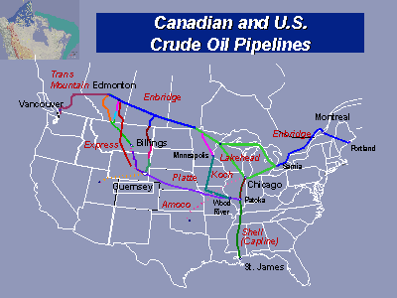

Slide 45
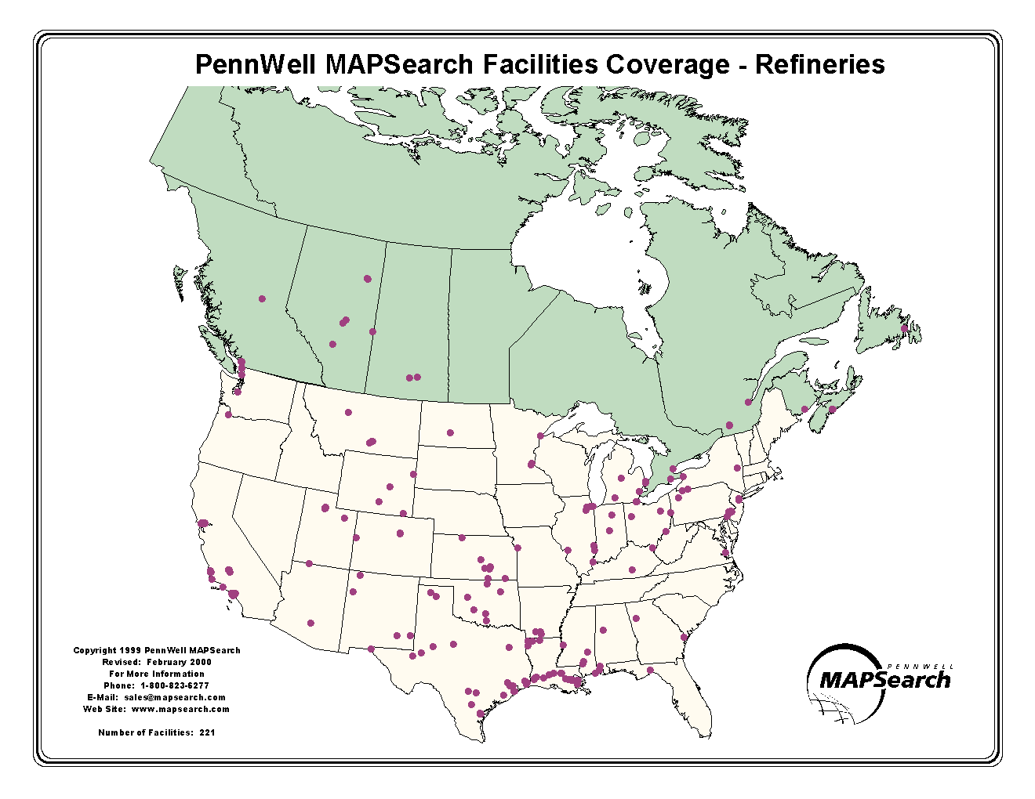
221 Total

Slide 46
Figure 11. Fossil Fuel Prices to Electric Utilities
Sources: History: EIA; Projections: Short-Term Energy Outlook, July 2001.

Slide 47
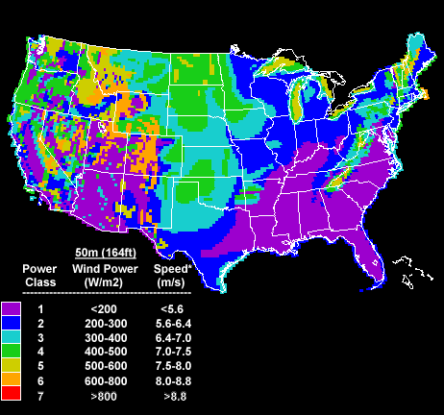
Wind Generation Potential

Slide 48
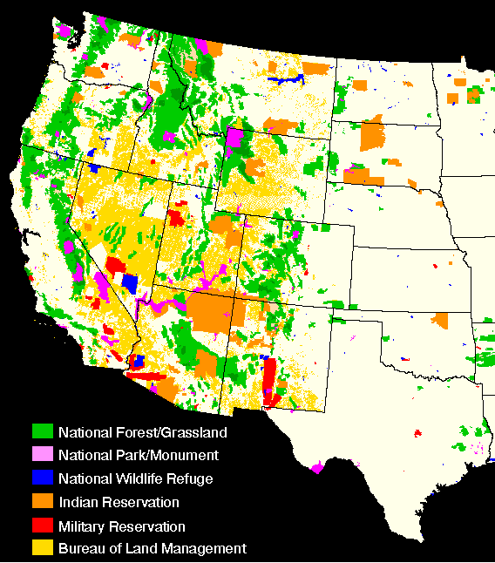

Western Land Ownership Challenges
Concurrent, not exclusive, responsibilities for resource development
Local economic and social impact on people and communities
Growth depends upon availability of energy
Notes:
<number>
<footer>
<header>
<date/time>

Slide 49
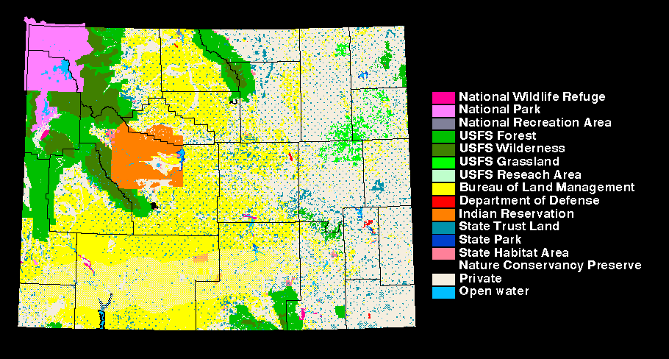
Wyoming Land Ownership Categories
15 Ownership Categories
Only 43% is
Private land
Each with a unique set of management procedures
<date/time>
<footer>
Notes:
<number>
<footer>
<header>
<date/time>

Slide 50
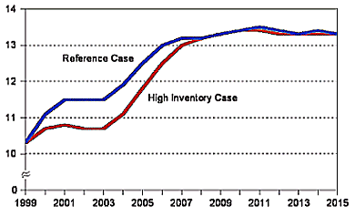
Projected Uranium Spot-Market Price, 1999-2015 (1998 Dollars per Pound U₃O₈)
Challenges: High capital costs, public perceptions,
storage of spent waste. Positive trends in 2001.
Source: Energy Information Administration - "Uranium Market Model", runs 1999_12 and 1999_26, (August 30, 1999).
DOE updated Jan 31, 2001

Slide 51
Coal in the West’s Energy Future
Advantages
Extensive reserves
Low, stable prices
Competitive electrical generation economics
Environmental Performance Improving
Coal (and gas) will need to address climate change concerns related to CO_{2,} and SOX. May take another 20 years
Investor Certainty Required
Achievable regulatory time frames
Streamlining siting and permitting
Emissions trading would be beneficial
Tax incentives not needed
Notes:
<number>
<footer>
<header>
<date/time>

Slide 52
Renewables
Wind potential is infinite
Cost competitive with natural gas
Depends on new transmission lines
Solar photovoltaics still a niche market
More suited for reliability applications
Hydro is the historical favorite
Affected by this year’s drought
No new dams likely
Western Regional Air Partnership has set a goal of 20% renewables by 2015

Slide 53
Conservation
Pure conservation saves only about 2 percent
Changes in design efficiencies needed
Buildings, technology equipment, appliances
Demand Management
Very effective in price sensitive supply situations
Move to off-peak
Use price signals and even rebates to encourage shift to non-peak

Slide 54
Distributed Processing
Smaller generation near the load
Microturbines, fuel cells, photovoltaic, even nuclear
Reverse the history of large central stations that require high voltage transmission
Must resolve operating practices and interconnections to the grid

Slide 55
Climate Change
WRAP goal is focused on visibility
Market based flexibility mechanisms are more practical than prohibition of fossil fuels
Carbon concerns have to include developing countries
China has 20 percent of world population, will soon be overtaken by India
90% of all new coal burned will be in India, China
Emissions trading encourages balance, meets demand schedules
Continue to use fossil fuels, encourage renewables, especially wind, for emissions trading, build transmission lines to connect energy rich areas with energy short
Carbon sequestration is logical but has limits

Slide 56
View from the States
Energy is an entire complex: BTU’s or electrons, not fuel specific
ENERGY – We have it, they need it
Coal, natural gas, solar, wind, hydro, ethanol, nuclear, oil
Environmental policy should be based on cooperation, not prescription or litigation
We live where we govern. Our approaches are based on sound science and practical application
No state is an island. Our energy excess is their necessity. Their decisions impact our citizens, our economy. We have to work together.

Slide 57
Future Actions
Regional solutions much preferred over national mandates
Planning must be consistent, not fragmented as it is today -Federal, state, private
Particularly for Regional Transmission Orgs
Likely intermediate solutuion
New electric generation fueled by natural gas located near the load
Existing permitted generation plus new coal, wind, and other renewables, distributed generation that need substantial transmission lines
Current trend would not support fuel diversity

Slide 58
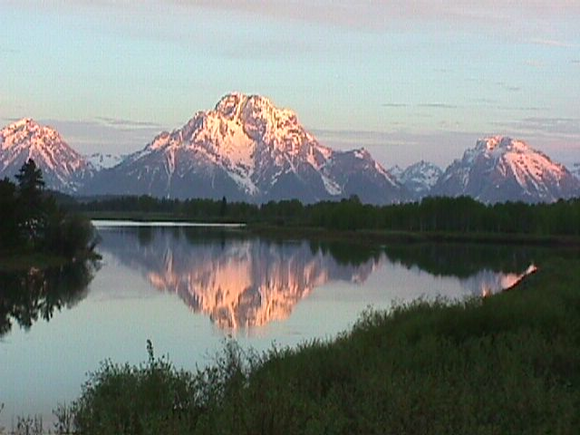
Leadership:
Not a selfish right but
An awesome responsibility

Slide 59
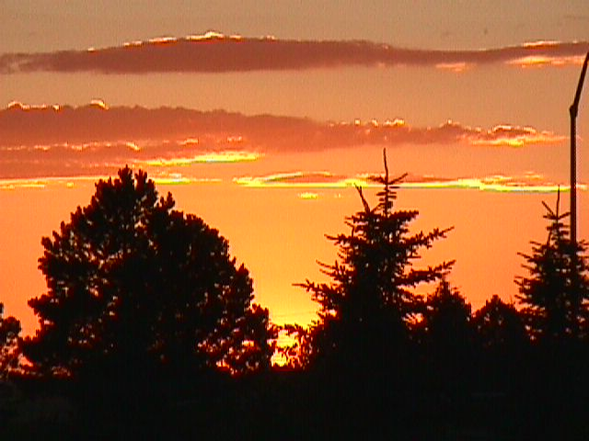
Thank You!

