Slide 1
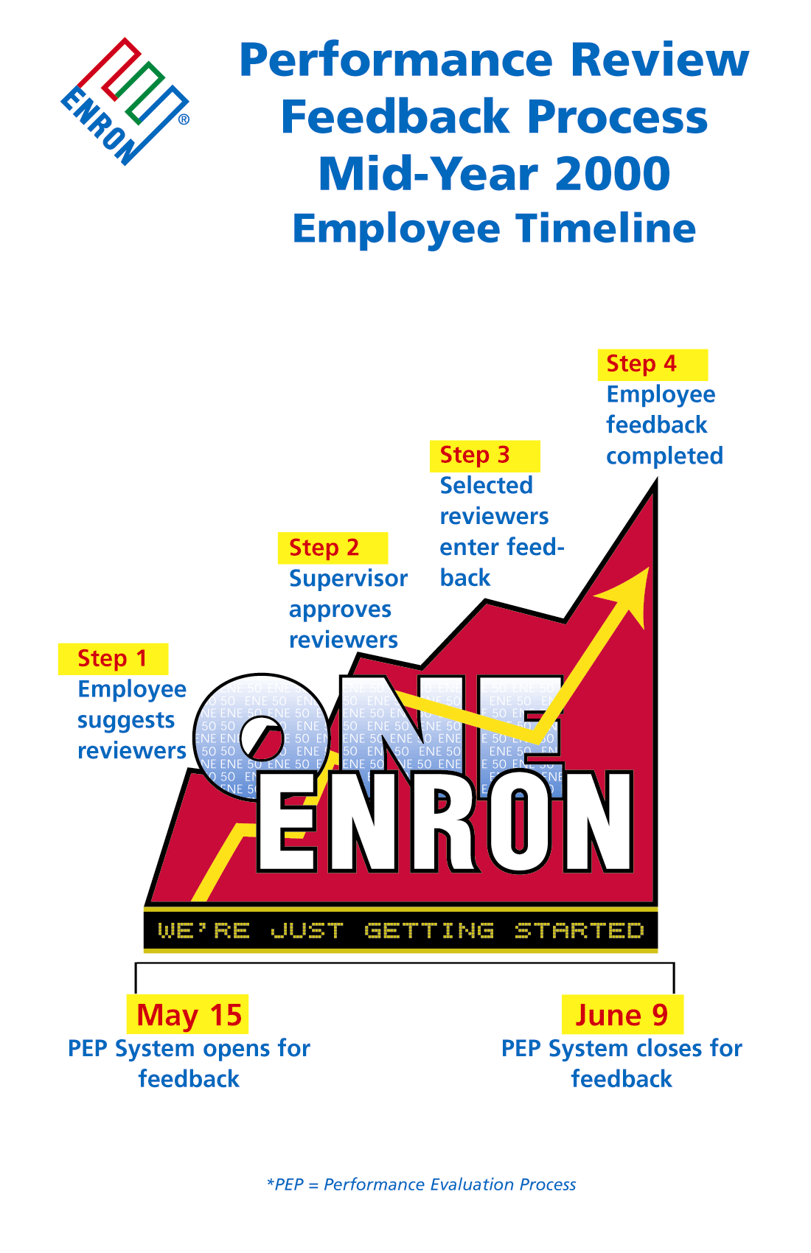
Training Manual

Slide 2
Contents
What Is the Performance Review Process? 3
System Access 4 - 5
Login - User ID and Password Employee Data 6
Employee Data 7
Suggest Your Own Reviewers 8
Choosing Reviewers 9
Select and Approve Reviewers (Supervisor only) 10
Complete/Decline a Request for Feedback 11 - 12
Feedback Forms 13
VP and Managing Director Form 14
VP and Managing Director Descriptors 15
Management/Professional (Analyst & Associate) Form 16
Management/Professional (Analyst & Associate) Descriptors 17
Administration/Support Form 18
Administration/Support Descriptors 19
Performance Ratings 20
Effective Feedback 21
Supervisor Reports 22
Consolidation of Feedback (Supervisors only) 23
Supervisor Consolidated Feedback Report 24
PRC Meetings 25
Employee Evaluations (Supervisors only) 25
Example Evaluation Form - draft only 26
PEP Help Desk contact details 27

Slide 3
What Is The Performance Review Process?
Performance Review, commonly referred to as the PRC, is a 360° feedback process that allows Enron to evaluate performance across functional groups, business units, and departments.
The PRC refers to the Performance Review Committee, a forum that meets to determine an employees overall rating.
Enron uses this information to identify promotional candidates, provide career guidance, determine compensation, and to assist in the effective deployment of human capital.
The PRC is facilitated via the Performance Evaluation Process (PEP). This system is accessible via the Enron Intra-net.

Slide 4
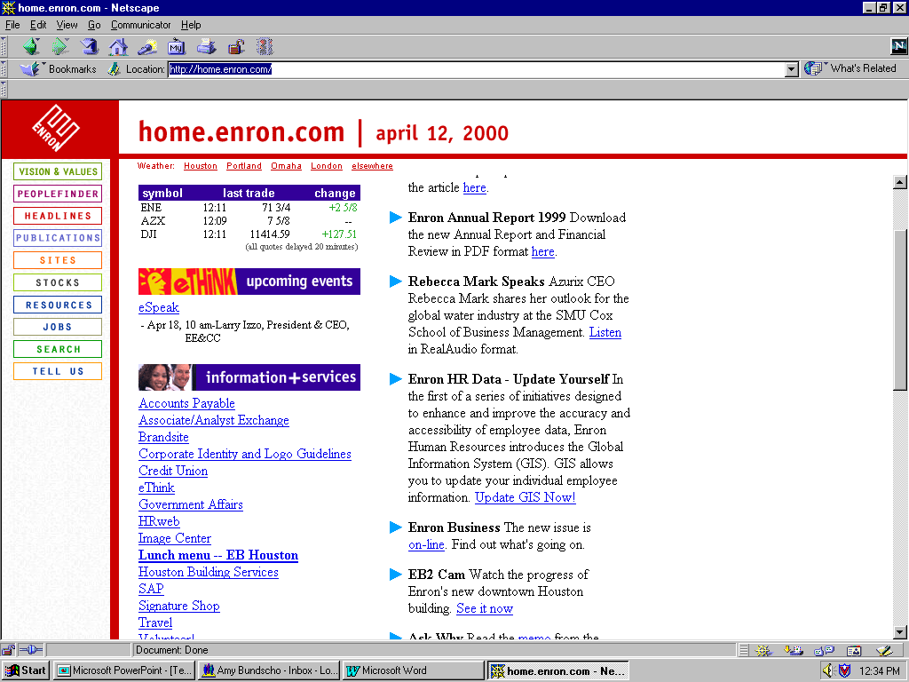
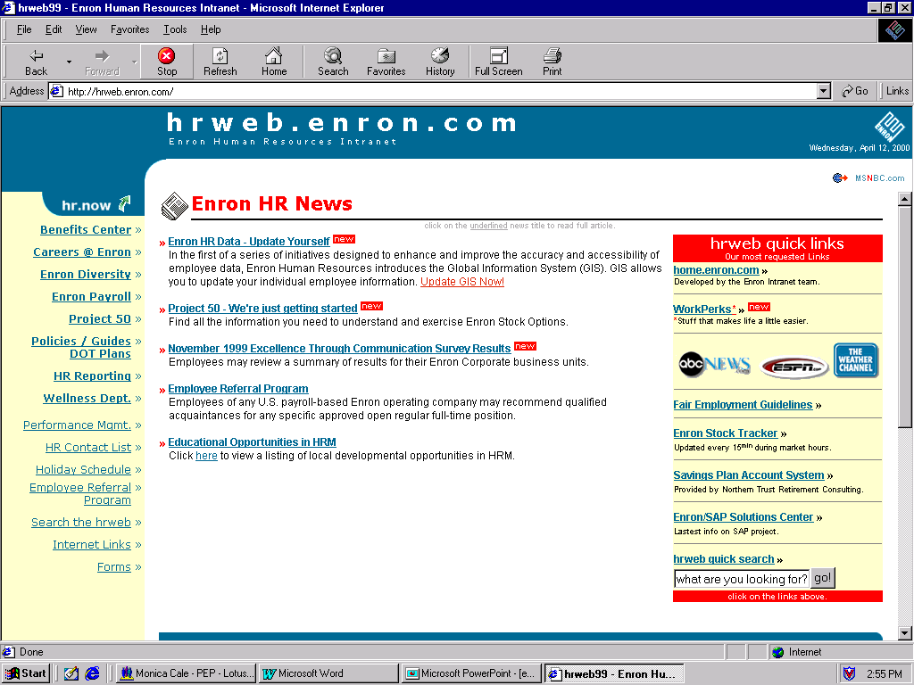
System Access
You will receive an email once the system opens advising you of your login and password details.
Click on the attached link and it will take you directly to the Enron Intra-net where you will proceed to login.
To start the system from your desktop:
1. Launch your web browser (which should be set to an Enron Intra-net site)
2. Locate the HR web
3. Locate the Performance Mgmt. site
Laptop access: dial into the Enron server as normal and access the Enron Intra-net. Note: you should be dialing in using VPN - virtual private network.
Note: if you have any access problems please contact the PEP Help Desk.

Slide 5
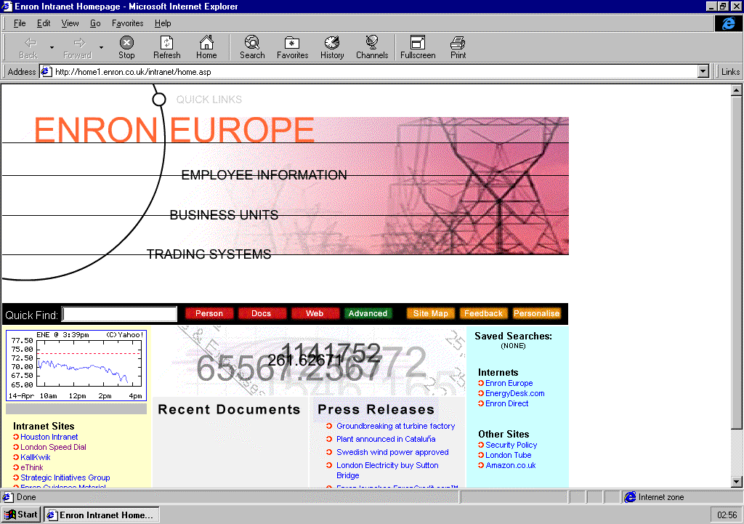
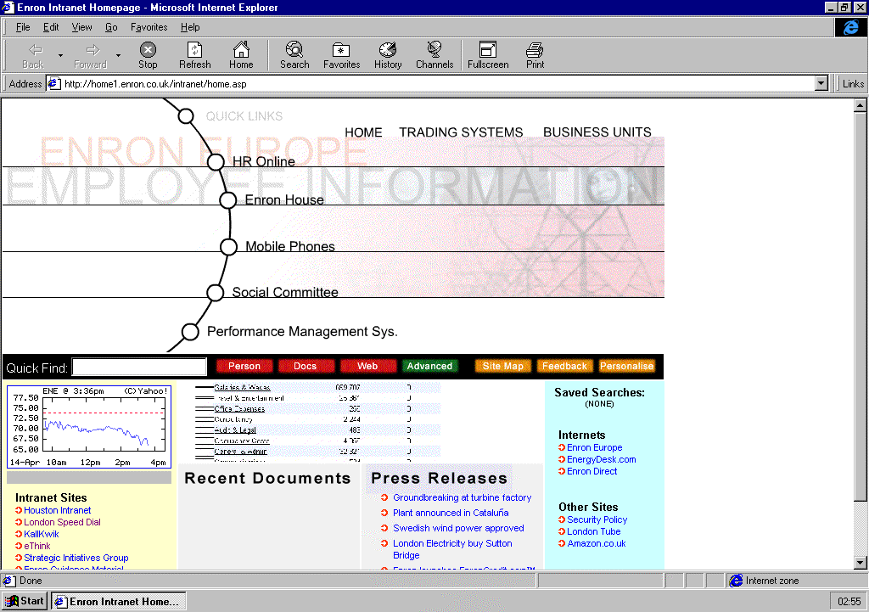
System Access (cont.)
Alternatively if you are in Europe:
1. Launch your web browser (which should be set to an Enron Intra-net site)
2. Locate Employee Information
3. Locate the Performance Management system
Note: For any access problems please contact the PEP Help Desk.

Slide 6
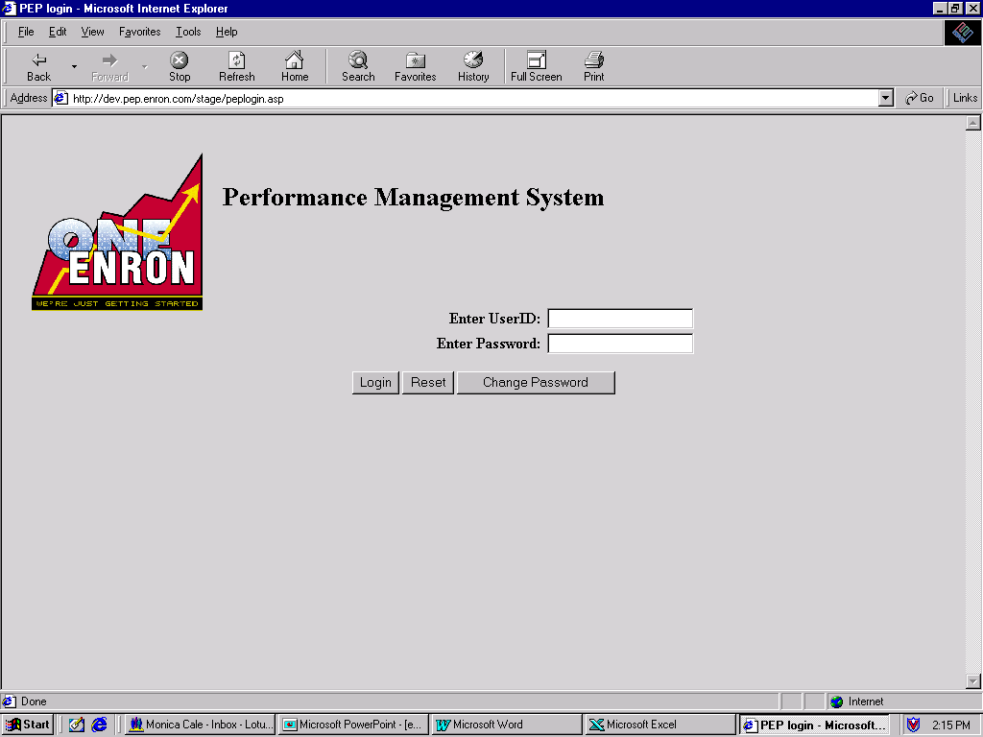
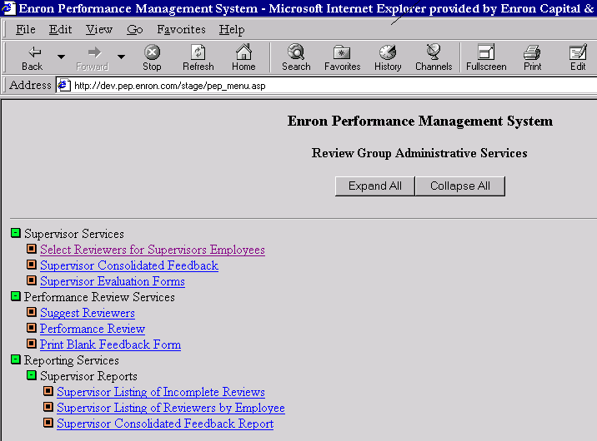
Login - User ID and Password
1. On the Performance Management System login window, type your user ID and password.
Note: The first time you login you will be asked to change
your initial password.
2. Click login
The Review Group Administrative Services (Main menu) opens

Slide 7
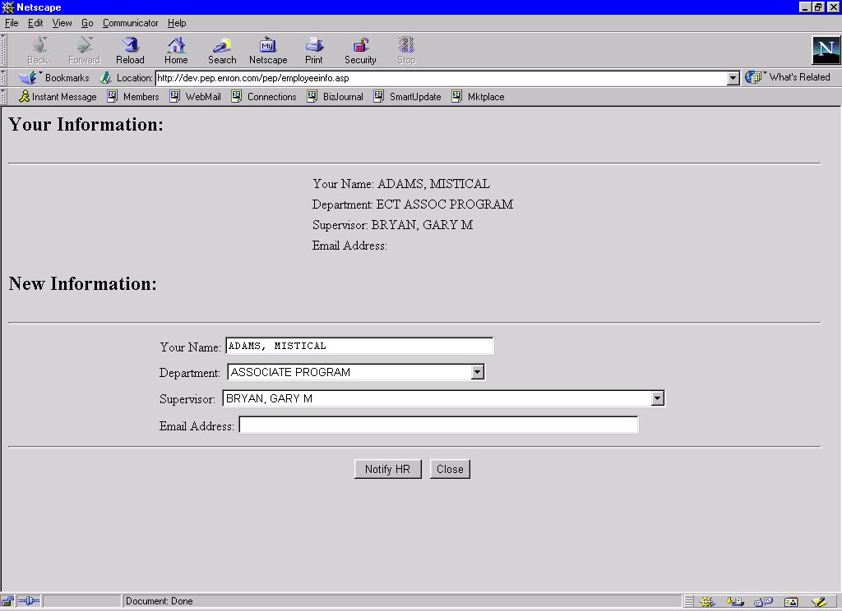
Employee Data
The Employee Data screen allows you to view and update your PEP profile. The profile is comprised of your name, dept, supervisor, and email address.
1. On the expanded Main Menu, click EMPLOYEE DATA. Your current information is displayed at the top of the screen.
2.If your profile is incorrect, make the appropriate changes in the New Information fields.
3. Click NOTIFY HR button to submit your changes (Note: this will not automatically update the PEP system but will advise HR to make the changes).
4. Click CLOSE to return to the Main Menu.

Slide 8
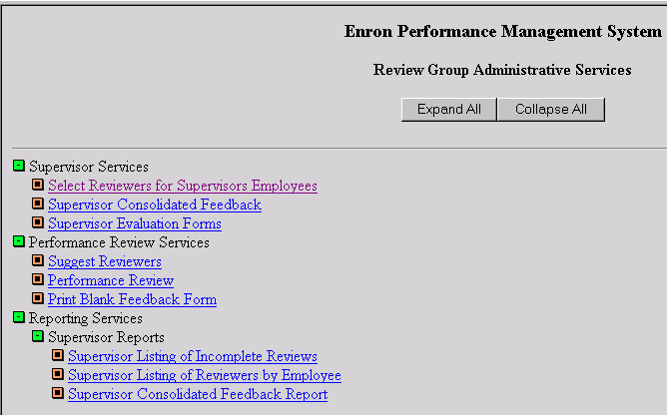
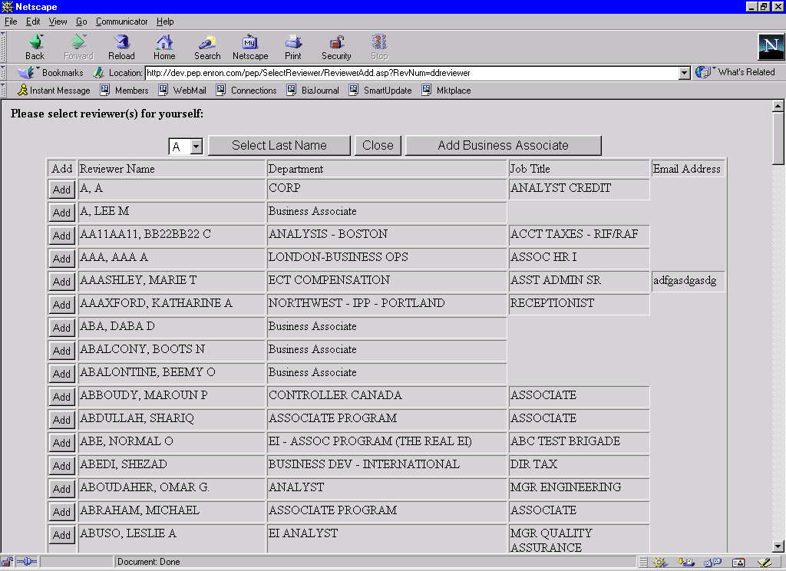
Suggest Your Own Reviewers
Each employee suggests a list of reviewers online, which must be approved by the supervisor. After you have made your selections and your supervisor has approved them, the SUGGEST REVIEWERS option is removed from your menu.
1. On the expanded Main Menu, click SUGGEST REVIEWERS. The Add Reviewer window opens with all employee names arranged alphabetically by last name.

Slide 9
Choosing Reviewers
Choose between 5 and 10 reviewers who are familiar with your work over the past 6 months.
Example reviewers would be, yourself, your supervisor, your direct reports, a peer, an internal client or external business associate.
An external business associate is someone who works outside of Enron and does not have access to the Enron Lan and thus the PEP system. Click the ADD BUSINESS ASSOCIATE button and complete the name, address and email fields.
Your supervisor will then approve or modify your suggested reviewers and the feedback process will begin.

Slide 10
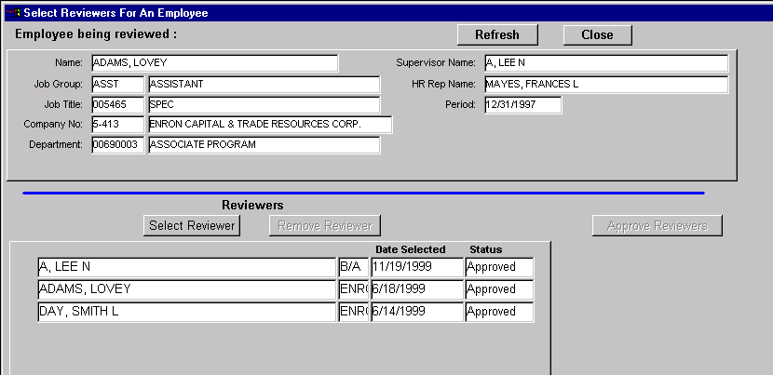
Select and Approve Reviewers (Supervisor only)
Supervisors can modify and/ or approve an employee’s list of suggested reviewers.

Slide 11
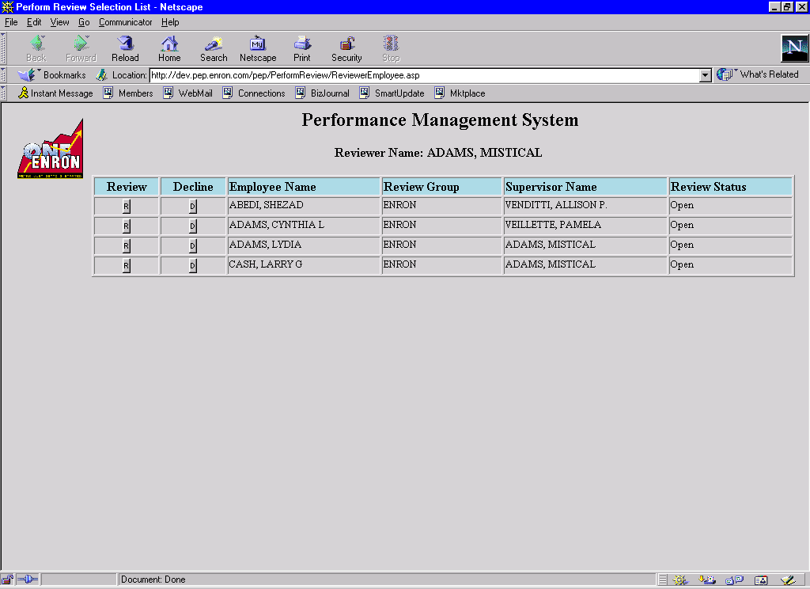
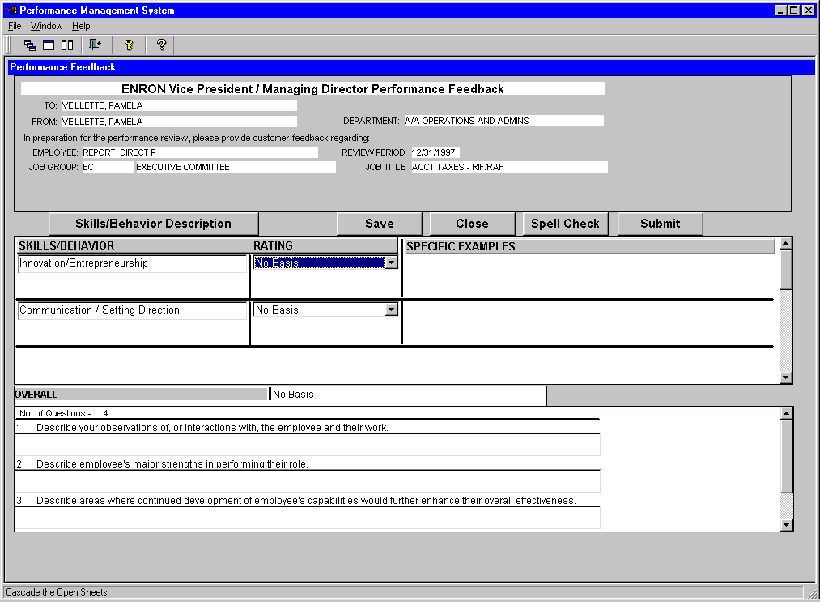
Complete/Decline a Request for Feedback
You may be selected as a reviewer and requested to provide feedback on an employee. You will be notified via an email and will need to go into the PEP system to complete the online Performance Feedback form.
1. Once in the PEP system, on the expanded Main Menu, click PERFORMANCE REVIEW.
2. Click the R button in the Review column to open the employee’s Performance Feedback form (if declining click the D button - refer to point 8 for clarification).

Slide 12
Complete/Decline a Request for Feedback (cont..)
3. Click the E button to enter relevant and meaningful feedback and a performance rating. For definitions, click SKILLS/BEHAVIORS DESCRIPTORS. Use the vertical scroll bar to see all categories.
4. Click SAVE when feedback is complete.
5. Repeat steps 3 and 4 until all appropriate categories are completed.
You may close the performance feedback at any time and complete the form later. All saved edits will be stored until feedback is submitted.
6. When you are finished with the review, click SUBMIT.
After SUBMIT is clicked, you can open the form, but you cannot make additional changes to it.
7. When doing your self-evaluation feedback you have the ability to print a copy for your personal record.
8. The decline feature would be used in some of the following instances:- you don’t feel you have sufficient working experience to provide relevant feedback on an employees performance, or if you have a personal relationship with this employee.
9. Unsolicited feedback - you will have the ability to provide unsolicited constructive feedback on an employee by contacting the PEP Help Desk. The Help Desk will add your name as a reviewer and you will follow the previously described feedback process.

Slide 13
Feedback Forms
The three feedback forms are attached to an employee’s ENE job group:-
VP and Managing Director
Management/Professional (Analyst and Associates)
Administration/Support
The forms address basic skills identified as core to Enron’s business model.
Each reviewer interprets/applies the descriptors based on their interaction with and evidence of the employee’s job performance
Notes:
Readable copies of the forms are in your manuals following the PowerPoint slides.
These will also be included in the handout materials used for client group training.
Try a few “test” cases: pick various people you know, whose performance you are familiar with. Then try using the form; it should work for anyone. Not every descriptor may be fully applicable, but enough should be to allow for a specific rating.

Slide 14
Notes:
In other words, Enron really has basically one model for defining performance.
These skills/behaviors, as identified by the descriptors, are what it takes to succeed at Enron and to make Enron successful.

Slide 15
Notes:
In other words, Enron really has basically one model for defining performance.
These skills/behaviors, as identified by the descriptors, are what it takes to succeed at Enron and to make Enron successful.

Slide 20
Performance Ratings
Superior: Consistently goes above and beyond expectations. Role model for criteria. Very little need for growth and change at current level.
Excellent: Exceeds most expectations. Role model for most criteria. Further development needs are minimal.
Strong: Meets most and exceeds some expectations. Role model for some criteria. Further development needed in some areas.
Satisfactory: Meets many but not all expectations. Demonstrates most of the criteria. Further development needs in many areas.
Needs Improvement: Does not meet most expectations. Demonstrates some of the criteria. Further development needs necessary in most areas.
Issues: Has significant performance issues. Does not demonstrate most of the criteria. Must make changes or termination likely.

Slide 21
Effective Feedback
Discuss specific skills and behaviors, not vague comments.
Discuss performance, not personality.
Report observed behaviors, not rumors.
Report on current performance only, not “old tapes”.
Report with a balanced, not an extreme view.

Slide 22
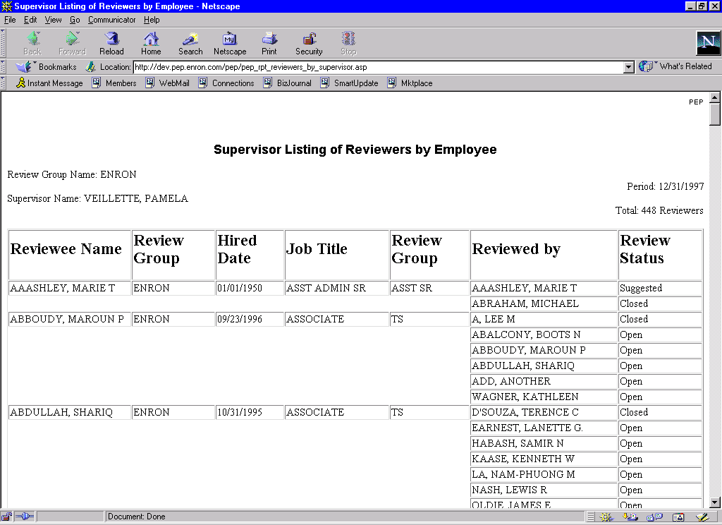
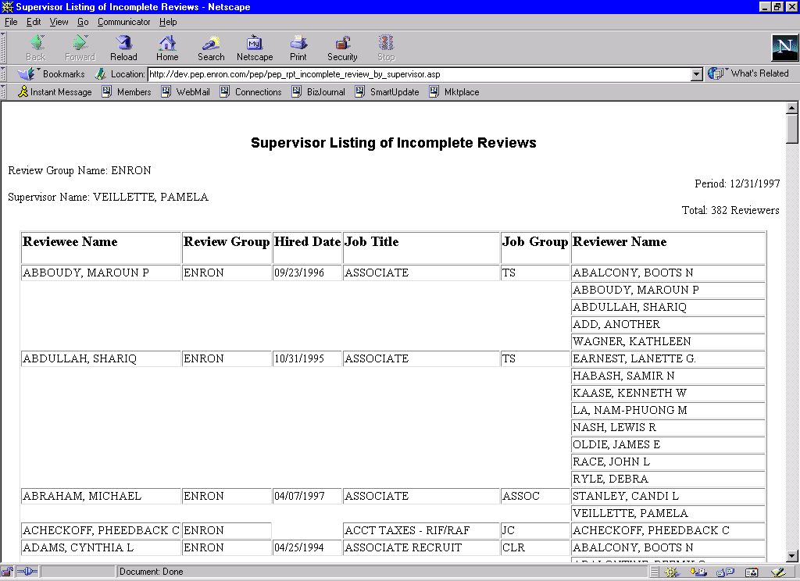
Supervisor Reports
Supervisors have the ability to print various status reports (see examples below).

Slide 23
Consolidation of Feedback (Supervisors only)
Supervisors can view and print completed feedback in PEP in a consolidated format for each of their employees.
If unsolicited feedback has been completed on the employee it will also be included in the consolidated feedback.
The supervisor prints out the form and, based on the feedback, develops a preliminary rating for their employee.
The supervisor utilizes the consolidated feedback as a reference at the PRC meeting if that employee is included.
The consolidated feedback should be used as a foundation to create the employee’s evaluation form.

Slide 24
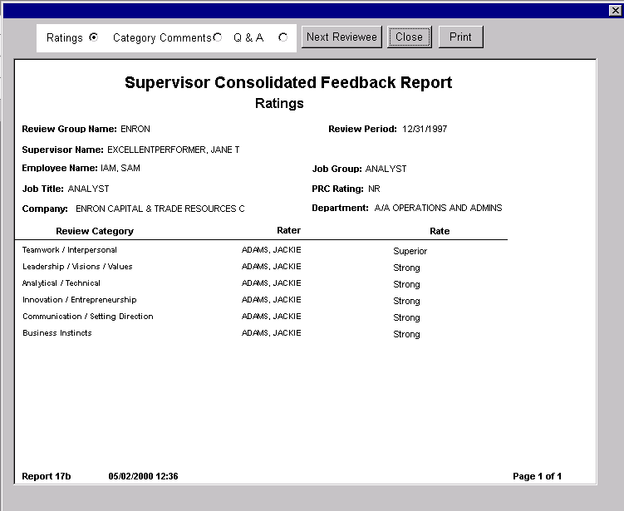
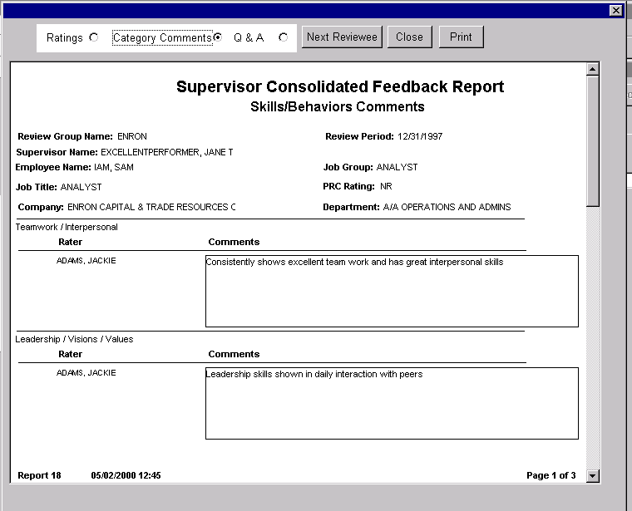
Supervisor Consolidated Feedback Report

Slide 25
PRC Meetings
During the months of June and July, Enron's top management will meet to evaluate various levels of employees across Enron.
Employee Evaluations (Supervisors only)
Supervisors can access the relevant employee evaluation form via the PEP system .
Once ratings have been finalized, employee and supervisor should:
Discuss job-specific performance
Identify issues
Discuss development goals
Identify training needs
Set goals and objectives for the next review period.

Slide 27


