Slide 1
Developing Merchant Opportunities in Japan
Enron Asia Pacific/ Africa / China
September 27, 2025

Slide 2

An Introduction

Slide 3
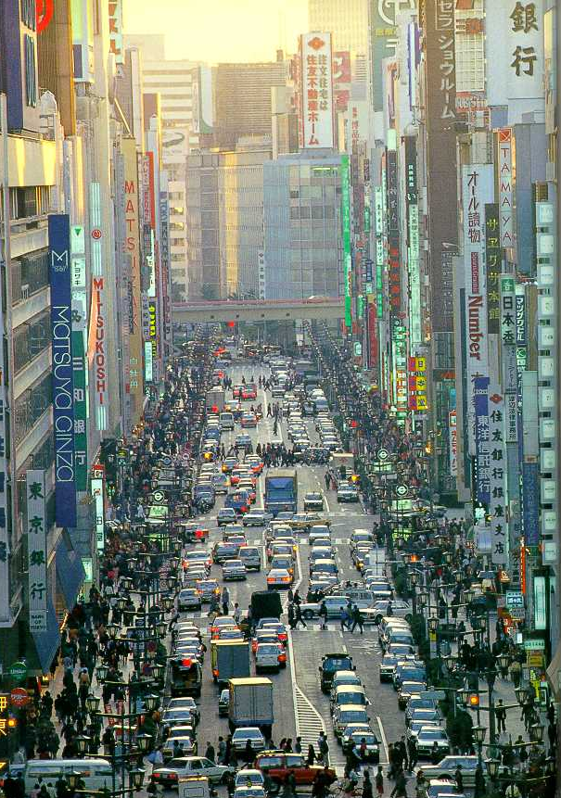
Japan Basic Statistics
2nd Largest Economy in the world (Population 127 MM)
As of 1999, economy still in recession
Hold 1/3 of world’s savings with approx 2900 trillion yen
World’s largest creditor with $1.2 trillion of overseas assets
Reliant on imports for 80% of energy supply
World’s largest importer of LNG (62% of world market)
World’s largest importer of coal (steaming and coking)
Pay 20% more for oil than OECD average and 80% more for coal
World’s second largest power market
Highest electricity prices in OECD
Tokyo Electric Power Co. (TEPCO) is the largest private power company with 14 trillion yen in assets
TEPCO is world’s second largest centrally dispatched entity (Greater than PJM but less than France)
World’s two largest banks Mizuho Financial Group (IBJ, Fuji, Daiichi) and Sumitomo/Sakura
M&A activity surged 343% during 1999 to $78 billion
E-Commerce/Internet usage increasing rapidly. B2B expected to be ½ of US by 2003 (increase of 800%)

Slide 4
For the Entire 1990s, Japan Has Been Recovering From the Excesses of the 1980s
With the “bubble bursting” in 1990, the share market value declined by greater than 60% over next two years
“Decline rivaled the Great Depression”
Much of 1980s growth driven by cheap money and loose lending practices
MOF efforts to weaken yen in mid 1980s by cutting rates from 5% to 2.5% simply encouraged spending
Land values skyrocketed
1985-1989 value of Japanese companies increased by >300% (NYSE and FTSE increased by 60%)

Slide 5
Japan’s Economy Has Been Through a Wild Ride in the 1990s as the Government Has Tried to Set a Consistent Tack

Slide 6
Japan’s Economic Recovery Is Heavily Dependent on Exports and Consequently the Value of the Yen

Slide 7
Many Foreign Companies Believe the End is in Sight and Have Substantially Increased Their Investments in the Country

Slide 8
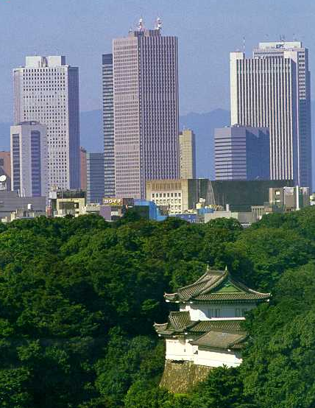
Japan Looking to Turn the Corner
What has been done to stimulate and reform the economy
Deregulation
Telecom
Banking
Energy
Standards increased
Significant accounting changes including marked to market from April 2000
Greater disclosure requirements
Greater accountability
Stimulus package
Japan trying to spend its way out of the recession
Budget deficit now exceeds 8% of GDP
Changes to tax and pension system
Pension system to resemble 401k

Slide 9
What Others Say About Japan

Slide 10
Market Perspectives (From Interviews and Recent Media)
Change
Real sense of urgency is developing after almost 10 years of malaise
Government attempting to bring Japan up to global standards in its capital, financial services, telecom, and energy markets. Prime Minister has stated that this includes unemployment to a “certain level ”
Life time employment structure is being dismantled. Non traditional institutions now finding it much easier to hire from university. Students now reluctant to follow the “salaryman” path
Need for foreign pressure (gai atsu) to bring change to the local market. Incumbents see this pressure for change as more acceptable (and quicker) than for it to happen internally (Enron, foreign banks, Ambassador Foley: Mr Gai Atsu, …)
Japanese banks now compete quite intensely for business and people whereas just a couple of years ago this was not possible (harmonization)
In discussing the keiretsu system, “It has been clear for some time that these corporate structures do not work anymore.” Sumitomo Bank president FT 17 Dec 1999
Change must balance the need for reform with social obligations (employment)
Traditional management structures breaking down (mergers,e.g. 38yo Mazda CEO)

Slide 11
Market Perspectives (From Interviews and Recent Media)
Electricity
Roughly one third of total physical market will open from the end of March 2000 (MITI)
MITI indicated it is likely to implement further reforms before the next formal review in 3 years
Daiwa SBCM and others believe that if no foreign companies enter the Japanese market, the liberalization will be considered a failure and MITI will likely implement further reforms – paradoxically, TEPCO will be working to limit further liberalization by encouraging new foreign entrants
Government is still interested in creating a pool although this was strongly opposed by the utilities. Central Research Institute believes that a voluntary pool (similar to Germany) is likely to develop from next year
The Nuclear “dilemma” is a big issue - the government does not yet know how to deal with this issue although even with recent incidents there is not a groundswell to change policy
Utilities will eventually compete… industry harmony is tenuous (Central Research Institute). As an example, Toyota is putting national electricity supply needs up for tender (initial efforts to drive utilities to compete against one another)
Consumers will switch if given a better deal, although some could be hesitant if they have a strong commercial arrangement with the incumbent utility
Large utility staff cuts are unlikely to occur, with redundancies handled through subsidiaries/ affiliates and natural attrition
Utilities are rapidly increasing sales forces to deal with coming deregulation (TEPCO has increased “sales” staff from ~70 to ~500, though the exact focus of these sales forces is still unclear

Slide 12
Market Perspectives (From Interviews and Recent Media)
Capital Markets
“We are at a historic moment. We are seeing the unraveling of 50 years of history.” (Barings Asset Management commenting on changes to Japanese economic model in FT 17 Dec 1999)
“Japan is the largest single opportunity for Merrill Lynch and we are focusing significant resources here.” (John Sievwright, president and COO of Merrill Lynch Japan)
“Japan is the largest emerging market in the world from an investment banking perspective. Even if Japan Inc is only changing at the margin, the market is so huge that even the margin offers big opportunities.” (Goldman Sachs FT 17 Dec 1999)
“Deregulation and the internet are [also] set to transform radically the business environment for Japanese companies. And finally, management itself, in a few cases, is forcing change from the top.” FT 17 Dec 1999
“Private equity is flooding in, and venture capital is suddenly available. Securitization has become a hot topic as Japanese companies try to rebuild balance sheets.” FT 17 Dec 1999
Domestic financial markets have responded quickly and decisively to foreign competition with the Mother’s OTC exchange having been created this year in response to threats from Nasdaq-Japan
Companies are decisively reducing cross shareholdings in response to unfunded pension funds, new mark to market regulations in April 2000 and to changes in the old “keiretsu” system. Trading houses concerned over MTM as it will show “unexpected” losses.
Retail market primarily interested in yield and are becoming more interested in managing their own security (However, only 180,000 online trading accounts currently exist)

Slide 13
What The Japanese Say About Enron

Slide 14
Excerpts From Recent Japanese Articles on Enron
Enron lands in Japan at last - What implications does Enron’s landing have for our electricity industry?
It will be interesting how TEPCO (a company that places importance on creating a happy society) will face the challenge of Enron (a market driven company)
However, Enron’s strength lies in its information and financial technologies, which allow it to perpetually generate a profit by taking advantage of the price difference between itself and existing power utilities
Quote from TEPCO CEO, “Enron is an energetic company and if it decides to enter the Japanese market, competition will increase and the electricity market is likely to become more deregulated (favourable)
However, due to the emphasis that Enron places on shareholder returns, we must be careful that the interests of consumers are not forgotten.”
I recently visited Enron headquarters in Houston and their reputation was not very good.
However, their philosophy has been to invest in a company, increase its share price and then sell it off for a profit
Enron has very strong political connections and the news of my visit to Enron immediately reached the US embassy
Enron, a major U.S. corporation, is planning to acquire a Japanese power company

Slide 15
What Enron Says About Japan

Slide 16
Excerpts From Enron’s Press Release Following Analyst Conference
ENRON HOSTS ANNUAL ANALYST CONFERENCE; PROVIDES BUSINESS OVERVIEW AND GOALS FOR 2000
FOR IMMEDIATE RELEASE: Thursday, January 20, 2000
HOUSTON - Enron Corp. hosted its annual equity analyst conference today in Houston. Ken Lay, Enron chairman and chief executive officer, opened the conference by highlighting Enron’s tremendous growth across all businesses and the outstanding 700 percent return to shareholders over the past decade.
Enron presented key objectives for 2000:
Continued strong growth in the core Wholesale Energy businesses.
Break-out performance from Retail Energy Services.
Rapid development of Enron Broadband Services.
Enron’s ability to extend core skills and competencies to new markets was a recurring theme throughout the day.
Wholesale Energy Business
Growth prospects remain strong for Wholesale Energy Operations and Services, Enron’s largest business. Wholesale energy growth in North America is expected to be driven by the continuing deregulation of power markets in the United States and large-scale energy outsourcing by utilities and large energy consumers. Enron expects to continue to broaden its early lead across the European continent as markets quickly open to competition. Finally, Enron is rapidly expanding its wholesale presence in other markets such as Japan, where large customers will be permitted to choose their electricity provider in March 2000.

Slide 17

E-Speak Comments on Japan
Other than the advent of the internet, what new trends do you think will impact our business the most in the coming decade? Mr. Jeff Skilling replies I expect to see continued opening of markets to direct competition all around the world. In Europe, for example, the Continental market for electricity is rapidly opening. We expect Japan to open during the next year. Each of these market liberalizations provides Enron a tremendous opportunity to create the "new style" electricity and natural gas delivery network. This change will continue to drive our business.
Hi,How can you describe the new Enron's international image campaign (the main points)? What are the new markets Enron will open in close future? Mr. Joe Sutton replies Enron's international image is very strong. Part of our new ad campaign will be focused on international markets as we roll it out. For example, in India, Enron has a brand name as well known than Coca-Cola. It is important that we continue to build our credibility in these markets. As we enter new markets like Japan, it will be important for us to build a solid image. The major new market we'll focus on this year is Japan.

Slide 18
Enron Japan Business Structure

Slide 19
Enron’s Japanese Business Structure (In Development)
Enron
Asia Pacific Africa China
Other Investors
(Orix)
Enron Japan
Risk Mgt, Mkting, Trading Services
Encom
Electricity
Finance
E-Commerce
Other
EPower
Provide marketing and risk mgt services for contestible customers in newly created market
Facilitate creation of financial market for electricity swaps and other derivatives
Provide risk mgt outsource services for “new players”
Provide 3rd party finance as a means to gain access to electricity positions and optionality
Develop other commodity/finance based transactions
Develop online trading system, Enrononline, for domestic energy market and for local use in accessing international commodities
Develop mkting and risk mgt businesses in areas of Enron expertise:
Coal
Gas
Liquid Fuels
Weather
Credit
Generat’n Capacity and Energy
Power Aggregation and Development
Aggregate existing generation from IPPs and self generators for onsale to market
Develop green field generation facilities to support developing mkt needs

Slide 20
Proposed Enron Japan Organization Plan
Enron Japan President/CEO
Commercial
Regulatory
Administration
Analyst/Associate
Director Trading
(Internal)
VP RA/GA
(Internal)
Controller
(Internal)
Associate
(Internal)
Manager Origination
(Internal)
Director RA/GA
(Internal)
Back Office
(Internal)
Analyst
(Internal)
Manager E-Commerce
(Internal)
Analyst RA/GA
(Internal)
IT Support
(Internal)
Analyst
(Internal)
Director Origination
(External)
Director RA/GA
(External)
Office Admin Manager
(External)
Director Origination
(External)
Interpreter/Translator
(External)
Expats: 4
Temporary: 9
Local: 5

Slide 21
Japanese Electricity Market Overview

Slide 22
Introduction
Japan offers an attractive and sizeable market opportunity for Enron in which to combine our international experiences and developed technologies to create a sizeable business with a critical focus on return on invested capital
Beginning in March 2000, Japan will make a significant step towards electricity market liberalization as customers with greater than 2 MWs of demand who are connected to the high voltage grid will become contestable. This will open approximately 24% of the Japanese electricity market, giving 8,300 industrials and large commercial customers the right to choose their supplier.
The prime motivation for liberalization is the government’s interest in making Japanese industry more competitive in world markets. It has been publicly stated that Japan’s industrial electricity rates should approach those of Germany; this would require at least a 50% rate reduction.
As the Japanese electricity market liberalizes, it is expected to be exceptionally risky and volatile. Numerous forces could drive prices in either direction and substantially change the shape of the forward curve. Entities with risk management acumen, such as Enron, will be key players in this opening market.

Slide 23
A Myriad of Factors Will Apply Tremendous Pressure on Incumbents and the Market in General
8,300 (219 TWh) Customers Free to Choose, March, 2000
OECD’s Highest Industrial Electricity Tariffs
Diverse Electric Utilities Facilities, Customer
Base and Cost of fuel
Redundant Maintenance Without Regard for Economics
Non-Smooth Marginal Cost Curve
Large Labor Force Compared to World Standards
Demand Growth Sensitive to Economic Recovery
Significant Excess Capacity in Off Peak
Complex Transmission System Creates Potential for Serious Constraints
Substantial Increase in Air Conditioning Load
Past Successes in Liberalization of Telecom, Petroleum Products & Banking
High Level of Gearing for Utilities (>80%)
Significant Capacity Additions Planned and In Construction
Internationally-Seasoned Electricity Traders/ Marketers to Enter Market
New Local Entrants to Market Power & Services

Slide 24
Large Contestable Power Market and Many Potential Counterparties Available March, 2000
Contestable & Total Market Comparison
Japan 1997 Power Statistics
Power Generation Capacity - 242 GW
Power Consumption - 926 TWh
Per Capita Power Consumption - 7.0 MWh
sources: EIU, IEA, US DOE, CERA
Eligible Customers Starting March 2000
Total Market Demand
TWh
Eligible
Demand March 2000
TWh
Japan’s Contestable Market Represents:
Approx. 24% of Total Japanese Power Market (US 2000 Opening = 19%)
50% of Industrial Market
15% of Commercial Market
Residential
Commercial Power
Industrial Small Power
Industrial Power Large
Industrial Power (Other)
Sub-Total (Utility Market)
Auto Generators & Other
TOTAL
0
2,200
0
6,100
0
8,300
na
8,300
232
167
111
265
16
791
135
926
0
25
0
194
0
219
na
219
Sources: EIU, IEA, Morgan Stanley Dean Witter, CERA

Slide 25
Japanese Electricity Prices Are Among the Highest in the World
Comparison of Average Industrial Rates (1997)
($/KWh)
Comparison of Electricity Rates (¥/KWh)
Average Japanese Utility Rates (1997)
Residential ¥24.47/kWh (20¢)
Commercial ¥21.63/kWh (18¢)
Large Industrial ¥15.43/kWh (13¢)
Extra High Industrial ¥11.18/kWh (9¢)
(¥/KWh)
Note: 120¥/$ used as exchange rate
Source: EIU, IEA, US DOE, Solomon Smith Barney

Slide 26
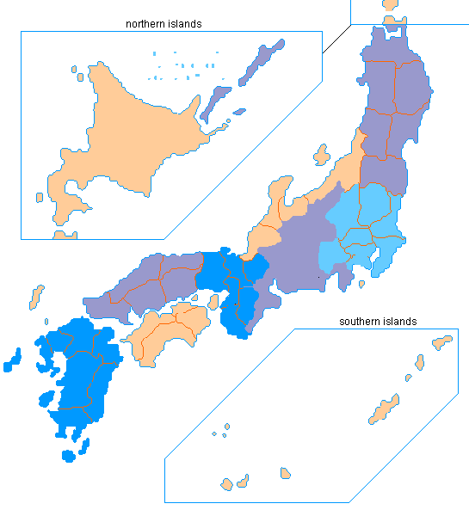
Load and Generation Are Widely Distributed Across a Complex Transmission System
13,409 MW
7.3
1 - Hokkaido EPCO
2 - Tohoku EPCO
3 - Tokyo EPCO
4 - Chubu EPCO
5 - Kansai EPCO
6 - Shikoku EPCO
7 - Kyushu EPCO
8 - Chugoku EPCO
9 - Hokuriku EPCO
1
55,755 MW
5,867 MW
60Hz
3.6
5,509 MW
2
1.8
25.7
37,049 MW
50Hz
9
12.3
30,310 MW
3
10,934 MW
8
4.9
4
9.6
5
6
18,172 MW
7.8
6,314 MW
7
2.7
Generation
Customers (millions)
Sources: JEPIC, Morgan Stanley Dean Witter

Slide 27
Japan Continues to Move Towards Liberalization
Timetable for Electricity Deregulation
Partial retail competition to take effect. Expanded wholesale bidding (all thermal plants)
Electric Utility Industry Law revised to allow wholesale IPPs
Fourth Round of IPP bidding
First Round of IPP bidding
Second Round of IPP bidding
Third Round of IPP bidding
MITI review - will liberalization continue?
1995
1996
1997
1998
1999
2000
2003
Electric Utility Industry Law revised to allow retail competition for large industrial users
Public comment period
Large commercial and industrial users free to choose electricity suppliers
Subcommittee scheduled to complete formula for transmission access and tariff (3 months behind)
MITI Regulations/guidelines for transmission access and wheeling. Fourth Round IPP winners to be announced
Utilities publish wheeling tariff based on new MITI guidelines
Source: Cambridge Energy Research Associates

Slide 28
A Significant Opportunity is Created as New Participants (Aggregators, Marketers, Additional IPPs) Enter the Market
Utility Supply
184,318 Mw
Existing Wholesale
Suppliers
37,792 Mw
Self Generators
25,844 Mw
New
Entrants
?
13,915
3,783
2,491
11,649
954
9 Electric Utilities
EDPC
JAPC
Munies
JV’s
IPPs
Industrials
IPPs
Utility Transmission
Wholesale
Aggregator
Marketer
Old World
New World
Utility Distribution
Residential
Commercial
Industrial
Large Industrial
Commercial
Source: CERA. Note: Okinawa is excluded from partial retail competition.

Slide 29
Electricity Demand Growth Has Slowed Due to Depressed Economic Conditions
Total Demand & GDP Growth (TWh: Historical and Projections)
Actual Historical; EIA Projection
Projected Pre-Recession Data Trend Line
But, This is Growth on A Very Large Base and as Economic Conditions Improve, Demand Could Increase More Than Projected
Sources: JEPIC Handbook, 1998, EIA

Slide 30
Planned Utility Capacity Additions are Significant...
Notes: Does not include IPP or Self Generation
…But some of this growth will be offset by retirement of older plants
Plus, Long Project Development Times and Increased Sensitivity to Nuclear Power and Emissions Issues Could Endanger the Viability of New Construction Projects
Source: Morgan Stanley Dean Witter

Slide 31
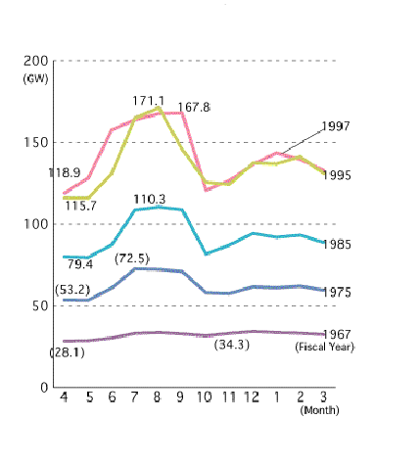
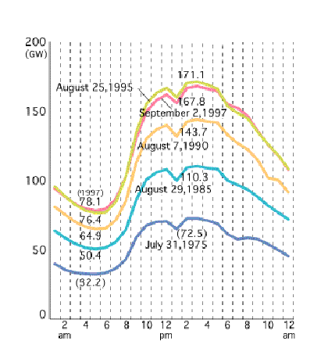
The Electricity Market Has Two Seasonal Peaks and Reflects Increasing Variances Between Daily Peak and Off-Peak Periods...
Annual Trend in Electricity Use for Nine Companies (by month)
Daily Load Curve for Nine Companies (by time of day)
Power Demand Forecast Annual Growth: ~2%
GDP Growth Forecast (1999) - 0.9%
…And With the Increased Penetration of A/C Load, the Peaks May Become More Pronounced
Source: Federation of Electric Power Companies, 1997

Slide 32
Japan has Traditionally Promoted a Mix of Generation Types and Fuel Sources
% Energy Generated by Type Installed Capacity
Hydro 10% 44.5 GW
Thermal 60% 152.2 GW
Nuclear 30% 45.2 GW
Notes:
Muni’s, JVs & IPPs distributed throughout Utilities’ service areas
JVs are Joint Ventures between utilities and industrials
IPPs are all thermal
Sources: CERA, Japan Electric Power Information Center, Morgan Stanley Dean Witter

Slide 33
Reserve Margins Are Adequate but Could Change Dramatically with Supply and Demand Variances
4.9 GW
5.3 GW
26.1 GW
31.4 GW
15.5 GW
5.2 GW
13.5 GW
11.0 GW
58.0 GW
Notes: Does not include wholesale and self generation
Numbers on the top of the bars represent peak demand for the utility
Greater Reliance on Non-Utility Generation and Inter-Regional Imports to Meet Peak
Source: Morgan Stanley Dean Witter

Slide 34
Capacity Factors are Relatively Low Exacerbating the Surplus Energy Potentially Available Off-Peak
Capacity Factors
Significant excess capacity likely exists within the system that could be released with increasing competition and as an alternative to new build
More economic-minded maintenance scheduling will also result in the availability of additional MWs
Source: Morgan Stanley Dean Witter

Slide 35
Fuel Mix Reflects Variances In Marginal Generation Costs
11
10
9
8
7
6
5
4
3
2
1
0
10.9
8.6
8.2
Oil
208 TWh
LNG
235 TWh
6.5
Pumped Storage 76 TWh
¥/kWh
Coal
90
TWh
4.7
3.7
Nuclear
189 TWh
(77.5% Capacity
Factor
Run of
River
104
TWh
(30% Capacity
Factor)
Average Thermal Capacity Factor = 45.4%
100
200
300
400
500
600
700
800
900
1000
TWh Demand
Source: Morgan Stanley Dean Witter

Slide 36
Economic Pressures and Regulatory Change are Set to Dramatically Alter the Dynamics of the Japanese Electricity Market
Market Characteristics
Economic Pressure
Regulatory Changes
Large total market demand
High industrial, commercial and retail rates
Diverse generation w/ variances in fuel type and marginal costs
Complex transmission system
Significant increases in A/C load
Large variances in reserve margins
Substantial excess capacity in off peak
Demand growth and building program uncertainties
Primary exports are energy intensive products (cars, metals, chemicals)
Since 1991 real GDP growth averaged ~1.0% and was negative in 1998. Forecasts for 1999 & 2000 are also negative
Japanese electric utilities levered 80-85%, ROA < 3%
Energy intensive industries represent 25% of GDP
Current exchange rates are making Japanese exports more expensive (¥105/$)
8,300 high voltage customers available from March, 2000
Opening of 24% of total market
Access to the high voltage grid
Stage for purely physical bilateral market
Competition for new thermal capacity
Introduction of limited competition
Other Japanese Deregulation
Telecom reform in 1985
Service costs reduced by 75%
# of carriers increased > 7000%
Petroleum Products Reform 1996
Retail gas prices reduced by 15%
Significant increase in # of importers
Banking
Electricity Market “Big Bang”

Slide 37
Given the Pressures for Change, the Electricity Market Will Be Dynamic and Volatile
Spot
Near Forward
LT Forward
Other
High Industrial Rates
Large International Industrials
National Economy
Extensive Building Program
Greater Intraday Spreads; LT Uncertainty
Stranded Costs
Increased A/C Load
Peak
Large Off Peak Capacity
Off Peak
Large Price Variances in Fuel
High Volatility in Spot with Chgs in Demand
High Demand Correlation to Weather
High Volatility in Spot with Chgs in Demand
Utilities Maintain or Increase Mkt Share
Maintain
Complex Transmission Grid
Potential for Large Xmission Basis
Sinks and Sources Physically Dispersed
Potential for Large Xmission Basis
Financial State of Utilities
New Mkt Participants
Increased Volatility
Nuclear Power Pressures
Kyoto Protocol

Slide 38
EnCom and Enron Relationship
Communications
IT Services
Internet/Intranet
Evolutionary Relationship
Fuels/Gas Trading
Fuels/Gas Origination
Enron Japan
Elecy Trading
Elec Origination
Risk Mgt
Finance
Generation Credibility
Generation Excess
Leads
Generation Excess
Finance
Risk Management
Dispatch Control
Sales Services
IT Systems
Fuel Services
Communication
Leads
Additional Demand
Finance
Basis Risk Mgt
E Power
Time

Slide 39
E-Commerce Opportunities in Japan

Slide 40

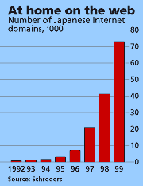
Japan: Shifting From Manufacturing Base to Technology (IT) Based Economy
Excerpts from recent Fortune Magazine Article, “Japan Goes Web Crazy”
Only 1 year ago, cell phone company NTT DoCoMo offered a handset that hooks up to the internet. Today it has 5 million subscribers
Japan is what you might call the middleman economy, and if there is anything that the Internet is great at, it’s killing of middlemen
McKinsey & MITI study estimated that the Internet would produce cost savings in Japanese industry of about $600 billion a year every year from 2003 to 2008 – an amount equal to roughly 13% of Japan’s GDP
“A restructured Japan is going to be an immensely powerful competitor. If you thought Japan in the 1980’s was mighty, wait till you see the post-internet version”
Excerpts from a recent Economist article, “In Search of the new Japanese Dream”
Expect in excess of 200 companies (mostly high tech) to go public this year
Fundamental shift in recruiting at universities. The most ambitious want to join start-ups or to found their won Internet firms

Slide 41

Japan Hit Statistics (Data since 1 Jan 2000)
77 unique .jp addresses visited homepage 165 times responsible for 4525 distinct page views
Sample of those visiting
NTT
Hitachi
Tokyo Electric
Tokyo Gas
Tohuko Electric
Itochu
NEC
Mitsui
Fujixerox
Bain
ABB
IBM

Slide 42
Other

Slide 43

The barriers to entry are too high The Japanese will never let us in The market incumbents are too big The regulator is there to support the Japanese It is impossible to hire away good talent The Japanese are not serious about change An innovative company cannot survive in Japan The Japanese move too slowly The keiretsu control everything Japanese companies will only do business amongst themselves Customers will not switch to new foreign entrants The internet as B2B tool will not work Employees all want life long employment New graduates will only work for big name Japanese companies

