Slide 1
CDWR’s Stranded Costs
A Costly Reflection of Missed Opportunity, Lack of Foresight and Over-Commitment

Slide 2
Background
This spring, CDWR entered into 38 contracts with 18 power suppliers as part of its efforts to cover CA’s “net short power.” Ninety-two percent of the energy comes from 8 suppliers
Limited details about these contracts were released on 6/13, following a court order; on 6/28 a judge ordered the remaining details to be released
As of 2004, 96% of expected net short will be locked into long-term contracts
(California Energy Markets newsletter, 6/22/01)

Slide 3
Consequences
Over-commits power procurement at high prices
Obstructs the realization of consumer choice through Direct Access

Slide 4
Missed Opportunities
Approximate Price/MWh offered to California in late 2000: $50/MWh
(LA Times, 6/13/01)
Price range in CDWR’s long-term contracts: $59-$249/MWh
Average Price/MWh in CDWR contracts: $77/MWh
(Average over 10 years according to Enron internal analysis)
Current Price in Southern California: $51/MWh
(SP15 weighted average index, 16 hour daily, 6/28/01, Megawatt Daily)

Slide 5
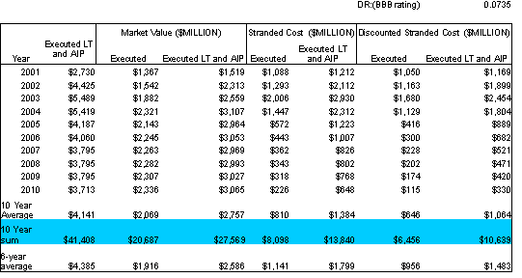
Forecast Stranded Costs (Note: Numbers are not ready for release)

