Slide 1
World Oil and Gas Markets: Myth and Reality
A presentation to the Division of Professional Affairs on the occasion of their annual luncheon meeting by Dennis O’Brien, PhD, Director, Institute for Energy Economics and Policy, Sarkeys Energy Center and John A. and Donnie Brock Professor for Energy Economics and Business
2000AAPG
Annual Convention
New Orleans
April 18, 2000

Slide 2
Introduction
Are higher energy prices sustainable?
Will markets continue to be volatile?
What can I do to better understand, plan, and deal with risk?
Who/what is IEEP?

Slide 3
The Institute for Energy Economics and Policy (IEEP) is located in the Sarkeys Energy Center, University of Oklahoma. Sarkeys Energy Center is the most comprehensive center of knowledge in the oil and gas industry with seven institutes dedicated to applied research with partners in over 30 countries and over 30 private, public and state oil companies worldwide. Sarkeys technical research is on the cutting edge of technology and has over 160 research associates and graduate students from nearly all the APEC economies.
IEEP has a global energy vision and has the mission of developing quality energy economics based on quality research and technical understanding of energy systems, organization, and global supply and demand. IEEP is experienced facilitator and provider of strategic advice for energy organizations. The IEEP works closely with the Caspian Petroleum Technology Institute and the PECC Energy Forum and is the home of the PECC Energy Forum Technical and Policy Center.

Slide 4
The Center for Energy Management (CEM)) provides executive energy management training and assistance in developing strategic visions and planning for clients.
The Center for Energy Policy Analysis (CEPA) vision is to provide energy policy analysis and recommendations based on quality technical and economic understanding and research. CEPA also is developing an Energy Technology Assessment System (ETAS) which will provide a time and cost evaluation of emerging energy technologies. CEPA has provided extensive advice to public, private, and state energy companies and governments regarding organization, deregulation, finance, and privatization.

Slide 5
The Center for Energy Market Analysis( CEMA) will develop an annual global energy outlook beginning in 1999 in addition to forecasts for the supply/demand for oil products for North America (NAOPS) and the Eastern Hemisphere (ESOPS). CEMA is also developing EWxAS which will provide a unique tool to plan and risk manage weather for energy companies world wide.
The PECC Energy Forum Technical and Policy Center (PEFTP) vision is to provide the 24 PECC member economies quality energy analysis and support (all APEC economies are members) PEFTP is currently developing a major study of PECC gas infrastructure with policy recommendations for member economies

Slide 6
Topics of Discussion
Volatile and uncertain oil markets need to be understood in order to plan for the future
The recent market is a classic case in which the media has created a misunderstanding of those markets
We need to look back over the last few years and in particular, the last few months to understand the next few months, year, and decade.
supply
E&P Transport Refining Terminal Marketing end user
primary stocks secondary stocks tertciary stocks (1.5 bb) (1 bb) (2-5bb)
demand
consumption

Slide 7
Myth and reality in oil markets
It is very tempting for those who explore and develop oil and gas to believe that producers should and do determine the price of oil
This view often exaggerates the role of OPEC and uses over simplified economics as justification
The keystone in the market is the refiner--he determines the price daily and is mainly influenced by upward or downward movement since this impacts his margin
Geologists need to understand how oil becomes products and how the buyers and their agents determine the fate of the E&P world.

Slide 8
Myths
>OPEC alone drives the market
>The decline curve moves downward the year after next
>The 1970's will return (it has--will it stay?)
>The Reagan Administration got the Saudi's to adopt netback price/market share (conspiracy thesis 1)
>Washington can fix the problem
>The IEA misleads Wall Street causing low oil prices? high prices? (conspiracy thesis 2)
>OPEC dumps oil in US to shut in marginal production
(conspiracy thesis 3)
>Mergers will raise oil prices

Slide 9
Realities
>$11WTI,$8.50 OK sweet, $5.50 OK sour, $3.00 HHS Caspian, $11Dubai in early 99
>$31WTI, $25Dubai in March 2000
>LNG, other gas projects in trouble
>Efficient, transparent markets and refiners set the pace
>Some things can't be controlled like weather, politics
>Some exporters, producers were really hurt.
>Many companies have not recovered
>Econpsych sets the markets and the product market drives the upstream
>"Something will happen"

Slide 10
“Oil prices are the collective notion of an
elite group of midstream refiners, traders,
trade journalists, based on a 360 degree
scan of the forward business environment
of the industry and its customers. Oil prices
have little physical relationship with the
substance of oil and are simply an electronic
value in financial transactions”

Slide 11
Wagging the oil dog with the
marginal barrel
Non OPEC supply
mild winters
Asian flu
El Nino
refiners run high
Iraq
Continuing down pressures
>market efficiency
>technology
>Caspian
>cost management
>deregulation
>privatization
>globalization
OPEC
strong La Nina
refiners low run
Asia boom
strong la nina

Slide 12
The great chain of (oil) being . . .
ANS
Caspian
IPE
Urals
Alb light
Brent
NYMEX
OKs/s
Taching
Med
WTI
Dubai
SIMEX
IS
SL
Tapis
Cusiana
Furrial
OR
The marginal barrel (crude or product) is the tail that wags the (oil) dog (Paul Frankel)

Slide 13
Annual marker crude prices (fob) are the stuff of annual reports, 10k
El nino

Slide 14
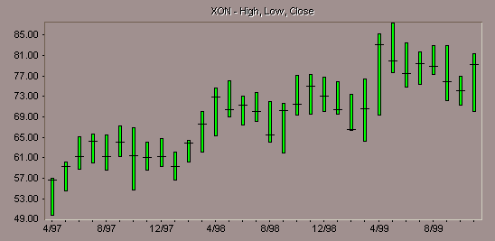
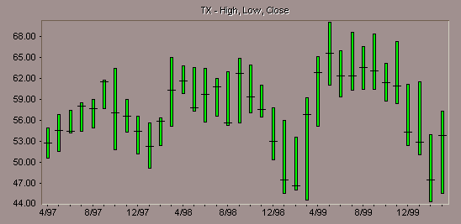
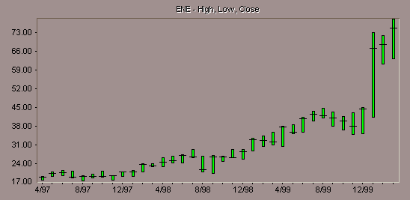
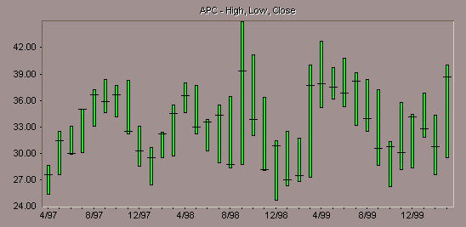
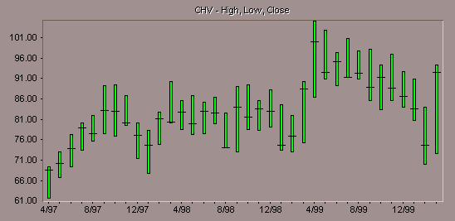
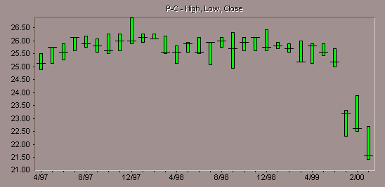
Share values favor the new economy and discount the old
Exxon Mobil
Texaco
Enron
Anadarko
Chevron
Phillips

Slide 15
OPEC takes Charge…on the fourth attempt (with a little help from)
The media and the U S Government who always need a bad guy to blame
The refiners who do not like rising crude markets or large inventories (which cost money and efficiency)
The weather which plays a devilish game with both producers and end users
Asian end users who once again are buying and shifting inventory
Mexico and few other fellow travelers
Will this unlikely coalition hold together?

Slide 16
Estimated OPEC quarterly compliance to production cuts--why did it work and will it continue to work?
Sources: History: EIA; Projections: Short-Term Energy Outlook, April 2000.
Notes:
<number>
<footer>
<header>
<date/time>
This forecast assumes that OPEC 9 (OPEC excluding Iraq and Iran) crude oil production will be 21.5 million barrels per day in the second quarter, 0.7 million barrels per day above first quarter production levels. This is nearly 0.5 million barrels per day above their production target of 21.07 million barrels per day. If Iran is included (OPEC 10), the increase in the second quarter is expected to be 0.9 million barrels per day. The forecast then assumes another 0.1 million barrels per day increase in OPEC 9 (and OPEC 10) crude oil production in the third quarter and an additional 0.4 million barrel per day increase in the fourth quarter of 2000 (a 0.5 million barrel per day increase for OPEC 10). Continued increases are expected throughout 2001.
Iraqi crude oil production is assumed to average about 2.3 million barrels per day in the first
quarter of 2000 and increase through the remainder of the year to average about 3.0 million
barrels per day in the fourth quarter of 2000. This is not as much as the Iraqis have said they
will be producing by the end of the year, but it is our best assumption of what we think Iraq will be actually producing. Iraqi oil production is assumed to increase even more in 2001. Our
projections of Iraqi crude oil production are merely an assumption and do not reflect any
official U.S. Government view on the future of Iraqi oil exports.
Non-OPEC production is expected to increase by 0.8 million barrels per day in 2000 and by
another 1.0 million barrels per day in 2001, primarily from the North Sea, Mexico, South America and Africa.

Slide 17
EIA expects world oil demand to grow 1.5-2.0 mb/d annually in 2000 and 2001
1.00
History
Projections
0.80
0.60
0.40
Million Barrels per Day
0.20
0.00
-0.20
1999
2000
2001
OECD
Non-OECD Asia
FSU & E. Europe
Other
Sources: History: EIA; Projections: Short-Term Energy Outlook, April 2000.
Notes:
<number>
<footer>
<header>
<date/time>
In 1999, world oil demand growth was mainly due to growth in OECD countries, particularly the
U.S. In 2000, non-OECD Asia is expected to once again be the predominant region for oil
demand growth, although growing much less than before the economic crisis as it may take
some time before many Asian economies fully recover. By 2001, not only is non-OECD
oil demand expected to grow even more, but OECD oil demand growth is expected to be
strong as well.
This forecast assumes a growth in world oil demand in 2000 of 1.3 million barrels per
day (about 1.7 percent), to average nearly 76 million barrels per day). In 1999, world
oil demand grew by 1.0 million barrels per day (1.4 percent). World oil demand growth in 1999
and 2000 is expected to be much less than the 1.5 - 2.0 million barrels per day growth that was
seen in the 1995-1997 period. The U.S., which accounted for more than half of the growth in
world oil demand in 1998 and 1999, is expected to supply about 9 percent of world oil demand
growth in 2000 and about 25 percent in 2001. As Asia continues to recover from the economic
crisis of 1997-1998, it is expected to once again become an important engine for world oil
demand growth. However, overall demand growth in 2000 is expected to be slowed by high oil
prices, even for a relatively inelastic commodity such as oil. By 2001, oil demand is expected to
grow substantially, increasing by nearly 1.9 million barrels per day to nearly 78 million barrels
per day.

Slide 18
Total OECD Oil Stocks* were drawn down rapidly in late 1999 and early 2000
Sources: History: EIA; Projections: Short-Term Energy Outlook, April 2000.
Notes:
<number>
<footer>
<header>
<date/time>
OECD oil stock levels are expected to remain well below the depressed 1996 levels
throughout 2000. The difference between normal OECD oil inventories and 2000 levels is
expected to widen after the first quarter, even with the OPEC production increases assumed in
our forecast. This is because the assumed increase in production is insufficient to build
inventories during thesecond and third quarters relative to the normal pattern. This would
lead to extremely low inventories by the end of the year, leaving almost no flexibility in the
world oil system to react to a cutoff in oil supplies somewhere or an extreme cold snap during
next winter.
While EIA does not attempt to estimate oil inventory levels on a global basis, we can discern the
direction oil inventories are headed from our world oil supply and demand estimates. Following
a 1 million barrel per day implied draw on world inventories in 1999 (based on world oil
consumption averaging 74.7 million barrels per day while world oil supply averaged 73.7 million
barrels per day), oil inventories are expected to be drawn down by an additional 0.3 million
barrels per day in 2000. This leaves global oil inventories in a particularly precarious position.
The additional draw in 2000 is a result of our world oil demand, OPEC production, and non-OPEC
production estimates discussed above.
In 2001, we expect a 0.3 million barrel per day build in world oil inventories, as supply exceeds
demand once again.

Slide 19
EIA expects U.S. crude oil prices to moderate
Sources: History: EIA; Projections: Short-Term Energy Outlook, April 2000.
Notes:
<number>
<footer>
<header>
<date/time>
In the current base case, world oil prices are expected to begin a gradual decline as increased oil
production from OPEC enters the world oil market. Based on our assessment of world oil supply
and demand, the average cost per barrel of crude oil imported into the U.S. and delivered to U.S.
refiners (the benchmark price used in this forecast) is expected to decline from an estimate of
$26.75 per barrel in February and March 2000 to about $25 per barrel by June 2000 and $23.50
per barrel by the end of 2000. In 2001, the price is expected to continue to decline to about $21.50
by the end of the year. (Note: for comparison purposes, the price of West Texas Intermediate crude
oil is generally about $2 per barrel higher than our benchmark price, the price of Brent crude oil
is generally about $0.50 - $1.00 per barrel higher, and the OPEC basket price is generally within
about $0.50 per barrel in either direction.)
Our normal uncertainty range around this forecast is that the world oil price could be between $20
and $27 per barrel by the end of this year and between $17.50 and $25.50 per barrel by the end of
2001. Of course, this price forecast is based on our assumptions regarding world oil supply and
demand, which are detailed later in this report.

Slide 20
Case study--the weather
The weather game has had a major influence on oil markets since 1994 (and before)
The cold la nina winter of 1995-6 reversed falling oil markets which didn’t sort out until Summer 97
The warm el nino in winter 97-8 and its effects created the largest inventory build in recent history which set the stage for the lowest prices in recent history in late 98
The system came into balance in late winter 99 and late cold weather combined with OPEC to push the market upward
The focused cold weather on the weather sensitive area within 400 miles of NYC (90% of U.S. #2 heating oil demand) had both a physical and “econpsych” impact on the notion of oil prices

Slide 21
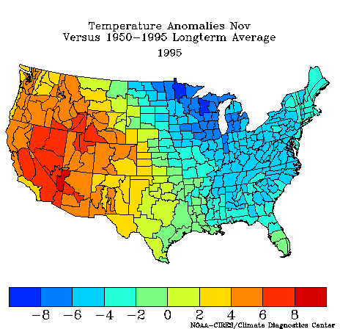
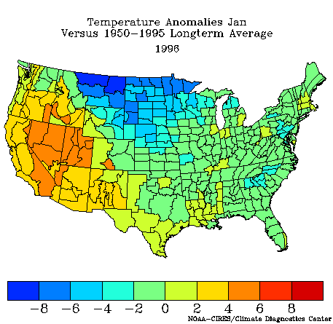
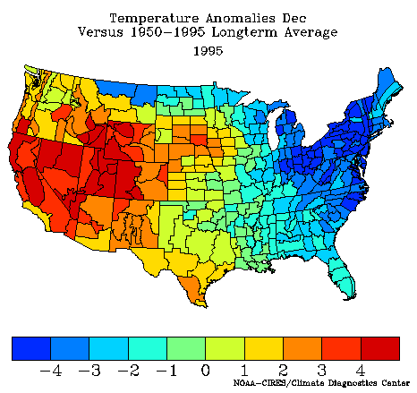
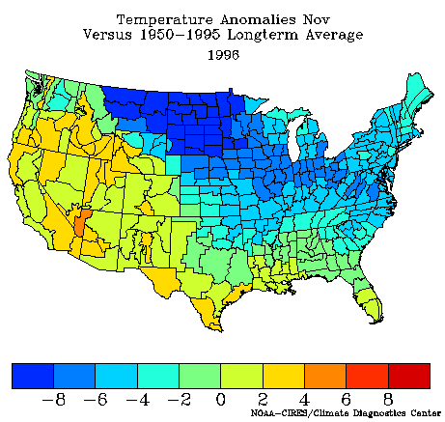
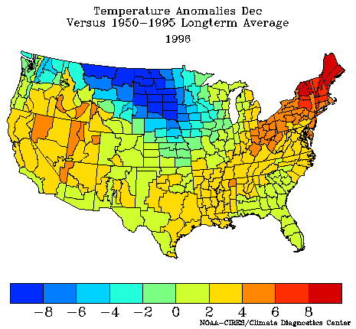
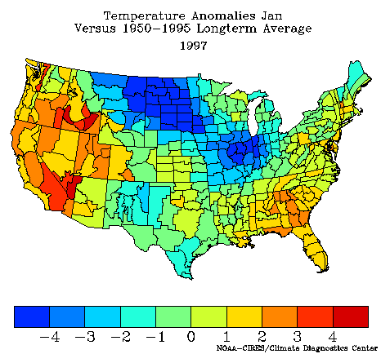
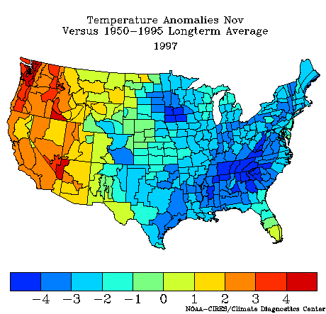
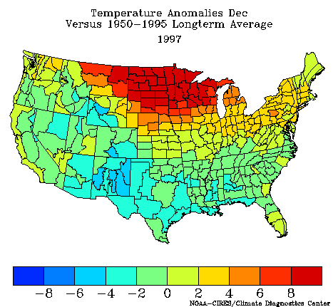
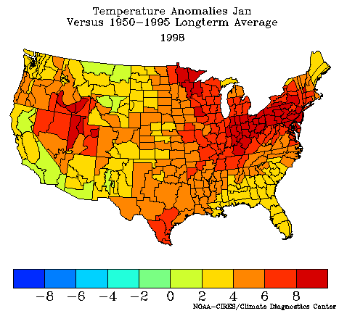
Observed U.S. winter surface temperature anomalies, 1995-1998 (Nov-Jan)
NOV DEC JAN
95-96
96-97
97-98

Slide 22
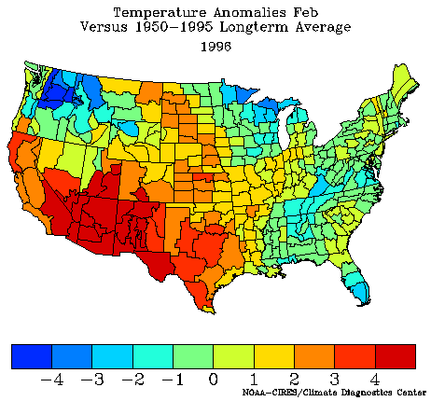
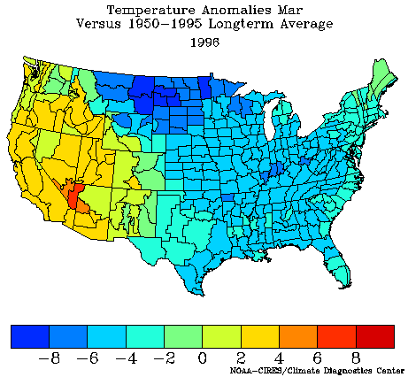
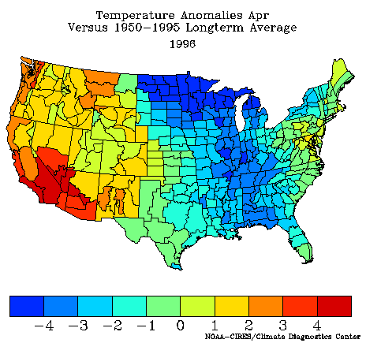
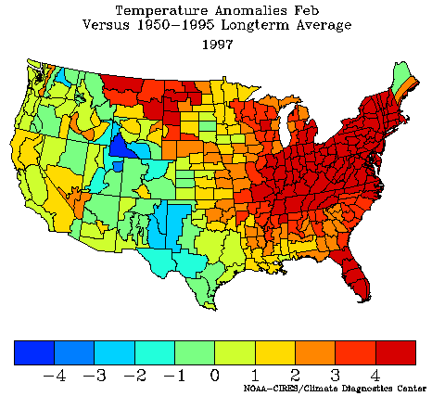
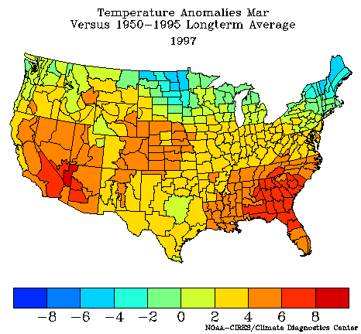
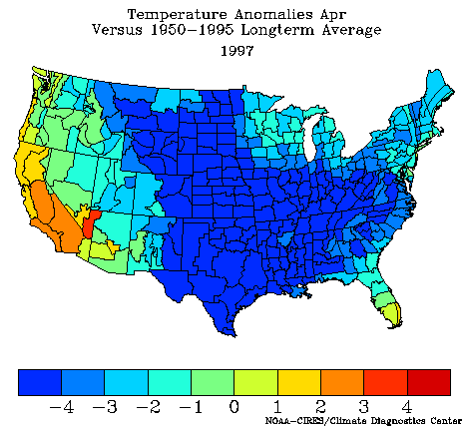
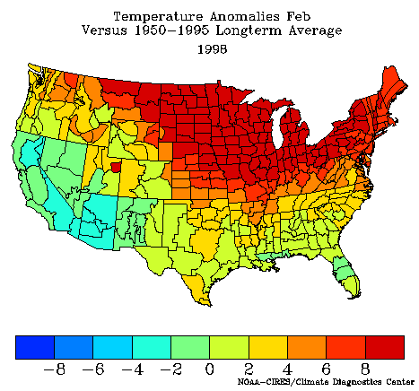
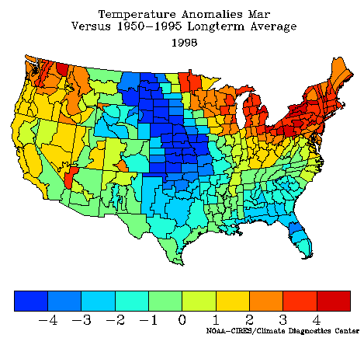
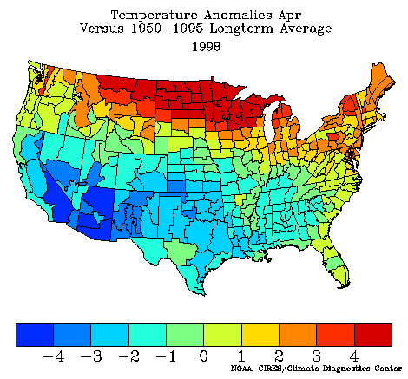
Observed U.S. winter surface temperature anomalies, 1995-1998 (Feb-April)
Feb Mar April
96
97
98

Slide 23
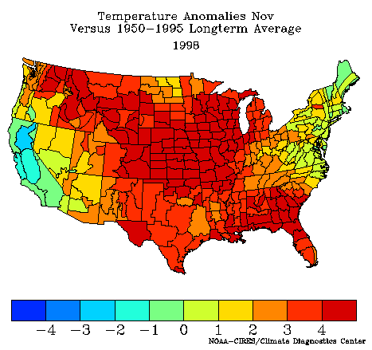
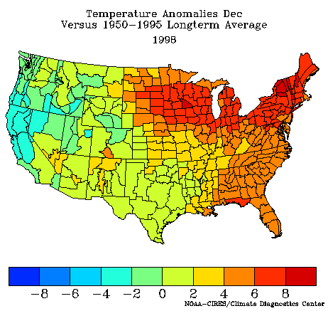
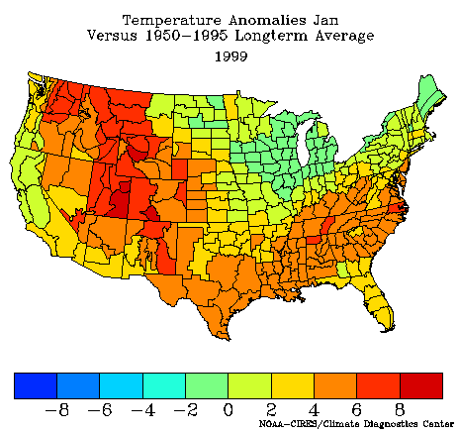
Observed U.S. winter surface temperature anomalies, 1998-2000 (Nov-Jan)
Nov Dec Jan
99
99-00

Slide 24
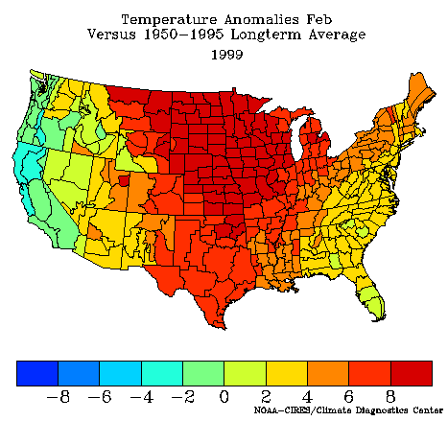
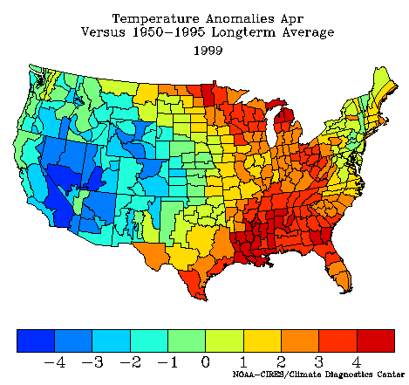
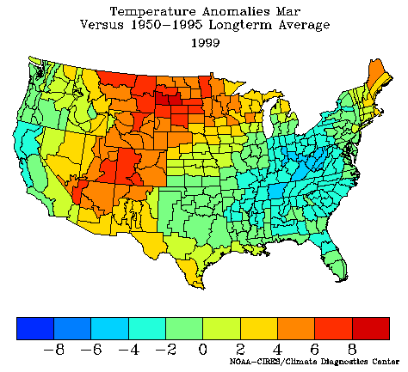
Observed U.S. winter surface temperature anomalies, 1998-2000 (Feb-April)
Feb Mar Apr
99
2000

Slide 26
Transport fuels dominate U.S. demand
Sources: History: EIA; Projections: Short-Term Energy Outlook, April 2000.
Notes:
<number>
<footer>
<header>
<date/time>
Petroleum demand during the 2000-2001 forecast interval is expected to increase
by an annual average of 280,000 barrels per day, or 1.5 percent. This average rate
of growth is slower than the 2.3-percent average seen in the previous 2 years.
Higher fuel prices and relatively mild weather are projected to constrain 2000
growth to only 110,000 barrels per day, or 0.6 percent. Transportation-related
demand is projected to increase 1.5 percent. Despite a cold snap in late January
of this year and a serious heating oil price run-up, space-heating demand for petroleum
products is projected to rise less than 1 percent as a result of first-quarter weather that
was, on the whole, relatively mild. Following a 5-percent decline in 1999, residual
fuel oil demand is projected to decline a further 17 percent as a result of price-related
fuel switching in the electric utility and industrial sectors.
In 2001, a presumed return to normal weather and a retreat of oil prices from
their peaks of the previous year is projected to boost total petroleum demand by
470,000 barrels per day, or 2.5 percent. Transportation demand is projected to
rise by 1.8 percent, reflecting a slight increase from price-restrained growth in 2000.

Slide 27
Natural gas and #2 distillate dominate residential demand in the Northeast (1996)
Notes:
<number>
<footer>
<header>
<date/time>
Residential customers in the Northeast are more heavily dependent on heating oil than are residential consumers in the rest of the country.
Rhode Island is no exception. In 1996, which is shown here because the weather was more typical than the warm weather of 1997, heating oil comprised about 38% of the energy used in the residential sector -- similar to other states in the Northeast.
Natural gas serves 37% of the residential market, and electricity meets about 16% of the state’s residential needs. Wood is also significant in the Northeast, representing about 7% of residential energy consumed.

Slide 28
Distillate Stocks Are Important Part of Northeast Winter Supply
Notes:
<number>
<footer>
<header>
<date/time>
The weather alone was not enough to cause the price spike. The low stocks left the area vulnerable to sudden changes in the market, such as the weather change. Why do stocks matter in the Northeast?
Stocks are normally an important part of PADD 1 winter distillate supply. Over the last 5 years, PADD 1 stocks provided about 15% of supply during the peak winter months of January and February. They are the closest source of supply to the consumer. PADD 1 depends on about 60% of its supply from distant sources such as the Gulf Coast or imports, which can take several weeks to travel to the Northeast. Even product from East Coast refineries, if capacity is available, may take a week before it is produced and delivered to the regions needing new supply. Thus, stocks must be able to meet supply deficits for some time before much new supply can can arrive.
In PADD 1 this past January, stocks supplied 566 thousand barrels per day or 34 percent of total distillate demand, compared to the usual 16 percent. The high sulfur stocks alone fell 481 thousand barrels per day, covering 48 percent of the East Coast high sulfur heating oil demand that month.
While other regions had low stocks and cold weather, the Northeast saw the unusual heating oil and diesel fuel price surges as a result of:
Its being the largest regional market in the country for heating oil, representing about two thirds of total U.S. heating oil used during the peak winter demand months;
Its heavy reliance on stocks during the peak winter demand months;
Its reliance on waterborne supply that can be affected by cold weather; and
Its large, short-term swings in demand coming from the large utility and interruptible gas consumers jumping into the heating oil market, on top of the increase in demand from home heating oil customers.

Slide 29
Late January Cold Impacted Both Supply & Demand
Weekly Heating Degree-Days
Mid Atlantic
New England
Notes:
<number>
<footer>
<header>
<date/time>
A brief cold spell occurred in the second half of January on top of the low stocks. Cold weather increases demand, but it also can interfere with supply, as happened this past January.
During the week ending January 22, temperatures in the New England and the Mid-Atlantic areas shifted from being15 percent and 17 percent warmer than normal, respectively, to 24 percent and 22 percent colder than normal. The weather change increased weekly heating requirements by about 40 percent.
Temperature declines during the winter affect heating oil demand in a number of ways:
Space heating demand increases;
Electricity peaking demand increases and power generators must turn to distillate to meet the new peak needs;
Fuel switching from natural gas to distillate occurs among large customers with dual fuel capabilities, some by choice if distillate is cheaper, and some by the terms of their natural gas contracts.
The weather not only increased demand, but high winds and frozen rivers kept barges from landing, further hindering re-supply.

Slide 30
Low Stocks Set Stage for Price Volatility
Notes:
<number>
<footer>
<header>
<date/time>
This distillate price spike is a classic response to a local supply and demand imbalance that began as a result of low distillate stocks.
Low distillate stocks in the winter create the potential for price volatility. In this situation, unexpected high demand from cold weather or sudden loss of supply can quickly deplete low stocks in local areas for a time, requiring unusual movement of stock from other areas. As buyers search for product, they bid prices up rapidly, which attracts product, but the time lag can cause prices to rise very high briefly before product arrives.
Low stocks of distillate fuels at the end of 1999 left heating oil markets in a vulnerable position. Stocks began the winter of 1999/00 well above average. They deteriorated somewhat as low margins kept refiners from continuing to build inventories along the lines of the normal pattern. Stocks were still well within the normal range at the end of November, but declined much more than usual in December, ending the year 6% below the low end of the normal range.
Thus, as we went into our two biggest distillate demand months, January and February, U.S. distillate stocks were very low -- particularly on the East and Gulf Coasts. The East Coast is the primary heating oil region, and it depends heavily on production from the Gulf Coast as well.

Slide 31
U.S. Refinery Capacity and throughput declined in 4th quarter 98 and is now rising in response to falling prices and demand
Sources: History: EIA; Projections: Short-Term Energy Outlook, April 2000.
Notes:
<number>
<footer>
<header>
<date/time>
The increasing tightness in world oil markets that developed in 1999, and which continued through early 2000, generated a dramatic falloff in peak U.S. refinery utilization which culminated in a 9-year low for monthly utilization being recorded this past January of 86.2 percent.
The United States will need to see significantly higher gasoline output this summer in order to meet increased demand without relying on inventory withdrawals. Currently, high gasoline spreads (the difference between gasoline prices and oil input costs) would seem to provide sufficient incentive for increased output.
Total domestic output (refinery and field production) is projected to average 8.40 million barrels per day during the summer months, up about 190,000 barrels per day from last summer. This reflects the expectation that refineries will be expected to meet not only the increase in demand but also compensate for reduced availability from stocks and net imports. As a result, refinery utilization rates for the summer are projected to average 96.8 percent, up from 94.3 percent last summer.

Slide 32
Regional residential heating oil prices spiked in early February 2000
Notes:
<number>
<footer>
<header>
<date/time>
Residential heating oil customers in the Northeast experienced a severe upsurge in prices in late January and early February this past winter.
The general level of heating oil prices each year is largely a function of crude oil prices, and over the course of the heating season, prices will usually vary by about 10 cents per gallon. However, exceptions occur in unusual circumstances, such as very cold weather, large changes in crude oil prices, or supply problems.
Although heating oil prices for East Coast consumers started this winter at similar levels to those in 1997, they had already risen nearly 21 cents per gallon through mid-January. With the continuing upward pressure from crude oil markets, magnified by a regional shortfall of heating oil supplies, residential prices rose rapidly to peak February 7.
The problem was basically limited to the Northeast. The Midwest saw very little runup. From January 17 to the peak on February 7, Rhode Island prices rose 85 cents per gallon to peak at $2.04. The Mid-Atlantic rose over 76 cents per gallon, while the South Atlantic increased about 26 cents and the Midwest only increased about 10 cents.
Note:
New England includes: Connecticut, Maine, Massachusetts, New Hampshire, Rhode Island, Vermont.
Mid-Atlantic includes: Delaware, District of Columbia, Maryland, New Jersey, New York, Pennsylvania.

Slide 33
Spot NY harbor #2 distillate prices spiked in early February in response to cold weather in the Northeast and WTI responded (to 4/5/2000)
Notes:
<number>
<footer>
<header>
<date/time>
Retail distillate prices follow the spot distillate markets, and crude oil prices have been the main driver behind distillate spot price increases until mid-January, 2000. WTI crude oil price rose about $17 per barrel or 40 cents per gallon from its low point in mid February 1999 to January 17, 2000.
Over this same time period, New York Harbor spot heating oil had risen about 42 cents per gallon, reflecting both the crude price rise and the beginning of a return to a more usual seasonal spread over the price of crude oil.
The week ending January 21, distillate spot prices in the Northeast spiked dramatically to record levels, closing on Friday at $1.26 per gallon -- up 50 cents from the prior week. Gulf Coast prices were not spiking, but were probably pulled higher as the New York Harbor market began to draw on product from other areas. They closed at 83 cents per gallon, an increase of 11 cents from the prior Friday. Crude oil had risen about 4 cents from the prior week.
New York Harbor spot distillate prices remained highly volatile for several weeks. Prices initially peaked on Tuesday, January 25 at almost $1.36 per gallon before a brief weather respite and signs of cargoes coming to the East Coast encouraged buyers to begin to relax. By January 31, New York heating oil prices had fallen to 82 cents, only to rebound again as cold weather and supply delays continued, peaking February 4, at $1.77 as weather continued to hinder re-supply. By Thursday, February 10, prices had fallen back to $0.82.
What happened the week ending January 21 to set off this price spike?

Slide 34
Distillate imports surged to meet supply/demand imbalance and price differentials
Notes:
<number>
<footer>
<header>
<date/time>
Prices receded when weather moderated and new supply began to arrive.
Imports were the largest source of new supply that arrived to relieve the imbalance that was behind the price spike. This graph shows the dramatic increase on a calendar monthly average basis.
During the three weeks ending February 25, distillate fuel oil imports averaged 566 thousand barrels per day. During the prior four weeks, imports only averaged 162 thousand barrels per day.
Refinery production on the East Coast also increased. For the three weeks ending February 25, East Coast distillate production averaged 478 thousand barrels per day, which was an increase of about 91 thousand barrels per day or 24% over the prior four weeks. (During the same time period, national distillate production only rose 7 percent.)

Slide 35
Retail diesel fuel oil prices followed heating oil up and are just now moderating
Notes:
<number>
<footer>
<header>
<date/time>
Along with heating oil prices, the distillate supply squeeze has severely impacted diesel fuel prices, especially in the Northeast.
Diesel fuel is bascially the same product as home heating oil. The primary difference is that diesel has a lower sulfur content.
When heating oil is in short supply, low sulfur diesel fuel can be diverted to heating oil supply. Thus, diesel fuel prices rise with heating heating oil prices.
Retail diesel fuel prices nationally, along with those of most other petroleum prices, increased steadily through most of 1999. But prices in the Northeast jumped dramatically in the third week of January.
Diesel fuel prices in New England rose nearly 68 cents per gallon, or 47 percent, between January 17 and February 7. While EIA does not have weekly diesel price data by state, you can assume Rhode Island was following the New England prices upward. Diesel fuel prices in the Mid-Atlantic region rose about 58 cents per gallon (42 percent) in the same period, compared to an increase of 16 cents in the national average.

Slide 36
U.S. distillate stocks are expected to return to the low normal range as the result of increased refinery runs, political jawboning, and consumers
Notes:
<number>
<footer>
<header>
<date/time>
Continued mild weather and the new supply that arrived allowed stocks in the Northeast to stop dropping and hold steady.
At the national level, stocks dropped a little further, but entered the low end of the normal band in March.
EIA is not projecting a large recovery over the summer, but because refineries are forecast to run at high utilization rates, they may produce more distillate than expected and allow us to rebuild to more comfortable levels.

Slide 37
IEA expects #2 heating oil and crude prices to moderate
Notes:
<number>
<footer>
<header>
<date/time>
Prices have already recovered from the spike, but are expected to remain elevated over year-ago levels because of the higher crude oil prices.
There is a lot of uncertainty in the market as to where crude oil prices will be next winter, but our current forecast has them declining about $2.50 per barrel (6 cents per gallon) from today’s levels by next October.
U.S. average residential heating oil prices peaked at almost $1.50 as a result of the problems in the Northeast this past winter. The current forecast has them peaking at $1.08 next winter, but we will be revisiting the outlook in more detail next fall and presenting our findings at the annual Winter Fuels Conference.
Similarly, diesel prices are also expected to fall. The current outlook projects retail diesel prices dropping about 14 cents per gallon from their U.S. March average of $1.49 per gallon to about $1.35 by the middle of summer. They are not expected to drop much further by the end of the year under the base case crude price scenario.

Slide 38
Case study--Summer driving always follows winter heating
U.S. refiners can’t meet the daily peak requirements of the winter heating or summer driving requirements of the U.S. market
The build stocks during the Spring and Fall and import middle distillate and gasoline
They have not been very good in factoring weather into their planning
When the system gets tilted out of balance it takes 12-18 months to recover. This can bring $0.70 or $1.70 gasoline
Politics gets into picture like 95-6 and 99-00
The natural gas suppliers are much better in planning

Slide 39
U.S. regional gasoline stocks are significantly low in the East, Midwest, and Southwest (as of 3/31/2000) but appear to have improved since
220
200
180
160
140
120
Million Barrels
100
80
60
40
20
0
PADD 1
PADD 2
PADD 3
PADD 4
PADD 5
Total U.S.
1998
1999
2000 (estimated)
Sources: History: EIA; Projections: Short-Term Energy Outlook, April 2000.
Notes:
<number>
<footer>
<header>
<date/time>
Some regional differences are worth noting. Much of the shortfall in inventories relative to normal or average levels appears in PADD 3 (Gulf Coast), as is clear from the figure. Below-average levels are seen in PADD1 (East Coast) and PADD2 (Midwest) as well.
So far this year, the region with the strongest reaction to the tight gasoline market has been the West Coast (particularly California) with disproportionately high increases in pump prices since mid January. However, since stocks are particularly low in other areas, the potential for unusually sharp seasonal runups in price somewhere other than the West Coast seems evident.
Since most gasoline imports come into the East Coast, and since the East Coast and the domestic region from which incremental supplies would normally come are currently holding below-normal stocks, it seems clear that the availability of imports is an issue which is of particular interest this summer for those concerned about potential additional short-term increases in gasoline prices.

Slide 40
Total U.S. Motor Gasoline Stocks are below normal operating levels and will not recover until 2001
Sources: History: EIA; Projections: Short-Term Energy Outlook, April 2000.
Notes:
<number>
<footer>
<header>
<date/time>
A decline from ample levels of gasoline stocks has occurred since last summer. In June 1999, total motor gasoline stocks stood at 215 million barrels, or 6 million barrels above the middle of the normal range. This situation deteriorated as the year went on, particularly during the late-fall and mid-winter periods, such that at the outset of the summer 2000 driving season (April 1) stocks were sharply below last year’s level and well below the midpoint of the normal range. Total stocks are projected to remain relatively low throughout the driving season.
Under normal conditions, while U.S. refiners need to ramp up refinery output of gasoline significantly during the summer in order to meet demand, a key component of insuring uninterrupted gasoline supply is sufficient stocks to bridge the gap between peak demand and output volumes plus available imports. This year, a much-narrowed safety margin in terms of available stocks is facing the domestic gasoline market, which increases the susceptibility of the market to price shocks.

Slide 41
Retail gasoline price* components include 40-45 cents state and federal tax
Sources: History: EIA; Projections: Short-Term Energy Outlook, April 2000.
Notes:
<number>
<footer>
<header>
<date/time>
Some perspective on the causes of average summer gasoline price movements is provided in the Figure above. The dramatic increase in crude oil costs that has occurred since last summer and which is expected to dominate the price changes anticipated for summer 2000, makes the importance of previous year-to-year variations in price pale in comparison, certainly since the early 1990's.
This summer promises to present a very stark contrast to the sharply depressed gasoline prices of just two summers ago. Far from the record low real (inflation-adjusted) prices of summer 1998, we expect to see a summer 2000 average price which marks a 15-year high in real terms.
We estimate that the average household in the United States, which typically logs about 12,000 miles during the summer months, would see a $160-$170 increase (25 percent) in summer gasoline expenditures if the conditions included in the base case forecast hold.
A return to more normal price and expenditure levels is envisioned for summer 2001, as continued expansion of OPEC and non-OPEC oil output eases oil market pressures.

Slide 42
Retail gasoline price cases* (base case and 95 % confidence range)
180
History
Projections
160
140
120
Cents per Gallon
100
Summer
Summer
Summer
Summer
80
1997
1998
1999
2000
(Avg. 120)
(Avg. 104)
(Avg. 117)
(Avg. 137-
154)
60
40
0
Jan-97
Apr-97
Jul-97
Oct-97
Jan-98
Apr-98
Jul-98
Oct-98
Jan-99
Apr-99
Jul-99
Oct-99
Jan-00
Apr-00
Jul-00
Oct-00
Monthly
Base
+2 Std. Err
-2 Std. Err
* Regular gasoline, self-serve cash.
Sources: History: EIA; Projections: Short-Term Energy Outlook, April 2000.
Notes:
<number>
<footer>
<header>
<date/time>
Retail gasoline prices (regular grade) are expected to average $1.46 per gallon, 25 percent higher than last summer’s average of $1.17 per gallon. That projection also exceeds the previous (current-dollar) record summer average of $1.35 recorded in 1981. The peak monthly average price this summer (April) is expected to be $1.52 per gallon, the same as seen in March. Prices are then expected to decline to $1.39 by the end of summer, given the implications of the recently concluded agreement by OPEC members to increase production.
Despite that agreement, uncertainty about world petroleum supply and demand patterns over the next few quarters remains. The impact of that uncertainty engenders a broad range of plausible paths for crude oil and petroleum product prices over time. The range of potential outcomes that constitute approximately 2 standard errors on either side of the base case projection is illustrated for the average pump price for regular gasoline in the above figure.
The probability of prices ranging above (or below) these curves is, for any month, approximately 5 percent. An interesting result of this kind of analysis is the conclusion that, even in the currently bullish atmosphere relating to gasoline, the approximate probability of the average pump price for regular gasoline exceeding $1.57 per gallon in any month this summer is about 3 percent or less. This calculation, however, reflects underlying uncertainties in crude oil markets but assumes that no significant refinery or other supply disruptions occur.

Slide 43
California retail regular gasoline prices are higher because of refinery outages, taxes,and environmental fuels requirements
Sources: History: EIA; Projections: Short-Term Energy Outlook, April 2000.
Notes:
<number>
<footer>
<header>
<date/time>

Slide 44
Heating oil led all petroleum product prices* upward
*Diesel and Motor gasoline include taxes
D
Sources: History: EIA; Projections: Short-Term Energy Outlook, April 2000.
Notes:
<number>
<footer>
<header>
<date/time>

Slide 45
Summer gasoline supply will require more production (Change from Year Ago)
0.3
History
Projections
0.25
0.2
0.15
Million Barrels per Day
0.1
0.05
0
-0.05
1998
1999
2000
2001
Demand
Production
Stock Draw
Net Imports
Sources: History: EIA; Projections: Short-Term Energy Outlook, April 2000.
Notes:
<number>
<footer>
<header>
<date/time>

Slide 46
Trans-Atlantic gasoline price differentials (New York Harbor less Rotterdam) have driven imports
10
9
8
7
6
5
Cents per Gallon
4
3
2
1
0
-1
Jul-92
Jul-93
Jul-94
Jul-95
Jul-96
Jul-97
Jul-98
Jul-99
Apr-92
Oct-92
Apr-93
Oct-93
Apr-94
Oct-94
Apr-95
Oct-95
Apr-96
Oct-96
Apr-97
Oct-97
Apr-98
Oct-98
Apr-99
Oct-99
Jan-92
Jan-93
Jan-94
Jan-95
Jan-96
Jan-97
Jan-98
Jan-99
Jan-00
Monthly
Sources: History: EIA; Projections: Short-Term Energy Outlook, April 2000.
Notes:
<number>
<footer>
<header>
<date/time>

Slide 47
Motor gasoline net imports flow to blenders and marketers
Sources: History: EIA; Projections: Short-Term Energy Outlook, April 2000.
Notes:
<number>
<footer>
<header>
<date/time>

Slide 48
Natural gas demand is expected to grow in all sectors(annual change in %)
Sources: History: EIA; Projections: Short-Term Energy Outlook, April 2000.
Notes:
<number>
<footer>
<header>
<date/time>
Natural gas demand is expected to increase by 3.5 percent and 4.1 percent,
respectively, to 22.17 trillion cubic feet in 2000 and 23.08 trillion cubic feet in
2001. These increases follow the less than 1 percent growth seen in
1999, when oil prices remained reasonably competitive with gas in electric power
and industrial production, and when strong nuclear power and hydroelectric power
increases backed out gas use in electric power output.
The increase in natural gas demand is expected to be across all sectors in both
2000 and 2001. Continued economic growth, the assumption of
normal weather for the forecast period and the relatively lower cost of natural
gas vis-à-vis oil are the reasons. Industrial sector demand for natural gas is
expected to rise by 5.4 percent in 2000 and by another 3.0 percent in 2001.
Sharply higher oil prices this summer should engender switching to natural
gas in the utility sector, an expectation that has helped support above normal
summer gas forward prices this year. The anticipated switching would
actually return third quarter gas consumption for power generation back to
about where it was in the very hot third quarter of 1998.

Slide 49
Natural gas in storage has declined (difference from previous 5-year average)
Sources: History: EIA; Projections: Short-Term Energy Outlook, April 2000.
Notes:
<number>
<footer>
<header>
<date/time>
Gas storage levels at the end of March 2000 are estimated to be much lower than they were
last year. The estimated end-February level fell below normal for the first time in over a
year. Although we are about at average levels now, increased demand this year is expected to
compete with normal storage injection requirements, contributing to higher-than-normal natural
gas spot prices during the Spring and Summer.
Dry natural gas production is expected to increase only slowly in 2000 and 2001. Natural
gas production increases are not meeting demand increases. In 1999, natural gas demand was
up by 0.8 percent, or almost 1 percent, while production was virtually flat. In 2000, gas
demand is expected to be up by 3.5 percent, while production is expected to increase by less
than 1 percent. In 2001 natural gas demand is projected to increase by 4.1 percent while
production rises by only 0.3 percent.
Natural gas net imports for 2000 and 2001 are expected to rise by 8.0 percent and by 3.0 percent,
respectively. Additional pipeline import capacity from Canada, as well as increasing demand for
natural gas are the reasons. The Alliance pipeline is on track for an October 2000 startup. Up to
1.3 billion cubic feet per day of gas will eventually flow to a facility near Chicago. The
Maritimes & Northeast Pipeline began operations at the start of 2000. The pipeline is expected to
transport up to 450 million cubic feet per day by the fall to New England markets, reaching full
capacity of 530 million cubic feet per day once lateral pipelines in Nova Scotia and New
Brunswick are completed. However, the ability of Canadian producers to fill the new pipelines will
depend on storage and drilling levels in Canada.

Slide 50
U.S. crude oil production continues to decline
Sources: History: EIA; Projections: Short-Term Energy Outlook, April 2000.
Notes:
<number>
<footer>
<header>
<date/time>

Slide 51
Reflection
I can always tell when crude prices go over $20 a barrel. I receive calls from a business or social acquaintance--usually a solid citizen who may be a prominent lawyer, business leader, technical or financial guy who is on the fringe of the oil business. They always begin saying they know someone who has a cargo to buy or sell at some impossible margin. Then then ask me to find a buyer or seller and we will split the finders fee of say $1 million.
At that point I ask them if they have put any of their money into the scheme. I tell them to ask that someone for their banking and business references
.
I have never seen one of these “deals”--over 100-- that was real. They were scams At worst and just nieve people at best. Some have lost money and all have lost time and ended up feeling foolish.
The oil and gas business is very different today and will change even more in the next decade. It is important that we understand the business and the new business environment in which we operate.

Slide 52
If we could conclude what would we conclude . . .
There is much more than OPEC in setting crude oil prices
Weather is a key factor which can now factored into planning and risk management
Stocks and stock management are little understood and the shift from secondary to tertiary (the black hole) makes it impossible to sort out demand (sales) and consumption
Asian demand is back and this should give Gulf OPEC good support

Slide 53
Next Steps
We will continue to work with AAPG in factoring the full business environment into oil, gas, and energy studies
Sarkeys Energy Center is an excellent place to do that since the College of Geosciences* (geology and meteorology) are part of the Center and we work together in a complimentary, interdisciplinary way.
Special thanks to Professor Peter Lamb, Meteorology; Ken Nixon, Director,
Computational Geosciences; Professor John Castagna, Director, Institute for Geosciences;
Dr Gus Gertsch, Director, Sarkeys Energy Center; and John Snow, Dean of the
College of Geosciences for their help and assistance.

