Slide 1

DealBench™ Overview
Jeff Bartlett
December 8, 2000

Slide 2

ETV Commercial

Slide 3
Agenda
Net Works’ Mission
DealBench™ Overview
DealBench™ Value Proposition
Markets & Customers
Auctions

Slide 4
Net Works’ Mission
To provide the framework for applying Enron’s successful wholesale business model to other commodity and commodity-like markets.
To develop the electronic platforms necessary to grow market share in both our current and future markets
To design tools for streamlining support processes that are valuable to both Enron and external users/customers

Slide 5
DealBench™ Overview
(as of Dec.1, 2000)
DealBench™ is a hosted ASP solution that enables licensees to conduct
large-ticket transactions on a secure platform. DealBench is a collaborative
environment to conduct auctions, manage RFQ/RFPs, share documents,
host webcasts, and monitor deal progress - efficiently and effectively.
Beta version launched 24th of April
v1.0 launched 16th of July
v2.0 launched 1st of November
Transaction statistics for the first seven months
42 separate transactions
with $ 6.4 billion nominal value
$ 1.6mm of revenues
700 users from over 200 entities

Slide 6
DealBench™ Overview
Secure/private deal space with features that facilitate efficient communication/auctions/multi-media features
Access to transactions by invitation only (not a “marketplace”)
Deal Manager has complete control over the transaction
5 key business tools:
    Auctioning
    Document sharing & RFQ management
    Multi-media
    Secure communication
    Deal management tools

Slide 7
DealBench™ Overview
Current Capabilities:
DealRooms: Bank Syndications, Lease Syndications and Legal Collaboration
DataRooms: M&A Due Diligence, Corporate Finance
Auctions: Energy related (Regular Auctions for Asset Sales, Reverse Auctions for Procurement)
New Markets Opportunities:
DealRooms: Insurance Syndications
Auctions: non-Energy related (ie, construction industry)

Slide 8
DealBench™ Value Proposition
DealRooms
Increased Deal Efficiency
    Greater bandwidth (ability to handle >transactions)
    Faster turn-around
    Organization of and 24-hour access to deal materials
Hosted ASP Solution
    Developed for reasonable cost
    Costs spread over multiple companies within different business niches
DataRooms
Eliminate month-long dataroom due diligence (for selected bidders)
Auctions
Savings from better price discovery through auctions

Slide 9
Markets & Customers
Target Markets:
Financial institutions - banks, leasing companies (DealRooms)
  Barclays, Societe Generale, Bank One, Deutsche Bank, Citibank
Law firms, investment banks (DealRooms & DataRooms)
  Freshfields, Vinson & Elkins, CSFB
Enron Markets (Auctions)
  Global Strategic Sourcing, EBS, Wholesale markets, EES, NEPCO, SA
Energy firms - utilities, commodities firms (DealRooms, DataRooms & Auctions)
  EOL clients/customers
  International Energy Competitors
  Hubs - Envera, Pantellos

Slide 10
Markets and Customers
Example Deals:
Online DataRoom for sale of Enron Peakers
  Enron first Energy company to utilize virtual online datarooms
Online DataRooms for Enron Global E&P
  Indian offshore oil and gas properties
Enron property services
  Auctions (4 separate for $20mm procured, $>2mm saved)
Bank One lease syndication
  efficiency play

Slide 11

Auctions: Overview
Suppliers
Buyer
Deal Experts
Technology Experts
Training Reps
Customer Support
Sourcing Experts

Slide 12
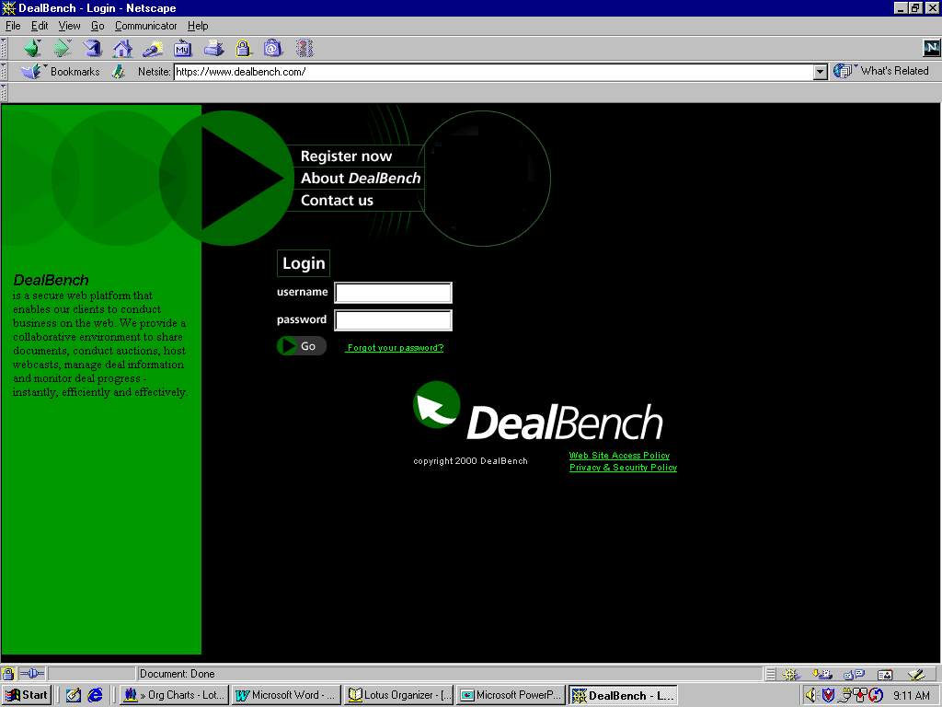
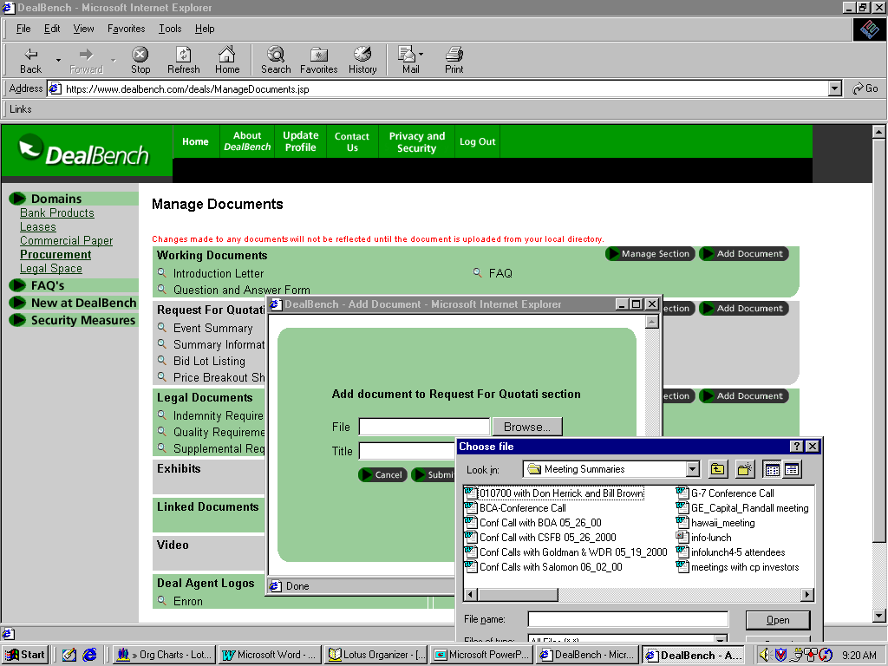
Auctions: Screen Shots
1. Deal Manager logs in at www.DealBench.com
2. Documents are uploaded to Deal Area

Slide 13
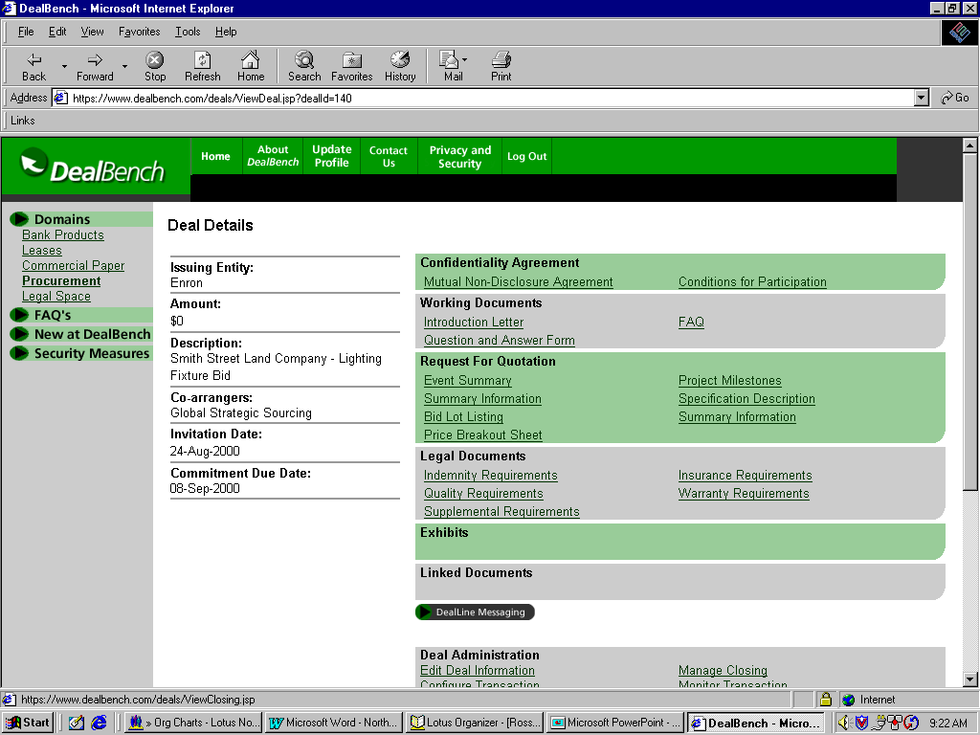
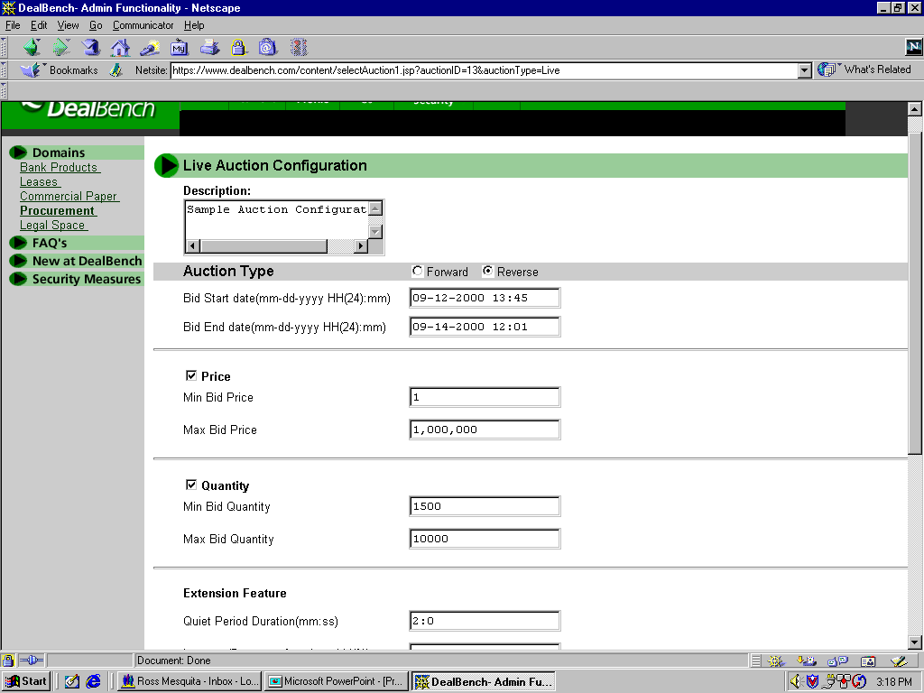
Auctions: Screen Shots
3. Deal page for participants
4. Deal Manager configures auction rules

Slide 14
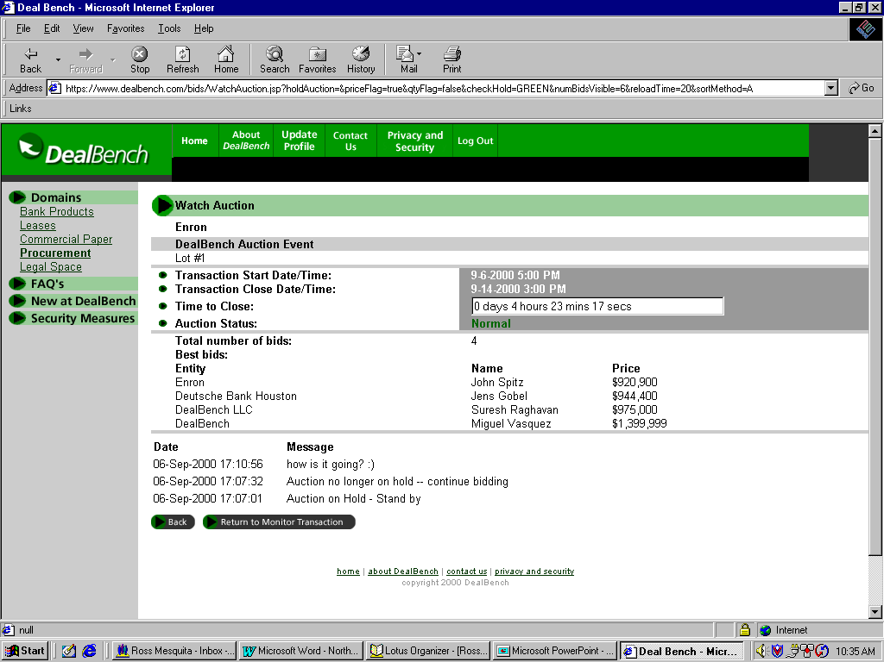
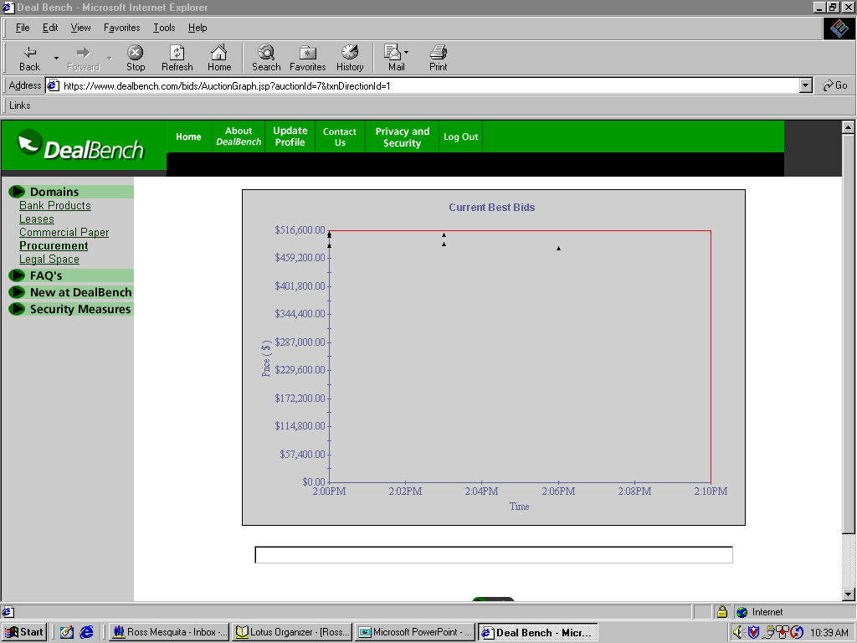
Auctions: Screen Shots
5. Watch transaction results
.
.
..
.
..
.
.
.
.
.
6. View auction graph

Slide 15
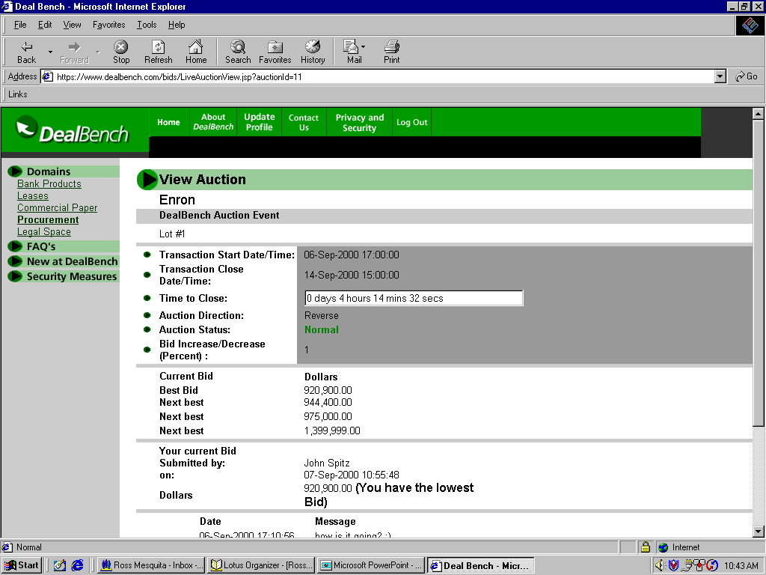
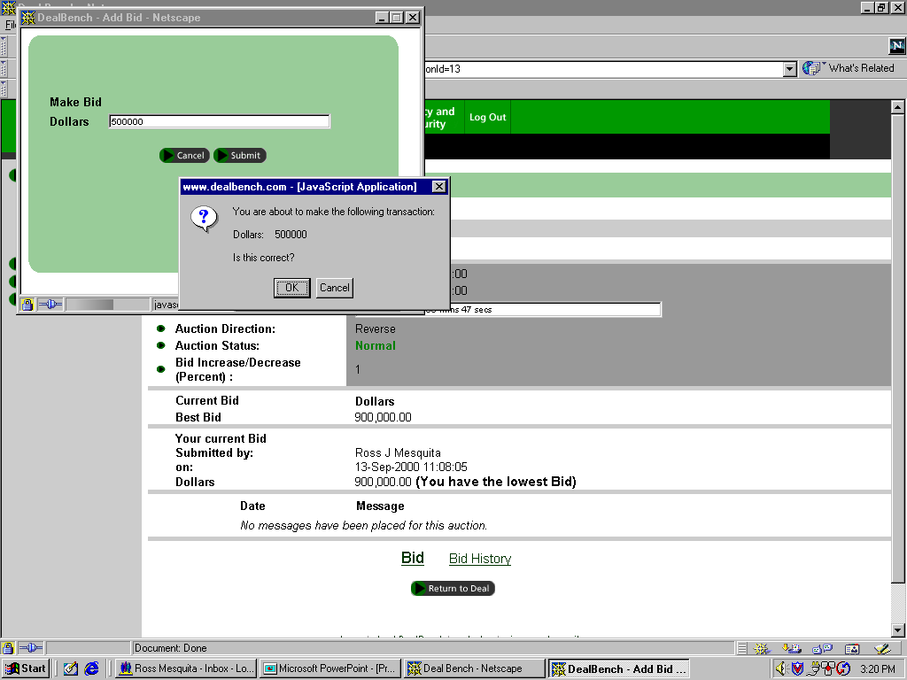
Auctions: Screen Shots
7. Bidder view screen
8. Bidder confirmation and verification

