Slide 1
Putting the Energy into e-commerce™

Slide 2
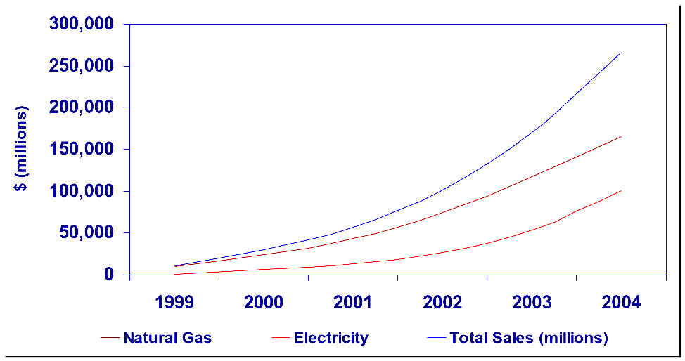
Sizing the Online Natural Gas
and Electricity Trade
>$266B
>$165B
>$100B
Source: Forrester Research, Inc. September 1999

Slide 3
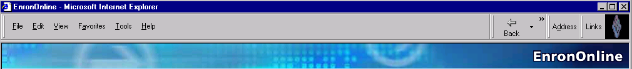
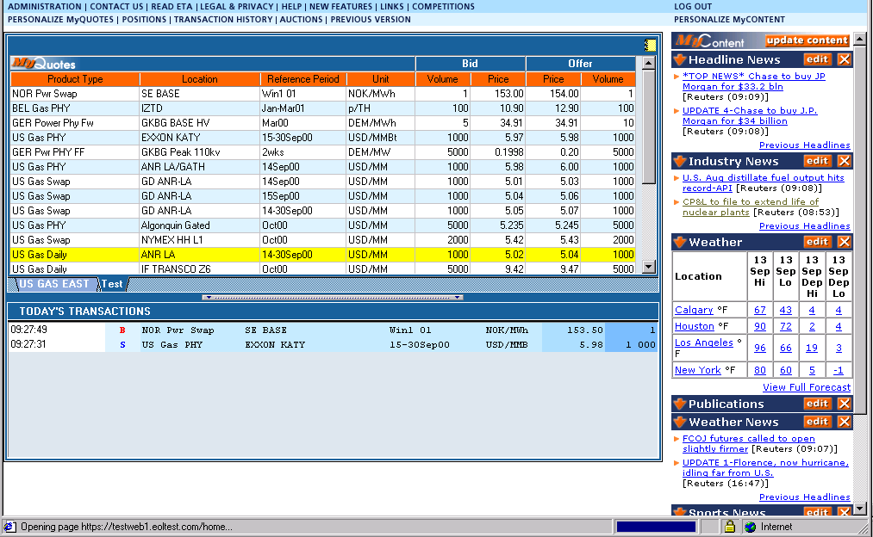
What is EnronOnline?
A Free, Internet-based, Global Transaction System Which Allows Counterparties to View Real Time Prices From Enron’s Traders and Transact Instantly Online

Slide 4
Benefits of EnronOnline
Free of Charge
Enron’s Best Prices
Real-Time Pricing Information
Faster than Traditional Channels
Access to Complementary Markets and Product Information
Secure Execution
Simple Access via the Internet
Easy to Use

Slide 5
Benefits of EnronOnline
Fast and Secure Execution
Market News and Quotes
Price Limit Orders
Industry Publications
Weather Insights
Advance Customization
Downloadable Transactions
Floating Windows

Slide 6
Markets Available on EnronOnline
Commodity Types
Argentine Natural Gas
Asian Crude & Products
Australian & Japanese Weather
Australian Power
Austrian Power
Bandwidth
Belgian Natural Gas
Canadian Natural Gas
Credit Derivatives
Dutch Power
Emissions
European Coal
European Weather
German Power
International Coal
Japanese Aluminum
LPG
Nordic Power
Oil & Refined Products
Petrochemicals
Plastics
Pulp & Paper
Sea Freight
Spanish Power
Swiss Power
UK Natural Gas
UK Power
US Metals
US Natural Gas
US Power
US Weather
Auctions
Emissions Auctions (US)
EnBank Virtual Storage Auction (UK)
Pipeline Capacity Auction
Options
Continental Power Options
Nuclear Outage Knock-In Call Options
Nordic Power Options

Slide 7
EnronOnline Prices on Other Electronic Trading Systems
Increase general customer access to Enron by providing additional transaction channels
Gives Enron access to customers who prefer to transact via multilateral platforms
Leverages the proven technology, liquidity and Enron resources that together provide superior services to all Enron customers

Slide 8
EnronOnline Statistics
Total Life to Date Transactions > 485,000
Average Daily Transactions > 3,500
Life to Date Notional Value of Transactions > $280 billion
Daily Notional Value Approximately $2.5 billion
Number of Products Offered: Approximately 1150
Number of Currencies Traded in = 13
EnronOnline Version 1.0 Launch Date: November 29, 1999
EnronOnline Version 2.0 Launch Date: September 18, 2000

Slide 9
Transactions via EnronOnline
Quarterly

Slide 10
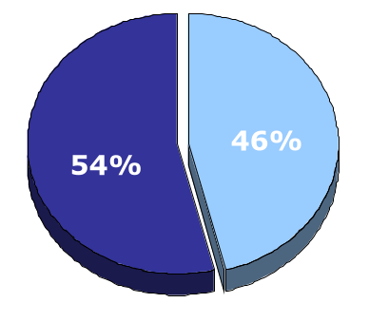
EnronOnline vs. Traditional Channels
Transactions
Daily % (30-day trailing average)
Traditional Channels
EnronOnline

Slide 11
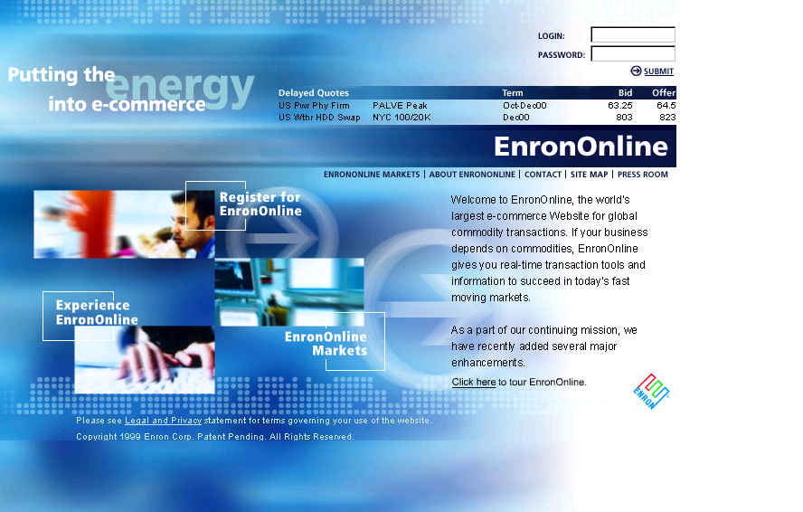
www.EnronOnline.com

Slide 12
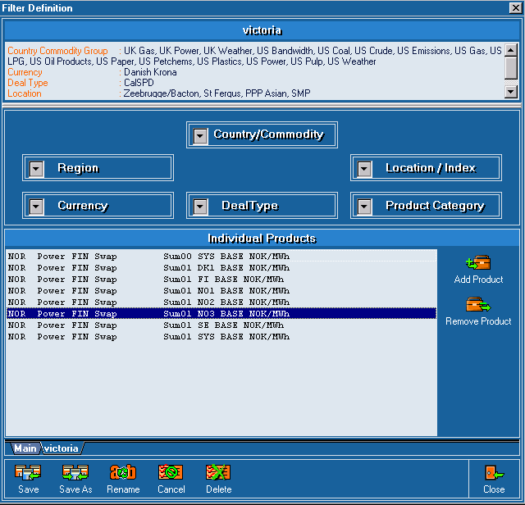
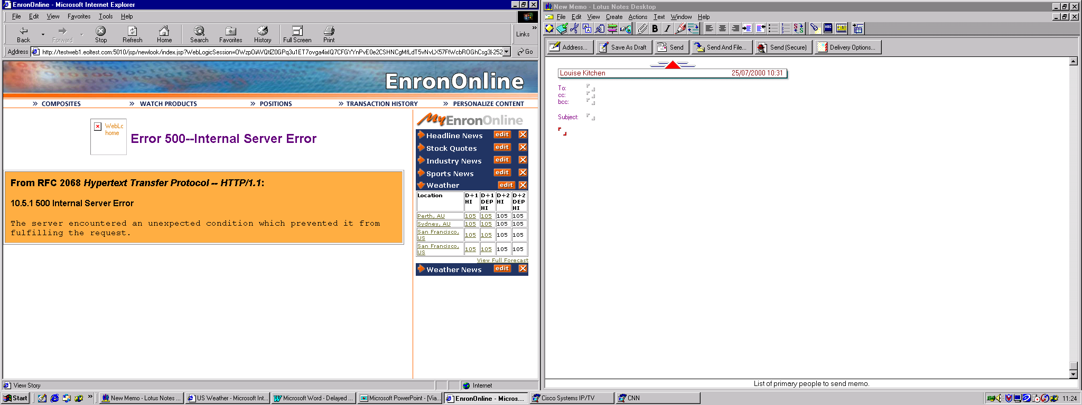
Customized Information
Customize your products and information according to your interests:
Commodity
Content

Slide 13
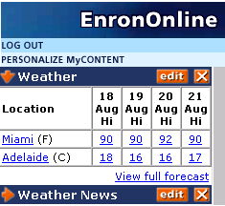
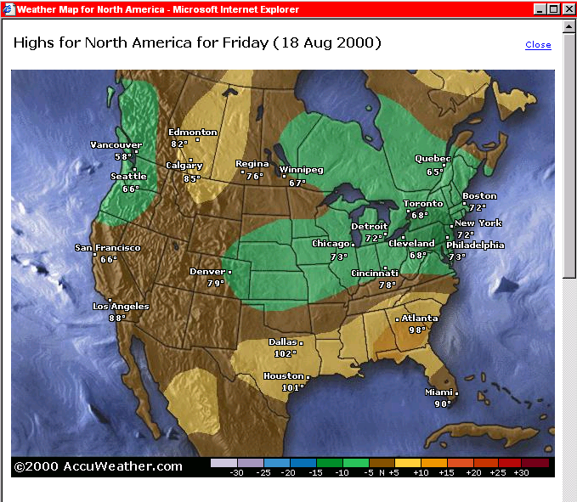
Weather Maps

Slide 14
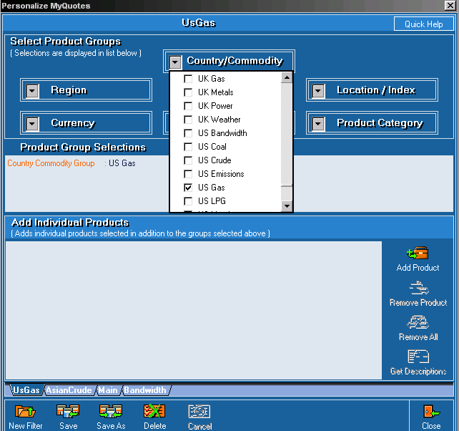
Customize Your Quotes
Customize by:
Country
Commodity
Region
Currency
Location/Index
Product Category
Deal Type

Slide 15
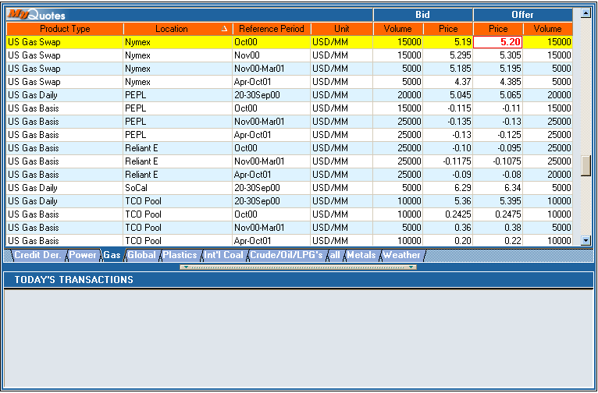
Click On Bid Or Offer Price

Slide 16
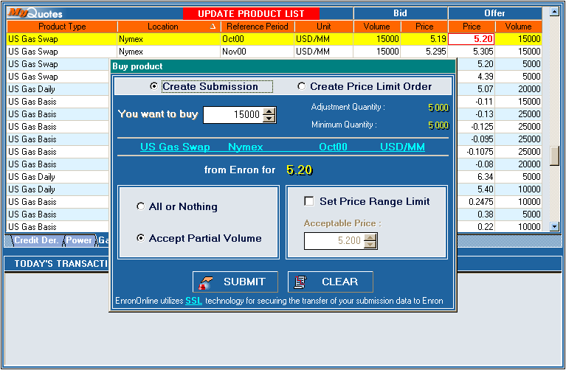
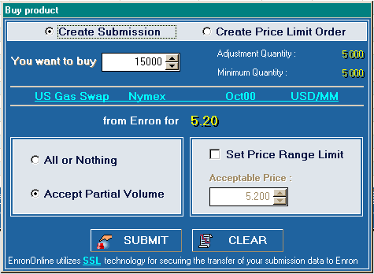
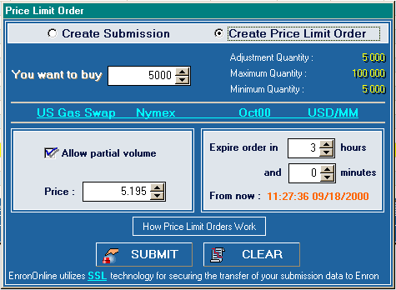
Submission Window
Notes:
Must accept partial volumes

Slide 17
Successful Transaction
B

Slide 18
Contact Us
If you have questions or problems regarding registration or using EnronOnline:
Call us:
The Americas: Asia and Australia All Other Regions:
+1 (713) 853-4357 (HELP) +61 2 9229 2300 +44 (0)20 7783 7783
Write us:
EnronOnline EnronOnline EnronOnline
P.O. Box 4656 Level 21 Enron House
1400 Smith Street 9 Castlereagh Street P.O.Box 29173
Houston, TX 77002 Sydney NSW 2000 London SW1X 7WB
USA Australia UK
E-Mail us at help@enrononline.com

Slide 19
Putting the Energy into e-commerce™

