Slide 1
CONFIDENTIAL
The Freight Transportation and Storage Market:
A New Business for Enron
Presentation to Greg Whalley
Jose Antonio Aguilar
Ricardo Charvel
September 20, 1999
The contents of this document are for the exclusive use of Enron personnel. This document was used in a presentation and does not include the full contents of the discussion. No part of it can be reproduced without written authorization from Jose Antonio Aguilar or Ricardo Charvel at Enron de Mexico

Slide 2
Objective
The objective of this document is to present a new business idea related to the creation of a market in which risk management and financial products are offered to the freight transportation and storage industries.

Slide 3
Contents
Introduction
1. The idea
2. The transportation and storage industries
3. The business opportunities for Enron
Products
Synergies
The future
4. Next steps

Slide 4
Introduction
Enron has always been innovative in creating markets in industries where no one thought it was possible.
Enron has always taken into account the physical part of the business.
while others focus mainly on financial products.
Enron has excelled in combining the physical, financial and risk management products for sectors such as electricity, natural gas, paper and telecommunications.
Enron has even gone into areas like weather derivatives and emissions trading.
Enron has the necessary capabilities and the opportunity to create the Transportation and Storage or Freight Market

Slide 5
1. The idea
Enron should develop the Transportation and Storage (freight) Commodity Market in order to increase and standardize the transactions in the industry and offer risk management and financial products required by the participants in this business sector.
The commodity in this market would be load and volume transport capacity and storage capacity. Enron would be the market maker.
Sounds familiar? Transport and storage. It is something like natural gas but with different logistics.
There are important benefits for the industry participants and the final users that have to do with certainty, long term planning, flexibility and efficiency.

Slide 6
What Makes a Product a Commodity?
CHARACTERISTICS...
...FIT THE BUSINESS
Crude oil, natural gas, electricity, bandwidth, paper, these are all commodities that trade in an open market for future delivery.
Providers of these commodities tend to be large, concentrated firms, and consumers are diverse.
The quality of each product is specified and measured, the price is fixed in advance, and delivery must take place within a defined period.
Each has a benchmark within its market, allowing lesser grades to trade at discount and superior grades to trade at a premium.
Transaction costs are low and margins thin and can only be achieved by bundling the commodity within a customized solution.
All provide solutions allowing price risk to be managed, preserving margins that otherwise approached zero.
All these characteristics fit the transportation and storage business

Slide 7
Elements of a commodity market
CONDITIONS FOR THE DEVELOPMENT OF THE COMMODITY
ELEMENTS OF THE TRANSPORTATION MARKETS
MARKET DRIVERS
Liquidity: The market invites
a large number of participants
Credibility: the market is
linked to existing physical
delivery mechanisms
Accountability: with the
creation of a benchmark,
monitored hubs, and liquidated
damages provisions, participants
will provide firm services
Quality of service standards
(QoS) can be developed and
measured, facilitating the
creation of a benchmark
Carrier capacity can be
“interconnected” or
exchanged (hubs),
facilitating immediate
provisioning of contracted
services.
Master agreements replace
one-off contracts allowing
the commodity to be
traded efficiently
City pair Routes: must be liquid
and volatile, remain strategic in
the future, level playing field and
with no barriers to access
Specifications:
They push technology for
better level of service
They can be monitored
objectively
Unambiguous and significant
liquidated damages
They promote liquidity
They simplify contracts in
size, term and choices
They expand possibilities
the industry
Hub operator: performs scheduling,
monitors QoS, certifies market integrity,
declares force majeure, etceteras.

Slide 8
2. The transportation and storage industries
The value of goods transported is of 7.6 trillion dollars
The industry will move more than 2 trillion ton-miles in 1999
The operating revenues for the trucking industry alone were nearly
U.S.$200 billion for 1997. This is roughly equivalent to 50% percent of
Mexico’s GDP or to the size of the U.S. electric market
The operating revenues for the storage industry were more than
U.S.$12 billion for 1997
There are no standardized contracts, terms or quality of service indexes
in the industry
A centralized market for trading capacity does not exist
The industry spends 14 billion dollars a year in fuel

Slide 9
Shipment Characteristics
TOTAL MODAL ACTIVITY
1997
6,000,000
5,000,000
4,000,000
The total value of goods shipped in the U.S. is US$7.6 trillion
Trucks are the leading mode of transportation in the U.S. (81% of the market value)
Rail represents 4% of total industry value and 35% of the total ton-km
The fastest growing mode of transportation is the Parcel and US Postal Service with a 11% YoY increase for the last 5 years
US$ million
3,000,000
2,000,000
1,000,000
0
Truck
Rail
Air
Pipeline
Other
Parcel, USPS
1,200,000
1,000,000
Million Ton-Km
800,000
600,000
400,000
200,000
0
Truck
Rail
Air
Pipeline
Other
Parcel, USPS
Source: Transportation-Commodity Flow Survey, DOC, 1999

Slide 10
Main Transported Products
Some of these commodities are produced by industries where Enron offers services and risk management solutions
20 MOST TRANSPORTED PRODUCTS
Commodity Description
Value
U.S.$(M)
Value%
Ton-
Ton-
miles%
Avg..
miles(M)
miles
COAL
27,013
0.4
520,046
18.5
94
CEREAL GRAINS
62,915
0.8
241,971
8.6
116
GASOLINE AND AVIATION TURBINE FUEL
191,957
2.5
139,709
5
46
PREPARED FOODSTUFFS N.E.C. AND FATS AND OILS
347,241
4.6
129,920
4.6
103
BASE METAL IN PRIMARY OR SEMI-FINISHED FORMS AND IN FINISHED
289,994
3.8
129,049
4.6
247
BASIC CHEMICALS
137,285
1.8
118,239
4.2
250
GRAVEL AND CRUSHED STONE
11,568
0.2
102,191
3.6
38
WOOD PRODUCTS
137,872
1.8
101,708
3.6
258
NON-METALLIC MINERAL PRODUCTS
112,830
1.5
95,189
3.4
335
PULP, NEWSPRINT, PAPER, AND PAPERBOARD
121,681
1.6
93,721
3.3
180
AGRICULTURAL PRODUCTS EXCEPT LIVE ANIMALS, CEREAL GRAINS
106,487
1.4
88,367
3.1
342
PRODUCTS OF PETROLEUM REFINING N.E.C. AND COAL PRODUCTS
68,279
0.9
82,878
3
70
PLASTICS AND RUBBER
298,160
3.9
75,018
2.7
390
FUEL OILS
88,104
1.2
59,918
2.1
28
NON-METALLIC MINERALS N.E.C.
11,672
0.2
54,229
1.9
167
MILLED GRAIN PRODUCTS AND PREPARATIONS, AND BAKERY PRODUCTS
109,437
1.4
50,066
1.8
109
ARTICLES OF BASE METAL
250,227
3.3
49,042
1.7
477
ANIMAL FEED AND FEED INGREDIENTS, CEREAL STRAW, AND EGGS AND
67,113
0.9
48,649
1.7
65
VEHICLES
591,021
7.8
47,406
1.7
189
FERTILIZERS AND FERTILIZER MATERIALS
31,653
0.4
47,330
1.7
102
TOTAL TOP 20 PRODUCTS
3,062,509
40
2,274,646
81

Slide 11
Growth in the Trucking and Storage Industry
OPERATING REVENUES/TRUCKING
US$ million
200,000
150,000
100,000
50,000
For the past five years, the trucking industry has grown at a 5% rate as a result of a strong US economy and increased demand for transportation services.
On the other hand, there has also been a substantial recovery in storage, mainly because supply companies’ inventories have grown as the use of just-in-time operations by the final users have increased.
0
1997
1996
1995
1994
1993
OPERATING REVENUES/STORAGE
US$ million
16,000
12,000
8,000
4,000
0
1997
1996
1995
1994
1993

Slide 12
Operating Revenue and Expenses/ Trucking Industry
EXPENSE DETAIL
100% = U.S.$171.0 Billion
Other operating expenses
15%
Drug and alcohol testing
0%
Taxes and licenses
Annual payroll
2%
31%
Depreciation
Total operating revenue in 1997 for the for-hiring trucking and courier services industry (excluding air services) was estimated at US$183.2 billion.
5%
Maintenance
and repair
6%
Insurance
3%
Lease and rental
Employer contribution
to Social Security
2%
8%
Purchased transportation
Purchased fuels
20%
8%
Source: Transportation Annual Survey, DOC, 1999

Slide 13
Operating Revenue/ Storage and Warehousing Industry
EXPENSE DETAIL
100% = U.S.$10.3 Billion
Total operating revenue for public warehousing services reached $12.8 billion during 1997.
Lease and rental
14%
Purchased repairs
Purchased fuel
4%
1%
Insurance
Depreciation
2%
8%
Employer contributions
to Social Security
Taxes and licenses
7%
4%
Other operating
expenses
28%
Annual payroll
32%

Slide 14
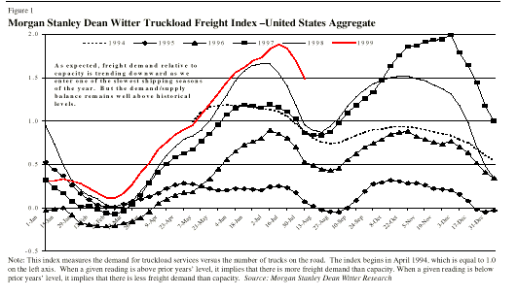
Seasonality
TRUCKING FREIGHT INDEX
U.S. Aggregate
The trucking industry is highly seasonal, with high peaks by the end of the year,and lows during the winter/spring season.
This situation creates a logistics and investment problem for the transportation industry, as some equipment might become idle during some periods of time a year as a result of a lack of freight
2.0
1.5
1.0
0.5
0.0
-0.5
Note: this index measures demand for truckload services versus the number of trucks on the road. The index begins in April 1994, which is equal to 1.0 on the left axis. When a given reading is above prior year’s level, it implies that there is more freight demand than Capacity and vice versa.
Source: Morgan Stanley Dean Witter

Slide 15
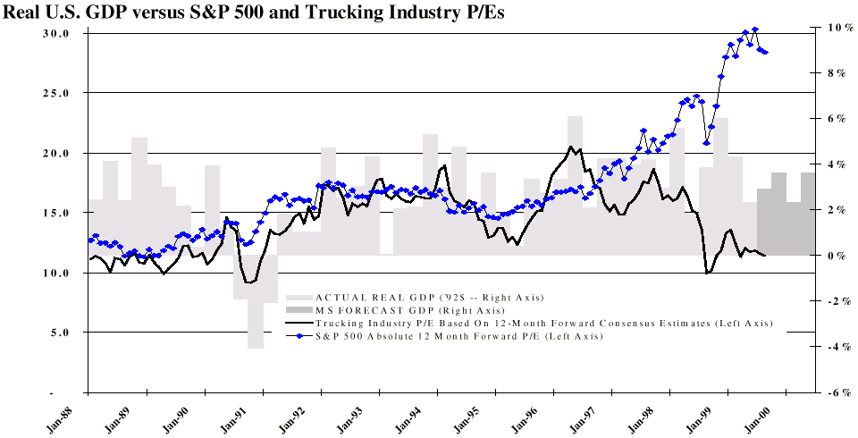
Economics
Factors influencing the performance of the transportation industry, especially the trucking industry, are GDP growth, export levels, fuel prices and inventory (storage) levels
REAL U.S. GDP VS. S&P 500 AND TRUCKING INDUSTRY P/Es

Slide 16
Leading Transportation Companies
The top ten companies on Wall Street have sales above US$1 billion with average credit ratings of BBB
Industry
Company
Symbol
Last Qtr EPS
This Qtr EPS
Sales
Net Income
Rank
1
LAIDLAW INC
LDW
0.17
0.08
3,500
319
2
YELLOW CORP
YELL
0.52
0.61
2,960
42
3
ROADWAY EXPRESS
ROAD
0.4
0.43
2,650
30
4
CONSOL FRGT CP
CFWY
0.11
0.31
2,290
21
5
USFREIGHTWAYS
USFC
0.96
0.99
2,010
84
6
HUNT (JB) TRANS
JBHT
0.3
0.35
1,930
43
7
ARKANSAS BEST
ABFS
0.47
0.46
1,660
36
8
LANDSTAR SYSTEM
LSTR
1.05
1.1
1,320
39
9
AMER FREIGHTWAY
AFWY
0.4
0.4
1,070
37
10
ALLIED HOLDINGS
AHI
0.53
-0.21
1,040
4

Slide 17
The freight trail
There are many transaction opportunities to serve different parties in
the daily course of business
Rail
Storage
Minerals
Logistics
Truck
Distribution
Grains
Air
End-Use
Consumers
Perishables
Ship
Storage
Paper
Container
Chemicals
Tanks
Refrigerated
Distribution
Goods and
services
Other

Slide 18
3. The business opportunities for Enron
REASONS FOR ENRON TO BE IN THIS BUSINESS
Market
Strategy
Synergies
The size of the industry is very attractive
There are important information gaps within the industry participants
There are important risks that are not covered
There are many transaction opportunities
Enron will create a market that does not exist
There is an extraordinary opportunity to gather information on commodities
We already have most of the necessary capabilities
We can change the industry and create enormous value
Risk management products are needed
Financing development will be necessary
Physical delivery of fuels and other commodities will be part of the business
Telecommunication technologies will be used
.

Slide 19
Physical and Financial Fundamentals of the Industry
TRANSPORTATION
Concept
Physical
Financial
Assets
Logistics
Leasing / Acquisition
Equipment Availability
Short Term Contracts
Equipment Usage
Equipment Renewal
Liabilities
Service Delivery
Financing Costs
Equipment Leases
Debt Financing
vs.
Leases
No Known Prices
STORAGE
Concept
Physical
Financial
Assets
Logistics
Leasing / Acquisition
Space Availability
Long Term Contracts
Space Usage
Special Needs Service
Liabilities
Service Provision
Financing Costs

Slide 20
Industry Structure and Analysis
Rivalry Among Existing Firms
4% CAGR growth for the last five years
The 10 largest companies hold 20% of
the market
Differentiation is based on service
Low switching costs
Complex and expensive learning curve
Capacity issues are seasonality driven
Threat of New Entrants
Large scale economics: size matters
First mover advantage is not an issue
Access to clients is open to new entrants
No client loyalty but relationship matters
No legal barriers
Industry
Profitability
Bargaining Power of Buyers
Low switching costs
Differentiation based on service
Number of buyers is large and growing
No control over availability of equipment
Threat of Substitute Products
Multimodal possible for some shippers
Relative prices define modal usage
Shippers willing to switch in bulk cargo
Bargaining Power of Suppliers
Low switching costs
Differentiation based on service and quality
Large number of buyers
Control over costs associated with industry

Slide 21
Risks Associated with the Industry
THEIR PROBLEMS…OUR SOLUTIONS
Risk
Problem
Enron Solution
Availability and
Transportation equipment
Long term contract to serve
Service
not available to serve
customer at know prices and
New Product
customer
standard quality
No long term relationship
with shippers
Fuel Prices
Changing fuel prices affect
Diesel and other fuels
company cash flow
derivatives
Existing Enron Products
Weather
Quality and reliability
Weather derivatives
problems associated with
unpredictable weather
Reliability
Unable to serve customer
Enron Communications and
on time
information technology
Storage usage
Warehouses stand idle
Long term contracts for
New Product
during long periods of time
warehousing that can be
affecting the cash flow of
exchanged in an open market
the operators

Slide 22
Evidence for the feasibility of risk management
REQUIREMENTS
EVIDENCE
1. High degree of
product
commoditization
2. High price volatility
3. Large volume
4. Fragmented industry
5. Large number of
natural counterparts
6. Develop an accepted use
of industry indices for
pricing
• Several “benchmark” routes exhibit commodity-like
characteristics
• Many of the prices for routes are highly correlated with seasonality,
fuel prices or the weather
• Volatility high depending on routes, season, fuel price, etc.
• U.S. trucking industry revenues > U.S. $200+ billion/year
• Trucking segment alone is almost as large as the electricity
market and is larger than other commodities with active markets
(e.g.,petroleum, paper,natural gas and coal)
• No major companies are concentrated on a national or global scale
• Not all participants will see a compelling need to hedge,
but enough will to drive the market
• The indices could be developed by City-Pair Routes very much like
in the bandwidth business
The fundamentals are in place to suggest
that risk management products will take off

Slide 23
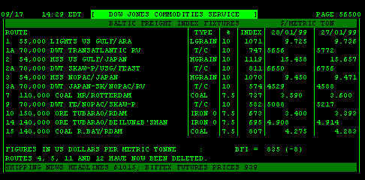
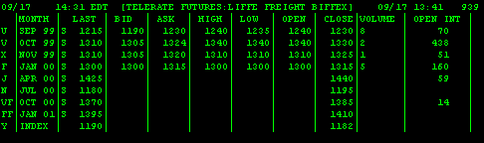
Something similar is working today
MARITIME SHIPPING MARKET INDEXES
Baltic Freight Index Fixtures
LIFFE
The index was created in 1970
These futures indexes are quoted daily in the LIFFE out of London.
The Baltic Fixtures operate on a port-pair basis and is under management of the Baltic Exchange
BIFFEX, the shipping index, works using the Baltic Freight Fixtures to compose the index, so both are related
BIFFEX is now part of the LIFFE
Port Pairs
Freight BIFFEX Index Futures
LIFFE
Source: Telerate

Slide 24
Enron Products/ Transportation
Physical
Provision of transportation capacity
Fuel delivery at hubs
Delivery of physical commodities
Risk Management
Fuel
Transportation Contracts
Storage availability
Weather
Financial
Contract Monetization
Equipment Acquisition
Facilities and Equipment Improvement

Slide 25
Enron Products/ Storage
Physical
Capacity exchange/swap
Swap excess storage volumes for re-delivery at later date
Index-minus high season commodity sale
Storage rights
Withdrawal rights
Risk Management
Hedging: Operationally allows to have commodity available when there
may be supply constraints. Economically it allows to buy low and sell high
Swaps: allows setting of term and quantity with different price structures
Options:Price caps, Floors, Collars, Swap options, Spread options, custom
Financial
Guarantees on stored commodities
Infrastructure development

Slide 26
Synergies
Fuel
Physical
Risk management
Weather
Risk management
Telecommunications
Services
e-trade
Finance
Infrastructure development
Financial guarantees on stored commodities
Other
Commodity risk management
Physical commodities

Slide 27
The future….endless possibilities
TELEMATICS:
This technological development uses telecommunications and information systems to transmit instructions to moving vehicles it is starting to be used in automobiles through accessories like GPUs and satellite tracking.
DEVELOPING INLAND HUBS:
The development of inland hubs for storage and distribution, very much like ports and airports might take off. This business would enable Enron to develop a business similar to natural gas storage.
EXPANDING GLOBALLY:
This business can be expanded globally once it takes off in the United States and Canada.
FINANCING INFRASTRUCTURE DEVELOPMENT:
Like in the energy sector, once Enron changes the way things are done in the industry massive infrastructure (facilities, telecommunications, roads, ports, etc.) development will be
needed worldwide
AIR PASSENGER MARKET:
The development of businesses as complicated as an air passenger transport market may be feasible.

Slide 28
4. Next steps
Evaluation and authorization to proceed by decision makers
Studies and detailed evaluation
Business plan
Development resources

