Slide 1
Quaker Oats – Industry Analysis
Food and beverage industry
Consolidated, concentrated with few niche players
Major players
Food: General Mills, Nestle, Pepsi, Kraft
Beverage: Coke, Pepsi, Cadbury-Schweppes, Cott
Major factors of growth:
Anticipate consumer demand
Distribution channels
Serve domestic and international markets
Price sensitive?
Recent industry changes:
Soft drink industry experiencing slowing growth for last three years (.2% 2000, .5% 1999, 3% 1998); growth of non-carbonated beverages outpace carbonated beverages
?? Emphasis on health products? Convenience? Lots of slightly different products?

Slide 2
Quaker Oats – Business Analysis
Background
Food and beverage business
Gatorade, cereals and snacks, Aunt Jemima, Rice-A-Roni
92% operating income and 81% sales from US and Canada
Mature, formed in 1901 by American pioneers
Gatorade accounts for 40% of OAT’s sales and profits ($1.84b)
CEO Robert Morrison (since 1997)
Position in industry
84% share of sports-drink market in US with Gatorade (Pepsi owns All Sport and Coke owns Powerade)
Fourth largest manufacturer of cereals
Fifth largest manufacturer of pasta
Strategy
Concentrate on Gatorade and grain businesses
Recent history
1994 bought Snapple for $1.7 billion, sold in 1997 for $300 million
1999 cut workforce by 10% shifting people from grain to Gatorade
2000 formed joint venture with Swiss pharmaceutical co. to develop and market function foods with health benefits

Slide 3
Quaker Oats – Financial Analysis
ROE decomposition
Common size financials
Cash flow analysis
Our valuation results
Quaker Oats – Accounting Analysis
Any data issues?

Slide 4
Story of Deal - Beginning
Pepsi makes surprise $14.8b takeover offer
OAT rejects Pepsi’s offer because Pepsi would not provide security against share price drop
Coke makes offer of $15.75b
Rookie CEO Douglas Daft’s idea
Strategy: boost Coke’s sales of non-carbonated drinks
CEOs posed for publicity photos together
Group Danone (French-based seller of Evian) makes offer of $15b

Slide 5
Story of Deal – Ending
COKE
“Giving up 10.5% of the Coca-Cola Company was just too much for what we would get” Mr. Buffet says.
COKE Board collectively decided to abandon the deal. It was never even brought to a vote.
11/21/200 – Douglas Daft announced that Coke will not pursue the transaction
“The Board of The Coca-Cola Company expressed its enthusiastic support for the current strategic course of the Company under Doug Daft’s leadership as the best means for enhancing shareowner value”

Slide 6
Story of Deal – Ending
PEPSI
12/4/00 – PEP agreed to buy OAT for $14.5b ($13.4b) in stock and assumed debt
Tax-free transaction: 2.3 PEP for each OAT share up to a maximum value of $105/OAT share (PEP issue approx 315 million new shares to OAT); assume $750 million of OAT debt
If value to OAT shareholders falls below $92/share, OAT can exit the deal
PEP and OAT shareholders on record as of March 9th vote on May 1
If deal not completed by June 2nd either party can terminate the agreement
Received preliminary approval by the SEC of the joint proxy statement
OAT discontinue $1 billion share repurchase program
3/27/01 – European Commission grants clearance for the merger
4/9/01 – PEP announces sale of 13.2 million shares to ensure merger can qualify for “pooling of interests”

Slide 7
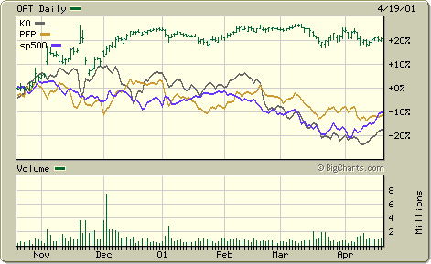
Stock Price Reactions
Stock price weekly percentage change for last 6 mos. For OAT, KO, PEP and S&P 500

