Slide 1
Customer Service Review
ETS Gas Logistics

Slide 2
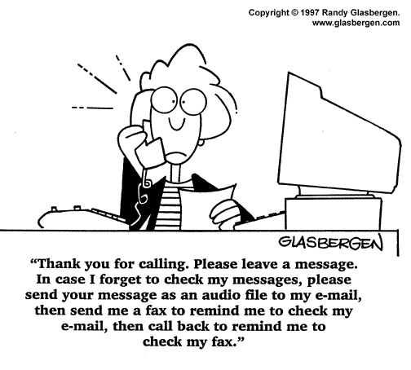
Notes:
Hopefully this isn’t the experience that you have when you call on our FGT team.
Admittedly, however, that while technology helps us get things done – sometimes it also removes the personal aspect of service.

Slide 3
Objectives for Meeting
Progress on Gas Logistics Vision
Share slides from Recent Presentations
Share and Discuss Customer Feedback

Slide 4
Gas Logistics 2001 Action Plan
Align Market Services with Commercial Group
Complete New Contracts System
Develop Plan for New Rates/Revenue System
Create Ongoing Customer Training Tools
Use Customer Meetings as a Tool to Solicit Feedback & Manage Customer Expectations
Revise Hottap Look
Develop Deal Execution Tools
Roll-out Measurement Desk on NNG
Implement Customer Call Center

Slide 5
Top Concerns for Gas Logistics
Follow-up on customer feedback
Continued automation of transactional processes
Best practices sharing / common computer systems
Outage coordination with marketing, operations & customers
Minimize ETS Exposure to commodity risk by minimizing imbalances, UAF and reducing prior period adjustments
Address recent computer system failures
Update and improve emergency communication plans

Slide 6
The Role of Gas Logistics
Liaison between Marketing, Operations, Operators and Customers
Responsible to ensure that transactions (“paper deals”) translate first into physical flows and ultimately into cash flow
Daily point of contact for customers

Slide 7
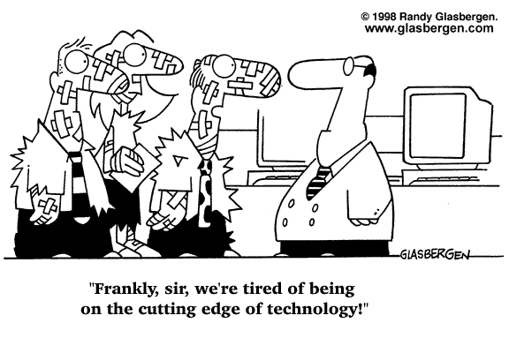

Slide 8
2000-2001 Customer Milestones
All pipes now on same TMS scheduling system
Email notification system (critical notices, bump notices, scheduled cuts)
Web based system to access flow volumes (FGT)
Measurement desk on FGT & NNG
Invoice and imbalance statements added to website
New contract / capacity release system
Expanded HotTap Helpdesk to provide central contact for logon and application concerns
Hands on customer training workshops
Notes:
Seriously though – We are committed to moving forward with better ways of doing things. We have been talking to you and your staff about this since 1999. We were unhappy with our performance in customer satisfaction surveys and were determined to improve in your eyes.
Since then, we have held annual operations meetings with you an your staff to talk in detail about what we are doing well and where we can improve.
As a result of your feedback, we have made a number of significant changes
Last year we implemented a new scheduling system. Your feedback this year indicates that it is easy to use and delivers dependable scheduled quantity reports.
We began to use automatic email notices to warn you of key business changes. This gives you the flexibility to leave your desk even though the business has become 24/7.
No one wants FGT to call Alert Days. But you realize that because the FGT system operates at a high load factor without the benefit of storage, that the system operates on reduced flexibility for days and periods of the year. You told us that you could better deal with 10 or 15% alert days when we see conditions tighten. In the last year we have not had to call an Alert Day with less than a 10% tolerance and in fact most Alert Days have still permitted 15% flexibility.
We worked with you to convert the real-time operational flow data from an old application to a new web-based system. This means that you can check on your flow status from home or anywhere that you can dial-in to HotTap.
We implemented the measurement desk as a single point of contact for customers and FGT field staff to log gas measurement concerns. At the customer meeting last year we talked to you about our vision of how the measurement desk can help make prior period adjustments a thing of the past.
And, we began to publish invoice and imbalance statements in electronic form.

Slide 9
Continuing Customer Service Initiatives
Customer Control of Security Access
Making critical notices more pager/palm device friendly
HotTap webpage navigation
Enhancing TMS scheduling reports
Notes:
But you provided us lots more feedback at the May operations meeting. Some of which we haven’t yet completed.
You told us that because of staff changes and for internal control reasons, you would like the ability to administer your own password access (I.e. decide who on your staff if authorized to submit capacity release, who can submit nominations, etc).
You told us that you like the automatic email notification, but that you would like more description in the header text that can be picked up by your pager or palm device
We recently conducted an on-line survey on HotTap and received suggestions about how to line the most commonly needed information to the start page.
You told us that you would like to see a listing of allocated points on the website.
In addition to the feedback you provided, we also have initiated our own efforts to improve the outage coordination process. I’d like to talk about that for a minute.

Slide 10
Some Customer Feedback
My rep does a great job and is pleasant to deal with
I like that I can usually get a live voice on the phone
It takes 3 levels of management to make a decision
Sometimes I receive a pat “per GISB, we’re not allowed” rather than a real explanation
It seems like the process drives the business. People are willing to help but they can’t stop the system
My rep seems bothered by my call
It’s difficult to reach reps on the phone
I’ve been told by a rep that they don’t know the answer or where to find it

Slide 11
Other Customer Service Feedback
Provide factual basis for ETS decisions or find someone who can.
Don’t blame ETS decisions on GISB, FERC, upper management or systems, etc.
Customized service carries with it an added burden of follow-through when rep is away.
In the long run, consistency is more important than saying “yes.”

Slide 12
Action Plan
Use Customer Service Commitment to manage customer expectations
Provide convenient training forum

Slide 13
SAMPLE
Customer Service Commitment
During the period {7:30 AM-12 AM} each day, we promise that your call will be answered by an ETS representative.
If we have other calls on the line, we will ask whether you would rather be put on hold or receive a return call. We will return calls about current day business within {15} minutes.
When you ask us to research a historical issue, we will commit to a timeframe for a reply. If the research will take more than a week, we promise to provide you with a weekly status.

Slide 14
Customer Service Commitment
If you ask a question that a particular representative cannot answer, we promise to stay on the line until we find someone to help you with your concern.
In the event of system outages, we will notify you by {phone or email} within {1} hour of the outage and explain our plan for completing business transactions for the day.
We will provide advance notice {at least 1 week} for any system changes or report changes.

