Slide 1
Customer Service Review
ETS Gas Logistics

Slide 2
Objectives for Meeting
Progress on Gas Logistics Vision
Slides from Recent Presentations
Share and Discuss Customer Feedback
Define “Customer Service”
Propose Action Plan

Slide 3
Gas Logistics 2001 Action Plan
Align Market Services with Commercial Group
Complete New Contracts System
Develop Plan for New Rates/Revenue System
Create Ongoing Customer Training Tools
Use Customer Meetings as a Tool to Solicit Feedback & Manage Customer Expectations
Revise Hottap Look
Develop Deal Execution Tools
Roll-out Measurement Desk on NNG
Implement Customer Call Center

Slide 4
Top Concerns for Gas Logistics
Follow-up on customer feedback
Continued automation of transactional processes
Best practices sharing / common computer systems
Outage coordination with marketing, operations & customers
Minimize ETS Exposure to commodity risk by minimizing imbalances, UAF and reducing prior period adjustments
Address recent computer system failures
Update and improve emergency communication plans

Slide 5
The Role of Gas Logistics
Liaison between Marketing, Operations, Operators and Customers
Responsible to ensure that transactions (“paper deals”) translate first into physical flows and ultimately into cash flow
Daily point of contact for customers

Slide 6
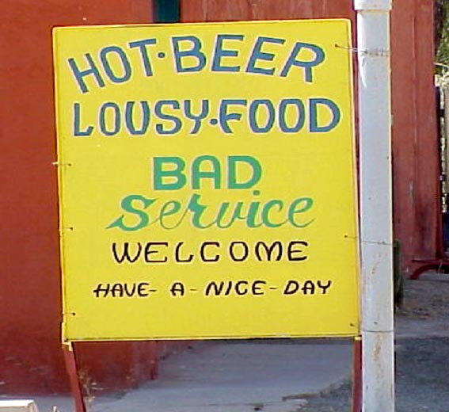

Slide 7
Some Customer Feedback
My rep does a great job and is pleasant to deal with
I like that I can usually get a live voice on the phone
It takes 3 levels of management to make a decision
Sometimes I receive a pat “per GISB, we’re not allowed” rather than a real explanation
It seems like the process drives the business. People are willing to help but they can’t stop the system
My rep seems bothered by my call
It’s difficult to reach reps on the phone
I’ve been told by a rep that they don’t know the answer or where to find it

Slide 8
Action Plan
Develop a Customer Service Commitment
Implement a training forum to supplement current skills
Ask teams to adjust activities to ensure that service commitment met

Slide 9
SAMPLE
Customer Service Commitment
During the period {7:30 AM-12 AM} each day, we promise that your call will be answered by an ETS representative.
If we have other calls on the line, we will ask whether you would rather be put on hold or receive a return call. We will return calls about current day business within {15} minutes.
When you ask us to research a historical issue, we will commit to a timeframe for a reply. If the research will take more than a week, we promise to provide you with a weekly status.

Slide 10
Customer Service Commitment
If you ask a question that a particular representative cannot answer, we promise to stay on the line until we find someone to help you with your concern.
In the event of system outages, we will notify you by {phone or email} within {1} hour of the outage and explain our plan for completing business transactions for the day.

Slide 11
Internal Customer Service Standard
Put yourselves in customer’s shoes.
Provide factual basis for ETS decisions or find someone who can.
Don’t blame ETS decisions on GISB, FERC, upper management or systems.
Customized service carries with it an added burden of follow-through when rep is away.
In the long run, consistency is more important than saying “yes.”
Ask for training for the things you don’t understand.
Hold your team to the Customer Service Standard.

