Slide 1

Jump-Diffusion Modeling & Option Pricing
The 3rd Annual Energy Derivatives
Quentin Kerr
email:qkerr@maths.uq.edu.au
The Department of Mathematics
The University of Queensland

Slide 2

Agenda
Stochastic Differential Equation (SDE) Modeling
Futures Curves
Options Pricing
Software Prototype in Matlab
Notes:
Introduction of this talk
1. Modeling
For simplicity, we only focus on the SDEs with one Wiener process and one Poisson process.
2. Futures
The analytic relationship between the spot price and the futures price will be developed under pure-diffusion model. How, the same idea will not work under jump case.
3. Options
For general purpose, we only give a European option’s formulation. Since these PDEs can not be solved analytically, only the numerical approach can be applied.
4. Prototyping
We will demonstrate our financial toolkits.

Slide 3
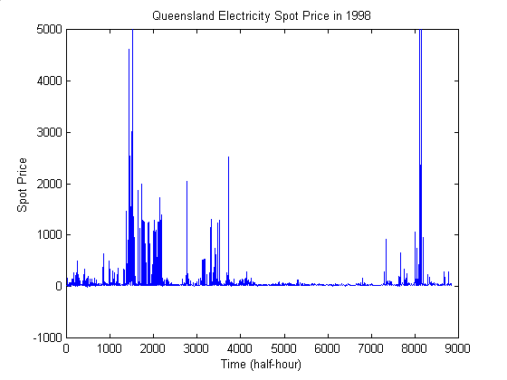
Spot Market Price Performance
Notes:
The graph of electricity spot price in QLD in 1998
The spikes on the curve represent the unexpected events bringing the spot price up, while the underlying values represent the normal spot price around its mean.

Slide 4
Pure-Diffusion Models
Black-Scholes Model (Geometric Brownian)
$\begin{aligned}{{\text{dS}}_{t}}/{S_{t}}=μ_{t}\text{dt}+σ_{t}{\text{dW}}_{t} \\ \text{ where} S_{t}\text{ Spot Price} \\ t\text{ Time} \\ μ_{t}\text{ Drift Rate} \\ σ_{t}\text{ Volatility} \\ W_{t}\text{ Wiener Process} \\ \end{aligned}$
Notes:
The Black-Scholes Model
The Black-Scholes option pricing formula was developed by Fisher Black and Myron Scholes in 1973. In their paper, they assumes that the stock price follows a geometric Brownian movement. We call it as the Black-Scholes model. However, it does not fit to our energy market.

Slide 5
Pure-Diffusion Models - cont.
Mean-Reverting Model in Price (Pilipovic)
$\begin{aligned}{\text{dS}}_{t}=κ_{t}\left(μ_{t}−S_{t}\right)\text{dt}+σ_{t}S_{t}{\text{dW}}_{t} \\ \text{ where} S_{t}\text{ Spot Price} \\ t\text{ Time} \\ κ_{t}\text{ Mean-Reversion Rate} \\ μ_{t}\text{ Drift Rate} \\ σ_{t}\text{ Volatility} \\ W_{t}\text{ Wiener Process} \\ \end{aligned}$
Notes:
The mean-reverting model in price
The mean-reverting model was introduced to the interest market since the paper written by Vasicek (1977). In modeling the energy market, the same mean-reverting behavior of the spot price can be seen from the spot market. However, it will not be used as easily as the Black-Scholes model, since it is not martingale under a risk-neutral measure. The only way we can do is to postulate directly that the futures follows a geometric Brownian movement, then we can have any arbitrage-free contingent claims referring to the futures carves.

Slide 6
Pure-Diffusion Models - cont.
Mean-Reverting Model in Log Price
$\begin{aligned}\text{If we suppose }X_{\text{t }}=\text{ln}S_{t}\text{ and }X_{t}\text{ follows } \\ \text{ Ornstein Uhlenbeck process,} \\ {\text{dX}}_{t}=κ_{t}\left(α_{t}−X_{t}\right)\text{dt}+σ_{t}{\text{dW}}_{t} i\text{.}e\text{.} \\ {\text{dS}}_{t}=κ_{t}\left(μ_{t}−\text{ln}S_{t}\right)S_{t}\text{dt}+σ_{t}S_{t}{\text{dW}}_{t} \\ \text{where }μ_{\text{t }}=α_{t}+{σ^{2_{t}}}/{\left(2κ_{t}\right)} \\ \text{ and }α_{t}\text{ is the drift rate for }X_{t} \text{.} \\ \end{aligned}$
Notes:
The mean-reverting model in log price
The advantage of using log price model is that we don’t have to postulate the previous assumption. Under the traditional expectation theory, we can develop an analytic relationship between the spot price and futures price. If you differentiate this formula, it shows that the futures indeed follows a geometric Brownian movement.

Slide 7
Futures under Pure-Diffusion
Traditional expectation theory for futures
$\begin{aligned}F(t,T)=E_{Q}(S_{T}| F_{t} )=E_{Q}(\text{exp}X_{t}|F_{t}) \\ =\text{ exp}(R_{1}(\text{t,T})+R_{2}(\text{t,T})) (∗) \\ \text{where} R_{1}(\text{t,T})=\text{exp}(\text{ -}\int{{}_{0^{T}}}κ_{s}\text{ds})\text{ exp }(\int{{{}_{0}}^{t}}κ_{s}\text{ds})\text{ln}S_{t} \\ R_{2}(\text{t,T})=\text{exp}(\text{ -}\int{{}_{0^{T}}}κ_{s}\text{ds})\int{{}_{t^{T}}}\text{exp}(\int{{}_{0^{s}}κ_{τ}}dτ)κ_{t}(α_{t}+\frac{δ_{t}}{κ_{t}})\text{ds } \\ \text{ +}\frac{1}{2}\text{exp}(\text{ -2}\int{{}_{0^{T}}}κ_{s}\text{ds})\int{{}_{t^{T}}}\text{exp}(\int{{}_{0^{s}}}2κ_{τ}dτ)σ_{s^{2}}\text{ds}\text{.} \\ (δ_{t}\text{ is the market price of risk})\end{aligned}$
Notes:
The analytic relationship between the spot price and the futures price
This evaluation procedure involves a mean and a variance calculation.

Slide 8
Futures - cont.
Merton’s rational option pricing theory for futures
$\begin{aligned}\frac{1}{2}σ_{t^{2}}S_{t^{2}}F_{\text{SS}}+κ_{t}(μ_{t}−δ_{t}−\text{ln}S_{t})S_{t}F_{S}+F_{t}=0 (\text{**}) \\ \text{where }δ_{t}\text{ is the market price of risk}\text{.}\end{aligned}$
Remarks:
It is easy to verified that (*) satisfies (**), so
the traditional expectation theory is consistent
with the rational option pricing theory under
pure-diffusion models.
Notes:
Futures PDE
Using Merton’s rational option pricing theory the futures PDE was developed.

Slide 9
Options under Pure-Diffusion
Merton’s rational option pricing theory for European option
$\begin{aligned}\frac{1}{2}σ_{t^{2}}S_{t^{2}}V_{\text{SS}}+κ_{t}(μ_{t}−δ_{t}−\text{ln}S_{t})S_{t}V_{S}−V_{t} \\ −\text{rV}=0 \\ \text{where }δ_{t}\text{ is the market price of risk}\text{.}\end{aligned}$
Notes:
The European option pricing PDE
Normally you can use the same PDE to evaluate the put option too, it is just a matter of the boundary conditions. The values of American options can be easily determined by changing the equal sign ‘=‘ to ‘<‘ so that we can solve it as a moving boundary condition problem.

Slide 10
Jump-Diffusion Models
Merton’s Jump-Diffusion Model
$\begin{aligned}{{\text{dS}}_{t}}/{S_{t}}=μ_{t}\text{dt}+σ_{t}{\text{dW}}_{t}+J_{t}{\text{dq}}_{t} \\ \text{ where} S_{t}\text{ Spot Price} \\ t\text{ Time} \\ μ_{t}\text{ Drift Rate} \\ σ_{t}\text{ Volatility }J_{t}\text{ Jump Size} \\ W_{t}\text{ Wiener Process } \\ q_{t}\text{ Poisson Process} \\ \end{aligned}$
Notes:
The jump-diffusion model
The jump-diffusion model was introduced by Merton (1976). In his paper, he develops a explicit option pricing formulas. However, once again it will not fit to our energy market.

Slide 11
Jump-Diffusion Models - cont.
Mean-Reverting Jump-Diffusion Model
$\begin{aligned}{\text{dX}}_{t}=κ_{t}(α_{t}−X_{t^{−}})\text{dt}+σ_{t}{\text{dW}}_{t}+ρ_{t}{\text{dq}}_{t}i\text{.}e\text{.} \\ {\text{dS}}_{t}=κ_{t}(μ_{t}−\text{ln}S_{t^{−}})S_{t^{−}}\text{dt}+σ_{t}S_{t^{−}}{\text{dW}}_{t}+J_{t}S_{t^{−}}{\text{dq}}_{t} \\ \text{ where} μ_{t}=α_{t}+{σ_{t^{2}}}/(2κ_{t}) \\ \text{ and }J_{t}=\text{exp}ρ_{t}\text{-1 } \\ (ρ_{t}\text{ is the jump size for }X_{t})\text{.} \\ \end{aligned}$
Notes:
The mean-reverting jump-diffusion model
This is a perfect fitting to our spot price curve.

Slide 12
Futures under Jump-Diffusion
Merton’s rational option pricing theory for futures
$\begin{aligned}\frac{1}{2}σ_{t^{2}}S_{t^{2}}F_{\text{SS}}+κ_{t}(μ_{t}−δ_{t}−\text{ln}S_{t})S_{t}F_{S} \\ +F_{t}+λE\left[F(S_{t}+J_{t}S_{t})−F(S_{t})\right]=0 \\ \text{ where }δ_{\text{t }}\text{is the market price of risk and } \\ λ\text{ is the density function of Poisson process}\text{.}\end{aligned}$
Remarks: The traditional expectation theory is
inconsistent with the rational option pricing
theory under jump-diffusion models.
Notes:
Futures pricing PDE
This time we cannot use the traditional expectation theory, since it is not consistent with Merton’s OPT.

Slide 13
Options under Jump-Diffusion
Merton’s rational option pricing theory for European option
$\begin{aligned}\frac{1}{2}σ_{t^{2}}S_{t^{2}}V_{\text{SS}}+κ_{t}(μ_{t}−δ_{t}−\text{ln}S_{t})S_{t}V_{S} \\ +V_{t}−\text{rV}+λE\left[V(S_{t}+J_{t}S_{t})−V(S_{t})\right]=0 \\ \text{where }δ_{t}\text{ is the market price of risk and} \\ λ\text{ is the density funtion of Poisson process}\text{.}\end{aligned}$
Notes:
Option pricing PDE
Once again Merton’s OPT was used.

Slide 14
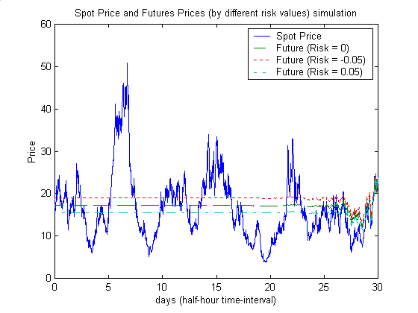
Futures v.s. Spot Price (Pure)
Notes:
Futures curves
This graph shows that as the contract date moves towards to the expiry date, the price of futures initially keeps flat but later moves like a Brownian motion when the contract date is close enough to the expiry date and then converges to the final spot price at expiry date, since F(T,T) = S(T).

Slide 15
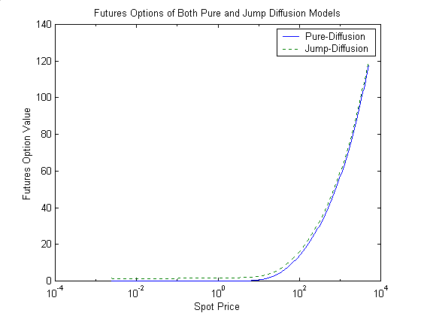
Options under Both Models
Notes:
The comparison of option values of two models
Under the same conditions, the option value of the jump-diffusion model is more expensive than its value of the pure-diffusion model, since the jump risk has to be concerned.

Slide 16
Functions in Matlab
Portfolio Selection - CAPM
Options - Vanilla Options & Exotic Options
SDEs simulation
- Black-Scholes Model
- Merton’s jump-diffusion model
Energy market applications
- Mean-reverting model’s simulation
- Futures
- Options
Notes:
Software demonstration
The financial toolkits for stock market and energy market was designed in Matlab.
1. Portfolio Selection - CAPM
2. Options - vanilla options, reset and reload options
3. SDEs simulation
4. Energy market applications
The finite difference method of solving PDEs was used.

Slide 17
Software Demonstration
The 3rd Annual Energy Derivatives
Quentin Kerr
email:qkerr@maths.uq.edu.au
The Department of Mathematics
The University of Queensland

