Slide 1
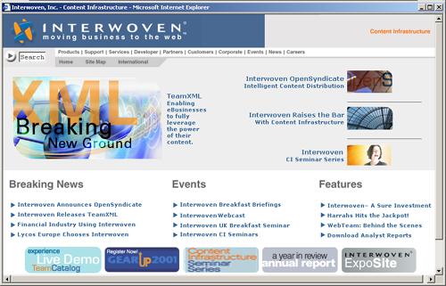
Interwoven, Inc.
Company
  Founded 1995
  HQ - Sunnyvale, California
  900 employees
  Global operations
  NASDAQ: IWOV
Products
  Content Infrastructure
  Product Suite
Customers and partners
  790+ customers
  Partnered with leading technology
  and consulting companies

Slide 2

Momentum
Annual Revenues
(in millions of dollars)
Market Share
220
Company License %Content Mgmt CM Revenue Market
($ million) (estimate) ($ million) Share
Interwoven $39 100% $39.0 25%
Vignette $48 55% $26.4 17%
Intranet Sol’ns $18 90% $16.2 10%
BroadVision $43 20% $8.6 6%
Rational $142 5% $7.1 5%
Documentum $21 25% $5.3 3%
Open Market $6.3 73% $4.6 3%
Blue Martini $12 30% $3.6 2%
FileNET $34 10% $3.4 2%
Merant $45 5% $2.3 1%
Eprise $1.7 100% $1.7 1%
Other $78 NA $36.8 15%
132
First Half
Actual
115.5
16.8
1999
2000
2001
Analyst Estimates
Aberdeen Group, June 2001
“Interwoven leads the market in the strength and breadth of its deliverables”
Scott Phillips, Merrill Lynch
“Interwoven: Leading the New Data Infrastructure,” June 2001

Slide 3




































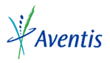


























Learning from the Leaders
Financial Services
Transportation
Technology
Telecom
Pharmaceuticals / Healthcare
Media / Entertainment
Government / Education
Manufacturing
Consumer / Retail

Slide 4



























Leading International Customers

Slide 5







Leading Customers in Europe

Slide 6







Leading AsiaPac Customers

