Slide 1
Study Regarding Retail Swaps Relating to Section 105(c) of CFMA
R. Scott Gahn
Managing Director
August 2, 2001

Slide 2
Enron Corp. Overview

Slide 3
Enron Corp.
Fortune’s Most Admired Companies
INNOVATIVENESS
PEER GROUP
Revenue - $101 Billion, 2000
Assets - $66 Billion, 2000
Largest Marketer of Natural Gas and Electricity in North America
Ranked #7 on Fortune 500
1. Enron
2. Charles Schwab
3. Herman Miller
1. Enron
2. Williams
3. El Paso
#1 for 6 years in a row
#1 for 7 years in a row
#22 on Fortune’s 100 Best Companies to Work For in America
Top 5: QUALITY OF MANAGEMENT EMPLOYEE TALENT QUALITY OF PRODUCTS/SERVICES
®
Enron
Transportation
Services
Enron
Wholesale
Services
Enron
Energy
Services
Natural Gas Transportation and Electric Distribution
Marketing and Delivery
of Commodities Worldwide
Energy Outsourcing to Commercial and Industrial Customers
Notes:
These are Enron’s core businesses
Highlighted among them is Enron Energy Services (EES)
EES is Enron’s retail business providing energy services to commercial and industrial customers, including among other things financially settled natural gas and electricity swaps to qualified parties
Affiliated businesses (TNPC) provide retail energy services to residential homeowners.

Slide 4
Enron–Accelerating Market Development
Freight
Credit
Metals
Bandwidth
Commodity
Product
Financial
Australian Power & Gas
Pulp & Paper
Coal
Weather
Scandinavian Power & Gas
Plastics
Emissions
Financials (interest rate, equity)
UK Power & Gas
Electricity
Currencies
Natural
Gas
1985
1986
1987
1988
1989
1990
1991
1992
1993
1994
1995
1996
1997
1998
1999
2000
2001
* Lighter shading indicates a developing market
Darker shading indicates a mature market
Notes:
Timeline reflecting the broadening scope of Enron products
The majority of these products are provided to wholesale customers
Liberalizing retail markets are creating needs and opportunities for new retail parties to use such products (Eg - power, gas, weather, etc.).

Slide 5
Our Financial Strength
Total Assets (Millions)
Total Revenues (Millions)
Net Income (Recurring, Millions)
$101
$979
$100
$957
$829
$66
$67
$453
$33
$40
$226
$9
$12
$9
$5
1989
1994
1999
2000
2001 Q1
1989
1994
1999
2000
2001 Q1-2
1989
1994
1999
2000
2001 Q1-2
Notes:
Reflects growth in business
Timeline coincides with deregulation and liberalization (?)

Slide 6
Risk Management Expertise – 2000
ELECTRICITY
NATURAL GAS
U.S. Swaps
#1 El Paso Energy
#2 Enron
#3 BP
#1 El Paso Energy
#2 Enron
#3 Koch Energy Trading
#1 Enron
#2 TXU Europe
#3 Accord Energy
#1 Enron
#2 Dynegy
#3 AEP
Basis Swaps
#1 Enron
#2 Koch Energy/ El Paso Energy
#1 Enron
#2 Bank of America
#3 El Paso Energy
#1 Enron
#2 Bank of America
#3 Koch Energy/ El Paso Energy
#1 Enron
#2 El Paso Energy
#3 Koch Energy
U.S. Options
Basis Options
U.K. Swaps
NYMEX Look-Alike Swaps
U.K. Options
NYMEX Look-Alike Options
Source: Risk Magazine, February 2001
Notes:
Enron is highly rated as a provider of financially settled products
Consistently in top 3 over last _____ years.

Slide 7
Enron Risk Assessment and Control (RAC)
Market Risk Management
Policy approved by Board of Directors
Trading Limits
Value at Risk (VAR) daily reports -- stress testing
Application of Extreme Value Theory
Credit Risk Management
Counterparty credit exposure aggregation and management
Counterparty Value at Risk (VAR) models
Segregation of Duties
Independence of RAC optimizes focus on risk identification and performance measurement

Slide 8
Enron Wholesale

Slide 9
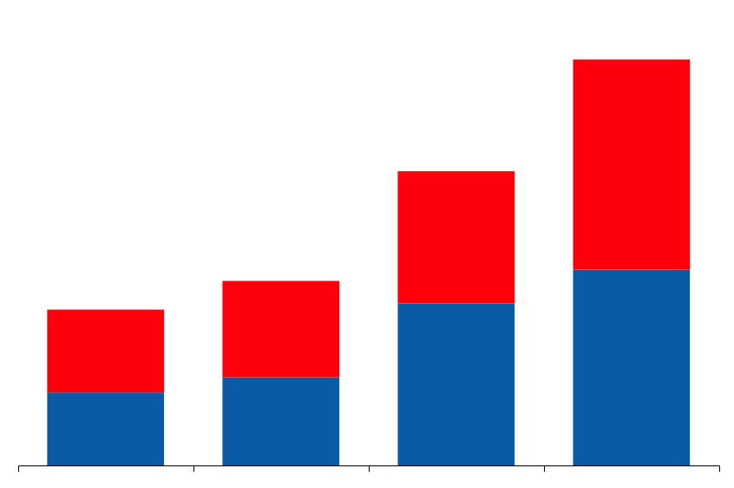
Wholesale Services
Physical Volumes
(BBtue/d)
Financial Settlements
(BBtue/d)
280,447
71,435
Power and Other
Gas
51,715
196,148
32,429
27,308
99,337
75,266
1998
1999
2000
2001
Q1-2
1998
1999
2000
2001
Q1-2
Notes:
Tremendous growth in physical and financial products in wholesale markets
Enron business model requires strength in both physical and financial markets

Slide 10
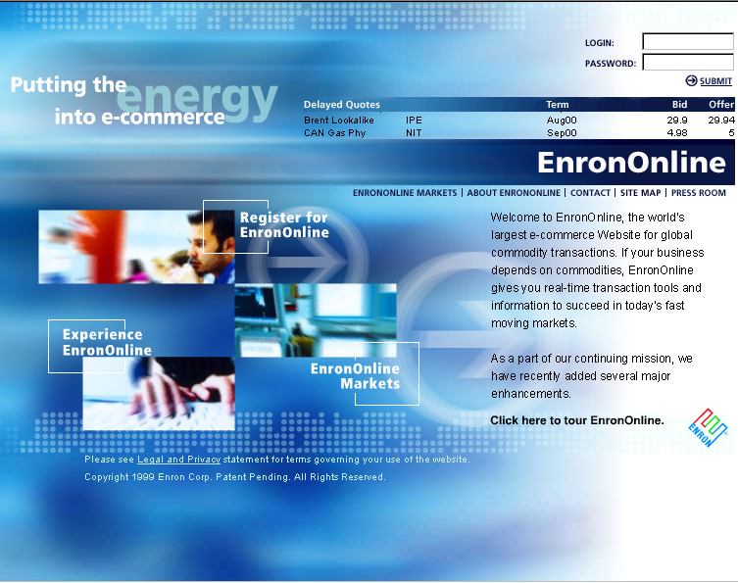
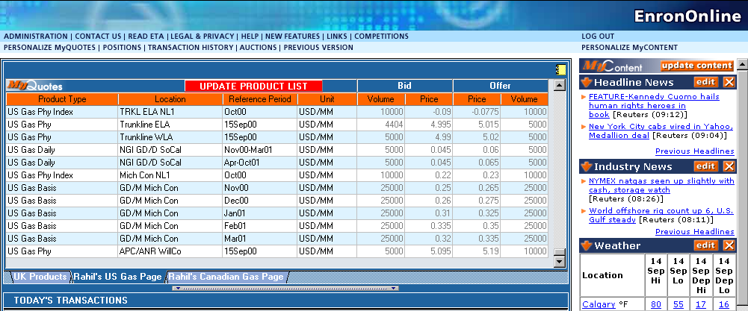
EnronOnline
World’s Largest Web-Based eCommerce Site
Notes:
Majority of wholesale transactions currently online
Volatility and need to transact real time will drive many retail transactions online (Eg - Nymex swaps).

Slide 11
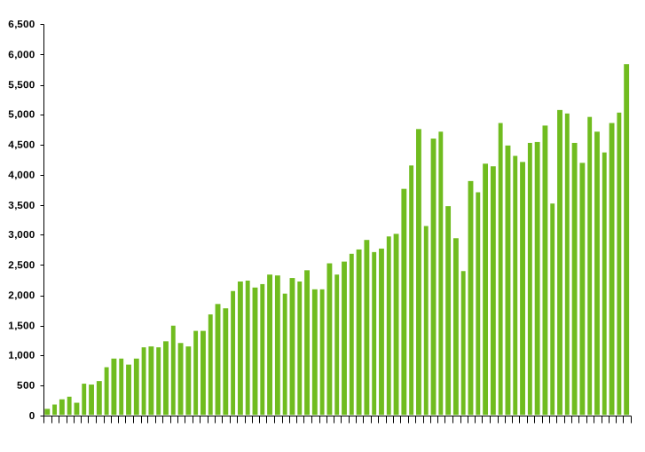
EnronOnline Average Daily Transactions
Since Inception
1,030,000 Transactions
$620 Billion Gross Value
>1,600 Products Offered
Nov 1999
Mar 2000
Jul 2000
Dec 2000
May 2001
Notes:
Product types: Underlying commodity, physical, financial, delivery point, term, etc.

Slide 12
EES Overview

Slide 13
EES Products & Services
Physical Supply of electricity and natural gas to retail customers in deregulated markets
Demand Side Management
Price Risk Management
Credit Risk Management
Well trained sales force providing products appropriate to the Customer’s needs
Reliable service
Savings as compared to Utility
Protection from market volatility and price risk
Service from an experienced market player with well established Risk Management controls
Notes:
The range of retail products and services provided to EES customers
Many products are provided in combination or bundled (?)
Go down list and briefly comment/describe each product component

Slide 14
Enron’s Value Proposition Extending To More Electricity Customers
Annual Electricity Expense
Range
Average Spend Per Company (Annual)
Average Number of Sites
Number of Companies
Segment Spend (Billions/Year)
Fortune 100
$100,000,000+ 100 100 $120,000,000
$20,000,000+ 70 1,000 $56,000,000
$2,000,000+ 50 10,000 $3,300,000
$20,000 to $2,000,000 1.2 1,100,000 $44,000
< $20,000 1.0 7,000,000 $3,500
$12
Fortune 1,000
$56
Fortune 10,000
$33
Mass Market
$49
Small Mass Market
$18
Notes:
EES market segmentation and energy spend
Broad range of customers face and manage energy decisions differently
Demand different products, however, price risk management is becoming more common among all segments.

Slide 15
Electric Restructuring Update
NH
WA
VT
ME
MT
ND
OR
MN
WI
NY
MA
ID
SD
MI
RI
WY
PA
CT
NE
IA
OH
NJ
NV
IL
IN
DE
UT
WV
VA
MD
CA
CO
KS
MO
KY
NC
TN
AZ
OK
AR
SC
NM
AL
GA
MS
TX
LA
FL
Restructuring Legislation/Order Enacted
Restructuring Enacted, Delay Implemented
Commission and/or Legislative Investigation
No significant Activity/Restructuring Denied
Status current as of 07/01
Notes:
<number>
<footer>
<header>
<date/time>
Deregulation status by state
Highly fragmented market - physical and regulatory
Often requires separation of physical from financial markets
Most deregulation moving from wholesale to retail and large customer (C&I) to small customers (homeowners)

Slide 16
What Drives Customer Need for Retail Swaps in Electricity Markets?
Deregulation
Customers are given the ability to choose another supplier other than their native Utility
Customers aware of the marketplace and eager to explore their alternatives
Price Volatility
Customers want price certainty
Need for Risk Management Services
Fixed Price for full requirements
Variable term
Price Caps
Notes:
Deregulation is increasingly exposing customers to price volatility
Customers want choice, not volatility
Price volatility in energy markets (electricity and natural gas) require prices to float in order to adequately allocate resources
Real-time electricity markets have naturally volatile spot markets as supply must continuously follow load without storage or inventories
Wholesale markets separated financial from physical - as price volatility becomes a retail phenomenon the same separation will likely be needed
Customer demands for more tailored risk management solutions prevent wholesale management of financial price risk.

Slide 17
Separation of Physical/Financial Markets
Need for Financially Settled Retail Swaps
NY City (Consolidated Edison)
Limited choice for physical supply
Exposure to wholesale market volatility can not be managed through physical delivery
This choice does permit Risk Management Providers to hedge their Retail Swap exposure
Physical Markets Need Financially Settled Retail Swaps
California – PX (Power Exchange) market failure
Suppliers were relying on PX to effectuate physical supply
Without the PX, Suppliers could not source supply and Customers had to buy from the Utility
Only through the use of financially settled swaps could Suppliers meet their fixed price commitments to their Customers
EES had no choice under its contract except to cancel approximately 20,000 residential customers because they were not Eligible Contract Participants
Notes:
Two examples of customer need for financially settled swaps
Both reflect an immature developing physical market, but also indicate a need for longer term availability of financial price risk management tools to deal with natural separations in physical and financial markets

Slide 18
Product Example – Power
Customer demands savings and price certainty therefore it:
Enters into a requirements contract with a Third Party Supplier at a floating market price
Enters into a financially settled swap with a Risk Management Provider that exchanges the floating market price for a fixed price for the Customer’s requirements
Notes:
This product is currently being provided to qualified parties in each one of EES’ markets
The complexity of physical delivery in electricity markets due to real time management requirements is driving the need to develop financial products to satisfy customer needs for price risk management.

Slide 19
Other Commodities
This analysis was specific for power but can be easily translated to natural gas, fuel oil, bandwidth, and other commodities.
Notes:
Indeed these products are already being provided to qualified parties in EES retail markets.

Slide 20
Need for Regulation
No Additional Regulation is necessary because:
No basis for concluding that regulation would provide benefits that would outweigh disincentives that regulation could impose on market participants
Companies with direct involvement in the industries and commodities underlying the retail swaps are the best qualified to understand and offer such swaps. Requiring additional regulation could discourage the best price and liquidity providers of retail swaps
Requiring that entities be otherwise regulated, particularly when they are not involved in the underlying industry or commodity, offers no additional benefits to retail participants
State and common-law antifraud prohibitions, along with the CFTC’s antifraud authority, are available to law enforcement authorities and private litigants and provide meaningful policing of retail swaps

Slide 21
Other Matters to Study
Tax Issues
Gains/Losses have to be treated as part of the energy expenditure of the end-use customer to enable the Retail Swap market to grow and allow the Customer to take advantage of price protection

