Slide 1
Cash Trading

Slide 2
Cash Trading -- What is it?
- The actual physical product on which a futures contract is based.
- Ultimately the balancing of Loads and Resources and netting of positions.
- Physical responsibilities/Short-term.

Slide 3
Cash Trading -- Who?
UTILITIES
MARKETERS
Load/Resource Balance
Less control over “position”
Lotta Hedge / Little Spec
Greater control over position
Lotta Spec / Little Hedge
END USERS
NON-UTILITY GEN
Mostly Hedge, but larger EUs
do spec (DSIs)
Hedge and Spec

Slide 4
Cash Trading -- Why?
UTILITIES
MARKETERS
Meet Load and Reserves
Optimize Resources
Reliability
Fill Existing Positions
Spec Trade
Optimize Positions
Market Maker (Some)
END USERS
NON-UTILITY GEN
Meet Load
Fill Existing Postiions
Spec Trade
Optimize Positions

Slide 5
Cash Trading -- Driving Factors
- Weather
- Outages (Unit, Transmission)
- Hydro
- Gas

Slide 6
Cash Trading -- Day in the Life -- NW
Canada
Montana
50 MW Long
100 MW Short
Northwest
MID-C
Busbar -- 200 MW Long
500 MW Short
NET Position: 650 Short
NOB
COB
100 MW Long
200 MW Short
Southern Cal
Northern Cal
100 MW Short
100 MW Short

Slide 7
Cash Trading -- Day in the Life -- SW
Midway
125 MW Short
Mona
25 MW Long
Mead 230
NP15
75 MW Long
100 MW Short
NET Position: Short 450
Four Corners 345
100 MW Long
SP15
200 MW Long
Palo Verde 500
625 MW Short

Slide 8
Mid-C Prices

Slide 9
Cash Trading -- Future Issues
Pools vs. Control Areas
Liquidity
Volatility

Slide 10
California Cash Trading
Victor

Slide 11
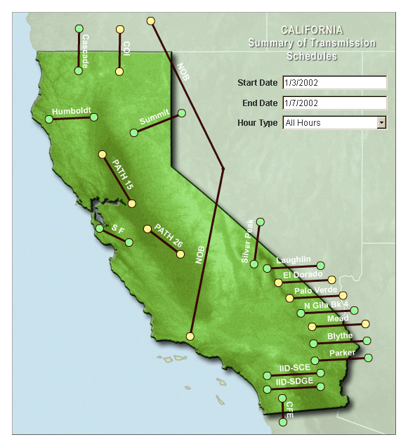
California
Notes:
<number>
<footer>
<header>
<date/time>

Slide 12
Position Summary
Load
Services
Cash
CAISO
Trades

Slide 13
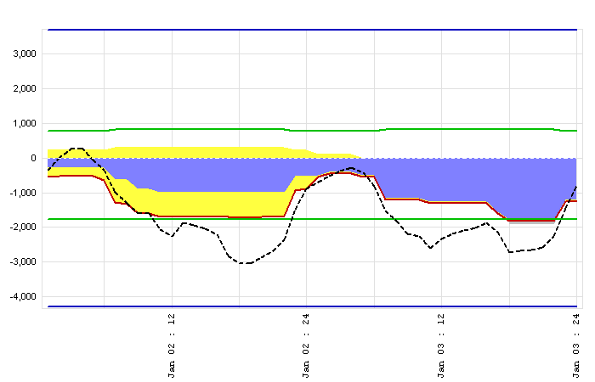
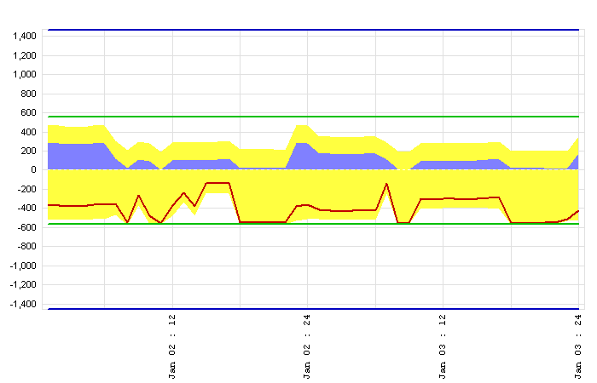
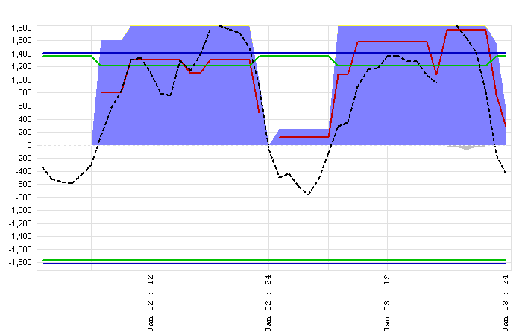
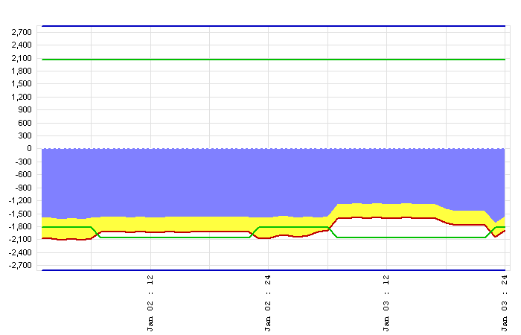
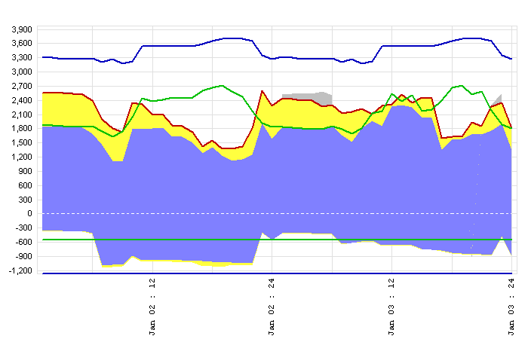
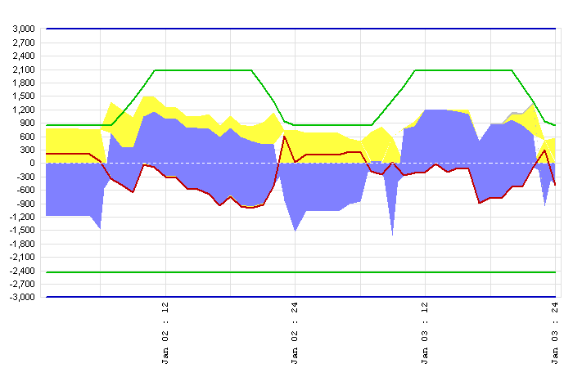
CALIFORNIA TRANSMISSION SUMMARY
COB
MEAD
NOB
PALO VERDE
PATH 15
PATH 26
Notes:
<number>
<footer>
<header>
<date/time>

Slide 14
Daily Trading
NP15
Price = $40
Path15
Position = <400>
ZP26
Path 26
SP15
Price = $32
Position = 200
Notes:
<number>
<footer>
<header>
<date/time>

Slide 15
Daily Trading
Cob
Price = $17.3
NP15
Price = $21.3
Path15
Position = <400>
ZP26
Path 26
SP15
Palo Verde
Price = $20.7
Price = $21.6
Position = 200
Notes:
<number>
<footer>
<header>
<date/time>

