Slide 1
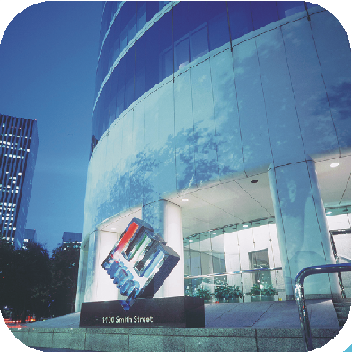
ENRON GLOBAL PERFORMANCE MANAGEMENT OCTOBER 2001
Notes:
Introduce the Team
Who is new to the Process?

Slide 2
Philosophy
Developing and maintaining the best talent
Remaining on the cutting edge
‘Raising the bar’ as new talent is brought in and developed
Creating value
Working as a partnership
Entrepreneurial environment
Promoting meritocracy
Performance is absolute

Slide 3
Purpose
Business identification of potential for competitive advantage and talent development
Clear identification of top performers on a regular basis for mobility and succession planning
Clear identification of performers for development actions and improved performance
Fair and equitable measure for promotion decisions
Identification of future recruitment needs
360⁰ feedback/evaluations/ coaching tool
Consistent global process fosters a ‘one Enron’ approach in measuring success.
Mechanism to help facilitate compensation decisions

Slide 4
Overview
This process allows Enron to evaluate employees performance within Business Units and across functional groups
PEP (Performance Evaluation Process) is a web-based 360° global performance evaluation system. Through the 360° evaluation process the employee receives feedback from selected reviewers that should include the employee, their supervisor, direct reports, peers, internal or external business associates.
Employees use the PEP system to suggest reviewers to their supervisor. The supervisor adjusts and approves reviewers.
Reviewers evaluate employees on specific performance categories such as innovation, communication, teamwork, vision & values, analytical, etc.
Enron uses this information to provide employees constructive feedback and as a basis for development.

Slide 5
DISCUSSION OF INTELLECUTAL CAPITAL
Identification of top 10% and bottom 10 % of performers. Meetings are lead by the senior business unit lead, typically facilitated by the HR Rep
Identification of top talent in each business unit for future business leaders and the bottom 10 % for continued development opportunities
Focus on intrinsic skills, leadership and future potential
Discussion on the redeployment of talent, bench strength
Discussion on the relative value to and the needs of the organization
Top tier management cross calibrate all VP’s and MD’s enterprise wide
Promotion discussions and decisions

Slide 6
PERFORMANCE EVALUATION PROCESS SYSTEM (PEP)
World wide access via the Enron Intranet
14, 000 employees and 3,000 plus Business Associates (scalable to support many times this number)
Integrated with worldwide HR Information Systems
Full HR Maintenance Services allowing quick and easy data integrity audits
Supports full Performance Management Process from feedback to meetings to formal employee reviews with same data source
Supports multi business units, functional areas and job groups
Customized feedback forms for different job groups or business areas based on job groups and performance categories
Tailored evaluation forms for formal employee reviews
Key players in the process employee, supervisor, HR Rep and Global Performance Management Team

Slide 7
GLOBAL PERFORMANCE MANAGEMENT
ACTIVITY FLOW
Testing/Implementation
Development
HR Training
System Opens for Feedback
Employee Training
System Closes for Feedback
Executive Committee Meeting
System Opens to HR Community
Relative Talent Review Meetings
Message to All Employees – UserID & Password
Employee One on One Evaluations
All Employee Communication Opening
Message to All Employees – Feedback Deadline

