Slide 1
“Over-the-Road” Services
(Xtransco)
Business Concept
September 6, 2001

Slide 2
Current Situation
US DOT law mandates long-haul drivers rest 8 hours after driving 10
Most truckers idle (leave the engine on) during these mandatory breaks
  To maintain a comfortable temperature in their cabins
  To prevent fuel from freezing in extremely cold weather
  To provide power for in-truck appliances (PCs, stereos, televisions, etc…)
  To keep refrigeration units operating
Idling has many disadvantages:
  Wastes fuel -- $3,200 per vehicle annually
  Increases engine wear and tear -- $1,400 per vehicle annually
  Causes air and noise pollution
  Creates an unhealthy environment for drivers
Most of the idling occurs at central locations—truck stops
  Provide parking space, food and facilities, and fuel
  Market is currently short 100,000 parking spaces
  Largest 7 players own 43% of the parking spaces
Growing bankruptcy rate for carriers
  Rising fuel prices
  Rising insurance costs

Slide 3
Potential Value Creation
Existing technologies have been innovatively adapted to alleviate the need for idling
Xtransco can provide a fuel and services management product based on capturing new technological efficiencies
Main product offering:
  Shared savings / total fuel outsource
  Reservations system for service slots
  Insurance and maintenance savings
  Fuel price hedging
  Communication and entertainment services
Potential to provide savings upfront to customers net of upfront investment costs through innovative finance packages
Capture and trade emissions credits

Slide 4
Opportunity Size
9 million trucks in the US
  4.2 million Class 7 & 8 trucks in the US
  1.3 million Class 8 long-haul trucks with sleeping compartments
  2% of the companies own 20% of the trucks
Value add opportunity of over $6 billion annually
  Class 8 avoided fuel consumption during lay-over idling of $4.2 billion (3.8 billion gallons)
  Avoided maintenance costs of $1.8 billion
Examples of targeted Class 8 trucks users
Company (TL) | Trucks | Savings*
Schneider | 19,000 | $ 80 mm
JB Hunt | 9,500 | $ 40 mm
Werner Enterprises | 7,100 | $ 30 mm
Swift Transportation | 7,000 | $ 30 mm
Ryder | 6,000 | $ 25 mm
Covenant | 3,900 | $15 mm
Company (PC/LTL) | Trucks | Savings*
Wal-Mart | 30,000 | $ 90 mm
Sysco | 7,300 | $ 30 mm
CNF | 10,000 | $ 45 mm
Consolidated Freight | 7,000 | $ 40 mm
Roadway Express | 6,000 | $ 40 mm
Yellow | 5,400 | $ 20 mm
*Estimated total annual fuel and maintenance savings

Slide 5
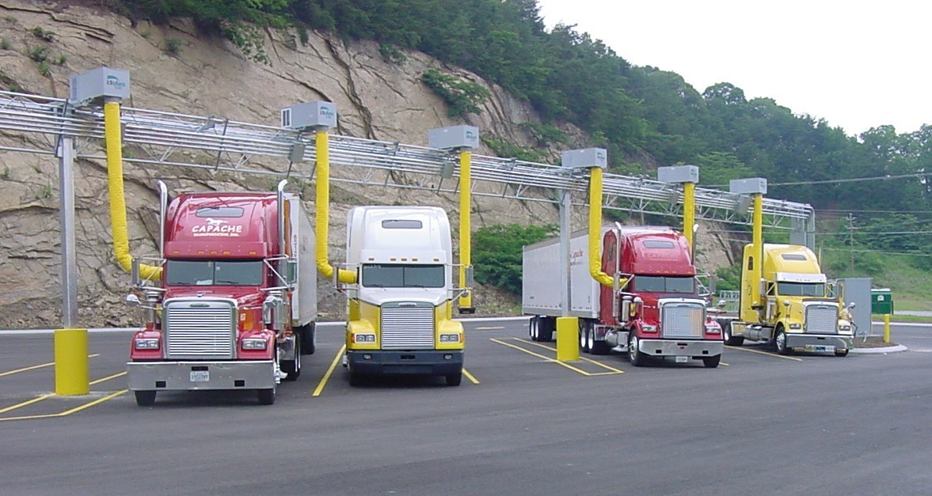
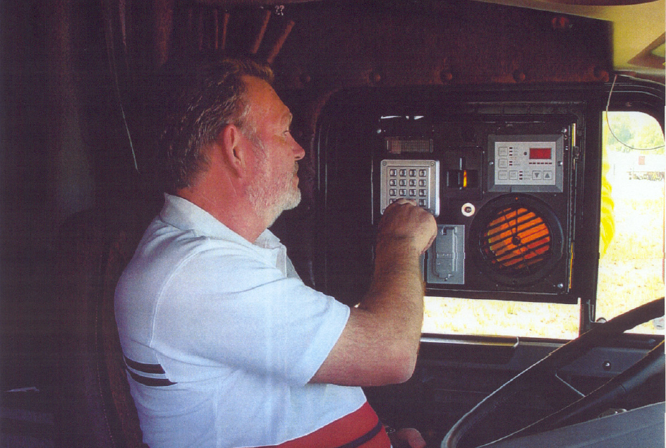
Technology
Proprietary, anti-idling technology
  Utilizes efficient, external heating, ventilation and air conditioning (HVAC) unit installed at each individual truck parking space
  Heating and air conditioning are delivered to the truck-side control console and return air supply to the external HVAC device
  Television, telephone and Internet service also will be supplied where available
  Logistics tracking capabilities
Competitors/Alternatives
  Direct fired heaters
  Auxiliary power units
  Thermal storage systems
  Electrification
  Team drivers
  Hotels

Slide 6
Value Proposition—Key Constituents
Value Proposition
Savings on fuel and maintenance
  Incremental EBITDA of 7-10% and net income of 26-38%
Improved risk profile (insurance savings)
Reduced turnover from unsatisfied drivers
Better lifestyle (amenities and healthier environment)
Loyalty rewards
Carriers offering fuel management incentives
Incremental revenues from sharing arrangements
More attractive location (e.g., state of the art)
Guaranteed slots (reservation system)
Carriers
Truck Drivers
Truck Stops

Slide 7
Value Proposition Unit Economics
Average number of days per year of a truck on the road 246
Average idling hour per day 8
Total number of idling hours 1,968
Long rung cost per gallon of fuel $1.1
Hourly gallons of fuel consumption when idling 1.5
Annual cost of fuel consumed when idling $3,247
Mile equivalent to an idling hour 7.0
Annual idling miles 13,776
Schedule maintenance cost $500
Miles per schedule maintenance 5,000
Annual cost of idling related maintenance $1,377
Direct Idling Annual Cost per truck $4,624

Slide 8
Business Strategy – Two Alternatives
Capacity as availability based on spot sales
  Simple fee for service approach
  High risk to test fuel savings proposition and support physical rollout
  Slow realization of ultimate value
  Lower return basis
  Improves the load factor on the system (risk mitigant)
Managed Implementation (based on forward contracts)
  Origination of idling solution sales to justifying physical rollout
  Reservation system – load factor management
  Fuel savings/emissions verification
  Risk management
    Savings
    Commodity prices
Build-it-they-will-come
(If they see the savings)
Pro-Active Demand Aggregation
(“Sell” the savings)
Non-exclusive strategies

Slide 9
Structure
IdleAire
(technology provider)
Exclusivity
Cash
Xcelerator Businesses
Technology
Cash
Fuelco
(fuel provider)
Cash
Xtransco
(origination –
reservation – M&V)
Cash/LT Contract
Xreitco
(infrastructure - finance)
Fuel
Services /
Guaranteed Slots
Fuel and Services
Guaranteed Slots
O&M Slots
Cash
Cash/LT Contract
Truckco
(customer)
Stopco
(O&M – real estate)

Slide 10
Enron Fit—Competencies
Knowledge
  Origination skills: carrying EES-like sell to the CEO/CFO
  Structuring skills: proven contractual framework
  Finance skills: ability to value and monetize energy flows
  M&V skills: ability to measure, quantify, and value fuel & emission savings
  Execution skills: EFS construction and deployment capabilities
Leverage existing customer relationships
  EES and customers operating their own private fleets (Wal-Mart and Sysco)
  Enron Freight Markets and TL carriers (Werner and Covenant)
Risk Management
  Tie up assets and components of the business proposition without direct ownership
  Fuel/Power commodity price hedging
  Managing volatility in fuel savings and ability to offer fix price contracts
  Service slot load factor management
Managed implementation is a great fit for Enron

Slide 11
Upsides
Emissions
  Layover idling at truck stops produces 35 million tons of emission annually
  High policy priority for incenting mobile source emissions reduction
  1.3 million U.S. sleeper trucks account for 760,500 tons of NOx emissions annually, the primary pollutant under scrutiny by the EPA
Insurance (Truck & Driver)
  Fatigue contributed 40% of heavy truck accidents
  15% of all U.S. freeway fatalities are attributed to truck driver fatigue
  Insurance costs represent over 3% of total operating expenses
  Positioned to negotiate lower premiums
Maintenance & Salvage Value
  Layover idling creates a wear and tear on the engine per hour equivalent to 7 driven miles
  Typically scheduled maintenance occurs every 5,000 miles and costs $500/ea.
Media Services
  Entertainment & Communications (Cable TV, Telephony, Internet)
  Advertising spaces
  $3,000 net value per subscriber

Slide 12
Xcelerator Businesses Assumptions

Slide 13
Xcelerator Businesses Cash Flow
Year
0
1
2
3
4
5
10
Gross Revenue
-
73,062,000
207,496,080
321,472,800
415,109,059
488,334,718
680,508,743
Revenue growth rate
0%
0%
184%
55%
29%
18%
3%
Less: Revenues share w/Fleet owners, truckstops & originators
-
18,359,364
52,140,595
80,781,203
104,310,564
122,711,054
171,001,450
Net Revenue
-
54,702,636
155,355,485
240,691,597
310,798,495
365,623,665
509,507,293
Net Revenue growth rate
0%
0%
184%
55%
29%
18%
3%
Less: Direct variable expenses
-
3,422,014
9,718,519
15,056,861
19,442,513
22,872,192
31,873,070
Direct expenses / Revenues
0%
5%
5%
5%
5%
5%
5%
Marginal contribution
-
51,280,622
145,636,966
225,634,737
291,355,982
342,751,472
477,634,223
Contribution margin
0%
94%
94%
94%
94%
94%
94%
Less: OPEX
6,487,875
24,913,440
46,972,215
65,408,161
80,225,429
91,907,341
121,733,913
EBITDA
(6,487,875)
26,367,182
98,664,751
160,226,576
211,130,553
250,844,131
355,900,310
EBITDA growth rate
-
0%
274%
62%
32%
19%
4%
EBITDA margin
0%
36%
48%
50%
51%
51%
52%
Less: Depreciation
9,342,540
32,138,338
51,047,639
57,176,345
55,642,673
49,481,081
15,042,864
EBIT
(15,830,415)
(5,771,156)
47,617,113
103,050,231
155,487,879
201,363,050
340,857,447
EBIT growth rate
0%
-64%
-925%
116%
51%
30%
6%
EBIT margin
0%
-8%
23%
32%
37%
41%
50%
Less: Federal Tax
-
-
16,189,818
35,037,079
52,865,879
68,463,437
115,891,532
Add: Accumulated Tax Shield
5,382,341
1,962,193
-
-
-
-
-
Less: Capex
63,284,969
88,250,687
63,555,109
47,380,617
34,722,082
26,422,007
4,037,134
Add: Depreciation
9,342,540
32,138,338
51,047,639
57,176,345
55,642,673
49,481,081
15,042,864
Free cash flow
(64,390,502)
(59,921,312)
18,919,823
77,808,880
123,542,591
155,958,687
235,971,644
Free cash flow growth rate
0%
0%
0%
311%
59%
26%
5%
Free Cash Flow margin
0%
-82%
9%
24%
30%
32%
35%
Assumes 25% savings sharing to customer

Slide 14
Xcelerator Businesses Valuation

Slide 15
Xcelerator Businesses Free Cash Flow
Free Cash Flow Summary @ Year 5
Total savings from fuel efficiency before sharing
236,947,982
Total realized by Xcelerator businesses after 25% sharing
155,958,687
Potential upside cash flow
517,723,868
Scheduled truck maintenance
136,733,520
Truck driver’s health insurance
92,295,262
Truck's salvage value
89,560,587
Entertainment & communications services
66,974,688
Truck's insurance savings
50,728,211
Emissions credit
50,496,668
Consolidating fuel purchasing
21,836,105
Advertising space
9,098,827
Total Business Opportunity Free Cash Flow
673,682,555

Slide 16
Path to Execution and Value
Free Cash Flow Valuation Summary of the Xcelerator Businesses
1,200
Fuel Efficiency
Schedule Maintenance
1,000
800
Entertainment & Communications
Size of the Opportunity
Drivers health insurance
Millions
600
Truck's Salvage Value
Emissions Credits
400
Fuel Purchasing
Truck Insurance
200
Advertising
100%
80%
60%
40%
20%
0%
Probability to Capture Value

Slide 17
Milestones
Costs assume 9/1/01 start date

