Slide 1
Woodside Petroleum Ltd. Briefing Materials For Meeting on May 17, 2001

Slide 2
Overview of Woodside (ADR: WOPEY)
Australia’s largest independent E&P company by market capitalization ($4.7 Billion)
Financial highlights (year-end 2000):
Total Assets of $3.1 Billion
Net Cash Flow of $794 MM vs. $290 MM in 1999
Long Term Debt of $785 MM, a decrease of $415 MM from 1999; Net Debt to Equity ratio of 34%
Record 1Q 2001 revenue of $606.8 MM vs. $483.6 MM in 1Q 2000
Existing business based on a diversified product range which includes liquified natural gas (LNG), natural gas, condensate, liquified petroleum gas (LPG) and crude oil
Probable reserves of 1133.4 MMboe (20 year plus life) located in offshore Australia
S&P recently upgraded Woodside’s long-term rating to A- from BBB+, reflecting the planned expansion in the North West Shelf Venture and oil diversification in the Timor Sea
34% owned by Shell Group of Companies; recent acquisition attempt vetoed by the Australian government on the grounds of national interest
Notes:
Add all the stuff Scott wrote down- Done

Slide 3
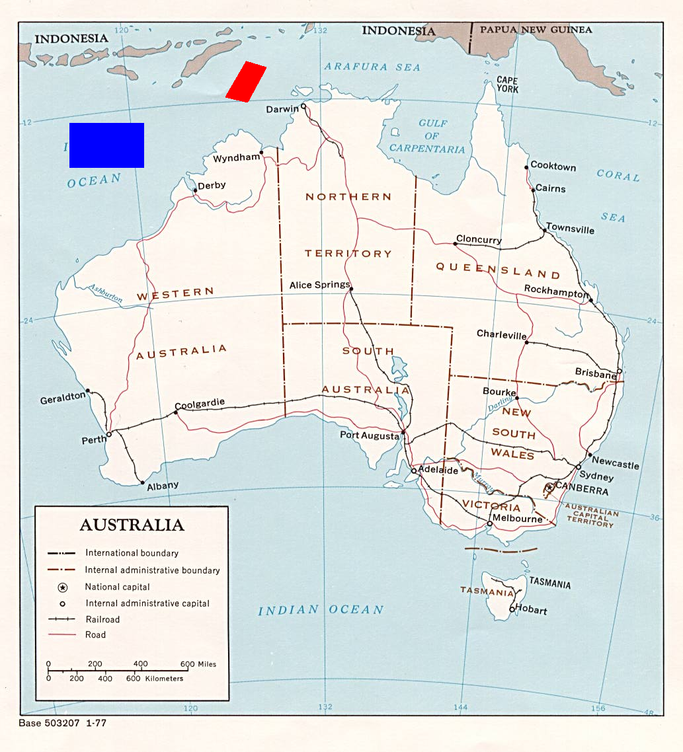
Map of Major Assets
Timor Sea Properties
NWSV

Slide 4
Major Assets
North West Shelf Venture (NWSV)
Operator and 50% partner in the Venture along with Shell (8.3%), BHP (8.3%), BP (16.7%), and Chevron (16.7%)
Annual production of 146 MMboe; Gas, Oil, Condensate, and LPG are all produced by this Venture, including 1.27 MM tonnes of LNG
Gas stream delivered to 1,000 Tj/d capacity Domgas Processing Plant
Three trains- 200,000 tpd current capacity
LPG plant- 800,000 tpa capacity
Condensate facilities- 123,000 bbl/d capacity
Oil separated offshore and delivered to FPSO
Woodside’s share of NWSV Reserves: (Proved + Probable)
Dry Gas 4.7 Tcf
Condensate 159.0 MMbbls
Crude Oil 37.0 MMbbls
Total 2000 Revenue of $324 MM
Accounts for 38% of Australian hydrocarbon production
Domestic gas is marketed to the following customers:
Western Power (AA+), Alinta Gas (AA+), Alcoa (A+)
Hamersley Iron (AA-), BHP (A), Robe Rive (NR), Mission Energy (NR)
Domestic gas marketed under long-term take or pay contracts linked to CPI

Slide 5
Major Assets (cont’d)
Timor Sea
Laminaria – Corallina Oilfields:
Woodside has 50% interest; partners with Shell (25%) and BHP (25%)
Annual production of 25.6 MM Barrels
Total 2000 Revenue of $512 MM
Proved Reserves of 121 MMBbl; Probable/Possible of 423 MMBbl

Slide 6
Business Development Areas with Enron
LNG:
Woodside sells LNG from NWSV under contract to eight Japanese gas and electricity companies on a delivered basis. The NWSV operates eight LNG vessels (each is capable of carrying 125,000 cubic meters of LNG)
The NWSV has signed Letters of Intent with five Japanese customers for additional volumes of 2.9 MM tonnes of LNG per annum, with contract periods ranging from 15-30 years
NWSV Joint venture approval of a fourth LNG processing train with a capacity of 4.2 MM tonnes per annum is anticipated to close this quarter
Early this year Enron and Woodside came very close to signing a long-term supply agreement for LNG out of the NWSV, along with a couple of spot LNG cargos
Pursuing new LNG plant at Darwin to be supplied by Timor Sea Gas. Announced March 2001 LOI with Phillips and El Paso Energy for supply of 4.8 MMtpa of LNG. Deliveries to commence as early as 2005
Woodside is evaluating LNG shipping to the United States, China, and India
Notes:
Add all the stuff Scott wrote down- Done

Slide 7
Business Development Areas with Enron (cont’d)
Gas Marketing:
The NWSV domestic gas venture (Woodside share 50%) supplies 70% of Western Australia’s natural gas demand
The Venture sells most of its gas under long term take or pay contracts to seven customers, including utilities, large industrials, and downstream gas marketers. New potential customers include:
130Tj/d to Syntroleum Sweetwater G-T-L plant (Delivery 10/02)
70 Tj/d to Plenty River Corp. for proposed ammonia-urea plant (Delivery 2003)
200 Tj/d to Amsteel Pty. (Delivery N/A)
In 2000, Woodside produced and marketed approximately 84 Bcf of gas in the domestic Australian market
Woodside is currently expanding in Eastern Australia through upstream acquisitions, and through interests in Pulse Energy, a Victoria-based energy retailer, and in EdgeCap, an energy merchant business which has commenced trading in wholesale electricity and gas.
Notes:
Add all the stuff Scott wrote down- Done

Slide 8
Business Development Areas with Enron (cont’d)
Risk Management:
Woodside hedged approximately 50% of its production a couple of years ago when crude prices were low. Potentially some form of blend and extend agreement, and even FX could be possible
As of 12/31/00, 47 MMBO hedged at an average price of $17.99/bbl for 4 years on a rolling calendar basis. Opportunity cost of oil hedging was $198.0 MM in 2000
Active currency and interest rate hedging program. Opportunity cost of currency hedging was $12.6 MM in 2000.
Notes:
Add all the stuff Scott wrote down- Done

Slide 9
Business Development Areas with Enron (cont’d)
Acquisition of Assets:
Woodside is actively evaluating acquisition opportunities in the U.S. where it plans to spend $1 Billion
Woodside has leasehold positions in the Gulf of Mexico: 48 blocks ($45.5 MM)
The Company has expressed an interest in assets managed by ECR including
Mariner (Deepwater GOM)
Juniper (Shelf GOM)
Cypress/Bonne Terre (South Louisiana)
Notes:
Add all the stuff Scott wrote down- Done

Slide 10
Relationship with Shell
In December 2000, Shell Australia Investments made an offer to the shareholders of Woodside:
A$14.80 cash for each Woodside share; Current Price (5/14) is A$14.04
One Call Option over one Woodside share, exercisable at A$14.80, if the proposal was approved
Shell’s goal was to gain a controlling interest in Woodside, preferably at 60% majority interest
In April 2001, Australian Treasurer Peter Costello vetoed the proposal, prohibiting it under the grounds of national interest under the Foreign Acquisition and Takeover act
Santos, an Australian oil and gas producer, and BHP have both shown interest in acquiring/merging with Woodside, and the Australian government prefers a deal with one of these companies
Notes:
Add all the stuff Scott wrote down- Done

Slide 11
Bios of Visitors from Woodside
Agu Kantsler, Director New Ventures
Agu joined Woodside in early 2000 after being seconded by Shell to Woodside in mid-1999 following 15 years of exploration activity with Shell, mostly on international assignments
Key Accountability: To build a profitable international exploration and production business and to develop the greenfield exploration portfolio in Australia in a cost-effective and profitable way
Chris Cronin, Director of Corporate Strategy, Planning & Performance
Chris joined Woodside in 1981 and was previously the General Manager of Human Resources, Corporate and Public Affairs.
Key Accountability: To drive the process for business strategy and planning, performance leadership, executive development, and external affairs activities and to provide shareholder value assurance for Woodside through North West Shelf Venture/Australia owner representation. Chris is also accountable for governance of the human resources process which will be run from within the Shared Services Division.
Agu and Chris report directly to John Akehurst, Woodside Petroleum Managing Director

