Slide 1
7EA DLN 1.0 Emissions Compliance Corrective Actions

Slide 2
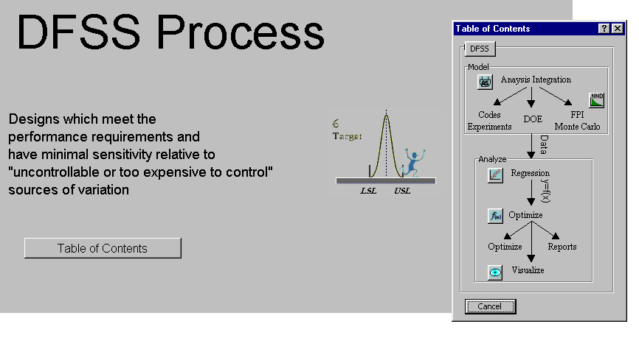
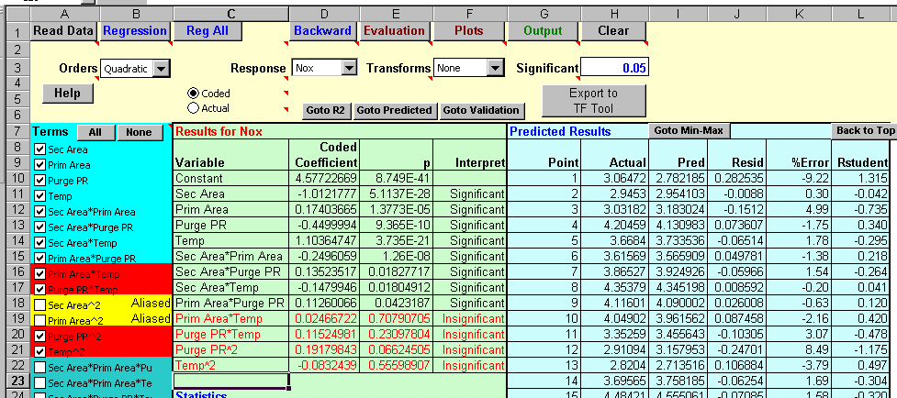
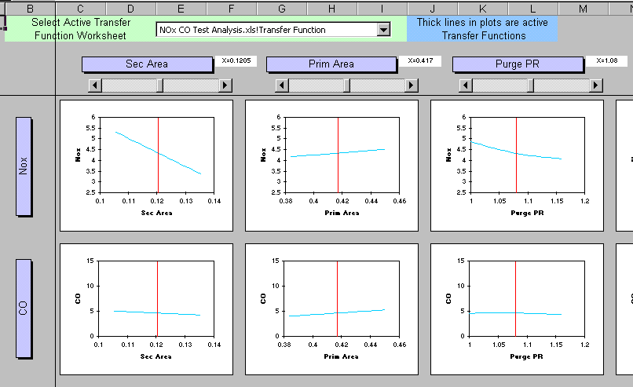
RCA Team Performed Evaluation of Fleet Data and Lab Test Data
Data Was Analyzed Using DFSS Gen III Tools
Generate Effects Plots from Which Curve/Fit Corrections can be Generated

Slide 3
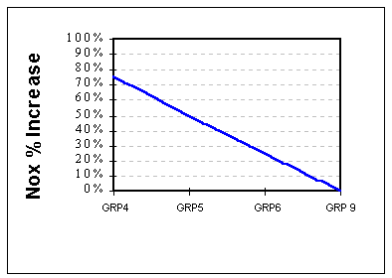
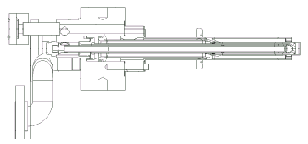
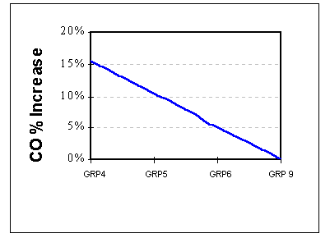
Secondary Nozzle Effective Area
Secondary Peg Hole Dia.
Effective Area (Nozzle Area)
Secondary Nozzle Area Drawing
Group Numbers
7EA Secondary Nozzle
Secondary Nozzle Area Drawing
Group Numbers
Resized Dilution Hole Patch
Changing Wilton Lincoln Center from the current Group 4 to Group 9 effective area will provide
an overall reduction in NOx and CO.

Slide 4
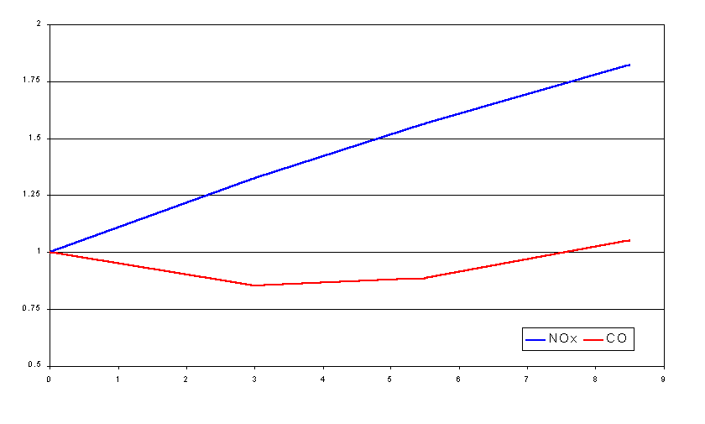
Secondary Nozzle Internal Leakage
Emissions Multiplier
Manufacturing issues found during 2000 fleet implementation for the secondary nozzles resulted in excessive internal leakages.
% Secondary Flow Leakage into Transfer Passage

Slide 5
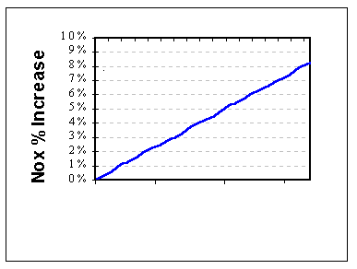
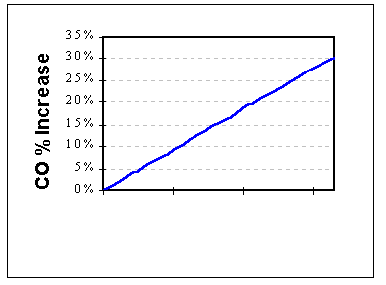
Primary Nozzle Effective Area
Primary Nozzle Nozzle Tip
Endcover With All 6 Primary Nozzles
GRP13 GRP11 GRP5 GRP 2
GRP13 GRP11 GRP5 GRP 2
Primary Nozzle Area Drawing Group Numbers
Primary Nozzle Area Drawing Group Numbers
Changing Wilton Lincoln Center from the current Group 2 to Group 13 effective area will provide
an overall reduction in NOx and CO.

Slide 6
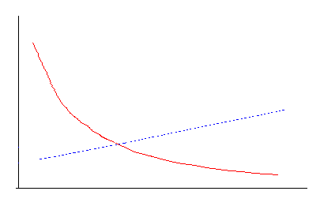
Combined Effective Area and Leakage’s Effects On Liner Tuning
CO
Secondary nozzle leakage's, varying degrees of leakage's across combustor cans, and non-optimum secondary and primary nozzle effective areas resulted in higher than expected NOx and CO. The resulting higher NOx lead to overtuning (ie. smaller liner dilution hole). Control curve adjustments were made to temporarily help mitigate CO emissions.
NOx
9 ppm
Decreasing Liner Dilution Hole Size

Slide 7
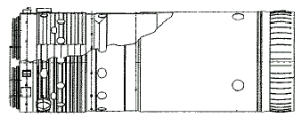
Corrective Actions
Resize Liner Dilution Holes To Optimize Unit Emissions to a Targeted NOx value of 7.5 - 8.5 and CO value of <10:
7EA DLN 1 Liner
Resized Dilution Hole

Slide 8
Corrective Action Process Flow Diagram
Run Unit, Heat Soak,
Perform Fuel Gas
Splitter Valve
Optimization at Base
Load
Complete Hardware Changeout and Install Nominal Control Constants *
Obtain latest reliable emissions data, if required.
Adjust
Control
Curve, If
Needed
Completed With
Emissions
Compliance
Collect data for analysis at Base Load
(Attachment A data -
MK-5 View 2 &
Emissions Data)
Data
Review
* Seed set hardware/consumables will be on site for 1st unit. Follow units will use hardware from previous units

