Slide 1
Managing Risk in a Volatile Environment

Slide 2
About Williams
More than $34 billion in assets
Over $10 billion in annual revenues
90+ years of experience
14,000 employees worldwide
81,500 ft² trading and risk management facility
700+ employees
20+ PhDs
150+ Master’s degrees

Slide 3
Market Realities What’s Happening?
Supply-demand imbalances and other fundamental changes
Infrastructure constraints
Asset rationalization with prudent investments
Lack of foresight
Players leery of or prohibited/ discouraged from participating in financial markets
Increased globalization

Slide 4
Increasing Volatility Natural Gas and Power
NYMEX Henry Hub
Into Cinergy

Slide 5
Simple Concepts
Risk
Chance that reality will deviate from expectations
Risk management/hedging
Reducing the chance for deviation
Danger
Hoping prices will come down or move up
Having risk you didn’t know about
Thinking of hedging as speculating

Slide 6
Hedging Basics
Why?
Potential for unfavorable market movements
Volatility increases risk
Locked-in costs
We value less risk if we’re risk-averse
If not, you’re speculating
Why not?
Potential for favorable market movements
Commissions, fees and premiums
Knowledge and expertise lacking

Slide 7
Select Terminology
Long - Positive benefits from upward movement in price
Short - Negative benefits from upward movement in price
Hedge - Reduces risk/uncertainty

Slide 8
Select Terminology …continued
Derivatives - A security whose value is "derived" from the performance or movement of another financial security, index or investment
Futures/forwards - An agreement to buy or sell a set amount of a commodity in a designated future month at a price agreed upon today by the buyer and seller
Options - The right, but not the obligation, to buy or sell a commodity at a specified price within a specific time period
Swaps - An exchange of one forward cash flow stream for another; most often fixed for floating

Slide 9
What Risks Should be Managed?
Price
Outage
Weather
Load
Credit
Transmission / capacity
Operational
Interest rate
Currency
Liquidity
Correlation
Regulatory / political
Economic
Model
Liability
Rogue trader

Slide 10
Price Paradigm
Then...
Stable
=
Low
=
Market

Slide 11
Price Paradigm
Now...
Stable
=
Low
=
Market

Slide 12



Basic Question What is the Role of the PUC and Utilities?
To eliminate some or all volatility on behalf of your ratepayers
To ensure ratepayers have the tools to manage their own perceived risks
To simply deliver the commodity to the ratepayers’ doors at market prices

Slide 13



Basic Question What is the Role of the PUC and Utilities?
Full requirements
Load variability
Exposures
Overages
To eliminate some or all volatility on behalf of your ratepayers
Low risk
Load serving
Fixed price mechanisms
Participating swaps
To ensure ratepayers have the tools to manage their own perceived risks
Options
Swaps
Caps
Collars
To simply deliver the commodity to the ratepayers’ doors at market prices
High risk
Doing nothing!

Slide 14
Simple Financial Instruments: Concepts and Perspectives

Slide 15
Swap Definition
An exchange of one forward cash flow stream for another; most often fixed for floating

Slide 16
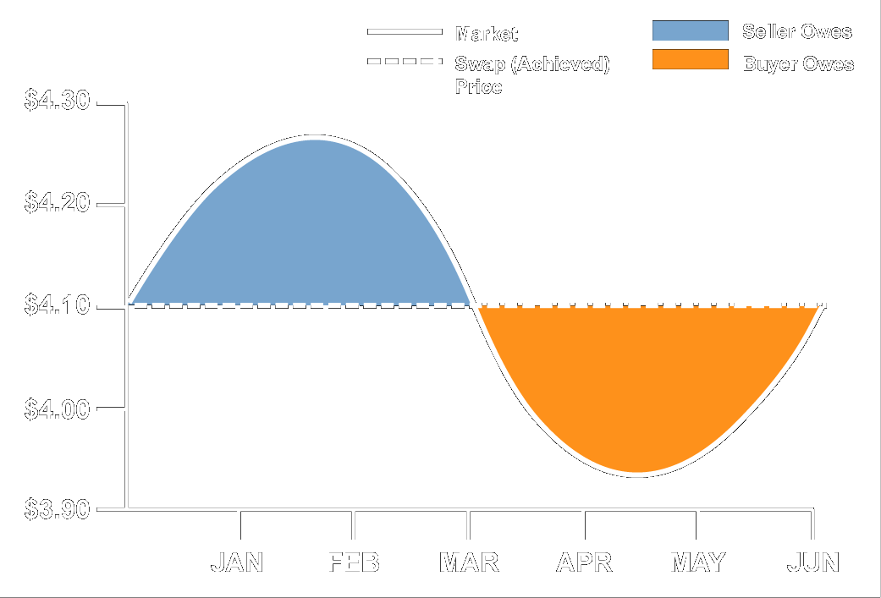
Swap Concept

Slide 17
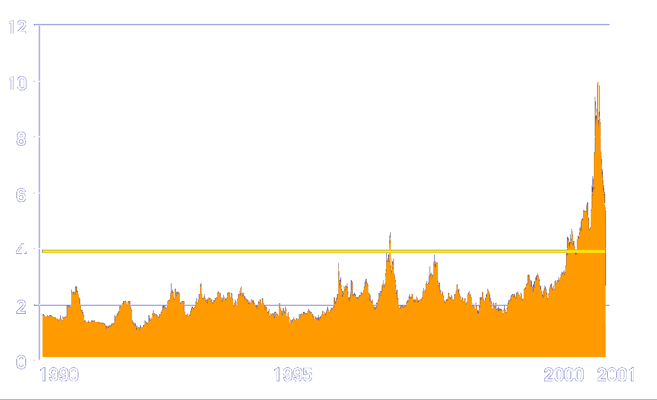
Swap Historical Perspective
NYMEX Henry Hub - 1990-2001

Slide 18
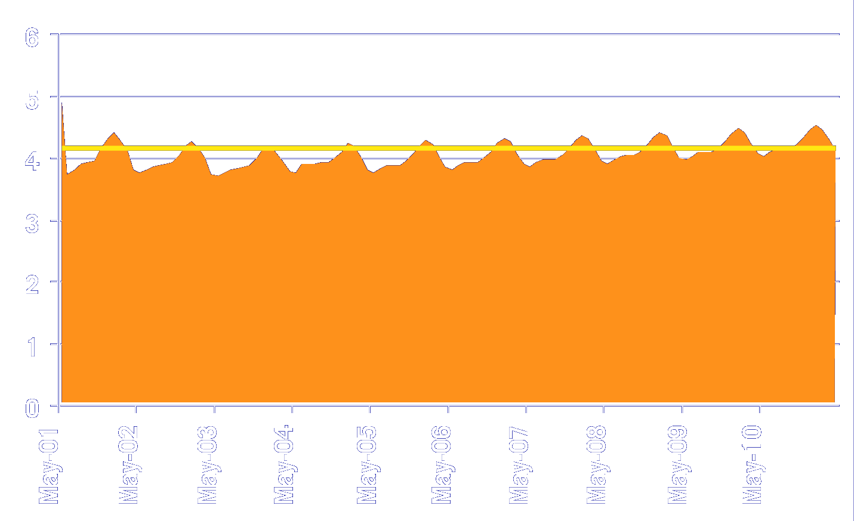
Swap Forward Perspective
NYMEX Henry Hub - 2001-2011

Slide 19
Cap Definition
An option that places a ceiling on the future price

Slide 20
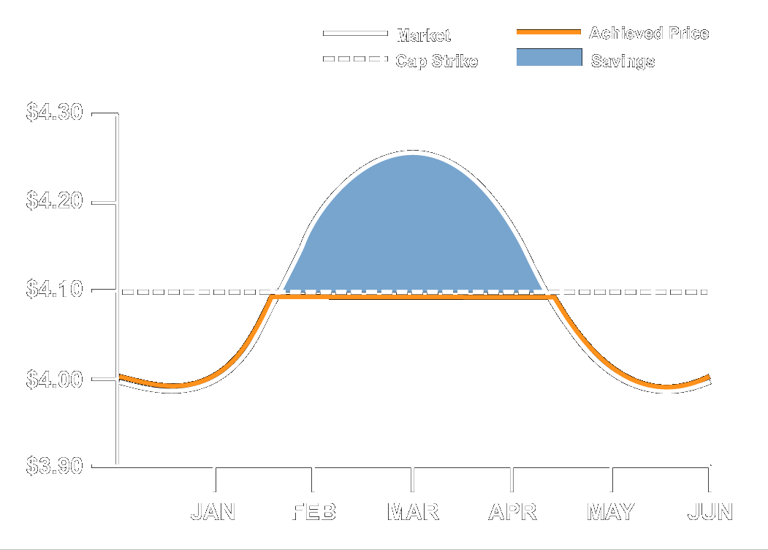
Cap Concept

Slide 21
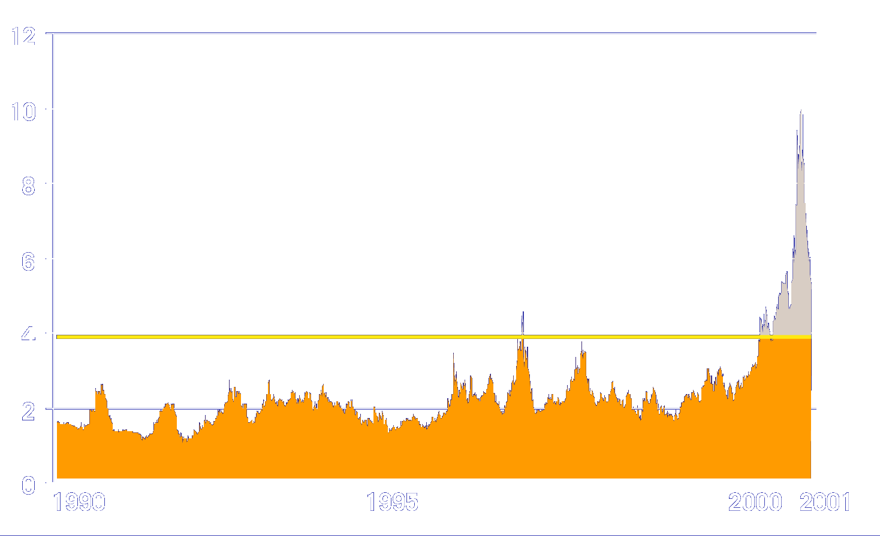
Cap Historical Perspective
NYMEX Henry Hub - 1990-2001

Slide 22

Cap Forward Perspective
NYMEX Henry Hub - 2001-2011

Slide 23
Collar Definition
Caps buyer’s upside in exchange for giving up some of the downside price benefit

Slide 24
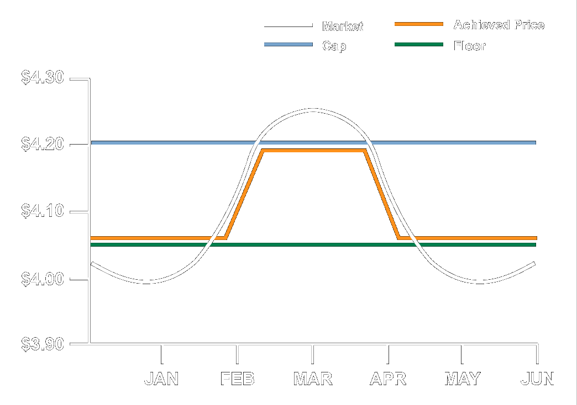
Collar Concept

Slide 25
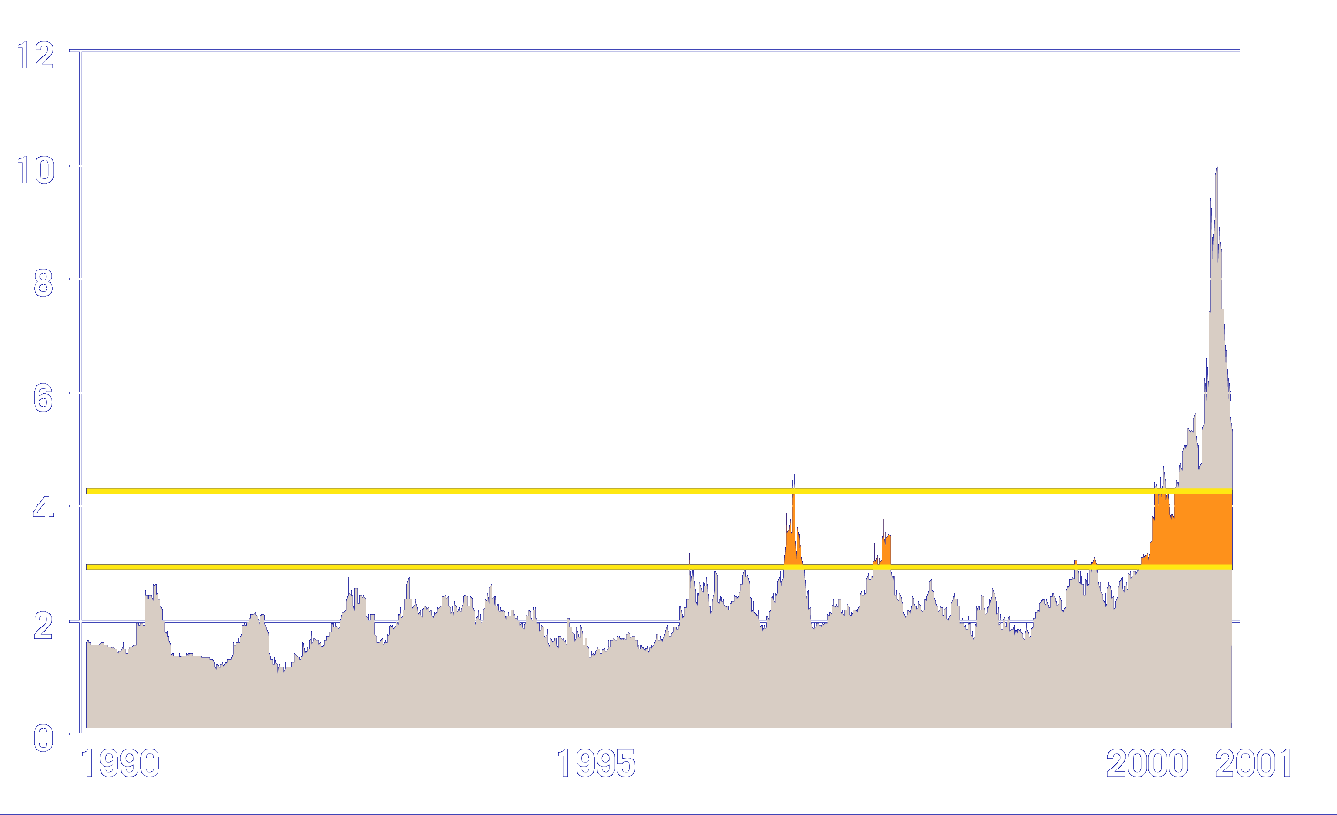
Collar Historical Perspective
NYMEX Henry Hub - 1990-2001

Slide 26
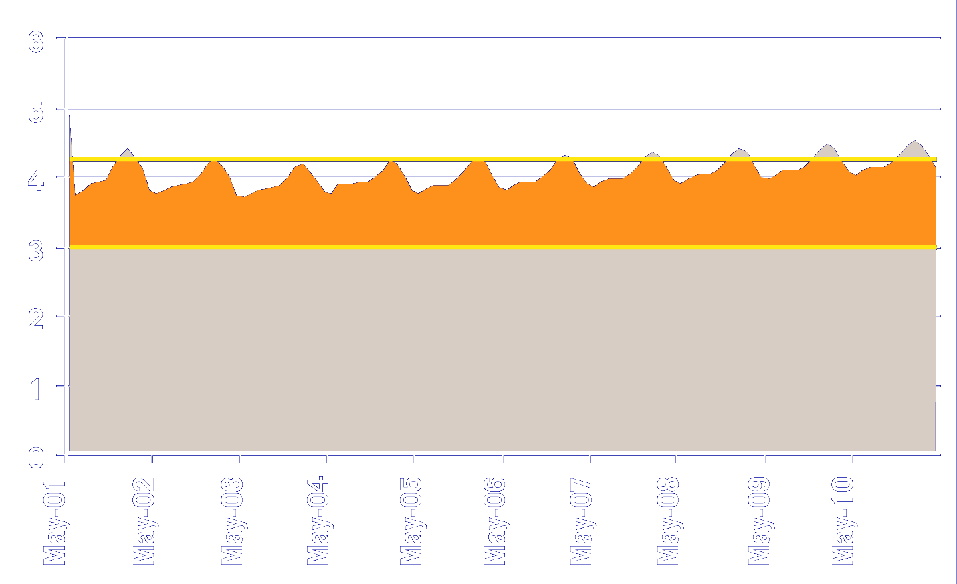
Collar Forward Perspective
NYMEX Henry Hub - 2001-2011

Slide 27
Complex Financial Instruments: Concepts and Case Studies

Slide 28
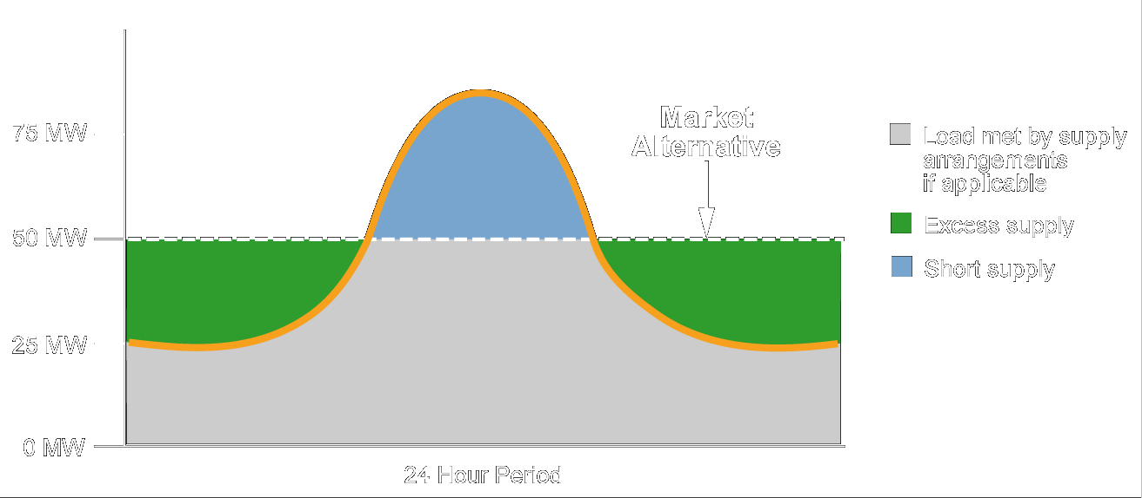
Load Serving General Concept
Notes:
Provides complete energy needs for a service area.
Can take many forms and include unique complexities depending upon the counterparty’s needs/risks.
Allows EM&T to optimize its portfolio and realize value from asset optimization while providing a growth platform.
Counterparty receives mitigated commodity risk and tools for growth.
How it works:
Counterparty has certain amount of load (demand) that can be serviced by existing generation.
Shortage must be obtained on open market as demand and volatility increases.
Counterparty lacks risk management tools/expertise and partners with EM&T.
EM&T meets shortage obligation via financial instruments, portfolio length and/or new generation.
Almost completed deal with major NE player…would have saved them $165 MM last year if legislation would’ve allowed the deal to go through…that value is out there to be captured and shared...
In short, you identify your risks, we identify our risks, and between us, no value is left on the table and we both have a fair and equitable exchange...

Slide 29
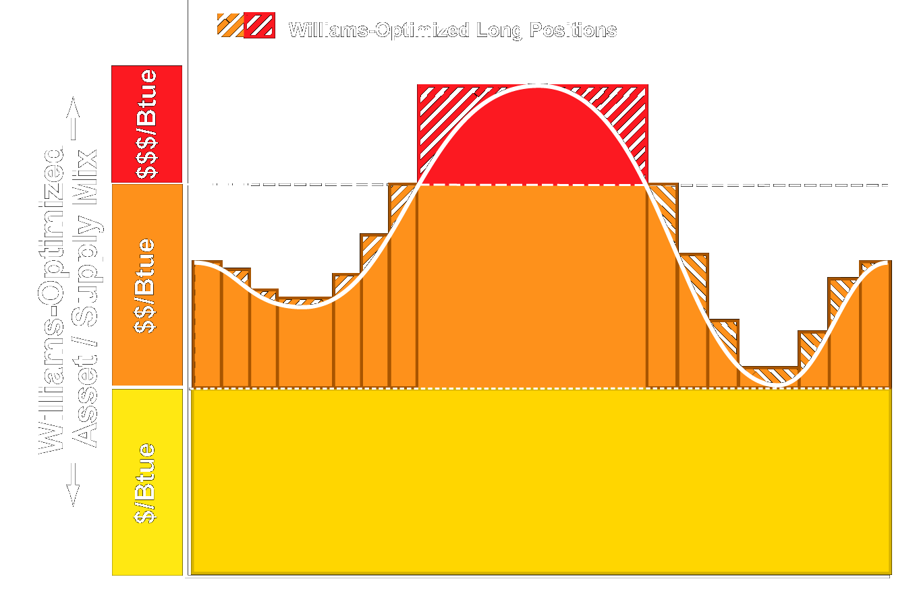
Full Requirements General Concept
Notes:
Provides complete energy needs for a service area.
Can take many forms and include unique complexities depending upon the counterparty’s needs/risks.
Allows EM&T to optimize its portfolio and realize value from asset optimization while providing a growth platform.
Counterparty receives mitigated commodity risk and tools for growth.
How it works:
Counterparty has certain amount of load (demand) that can be serviced by existing generation.
Shortage must be obtained on open market as demand and volatility increases.
Counterparty lacks risk management tools/expertise and partners with EM&T.
EM&T meets shortage obligation via financial instruments, portfolio length and/or new generation.
Almost completed deal with major NE player…would have saved them $165 MM last year if legislation would’ve allowed the deal to go through…that value is out there to be captured and shared...
In short, you identify your risks, we identify our risks, and between us, no value is left on the table and we both have a fair and equitable exchange...

Slide 30
Full Requirements Structure
Williams...
Serves 100% of the counterparty’s load requirements
Economically dispatches the counterparty’s resources on its behalf
Markets any excess energy produced by the counterparty’s resources, covers short positions and shares benefits with the counterparty
Takes on many risk elements
Notes:
<number>
<footer>
<header>
<date/time>

Slide 31
Full Requirements Structure Benefits of the Partnership
Reliability/certainty of supply
Allows focus on core competencies
Williams contributes expertise in operations, load forecasting and generation
Portfolios and economies of scale
Promotes load growth
Reduces risk
Notes:
<number>
<footer>
<header>
<date/time>

Slide 32



Case Study #1 Major Northeastern Municipality
Situation:
Large suite of assets
Significant load
Exposure to natural gas fixed price
Sub-optimal asset management; inadequate resource usage
Minimal diversity
Lack of risk management expertise
Solution:
Fixed price per MMBtu for one year
Took on load variability and weather risk
Optimized assets
Net Result:
Risk elimination
Estimated loss avoidance of $140MM

Slide 33
Case Study #2 Midwestern Rural Electric Cooperative
Situation:
Complex asset mix
Multi-fuel assets/contracts
Sizeable load
Poor understanding of risk given marketplace volatility
Solution:
Fixed price per month for five years
Supplied hourly load
Optimized assets, including building of generation facility
Net Result:
Price certainty
Estimated loss avoidance of $40MM in following summer

Slide 34
Full Requirements Concept…cont.
Resource Mix
Load
Market
Price

Slide 35
How Williams Prices and Manages

Slide 36
Risk Management Methodology
Price risks against liquid instruments
Where no instrument exists, create or build one
If all else fails, warehouse risk (at the right price)

Slide 37
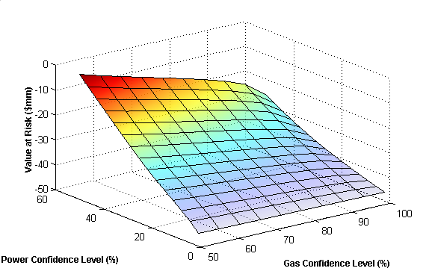
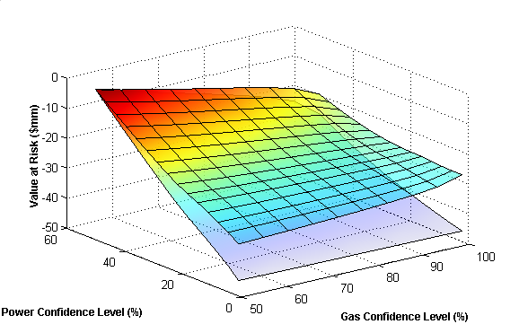
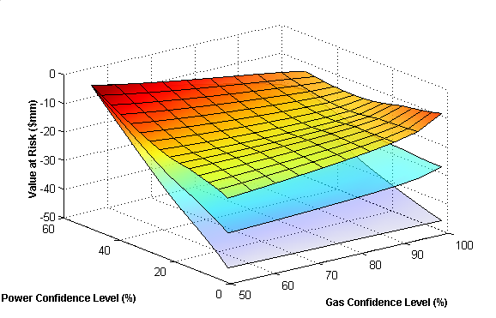
Portfolio Management

Slide 38


Hedging Against Liquid Markets

Slide 39
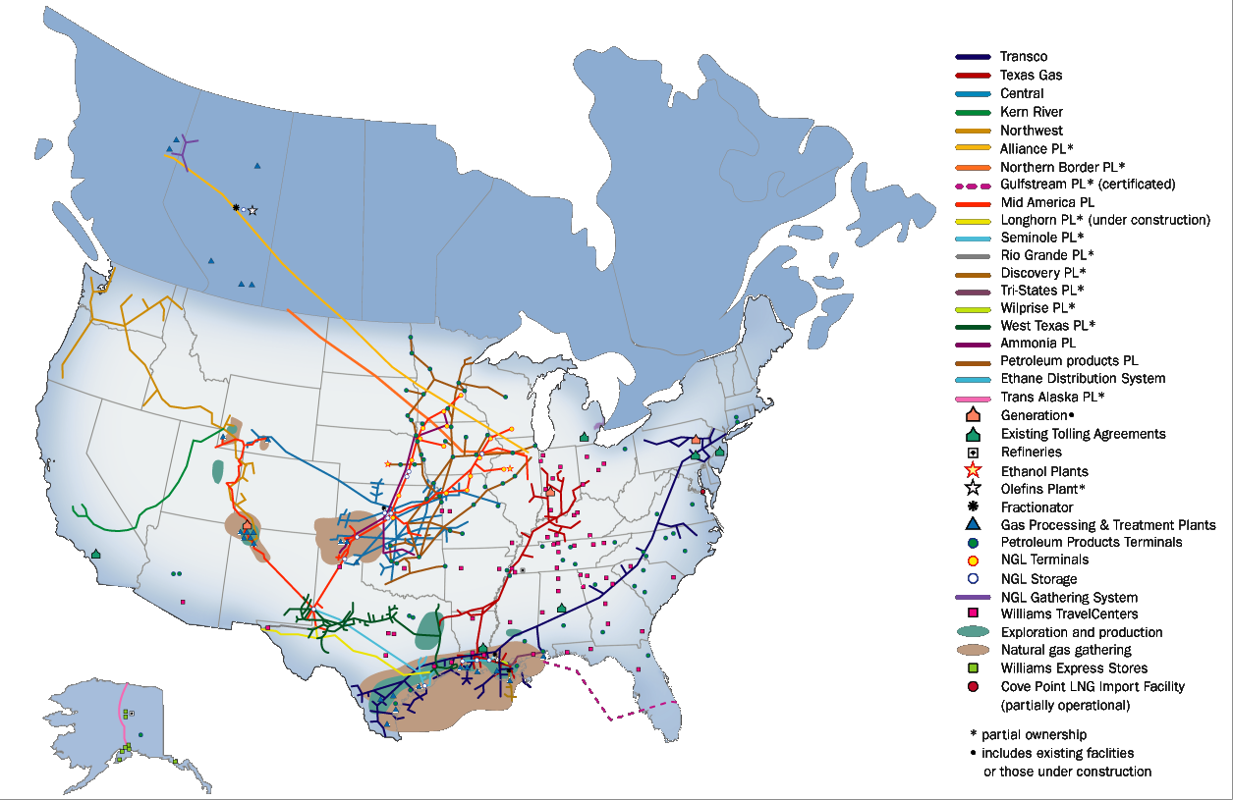
Other Hedging Alternatives
Transco
Texas Gas
Central
Kern River
Northwest
Alliance PL*
Northern Border PL*
Gulfstream PL* (certificated)
Mid America PL
Longhorn PL* (under construction)
Seminole PL*
Rio Grande PL*
Discovery PL*
Tri-States PL*
Wilprise PL*
West Texas PL*
Ammonia PL
Petroleum products PL
Ethane Distribution System
Trans Alaska PL*
Generation•
Existing Tolling Agreements
Refineries
Ethanol Plants
Olefins Plant*
Fractionator
Gas Processing & Treatment Plants
Petroleum Products Terminals
NGL Terminals
NGL Storage
NGL Gathering System
Williams TravelCenters
Exploration and production
Natural gas gathering
Williams Express Stores
Cove Point LNG Import Facility (partially operational)
* partial ownership
• includes existing facilities or those under construction

Slide 40
Risk Warehousing
Proactively create liquidity in residual risk
Offsetting structured deals, financial instruments
Build assets
Manage as a portfolio
Ultimately, optimize in the spot market

Slide 41
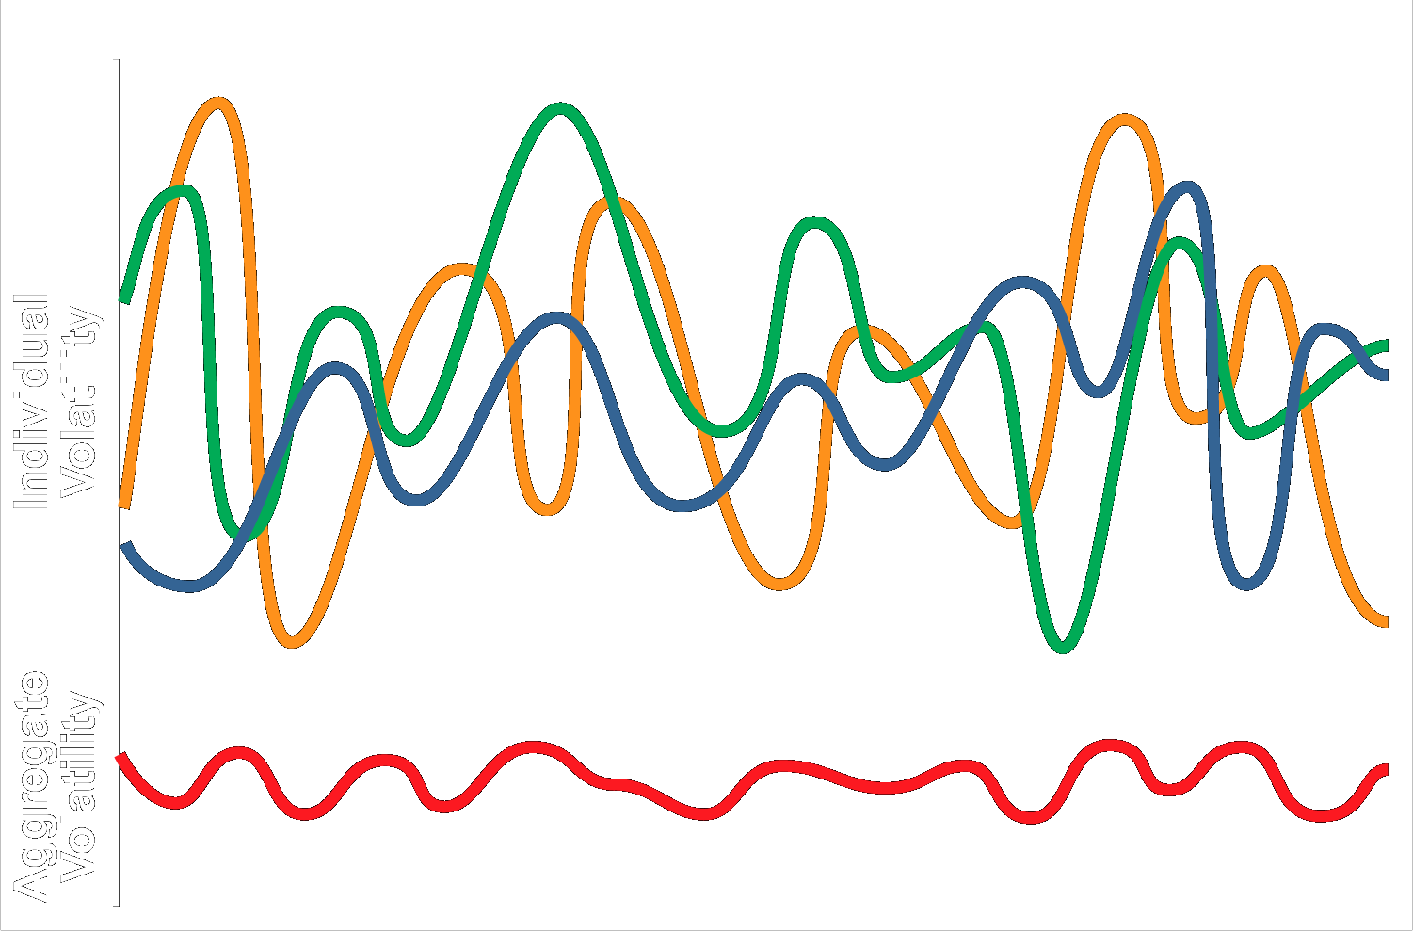
Portfolio Effect

Slide 42
Implementing a Hedging Program
Educate the enterprise
Understand portfolio and risk tolerance
Understand organizational capabilities
Identify, characterize and value risks
Develop optimal structure
Execute
Measure and manage residual risks

Slide 43
Selecting a Partner
If a partner has this...
Substantial portfolio
Sophisticated risk management tools and expertise
Creditworthiness
Minimized transaction costs
It can provide this...
Complexity to suit your needs
Potentially lower costs
Flexibility in deal structure

Slide 44
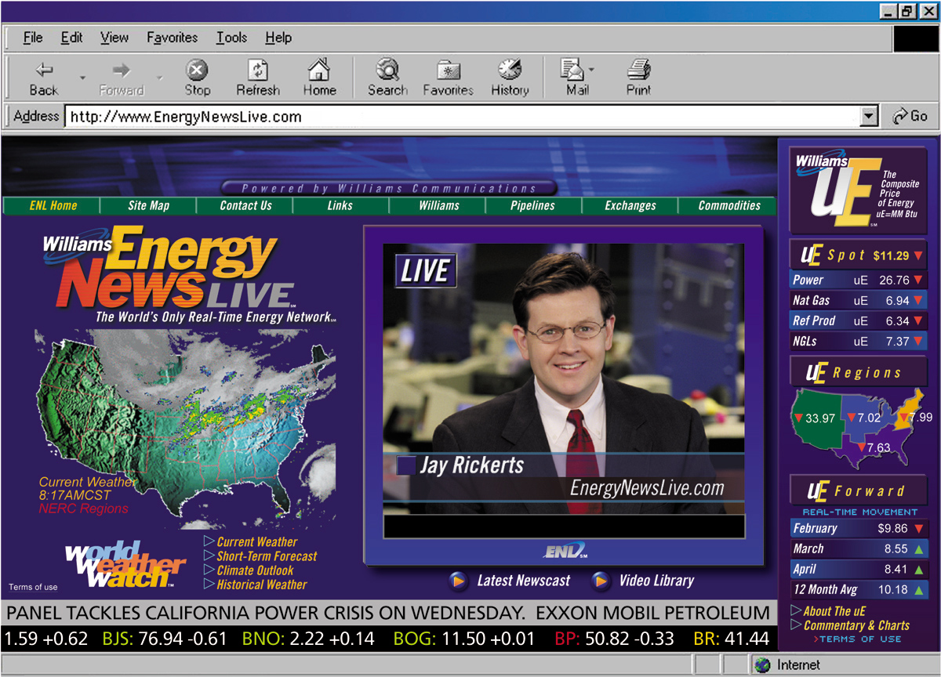
Know the Market

