Slide 1
Enron North America

Slide 2
Enron North America
North America Energy Markets Providing Tremendous Market Opportunity
Very Large and Rapidly Growing
Increasingly Volatile and Complex
Enron is the Leading Provider of Energy in North America
Enron Employs the Most Valuable, Flexible Network
Clear Liquidity and Information Advantages
Consistent Earnings Growth
Superior Returns on Invested Capital
Market-Making + Technology + Scale + Select Assets = Sustainable Competitive Advantage

Slide 3
Enron North America
Enron’s Leading Market Position
Further Distancing From Next Tier of Marketers
Major Positive Impact of EnronOnline
Broad-Based Network Growth
Enron’s Energy Network
Conclusion

Slide 4
North America Enron’s Leading Market Position
Third Quarter 2000
(TBtue/d)
40.5
37.4
Power
Gas
1999
19.2
15.0
14.1
13.3
13.2
13.1
12.3
10.9
9.9
Enron FY00
Enron
Duke
Aquila
AEP
PG&E
Reliant
Dynegy
Southern
Coral
Sempra
3QYTD
Source: Gas Daily, Power Markets Week, Oil Daily

Slide 5
EnronOnline – “The” Energy Market-Maker
(Average Daily Transactions)
EnronOnline
Traditional
4,922
4,042
3,463
3,539
3,049
3,076
3,171
2,761
2,165
2,166
1,898
1,499
917
650
1999 2000
Expanded Market Reach, Scalability, Information and Liquidity
North America Natural Gas and Power Transactions

Slide 6
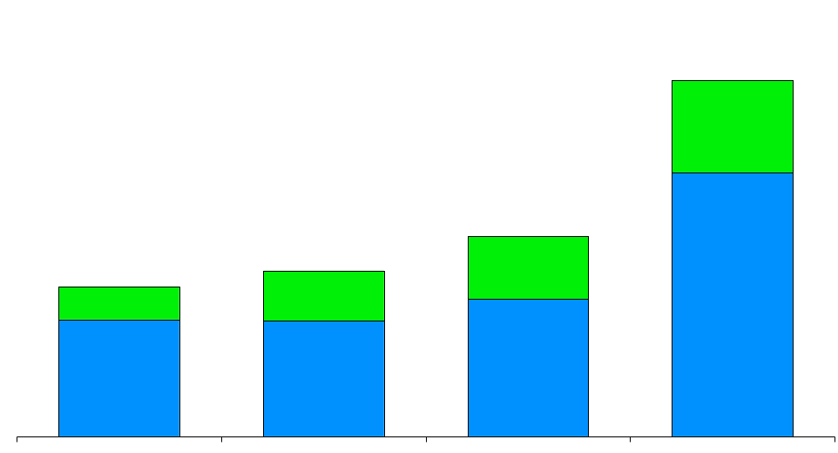
North America Physical Natural Gas Volumes
(Bcf/d)
Canada
U. S.
24.7
13.9
11.5
10.4
+77%
1997
1998
1999
2000

Slide 7
Enron’s Wholesale Gas Network
(Volumes in Bcf/d)
Canada
Central
6.3
4.4
5.9
2.3
43%
156%
1999
2000
1999
2000
West
East
2.4
7.4
1.1
4.1
118%
Henry
80%
Henry
Henry
Henry
Hub
Hub
Hub
Hub
1999
2000
1999
2000
Texas
Marketing Offices
Leased Capacity
NYMEX
Leased Storage
Gas Marketing Activity
2.7
2.0
35%
1999
2000

Slide 8
North America Physical Power Volumes
(Million MWh)
579
402
381
192
+52%
1997
1998
1999
2000

Slide 9
Enron’s Wholesale Power Network
(Volumes in Million MWh)
West
East
239
340
MAPP
MAIN
260
NPCC
260
ECAR
121
COB
ComEd
Hub
PJM
Hub
Hub
MAAC
Cinergy
Cinergy
Cinergy
Hub
Hub
Hub
WSCC
Cinergy
97%
SPP
Hub
31%
SERC
1999
2000
Palo
Palo
Palo
Palo
1999
2000
Verde
Verde
Verde
Verde
Hub
Hub
Hub
Hub
TVA
Hub
Entergy
Entergy
Entergy
Hub
Hub
Marketing Offices
NYMEX
Marketing Hub
ERCOT
Hub
FRCC
Power Plants
In Operation
In Operation; Sale Pending
Under Development
Power Marketing Activity
Transmission Grid

Slide 10
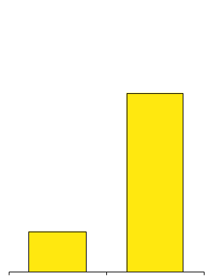
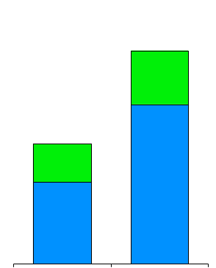
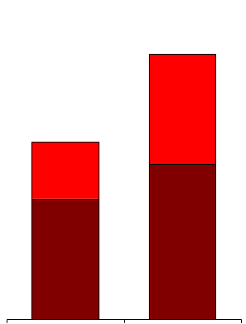
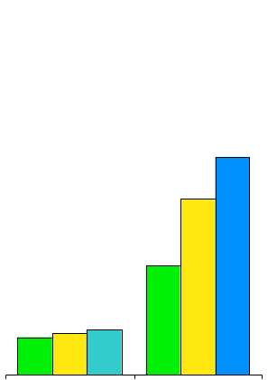
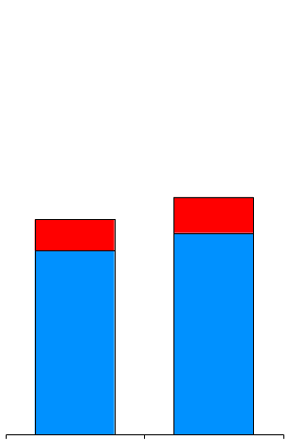
North America Network Growth
Natural Gas Volumes (Bcf/d)
Power Volumes (Million MWh)
EnronOnline Products
(N.A. Gas and Power)
Canada
U.S.
24.7
West
East
579
330
381
13.9
75
+77%
+52%
+340%
1999
2000
1999
2000
1999
2000
Gas Pipeline Nominations
(Thousands)
Physical Delivery Points
Power
Gas
West
Central
East
156
2,520
126
2,280
78
27
30
32
+10%
+304%
Q4 1999
Q4 2000
1999
2000

Slide 11
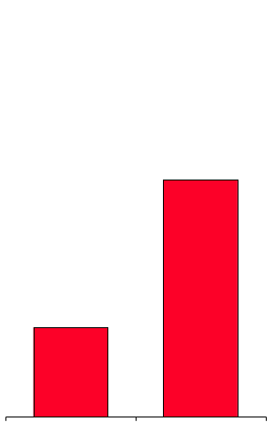
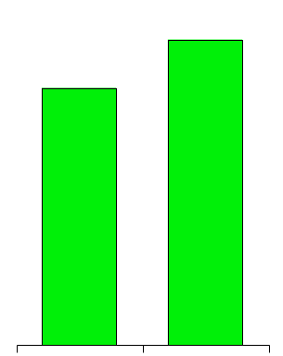
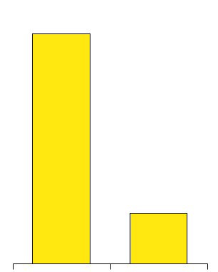
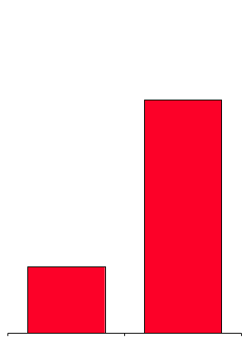
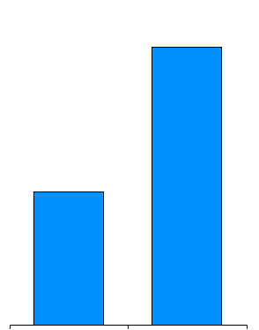
North America Network Growth
Systems Expenditures
($ Millions)
Transaction Costs
(Indexed)
Customers
1,250
$134
100
1,010
$116
25
+15%
-75%
+24%
1999
2000
1999
2000
1999
2000
Total Transactions
(Physical and Financial)
Commodity Books
775,071
314
150
220,247
+109%
+252%
1999
2000
1999
2000

Slide 12
Enron North America
The Most Flexible, Reliable and Valuable Energy Network
CALGARY
Marketing Offices
Gas Pipeline Access
Electric Grid Access
NYMEX
Leased Gas Storage
Power Plants
In Operation
In Operation; Sale Pending
Under Development
PORTLAND
TORONTO
NEW YORK
COB
PJM
Hub
OMAHA
Hub
SAN FRANCISCO
CHICAGO
WASHINGTON
DENVER
Palo
Verde
Hub
Entergy
Hub
Henry
Hub
HOUSTON
MONTERREY
Expansive Market-Making
Least-Cost Packaging
Reliable Delivery
Broad Customer Reach
Cross-Commodity Expertise
Innovative Products

Slide 13
Enron North America
Enron’s Leading Market Position
Enron’s Energy Network
Conclusion

Slide 14
Enron North America’s Energy Network
Industrials
Power Plants /IPPS
$
$
People
Technology
Contractual Assets
Owned Assets
$
Products & Services
Products & Services
Information
Information
Financial Market
$
$
Marketers
Products & Services
Products & Services
Information
Information
Producers
$
$
Utilities
Products & Services
Products & Services
Information
Information
Rapid Capture of Real Time Market and Grid Information
Quickly Disseminated and Acted Upon By Enron
Clear Information and Liquidity Advantage

Slide 15
Enron North America
Value Formula
Network Competitive Advantages
+
Core Capabilities
+
Enron Culture
=
Value
Physical Commodity Products
Greater Flexibility and Speed to Market
More Effective Risk Management in Volatile Markets
Price Advantages
Superior Market Knowledge
Innovative
Best and the Brightest Employees
Entrepreneurial Environment
Premium Structured Products
Financial Risk Management
Regional and Cross-Commodity Arbitrage
Capital Structuring and
Services
Liquidity Provision
Asset Development
And Operation
Generating Consistent Earnings Growth Regardless of Market Conditions

Slide 16
Tuning the Network
Contracted Sales
1999 Peakers - 900 MW
2000 Peakers - 1,600 MW
Houston Pipe Line (Intrastate)
Enron’s Network Approach is Flexible and Less Capital Intensive
Enron’s Increased Liquidity Diminishes Need for Certain Assets
Other Market Participants Value Assets Differently
Actions Result in Equal Earnings Power with Less Invested Capital
Enron Can Uniquely Replicate
Assets Through Contracts and Market-Making

Slide 17
Network Power Options
Alberta, Canada
Acquired Long-Term Contractual Access to 700 MW
Enron Controls Plant Dispatch
MAPP
MAIN
NPCC
Power Plants:
In Operation
In Early Development
In Operation; Sale Pending
Offices
Transmission Grid
ECAR
Cinergy
Hub
Hub
Hub
MACC
WSCC
SPP
SERC
E
ERCOT
Pastoria, California
Developing 750 MW Plant
Permitting in Progress, In Service Summer 2003
Strategic Location With Expansion Opportunities
Mexico
Developing 245 MW Gas-Fired Plant
Enron’s Continual Market Assessment
Drives Future Decisions

Slide 18


Enron North America Further Enhancing Strong Returns
Growth in Return on Capital Employed
(Indexed to 1998)
7.0
6.0
5.0
4.0
3.0
2.0
1.0
0
Accelerating Earnings with Minimal Incremental Capital
Capitalizing on People, Technology and the Network for Greater Returns Than Traditional Assets Generate
Further Expanding Strong Market Franchise for Future Growth Opportunities

Slide 19
Enron North America
North America Energy Markets Providing Tremendous Market Opportunity
Very Large and Rapidly Growing
Increasingly Volatile and Complex
Enron is the Leading Provider of Energy in North America
Enron Employs the Most Valuable, Flexible Network
Clear Liquidity and Information Advantages
Consistent Earnings Growth
Superior Returns on Invested Capital
Market-Making + Technology + Scale + Select Assets = Sustainable Competitive Advantage

