Slide 1
October 2000
Confidential & Proprietary
Management Presentation
Wheatland Overview

Slide 2
Overview
Wheatland Overview
Plant Description: 508 MW (nominal) natural gas-fired, simple-cycle facility
Location: 60-acre tract in Wheatland, Indiana, in southern subregion of ECAR
Power Interconnect: Dual interconnect with Indianapolis Power & Light 345 kV and Cinergy 345 kV
Gas Interconnect: Midwestern Gas Transmission Pipeline - Westfork Interconnect
Start of Construction: October 1999
Commercial Operation Date: June 1, 2000
Approx. Max. Annual MWh: 461,313 at 59ºF
Approx. Run Hours: 902
NOx (per unit): <25 ppm
CO (per unit): <25 ppm

Slide 3
Facility Strengths
Wheatland Overview
“First-mover advantage” in a key Midwest market
ECAR has historically experienced extreme power price volatility
Ideally suited to capitalize on gas/power arbitrage opportunities
Expansion/conversion potential
Site has room for additional gas turbines
Turbine technology and layout allow for conversion to combined cycle
Access to water through owned lake, potential back-up municipal supply
30-minute normal unit ramp-up from cold to full load

Slide 4
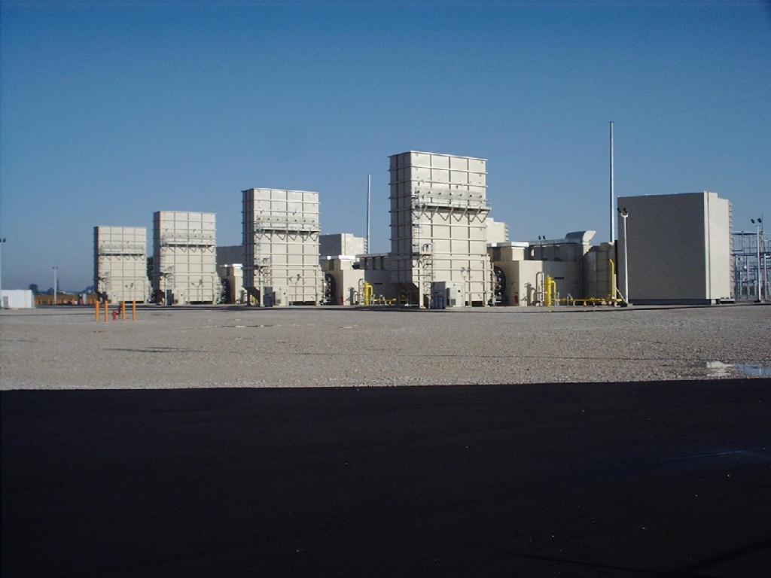
Plant Picture
Wheatland Overview

Slide 5
Regional Overview
Wheatland Overview
Wheatland Plant

Slide 6
Power Market Opportunities
Wheatland Overview
West Fork Land Development Company, L.L.C. is qualified as an Exempt Wholesale Generator and has authority to sell energy and capacity at market-based rates
Wheatland’s location in southern ECAR and access to eastern U.S. electricity market provide sales opportunities into wholesale power markets
Wheatland’s interconnection into two 345 kV lines provides option of dispatching into Cinergy Services Inc. and/or Indianapolis Power and Light systems
Wheatland’s location provides access into ECAR region with direct access to over 30 control area markets within two utility wheels

Slide 7
Equipment Overview
Wheatland Overview
Turbines: 4 Westinghouse 501 D5A turbines with evap. cooling
Turbine Warranty Expiration: June 1, 2001
Switchyard Equipment: ABB, 345 kV interconnect breakers
Switchyard Configuration: dual ring bus
Transformers: (2) ABB 333 MVA, 3 winding, 3 phase, 13.8 kV/345 kV
Control System: WDPF
Generator Circuit Breakers: (4) ABB HGC (7,500A)
Generator Voltages: 13.8 kV
Plant Distribution Voltages: 4160 V and 480 V

Slide 8
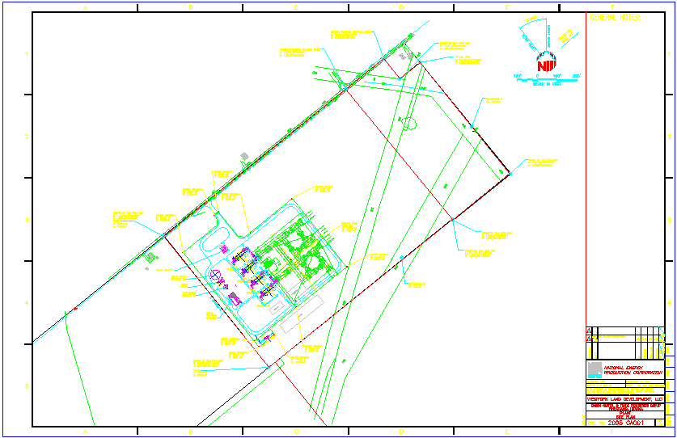
Plant Layout
Wheatland Overview

Slide 9
Performance Results
Wheatland Overview

Slide 10
Power Interconnection
Wheatland Overview
Interconnected to two 345 kV lines
Interconnection agreements with:
Cinergy Services Inc. (“Cinergy”) into Qualitech-Gibson 345 kV line
Indianapolis Power & Light (“IPL”) into Petersburg-Breed 345 kV line
With dual interconnect, Wheatland has option of dispatching into Cinergy and/or IPL systems

Slide 11
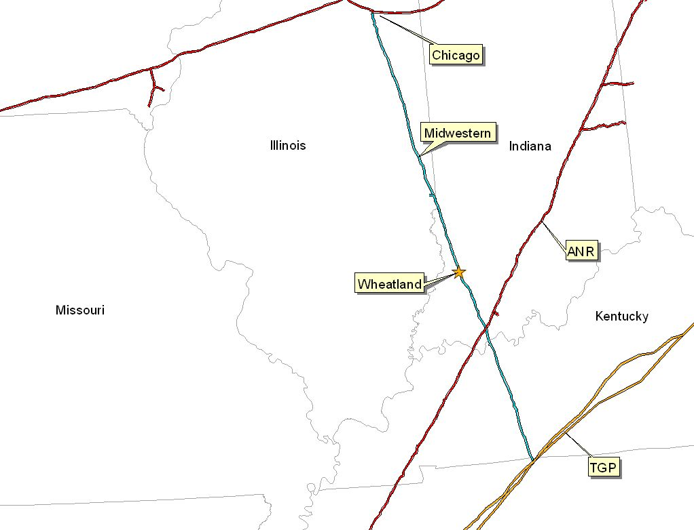
Gas Transportation
Wheatland Overview
Pipeline: Midwestern Gas Transmission Pipeline
Delivery Point: Wheatland Plant-gate
Base Contract:
Service: IT
Term: 8 years (Apr-Oct) beginning December 16, 1999
Volume: 85,200 MMBtu/d
Rate: 1st 3 Bcf: $0.0709 MMBtu/d
3 to 5 Bcf: $0.0422 MMBtu/d
5 Bcf & Up: Max. tariff rate, currently at $0.0781 per dekatherm mile
Fuel: 0.05% on backhaul; 1.0% on forward haul
Volume Commitment: None
Receipt Points: Chicago and Tennesse Gas Pipeline - Portland Interconnect
Backup Contract: None in place; however, capacity release or seasonal firm can be utilized under terms of agreement
Balancing: Via OBA, with Midwestern Gas subject to tariff imbalance parameters (5% end of month; 10% daily imbalance limit if daily variance implemented). Allows for uneven hourly flow at plant gate with even 24 hour supply subject to pipeline operating conditions

Slide 12
Plant Location
Wheatland Overview

Slide 13
Control Area Status
Wheatland Overview
Wheatland control areas, ENMI and ENWC, have been designated control areas in accordance with NERC policy
Both Cinergy and IPL allow scheduling of energy into and out of each control area, giving Wheatland option of generating power or filling scheduled energy delivery commitment from market when market economics warrant
enables playing day-ahead versus intra-day hourly market to maximize optionality
added flexibility ensures that plant is reserved for operation only during periods of economic dispatch
Control area options for Wheatland purchaser include:
control area services provided by IPL and/or Cinergy
control area re-established by purchaser in accordance with NERC procedures
control area and scheduling services provided by Enron affiliate under separate contract

Slide 14
Expansion/Conversion Opportunity
Wheatland Overview
Wheatland designed to facilitate future plant expansion and/or conversion to combined cycle
Net heat rate could go from 11,500 Btu/kWh (HHV) currently to approximately 7,800 (HHV), depending on equipment
Net output could go from 508 MW (nominal) currently to 850 MW (nominal), depending on equipment
Wheatland conversion should take approximately 18 to 24 months
Installation of an SCR should facilitate getting a PSD permit for combined cycle operation

Slide 15
Environmental Specifications
Wheatland Overview
Discharge Permit: Not Required
Air Permit: Non-PSD
NOx Control Method: Water injection
Compliance Method: CEMS
Limits: 250 T NOx per year
250 T CO per year
Actual Commission NOx: <25 ppm
Estimated Run Hours: 902

Slide 16
Operating Costs
Wheatland Overview

Slide 17
Organizational Chart
Wheatland Overview
Wheatland is currently operated by Operational Energy Corp (“OEC”), an Enron Corp. subsidiary
It is anticipated that at closing, O&M contract with OEC will be terminated
Wheatland personnel are currently employees of OEC

Slide 18
Legal Structure
Wheatland Overview
West Fork Land Development Company, L.L.C. (“West Fork”) has fee simple ownership of facility (including real property)
West Fork is a single member (Enron North America Corp.) Delaware limited liability company and is 100% owned by Enron North America Corp.
The lake, which provides water to the plant, is owned by Lake Acquisition Company, L.L.C. (“Lake Acquisition”), a single member Delaware limited liability company, and is leased to West Fork
Purchaser will acquire 100% of member interests in both West Fork and Lake Acquisition

